Slide 1



Squamous cell carcinoma ORAL CANCER
MAHMOUD AHMED SHAWISH
NUMBER 2918
2/2/2022

Slide 2

0bjectives
Definition of squamous cell carcinoma and it’s risk factors
Manifestations of squamous cell carcinoma
Prognosis of squamous cell carcinoma
Treatment of squamous cell carcinoma
1

Slide 3

ذ
2

Slide 4
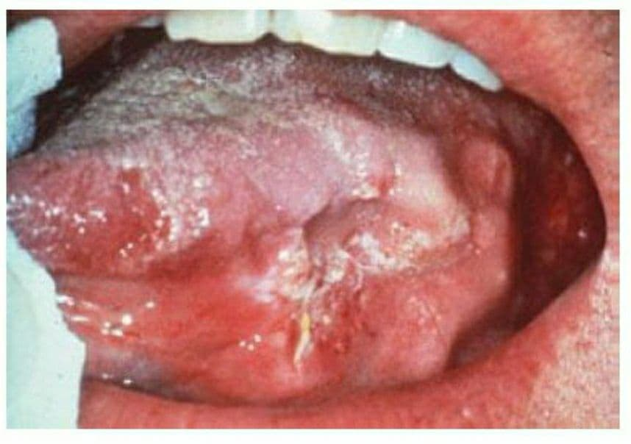
Definition of squamous cell carcinoma and it’s risk factors
OSCC is defined as malignant epithelial neoplasm affecting the oral cavity, exhibiting squamous differentiation by formation of keratin, typically seen at the lateral side of tongue.
3

Slide 5
Facts about squamous cell carcinoma
Considered as the most common type of oral cancer.
Male to female ratio is 2:1
Most cases are 40 to 70 years old.
Less common between blacks.
Accounts for 275,000 cases and 128,000 deaths annually.
4

Slide 6
Risk factors :
TOBACCO USE
HUMAN PAPILLOMA VIRUS
EXESSIVE EXPOSURE TO SUN
WEEK IMMUNE SYSTEM
ALCOHOL USE
5

Slide 7
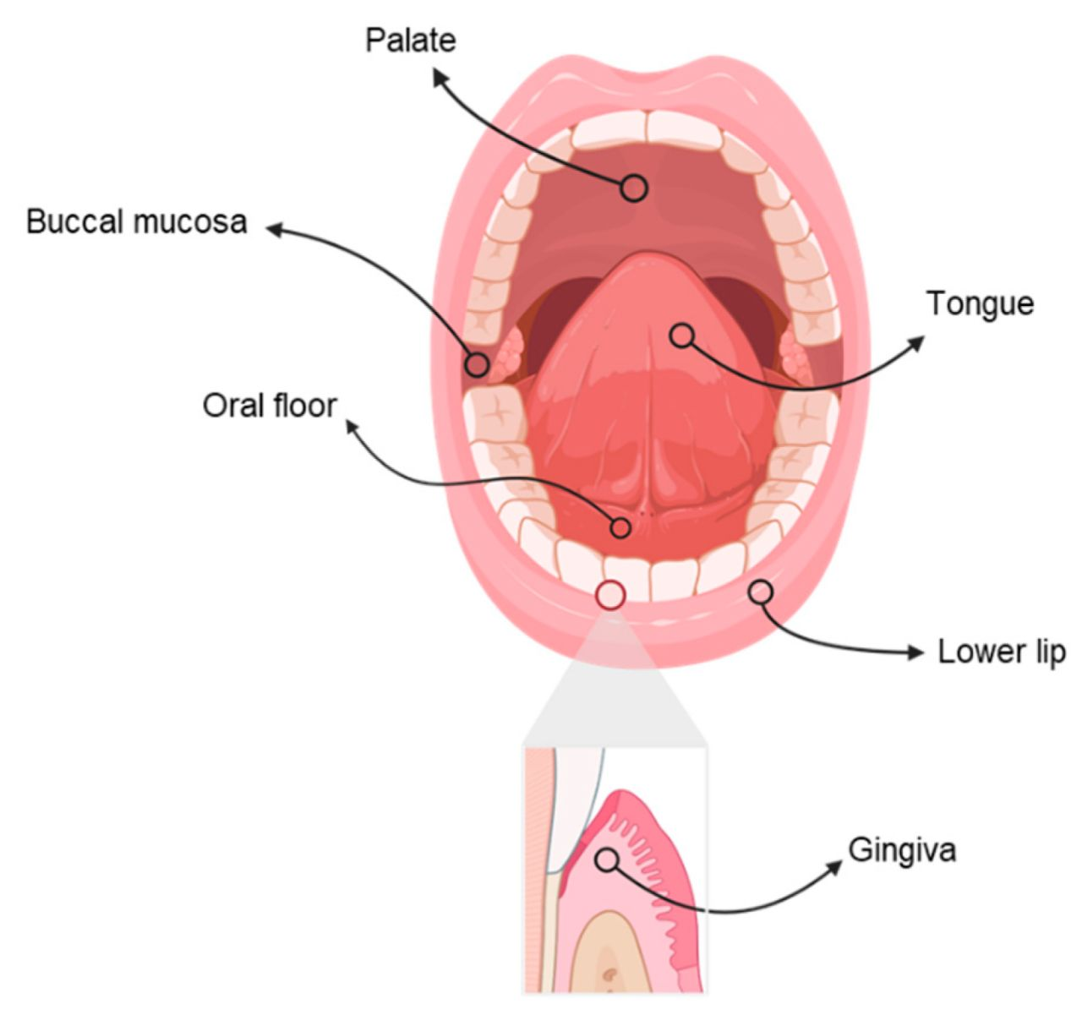
Manifestations of squamous cell carcinoma
Oral lesions are initially asymptomatic, lesions may appear as areas of erythroplakia or leukoplakia and may be exophatic or ulcerated.
Some precancerous disorders can progress to OSCC including :
Submucous fibrosis
Actinic cheilitis
Sideropenic dysphaga
Dyskeratosis congentia
Discoid lupus erythematous
6

Slide 8
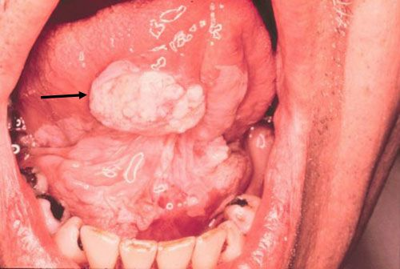
Leukoplakia and squamous cell carcinoma
Leukoplakia is a general term for white hyperkeratotic plaques that develop in the mouth.
7

Slide 9
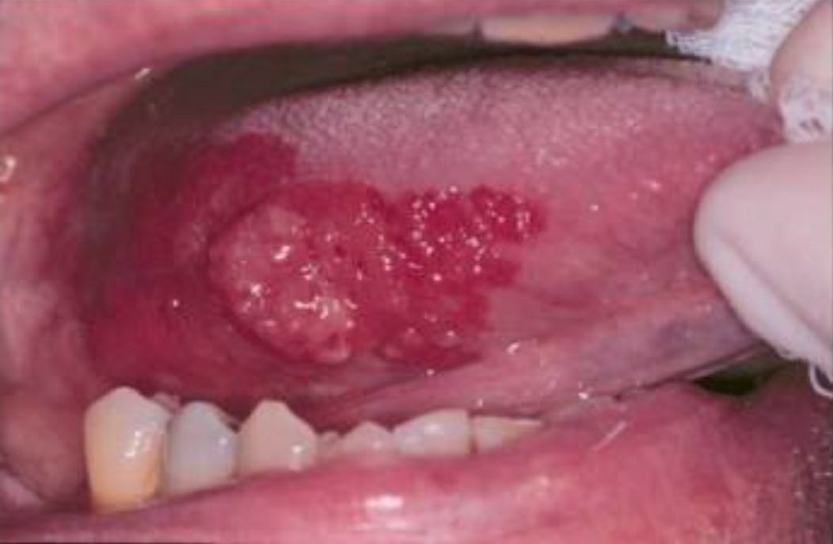
Erythroplakia and squamous cell carcinoma
Erythroplakia is a general term for red, flat, or eroded velvety lesion that develop in the mouth.
8

Slide 10
Prognosis of squamous cell carcinoma
Highly depends on lesion site:
Localized lesions of the tongue have a 5 year survival rate higher than 75%.
Localized lesions of floor of the mouth, 5 year survival rate is 75%.
Lower lip lesions, 5 year survival rate is 90%.
Note:
Lymph node metastases decreases survival rate by about 50%.
9

Slide 11



Treatment of squamous cell carcinoma
surgery
Radiation therapy
chemotherapy
10

Slide 12

Conclusion
A plan for the diagnosis and treatment of cancer is a key component of any overall cancer control plan.
It is main goal is to cure cancer patients or prolong their life considerably.
11

Slide 13
References
1-Sutton, D. N., Brown, J. S., Rogers, S. N., Vaughan, E. D., & Woolgar, J. A. (2003). The prognostic implications of the surgical margin in oral squamous cell carcinoma. International journal of oral and maxillofacial surgery.
2-Chen, Y. K., Huang, H. C., Lin, L. M., & Lin, C. C. (1999). Primary oral squamous cell carcinoma: an analysis of 703 cases in southern Taiwan. Oral oncology.
3-Markopoulos, A. K. (2012). Current aspects on oral squamous cell carcinoma. The open dentistry journal.
4-Wang, Bo, et al. "The recurrence and survival of oral squamous cell carcinoma: a report of 275 cases." Chinese journal of cancer .
12

Slide 14

13

