Slide 1
Acromegaly
Dr. Mousa Tawati Alfakhri

Slide 2
Acromegaly is caused by axcess growth hormone (GH) secretion due to a GH secreting pituitary tumour (somatotroph adenoma) usually a macroadenoma.
GH excess produces gigantism in children (if acquired before epiphyseal fusion) and acromegaly in adults

Slide 3
Symptoms
Change in appearance
Increased size of hands/feet
Headaches
Excessive sweating
Visual deterioration
Tiredness
Weight gain
Impotence or poor libido
Amenorrhoea or oligomenorrhoea
Galactorrhoea
Breathlessness
Pain/tingling in hands
Polyuria/polydipsia
Muscular weakness
Joint pains
Symptoms of hypopituitarism

Slide 4
Signs
Prominent supraorbital ridge
Prognathism
Interdental separation
Large tongue
Thick greasy skin
Spade-like hands and feet
Tight rings
Carpal tunnel syndrome
Visual field defects
Galactorrhoea
Hypertension
Oedema
Heart failure
Arthropathy
Proximal myopathy
Goiter

Slide 5
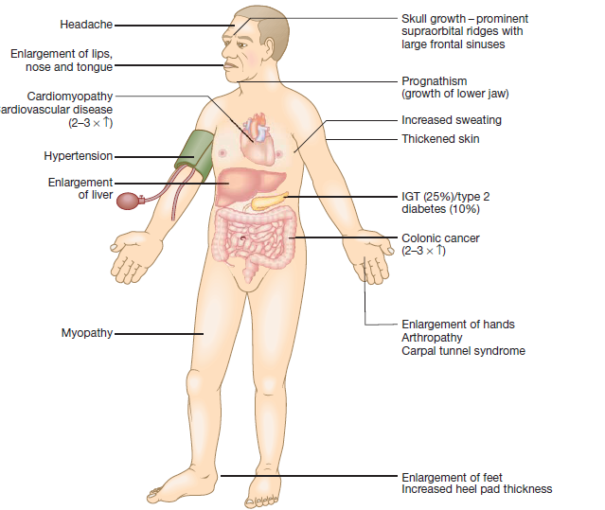

Slide 6
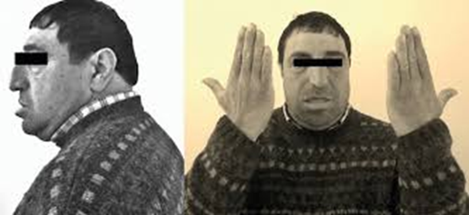

Slide 7
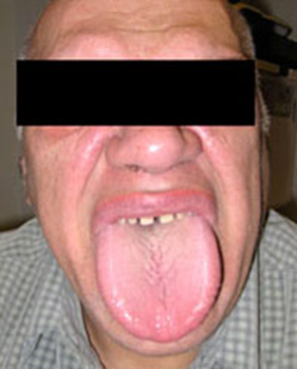
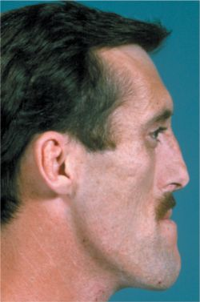
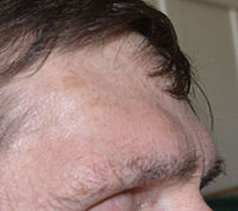
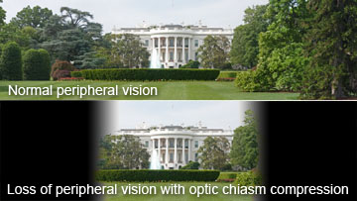

Slide 8
Investigation
GH level may exclude acromegaly if undetectable but detectable value is non-diagnostic taken alone.
A glucose tolerance test is diagnostic if there is no suppression of GH. Acromegalics fail to suppress GH below 0.5 μg/L( 2 mIU/L) and some show a paradoxical rise.
IGF-1 levels are almost always raised in acromegaly –. A normal IGF-1 together with random growth hormone <1 μg/L may be taken to exclude acromegaly if the diagnosis is clinically unlikely.
Prolactin concentrations are elevated in about 30% of patients due to co-secretion of prolactin from the tumour

Slide 9
Visual field examination by perimetry defects are common, e.g. bitemporal hemianopia.
MRI scan of pituitary if above tests abnormal. This will almost always reveal the pituitary adenoma.
Pituitary function: partial or complete anterior hypopituitarism is common

Slide 10
Treatment

Slide 11
Surgical
Trans-sphenoidal surgery is usually the first line of treatment and may result in cure of GH excess, especially in patients with microadenomas.

Slide 12
Radiotherapy
External radiotherapy is second-line treatment if acromegaly persists after surgery, to stop tumour growth and lower GH levels. However, GH levels fall slowly (over many years) and there is a risk of hypopituitarism.

Slide 13
Medical
If acromegaly persists after surgery, medical therapy is used.
Somatostatin analogues ( octreotide, lanreotide or pasireotide)
primary therapy for acromegaly either as alternative or in advance of surgery, given evidence that they can induce modest tumour shrinkage in some patients.
Dopamine agonists are less effective at lowering GH but may sometimes be helpful, especially with associated prolactin excess.
Pegvisomant is GH receptor antagonist .in patients
whose GH and IGF-1 concentrations fail to suppress sufficiently following somatostatin analogue therapy

