Slide 1



TUBERCULOSIS PREVENTION
Presented by : Mabrouka AL-shatiti
Student number : 2706
Year : 2 AMS (MED )
Date : 24 \ MAY \ 2022

Slide 2
Objectives :
Definition of tuberculosis .
Symptoms of this disease .
Mode of transmission .
Discussion ways of prevention from this disease .

Slide 3
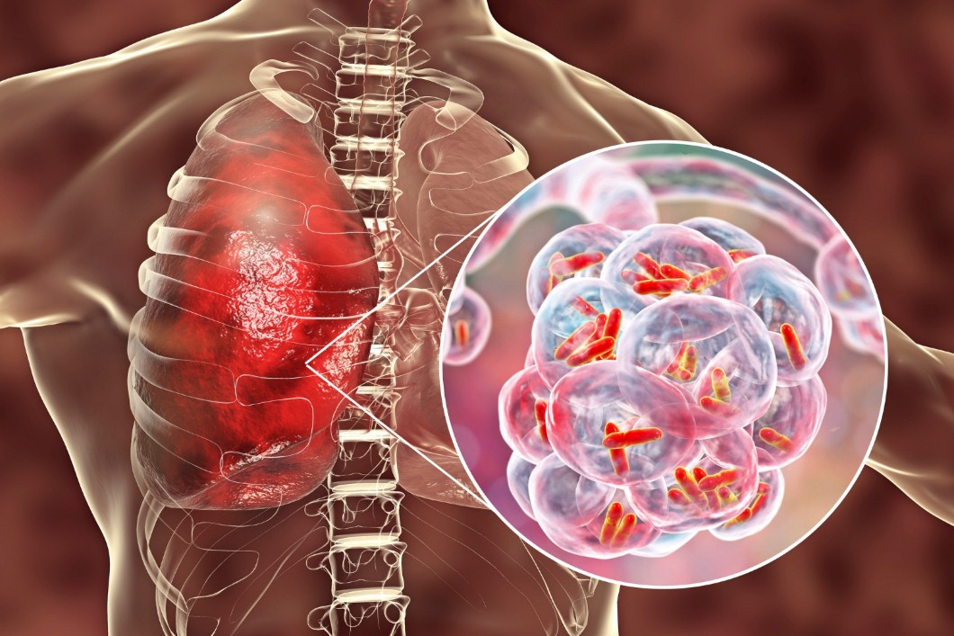
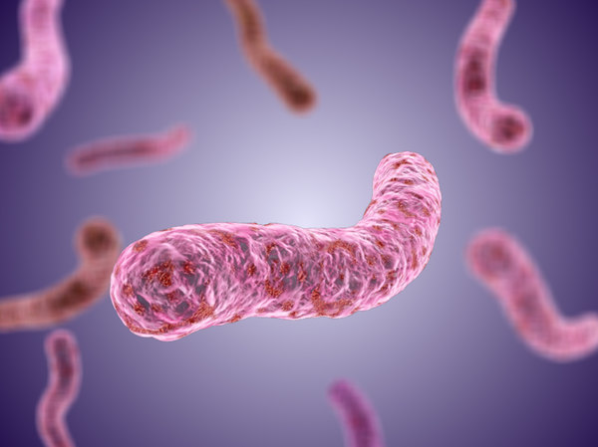
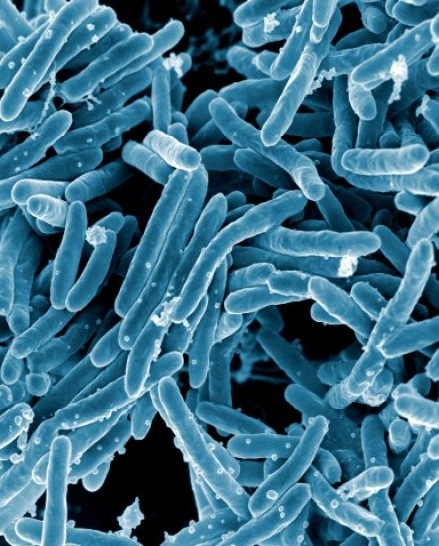
What’s TB?

Slide 4
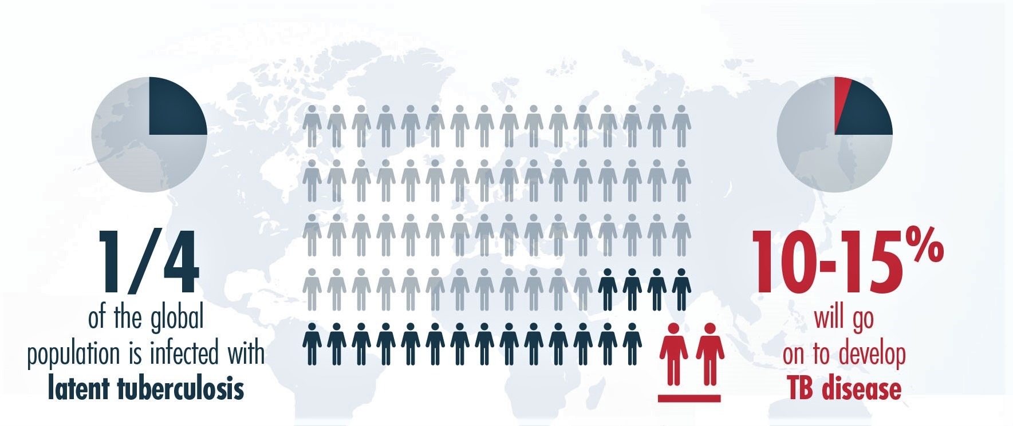
According to WHO :

Slide 5
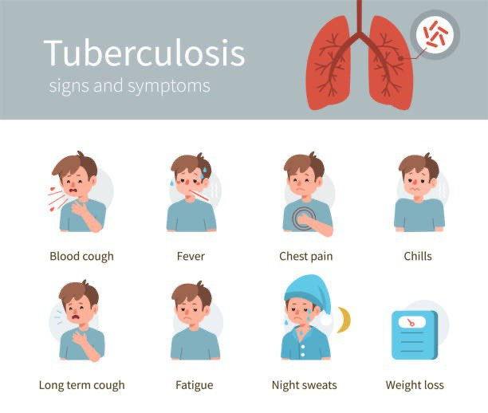

Slide 6
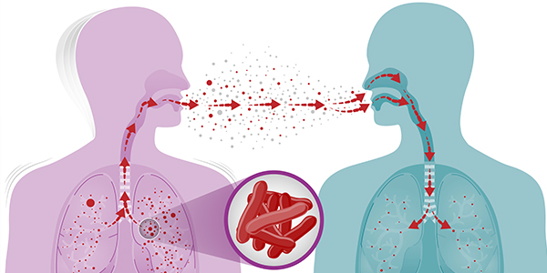
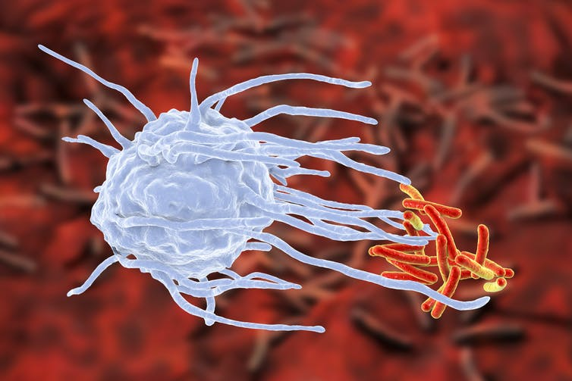
Transmission :
TB is spread through tiny drops by those who are infected with bacteria (sneezing , coughing or speaking).
Trans placental route from infected mother and is a rare mode of transmission.
The bacteria resides in tissue chiefly within macrophage cell .

Slide 7
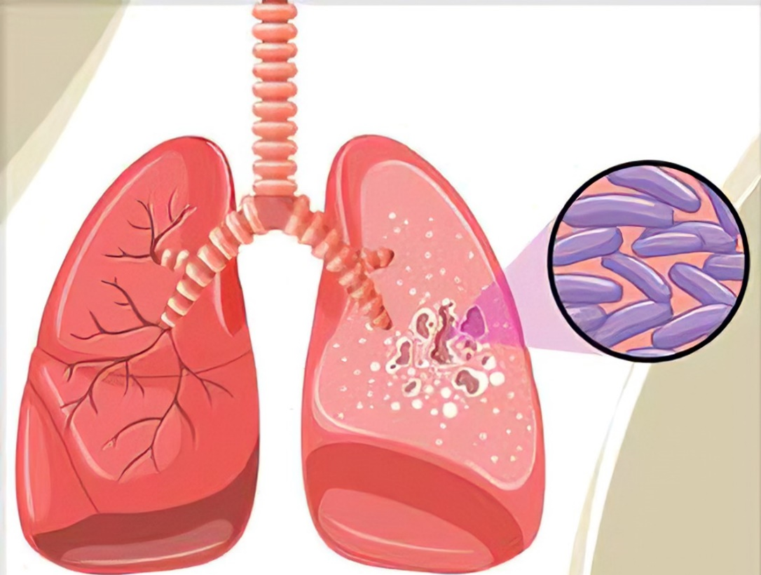
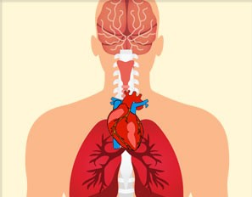
Pulmonary TB
Extra pulmonary TB

Slide 8
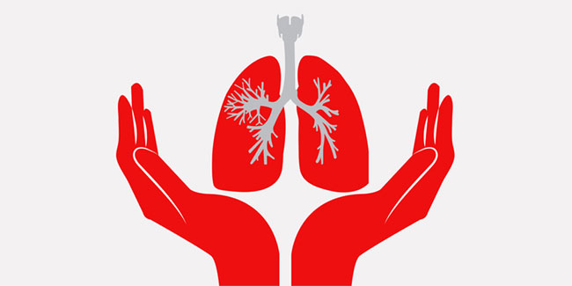
Prevention

Slide 9


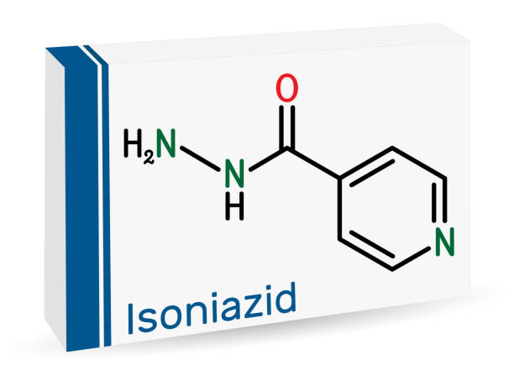
There are three strategies for
preventing TB:

Slide 10
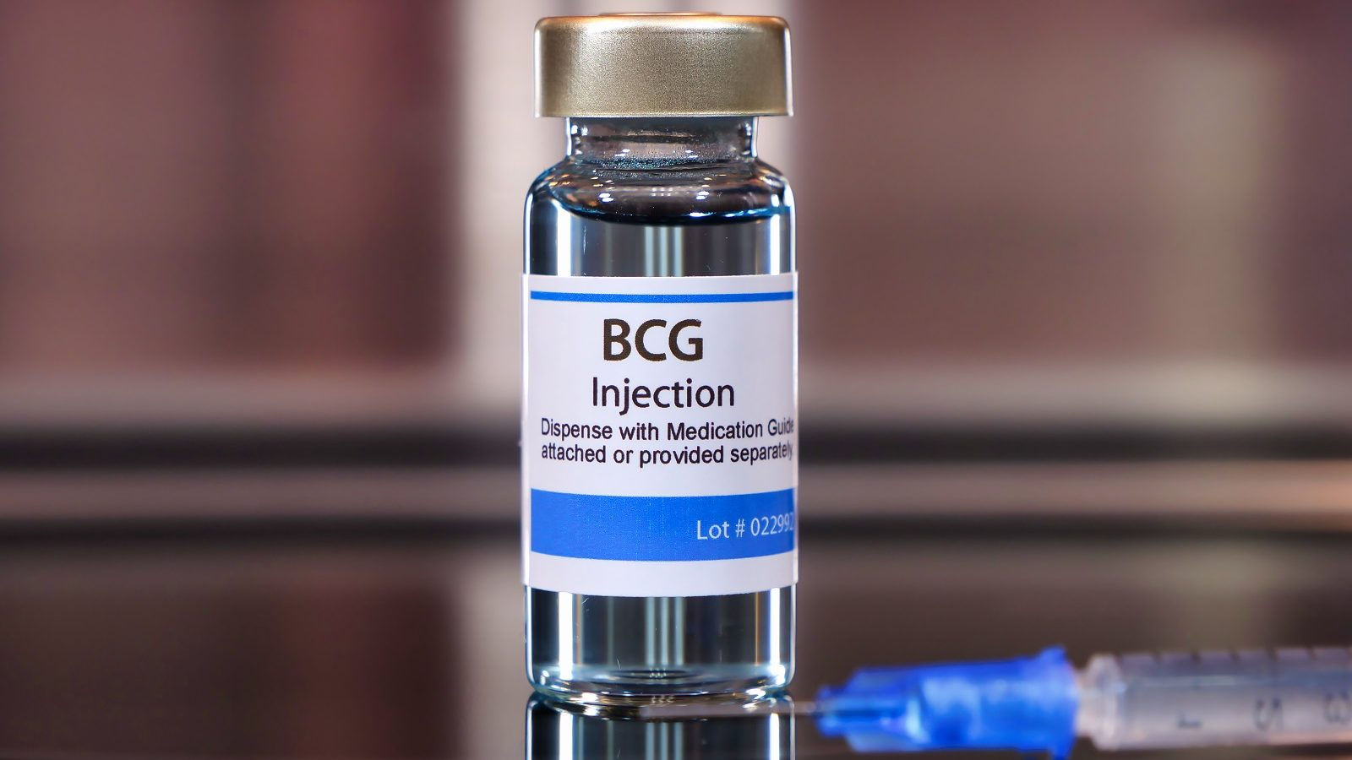
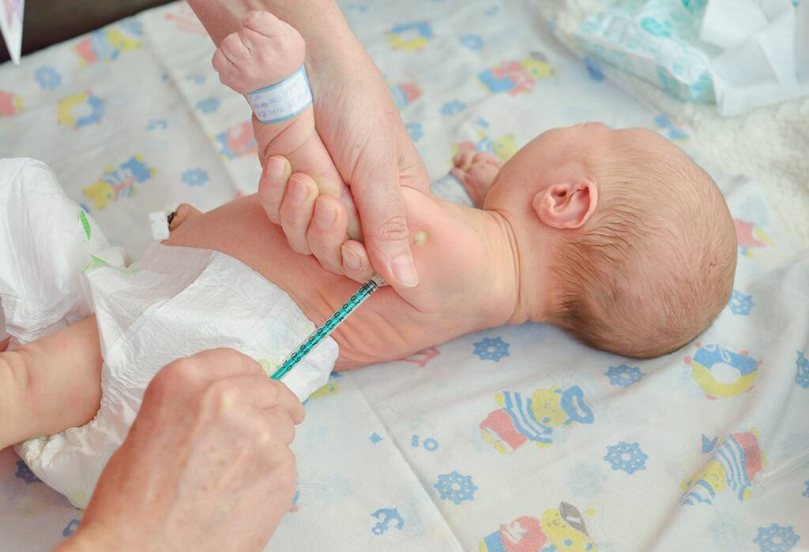
Preventative mechanisms used by public health organization .
May be administered at birth .
education health care staff about TB and screening health care workers for LTB to reduce spread the disease in hospital setting .

Slide 11
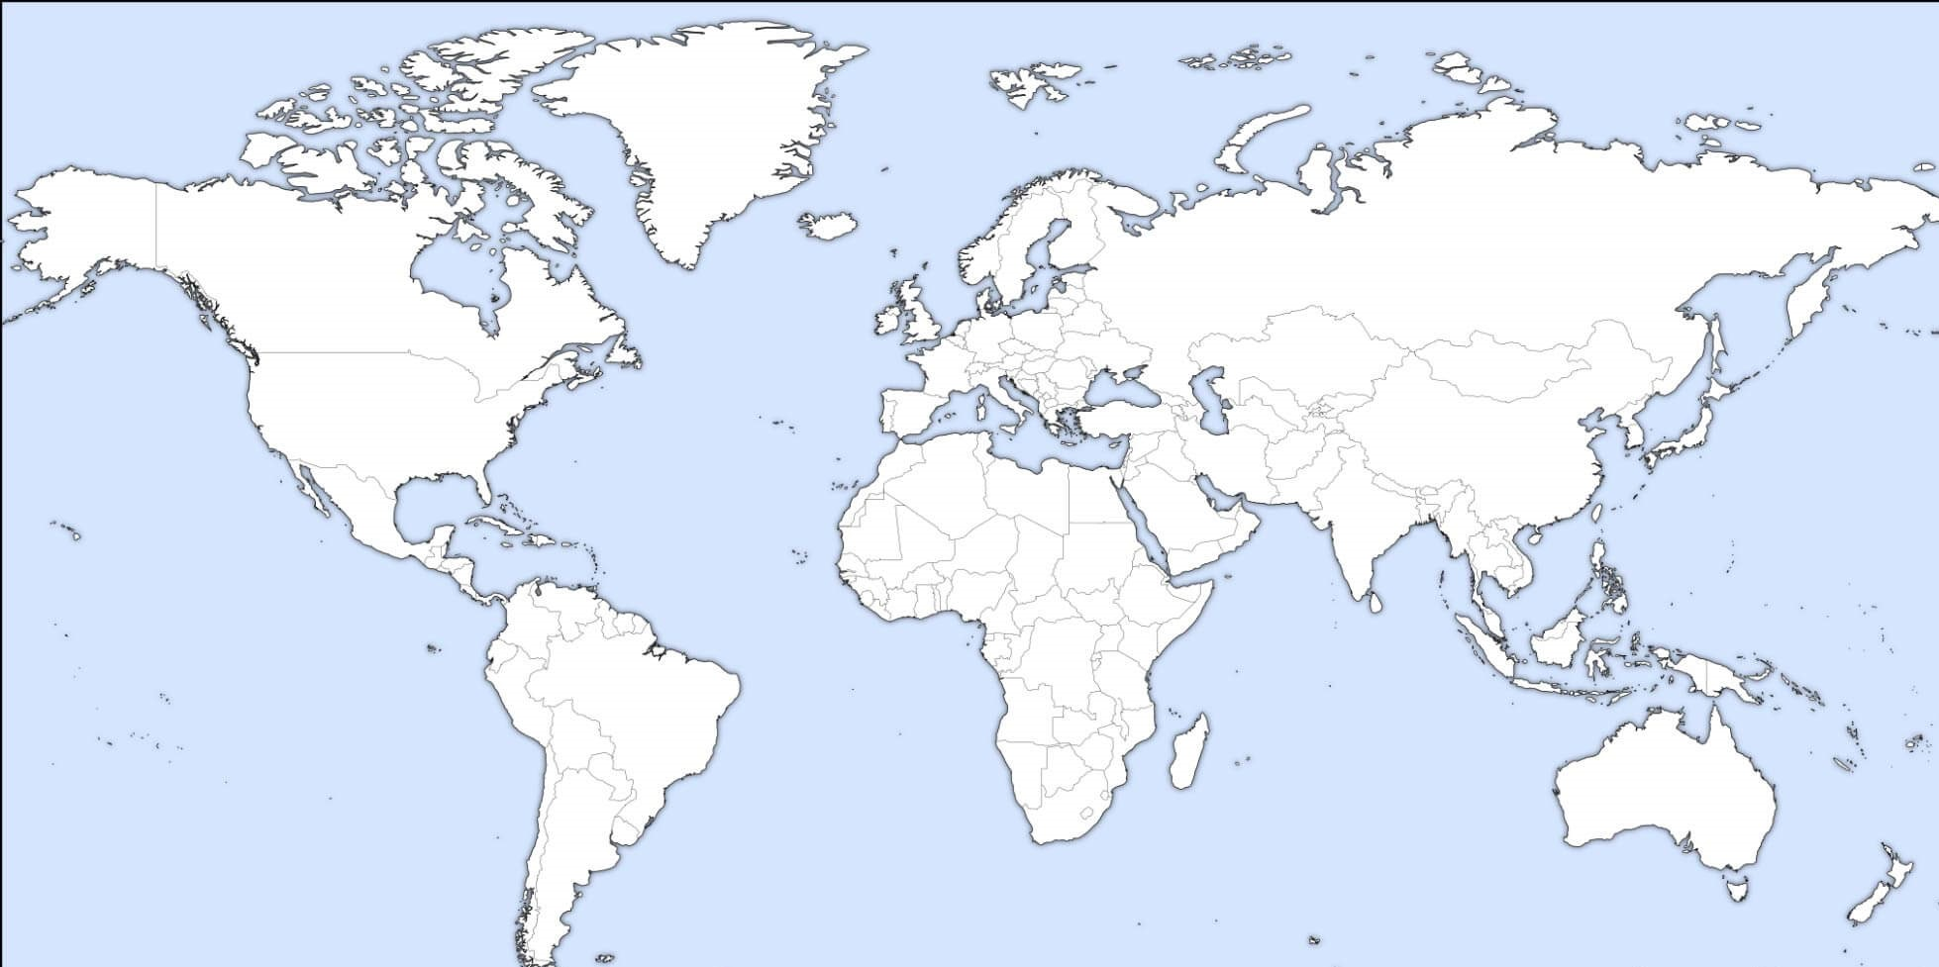
Effectiveness BCG ???
a global registry updated in 2017 indicates that numerous of countries still use BCG strategy .

Slide 12
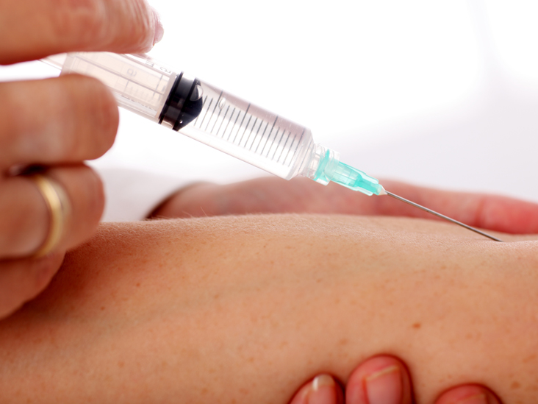
PPD skin test

Slide 13
Groups should be screened with the PPD skin test
Include :
HIV infection .
Contacts of patients with active TB .
Alcoholics .
IV drugs users .
People in countries with high incidence of TB .
Low income population .

Slide 14


Other ways to prevent :

Slide 15

In conclusion :
TB is serious and dangerous disease , widespread in our country .
We are now more aware of infectious diseases .
We mustn’t wait for the illness to come to use and destroy our body “ prevention is better than cure “ .

Slide 16

References :
Brett K, Dulong C, Severn M. Identification of Tuberculosis: A Review of the Guidelines. Ottawa (ON): Canadian Agency for Drugs and Technologies in Health; February 6, 2020.
Brett K, Dulong C, Severn M. Prevention of Tuberculosis: A Review of Guidelines. Ottawa (ON): Canadian Agency for Drugs and Technologies in Health; January 29, 2020.
Review_of_Medical_Microbiology_and_Immunology,_Fourteenth_Edition .
Harsh-Mohan-Textbook-of- Pathology-6th-Edition .
Brett K, Dulong C, Severn M. Prevention of Tuberculosis: A Review of Guidelines. Ottawa (ON): Canadian Agency for Drugs and Technologies in Health; January 29, 2020.
Brett K, Severn M. Bacille Calmette-Guérin Vaccination: A Review of Clinical Effectiveness and Guidelines. Ottawa (ON): Canadian Agency for Drugs and Technologies in Health; April 2, 2020.
Tuberculosis - Major Infectious Diseases - NCBI Bookshelf. (n.d.). National Center for Biotechnology Information.

Slide 17


