Slide 1
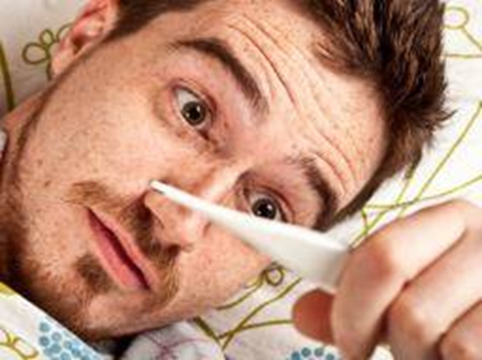
Fever of unknown origin

Slide 2
objective
Proper definition of FUO.
Epidemiology.
Etiology.
Approach to the patient with FUO.
Treatment strategies.

Slide 3
Fever is a protective response to infection . An elevated temperature enhances the body’s innate defense mechanisms by making conditions less favorable
for infectious microorganisms to thrive.

Slide 4
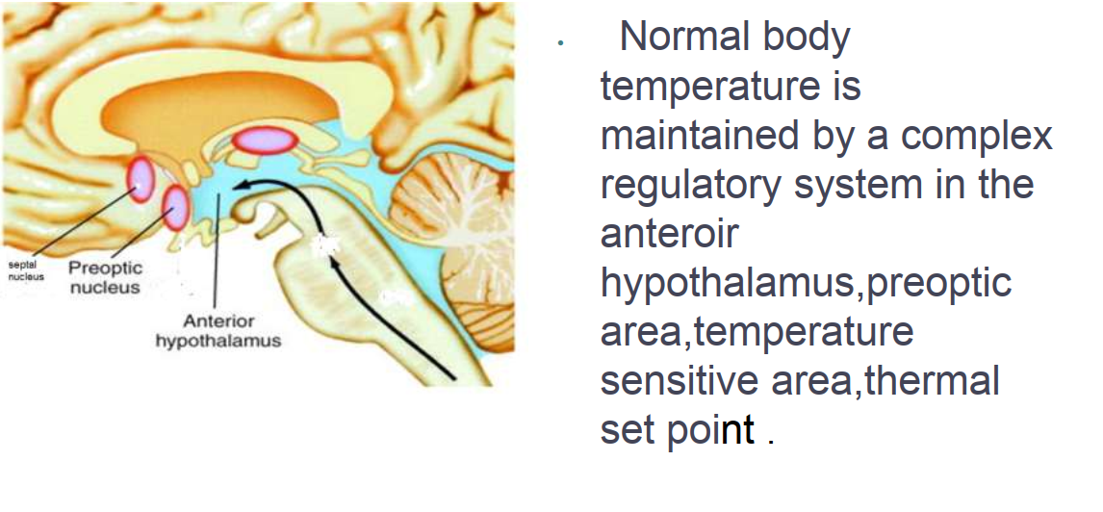

Slide 5
Pyrogens(Substances mediate the elevation of core body temperature).
Exogenous pyrogens derived from outside the host ,like Microorganisms and their products and, toxins.
They induce release of (endogenouse pyrogens) from macrophages.

Slide 6
Pyrogen (cytokines )trigger hypothalamus to release PGE2 resulting in Resetting of thermostatic temperature,activation of vasomotor center ,vasodilatation and heat production.

Slide 7
Clinicians commonly refer to a febrile illness without an initially obvious etiology as fever of unknown origin (FUO).
This usage is not accurate. Most febrile illnesses either resolve before a diagnosis can be made or develop distinguishing characteristics that lead to a diagnosis.

Slide 8
defintion
Fever higher than 38.3ºC on several occasions.
Duration of fever for at least three weeks .
Uncertain diagnosis after one week of study in the hospital

Slide 9
Establishing that a patient has an FUO As noted above, the degree and duration of fever are not the only criteria for defining an FUO.
Prior to concluding that a patient has an FUO, the following evaluation should have been performed and should have been unrevealing:

Slide 10
History and Physical examination.
Complete blood count, including .
differential and platelet count.
Routine blood chemistries, including liver enzymes and bilirubin .

Slide 11
Hepatitis serology (if liver tests abnormal).
Urinalysis, including microscopic examination, and urine culture.
Chest radiograph

Slide 12
Epidemiology
The incidence of specific etiologic agents of FUO varies by.
age of the population.
potential exposure to infectious agents.
host susceptibility to infection.

Slide 13
Etiology
Three general categories of illness account for the majority of "classic" FUO cases .
Infections.
Malignancies .
systemic inflammation (ctd).

Slide 14
Other causes
Factious fever.
Drug induced.
Carbamazepine
Isoniazid
Nitrofurantoin
Lamotrigine
Penicillin
Phenytoin

Slide 15
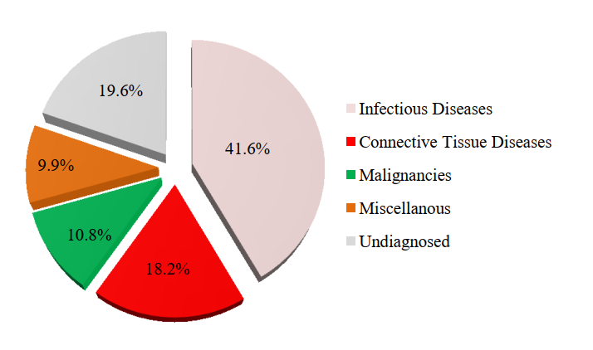
Distribution of different diagnoses

Slide 17
Viral infections
Most viruses cause self-limited infections of brief duration.
cytomegalovirus (CMV), Epstein-Barr virus (EBV), hepatitis viruses can cause FUO.
Symptoms and signs of these infections can be nonspecific.
Liver enzymes may be elevated. Viral cultures, serologic studies, and molecular techniques such as polymerase chain reaction (PCR) can be used to facilitate the Dx.

Slide 18
Brucellosis
Brucellosis frequently is considered in the differential diagnosis of FUO because the infection can be present as chronic non specfic symptoms and signs.
so, it is important to ask about exposure to animals or animal products.

Slide 19
Tuberculosis (TB)
Tuberculosis (important cause of FUO) Extrapulmonary TB (disseminated TB, or TB of the liver, peritoneum, pericardium, or genitourinary tract), is more likely to cause FUO than pulmonary TB, which is usually evident on chest radiography

Slide 20
Salmonellosis
Salmonella species can cause typhoidal as well as localized gastrointestinal (GI) illness
The diagnosis can be made with blood and stool cultures, which should be repeated if initially negative and fevers persist.

Slide 21
Toxoplasmosis
It should be considered in patient with exposure to soil contaminated with feline (cats) feces.
A rise in antibody titer can establish the diagnosis; however, a single high antibody titer is not sufficient.

Slide 22
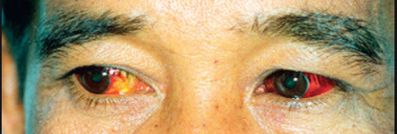
Leptospirosis
Leptospirosis is a common zoonotic infection with worldwide distribution.
The clinical manifestations are nonspecific and may include fever, rigors, myalgias, headache, cough, and gastrointestinal complaints.
Leptospirosis typically occurs after exposure to environmental sources, such as animal urine, contaminated soil or water (particularly during swimming), or infected animal tissue.

Slide 23
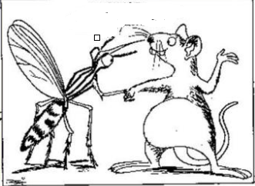

Slide 24
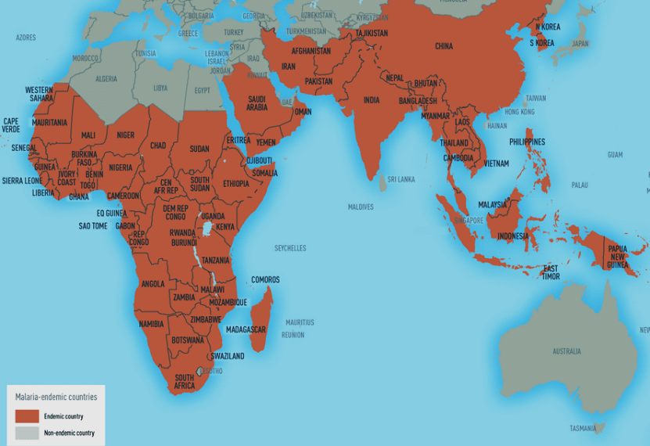

Slide 25
Malaria
Malaria is an important consideration in a patient with FUO.. Although the patient frequently has a history of travel to areas where malaria is endemic.
Malaria infection can be delayed for months after travel .
Splenomegaly usually accompanies fever The diagnosis is made by examining appropriately stained thin or thick smears of blood.

Slide 26
Localized infection
When common localized infections cause FUO, they may have an unusual presentation.
Careful and repeated history and physical examination, and careful review and interpretation of laboratory tests, can help to diagnose these infections.

Slide 27
approach
The most critical feature of the evaluation of a patient with FUO is to take a careful history and to reassess the patient frequently.
It is important to look for uncommon presentations of common diseases and to perform a detailed physical examination.

Slide 28

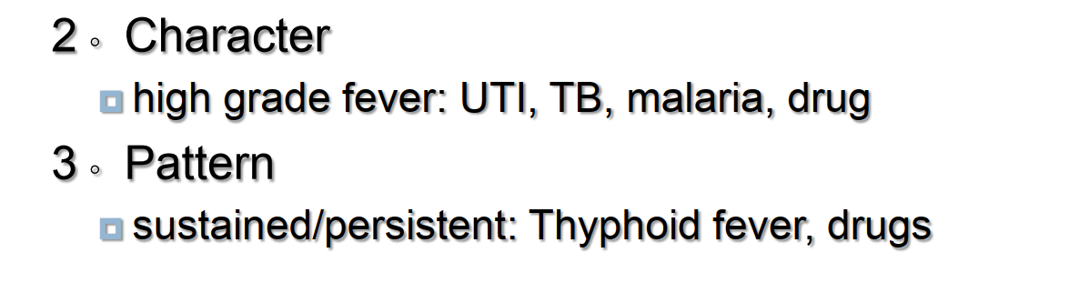

Slide 30
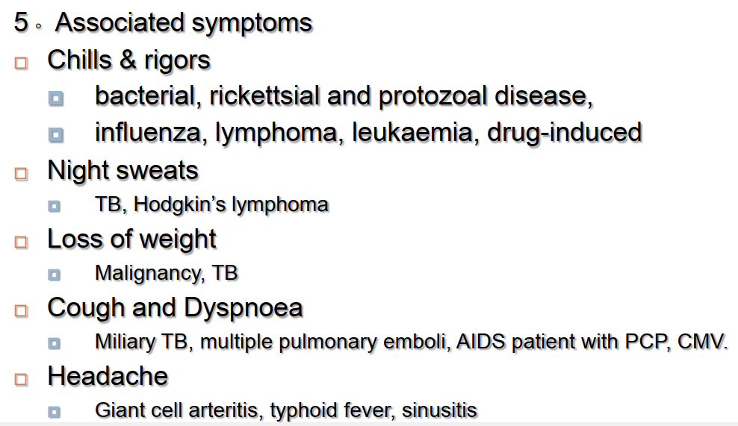

Slide 31
History and physical examination.
Detailed review of systems.
Localizing symptoms eg Joint pain RA, SLE, vasculitis
Headache +_abnormal behaviour eg mennigitis+_
encephalitis

Slide 32
Abd. Pain and change bowel habbit e g Cholangitis, Crohn’s disease,typhhoid gynaecological infection.
Bone pain: Osteomyelitis, lymphoma.
Sorethroat: IM, retropharyngeal abscess, post-Streptococcal infection.
Skin rash: viral ,CTD

Slide 33
Travel
Animal exposure (eg, pets, occupational, living on a farm).recent procedure (dntal,u cathetrization.iv catheters iv drugs
Immunosuppression.Vaccination.
Drug history: including antimicrobials.

Slide 34
Lab tests
Stage 1: screening
1. CBC,. ESR & CRP
2. RFT AND LFTs
3. Blood culture.cosider bl film for malaria.
4. Serum virology .
5. Urinalysis and culture
6. 9. Stool occult blood
7. CXR and Tuberculin test

Slide 35
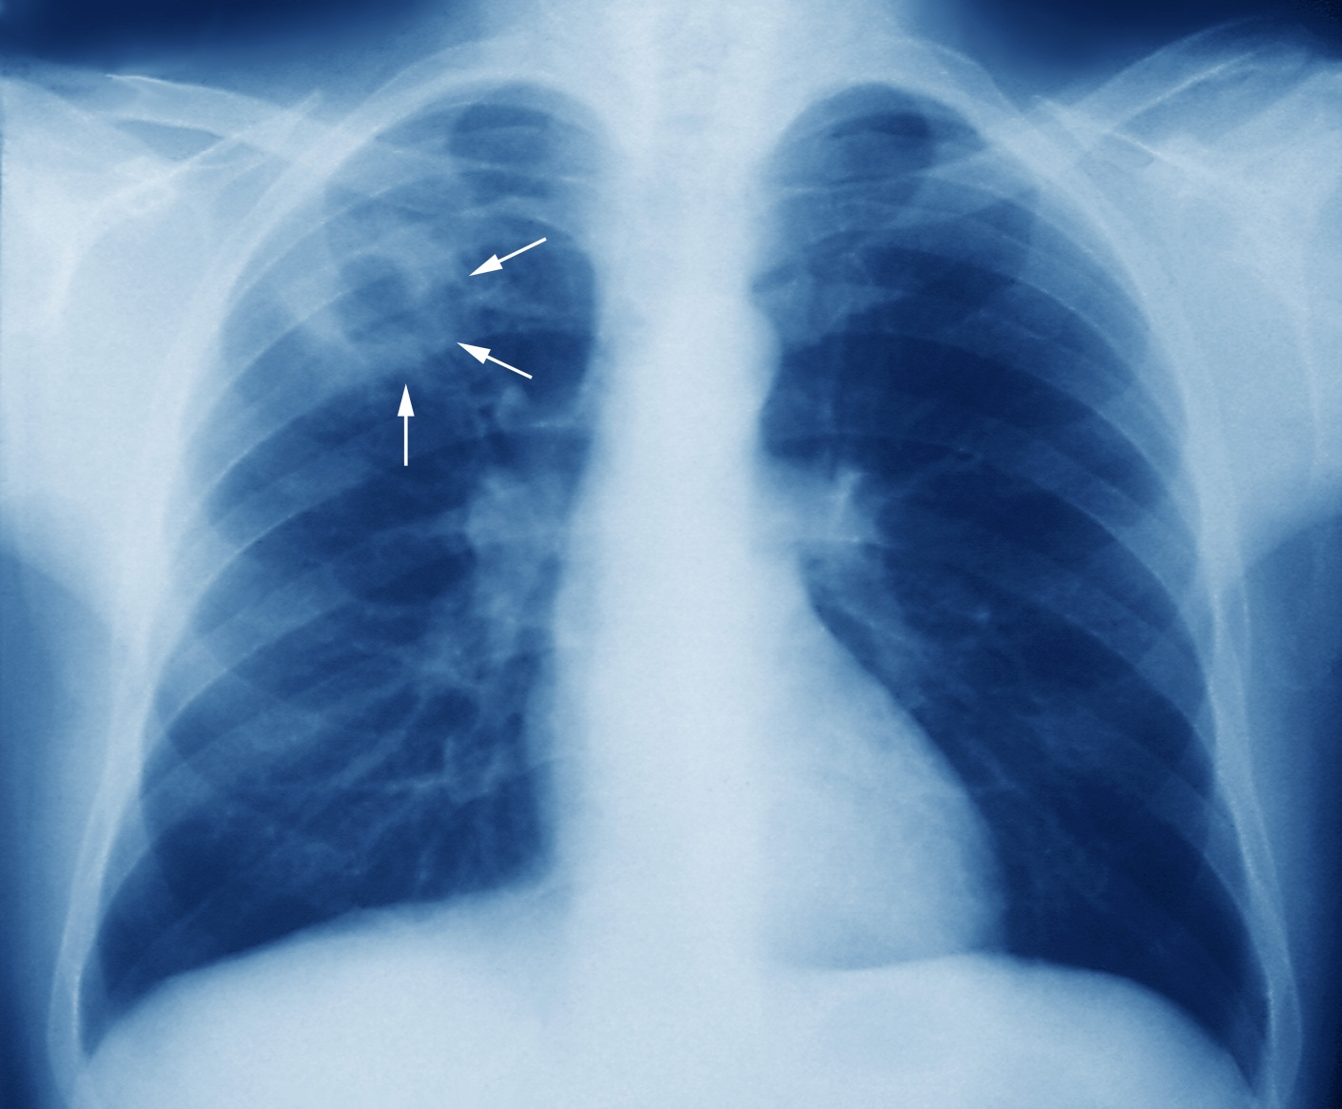
Lung tb

Slide 36
Blood culture
Three routine blood cultures drawn from different sites over a period of at least several hours without administering antibiotics, if not already performed.
Aerobic and non aerobic media should be used.

Slide 37
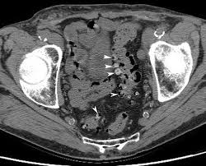
Stage 2
After Repeat history and examination
1. CT (chest,abdomen, pelvis)
2. Autoantibodyscreen(ANA, RF, antidsDNA )
3. LP
4.echocardiography.

Slide 38


Slide 39
Stage 3
Tissue biopsy
Lymph nodes ,bone marrow,liver biopsy.
Consultation.

Slide 40
Biopsy
Bone marrow or liver biopsy in the work-up for miliary tuberculosis Liver biopsy for possible granulomatous hepatitis or sarcoidosis.
Lymph node biopsy for malignancy, especially lymphoma, or infections such as cat-scratch disease.

Slide 41
Temporal artery to look for giant cell arteritis or biopsy of an affected tissue to diagnose a vasculitic process such as polyarteritis nodosa.
Pleural or pericardial biopsy in the evaluation of extrapulmonary tuberculosis

Slide 42
Therapeutic trials.
A therapeutic trial of corticosteroids for an inflammatory process .
A careful evaluation for infection should precede such a trial.

Slide 43
Antimicrobial agents.
Antimicrobial agents could be expected to suppress, but not cure, an infectious process such as an occult abscess since adjunctive drainage would usually be required.

Slide 44
FUO patients who remain undiagnosed after extensive evaluation generally have a favorable outcome and the fever usually resolves after 4-5 weeks.

Slide 45

Thank u

