Slide 1







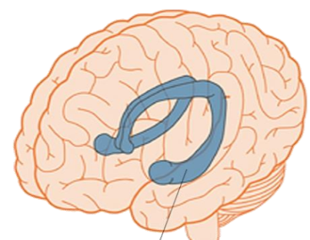
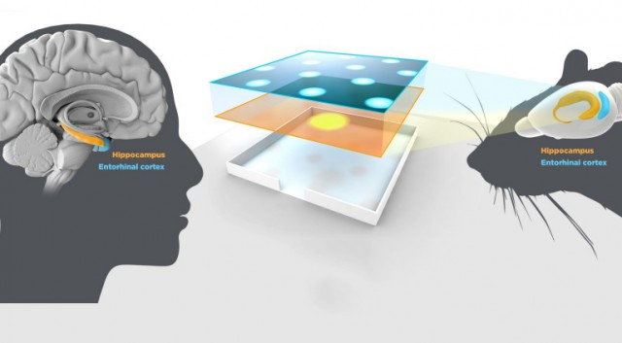
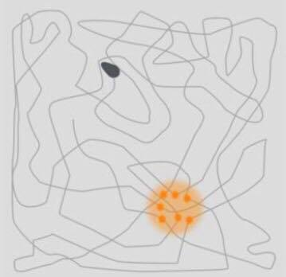
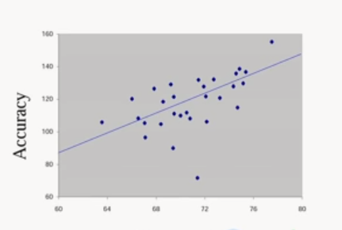
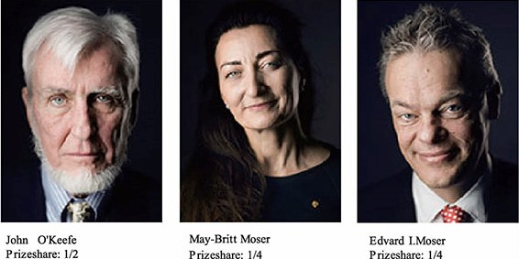
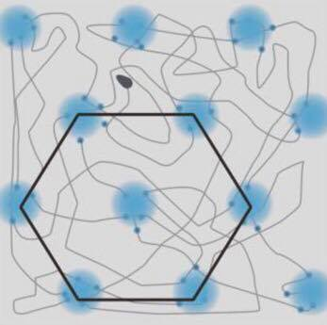
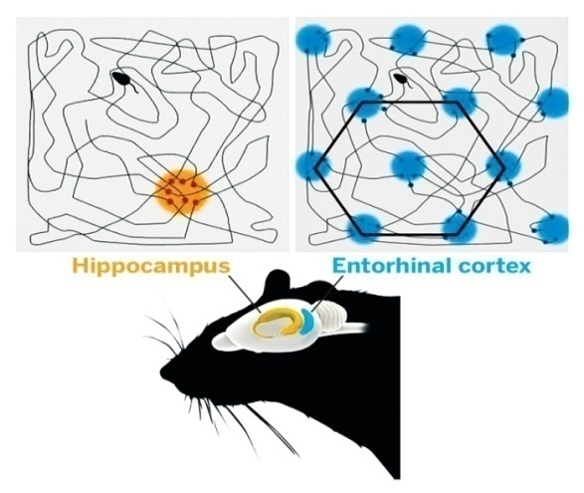

How Does our Brain GPS Work?
Halima Mohammed Bushiha 1491 – 4thYear Medical Student
Libyan International Medical University
The Nobel Prize in Physiology and Medicine 2014 was divided, one half awarded to John O'Keefe, the other half jointly to May-Britt Moser and Edvard I. Moser for their discoveries of cells that constitute a positioning system in the brain.
How do we know where we are? How can we find the way from one place to another? And how can we store this information in such a way that we can immediately find the way the next time we trace the same path? 2014 Nobel Laureates have discovered a positioning system, an “inner GPS” in the brain that makes it possible to orient ourselves in space, demonstrating a cellular basis for higher cognitive function⁽¹⁾.
In 1971, John O’Keefe discovered the first component
of t this positioning system. He found that a type of nerve
cell in an area of the brain called the hippocampus that was
always activated when a rat was at a certain place in a
room. Other nerve cells were activated when the rat was at
other places. O’Keefe concluded that these “place cells”
formed a map of the room⁽¹⁾ .
Introduction
Results
Discussion
John O'Keefe and the place in space
.
The hippocampus is a part of the brain that is involved in emotions, learning and memory formation
A place for maps in the human brain
Investigations have provided that place and grid cells exist also in humans. In patients with Alzheimer’s disease, the hippocampus and entorhinal cortex are frequently affected at an early stage, and these individuals often lose their way and cannot recognize the environment⁽²⁾ .
A
B
Figure(4): Similarity in form and function of hippocampus in rodents and humans.
Figure2: (A) place cells activation in certain places, (B) Amount of blood flow correlates with how good is navigation.
Place cells, grid cells, head direction cells and border cells are involved in creating spatial maps in brain that enables a sense of place and navigational ability.
Understanding of the brain positioning system may help us in the treatment of brain disorders like damentia and Alzheimer’s.
May-Britt and Edvard Moser find the cordinates
Conclusion
In 2005, May-Britt and Edvard Moser identified another type of nerve cell, which they called “grid cells”, that generate a coordinate system and allow for precise positioning and path finding. These grid cells together with other cells in the entorhinal cortex that recognize the direction and the border of the room form a network with the place cells constitutes an inner GPS, in the brain⁽²⁾
.
Figure1: 2014 nobel laureates.
C
Moser, E., Kropff, E. and Moser, M. Place Cells, Grid Cells, and the Brain's Spatial Representation System. Annual Review of Neuroscience.(2012) 31(1), pp.69-89.
Moser M-B, Rowland DC, Moser EI. Place Cells, Grid Cells, and Memory. Cold Spring Harbor Perspectives in Biology. 2015;7(2). doi:10.1101/cshperspect.a021808.
Materials and methods
D
References
The data in this poster was collected from 2 different studies.
Due to lack of technology at that time, first trials were only preformed on rodents and no human trials were available.
Figure3: (C) Grid cells hexagonal pattern, (D) Hippocampal-entorhinal circuit.

