Slide 1


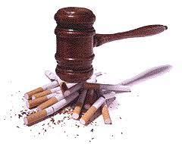
Tobacco control
Libyan International Medical University
^{1st} Year medicine
By: Hadeel Osama 3017

Slide 2
Objectives
1) Define smoking.
2) List side effect of nicotine.
3) Outline the role of UICC and its members.
2

Slide 3

Introduction

Slide 4

Definition of smoking
4

Slide 5
Smoking defined as a chemical toxicosis which is able to cause detrimental effects either of acute or chronic type on different structures of the body being Some of these like Cardiovascular System , respiratory system and epithelial glands target organs.
5

Slide 6
Smoking also causes physical addiction, primarily due to nicotine, that adversely influences Smoking cassation.
6

Slide 7
Side effect of nicotine
7

Slide 8
Nicotine is well known to have serious systemic side effects in addition to being highly addictive. It adversely affects the heart, reproductive system, lung, kidney.

Slide 9
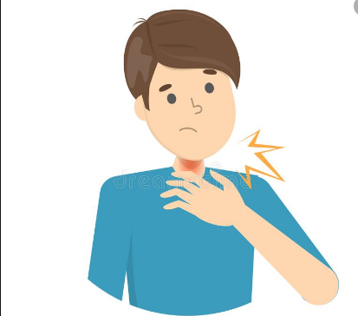
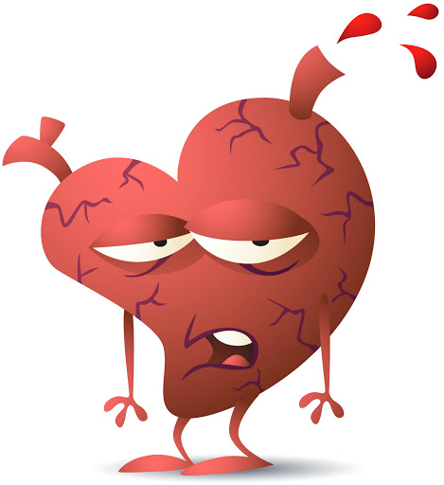
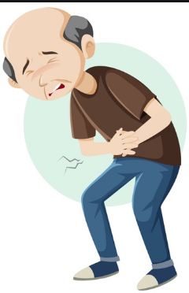
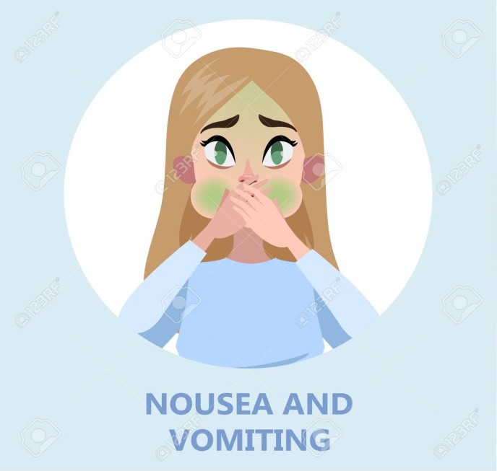

Slide 10
The role of UICC and its members
UICC and its members help with the implementation of the FCTC by encouraging governments and policy makers to adopt and effectively implement the WHO FCTC treaty and by raising awareness of the risks related to the use of tobacco.

Slide 11
Conclusion
Cigarette smoking by youth and young adults has immediate adverse health consequences, including addiction , and accelerates the development of chronic diseases across the full life course.
11

Slide 12
References
1)Leone A, Landini L, Leone A. What is tobacco smoke? Sociocultural dimensions of the association with cardiovascular risk. Curr Pharm Des. 2010;16(23):2510-7. doi: 10.2174/138161210792062948. PMID: 20550508.
2)Mishra A, Chaturvedi P, Datta S, Sinukumar S, Joshi P, Garg A. Harmful effects of nicotine. Indian J Med Paediatr Oncol. 2015;36(1):24-31. doi:10.4103/0971-5851.151771
3)National center of chronic Disease prevention and health promotion (US) office on smoking and Health. Preventing Tobacco Use Among Youth and Young Adults:A Report of the Surgeon General.Atlanta (GA):centers for Disease Control and prevention (US):2012.1,introduction,summary,and conclusions.Available from: https://www.ncbi.nlm,nih.gov/books/NBK99239/
12

Slide 13
Thank you
13

