Slide 1


CLIMATE CHANGE AND VECTOR-BORNE DISEASES
معين محمد مفتاح منسية
3411
Year 1 – AMS
04/06/2022

Slide 2

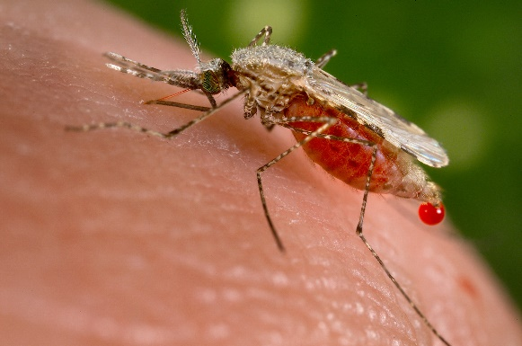
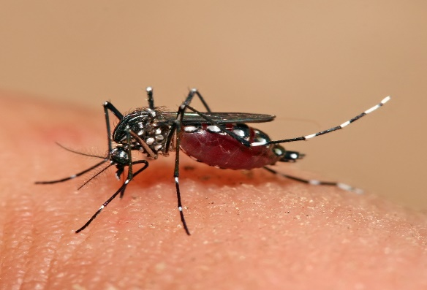
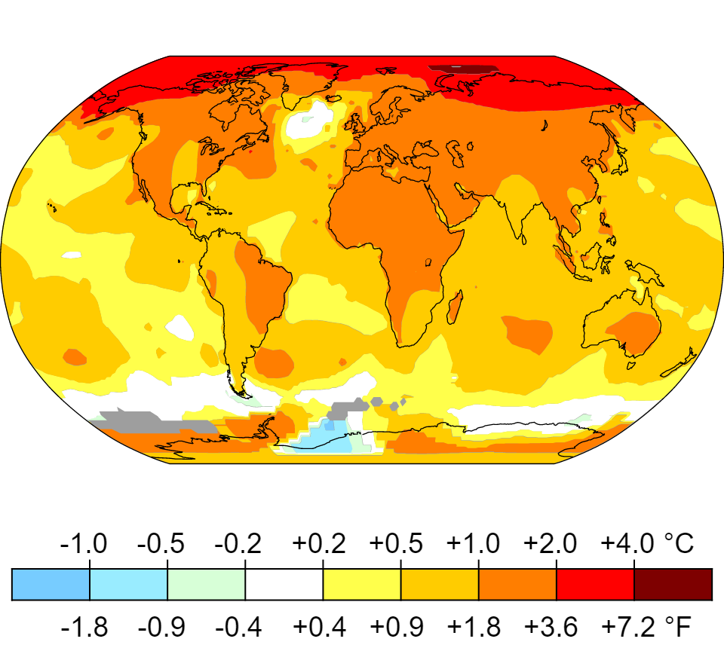
1
Objectives
01
Define climate change & outline its causes
02
Describe how climate change effects are predicted
03
Define vector-borne diseases & examples of them
04
Discuss how climate change effects the risk of vector-borne diseases
05
illustrate ways to control climate change

Slide 3

2
Introduction

Slide 4
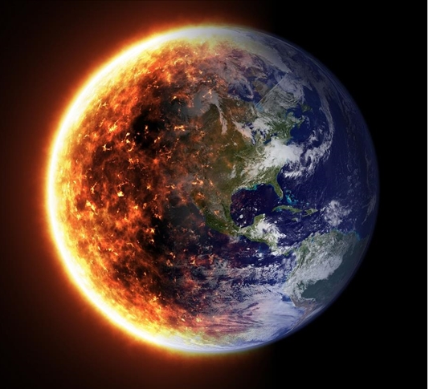
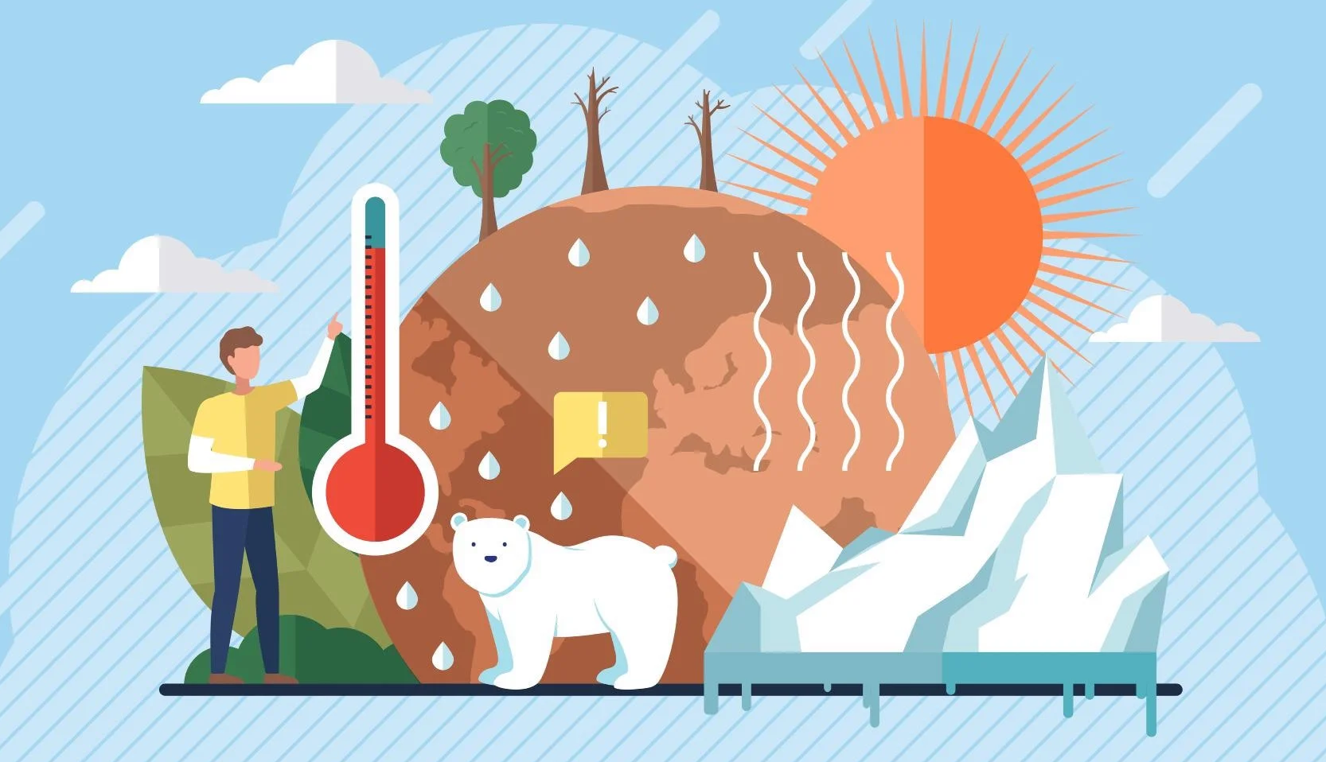
Climate change
3
Climate change is a long-term change in the average weather patterns that have come to define Earth’s local, regional and global climates.
Global warming
Global warming is the long-term heating of Earth’s climate system observed since the pre-industrial period (between 1850 and 1900) due to human activities

Slide 5
Causes of climate change
4
Natural
Artificial
Changes in the Earth’s Orbit and Rotation
Variations in Solar Activity
Volcanic Activity
Generating power
Manufacturing goods
Cutting down forests

Slide 6
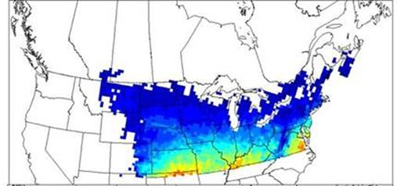
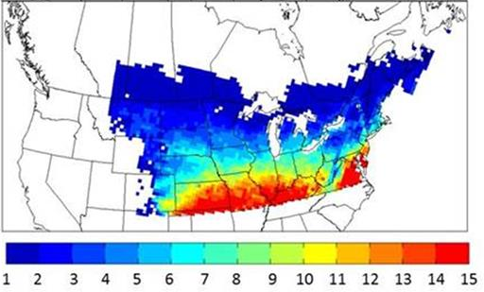
How climate change effects are predicted
5
Climate change effects are predicted by cross-referencing regional climate history and future projections with the topic of interest for which they’re studying it for.
For today’s topic’s, that topic of interest is vector-borne diseases of medical importance affected by climate change:

Slide 7
Vector-borne diseases
6
Vector-borne diseases are human illnesses caused by parasites, viruses and bacteria that are transmitted by vectors.
Vectors are living organisms that can transmit infectious pathogens between humans, or from animals to humans. Such as [Mosquitos, Fleas, and Aquatic snails]
Examples:
Malaria - parasitic infection transmitted by Anopheline mosquitoes
Dengue – viral infection transmitted by Aedes mosquitoes
Zika – another viral infection transmitted by Aedes mosquitoes

Slide 8


7
Aedes mosquito
Anopheline mosquito
Dengue and Zika’s vector
Malaria’s vector

Slide 9
Climate change effects on the risk of contracting a vector-borne disease
8
1st – What are the risks?
The risks of a human contracting a vector-borne disease is determined mainly by 3 factors:
Region of activity
Time spent outdoors
Protective measures taken

Slide 10
2nd – Where are the risks?
9
Rural regions/countries with a lot of commonly known insects as vectors (e.g. mosquitos) pose the highest risk for an individual to contract the disease carried by said vectors.
-Some of these regions are as following:
Large areas of Africa (Nigeria, Congo, Uganda)
Large areas of Asia (Bangladesh, Bhutan, India)
Central and South America
Parts of the middle-east (Yemen and Saudi Arabia)
Some Pacific islands (Vanuatu and Solomon Islands)

Slide 11
3rd – How are the risks affected by climate change?
10
Risk from vector-borne diseases is intrinsically sensitive to changes in weather and climate.
That means the “Where, When and How!” many arthropod vectors are found directly depend on multiple impacts of weather and climate
Direct
Indirect
Low and high temperatures
Temperature on rates of vector development from one life stage to the next
Temperature humidity on activity and host finding of vectors
Rainfall on availability of breeding habitat for insect vectors
Determining qualities of habitat and availability of animal hosts for vector blood meals

Slide 12
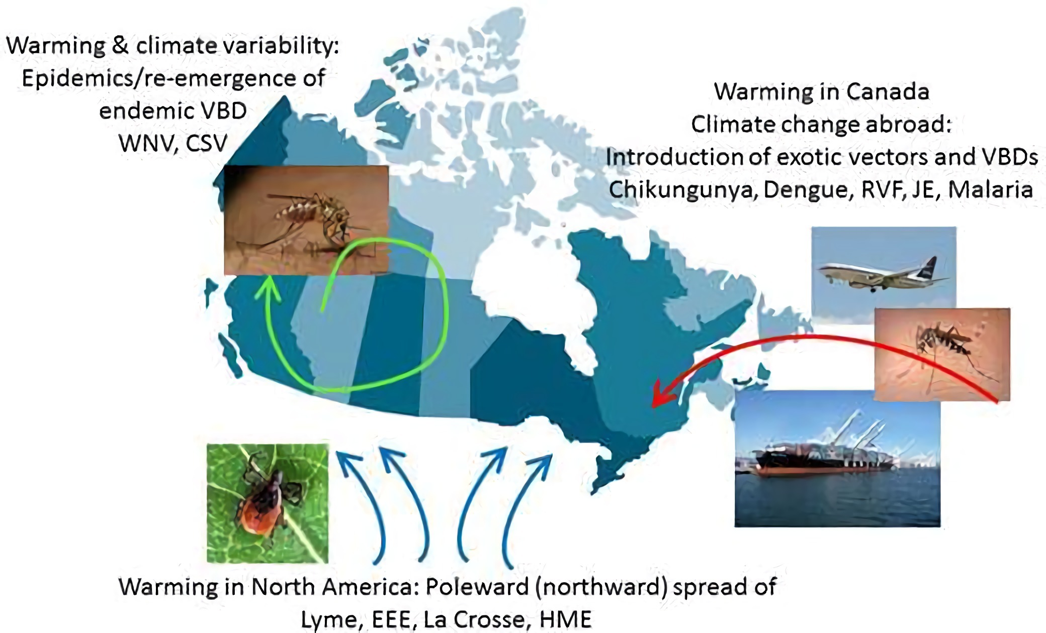
11

Slide 13
Methods to combat climate change
12
Reducing energy consumption
Since much of our energy comes from burning fossil fuels, lowering the energy we use lowers the amount of fuel we need
Walking, cycling, or taking public transport
Another large chunk of fossil fuel usage are gas-vehicles (cars, airplanes).
So, lowering the amount of gas-vehicles lowers the amount of fuel burnt.
Eating more vegetables and less meat
Producing plant-based foods generally results in fewer greenhouse gas emissions,
and requires less energy, land and water.

Slide 14
Conclusion
13
Climate change, whether you believe in it or not, Is something very real.
It opposes a threat to everything living on this Earth like nothing other.
And today, we have talked about one of many of climate change’s scary dangers on human health and well-being; vector-borne diseases.
Hopefully you’ve learned something new today!
Until next time! Stay safe.

Slide 15
14
PubMed. 2017. Climate change and vector-borne diseases of public health significance. [online]
Available at:
<https://pubmed.ncbi.nlm.nih.gov/28957457/>
[Accessed 28 May 2022].
REFERENCES

Slide 16
15
Thank you

