Slide 1


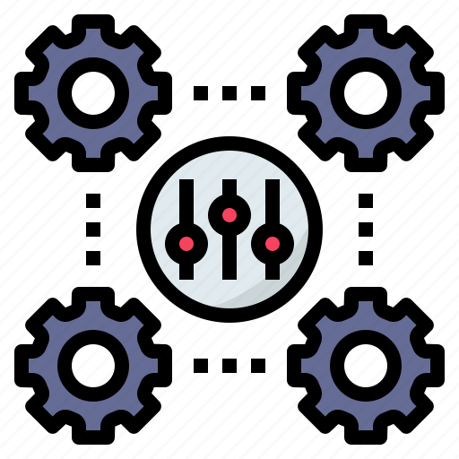
Introduction and Elements of MCS
Libyan International Medical University
Faculty of Business Administration
BY:Marwan Fouad Abed Eloshipi
ID:3782
EMAIL: marwan_3782@limu.edu.ly

Slide 2
Table of Contents
02
03
04
Management Control Systems
01
Definition
Elements of MCS
Conclusion
Reflection
References
2

Slide 3

Management Control Systems
01
Definition
Elements of MCS
3

Slide 4
Management Control Systems
Management Control Systems [MCS] are made up of procedures and processes that assist a company achieve its mission and goals. Employee behavior and work duties are defined by controls.
Business owners and managers must track and monitor performance after implementing standards. To meet goals, systems must be modified and adjusted on a regular basis.
Example:
When a HR director feels like there’s more people leaving this year than last year, they should track employee turnover. By using this control system they will know if more employees are leaving and the reason into why this might be happening
4

Slide 5

Elements of MCS
There are 5 main elements that are related to the MCS which is:
Planning
Building and implementing strategies that assist and help the firm to meet it goals and strategies is important to the business.
Establishment of standards
After the planning (defining the business processes and implementing strategies), the managers should set standards for measuring the success and efficiency of business operations. These measurements should be possible to achieve.
5

Slide 6
Elements of MCS
Monitor and evaluate actual performance
Followed by the standards establishment, the organizations should put the required measurements in to monitor and evaluate performance at several levels of the production process.
Compare actual results with the expected results
The performance details should be compared to the expected outcomes once they have been obtained.
Rectify differences and take corrective actions
When a difference between the expected results and the actual results is detected, the business should take an immediate action to address the cause of the problem.
6

Slide 7
Conclusion
The management control system is also referred to as MCS is a management tool that determines whether the effectivity of functions performance applies to the business’s goals or not by using methods to study and analyze data. And it helps businesses in making managerial decisions.
7

Slide 8
Reflection
The management control systems are a repetitive process that businesses must follow throughout their life span because it’s important for businesses to keep its actions in line with its goals. Apart from that, business environment changes frequently, this can have an impact on business processes.
8

Slide 9
References
Management Control Systems: Meaning and 05 Main Elements. (2022). Retrieved 11 May 2022, from https://www.econposts.com/business-management/management-control-systems/
Bhasin, H. (2022). Management Control System: Objectives, Functions and Advantages. Retrieved 11 May 2022, from https://www.marketing91.com/management-control-system/
Bhasin, H. (2022). Management Control System: Objectives, Functions and Advantages. Retrieved 11 May 2022, from https://www.marketing91.com/management-control-system/
9

Slide 10

THANKS!
Do you have any questions?

