Slide 1



Libyan International University
Faculty of Business Adminstration
The out of The Pocket Model
By: Ahmed Jadullah Hamad 2726
Salim Mohammed 2708
Nuri Founas 2733

Slide 2
Table of content :
Introduction .
Examples of the countries that use thise model .
The model that USA use.
Advantages and disadvantages of out of the pocket model.
Conclusion .
References.

Slide 3

Introduction
There are four main types of models :
Beveridge model .
Bismarck model.
National health insurance
Out of the pocket model.
The out-of-pocket model is the most common model in less-developed areas and countries where there aren't enough financial resources to create a medical system like the three models above. In other words In medicine, the amount of money a patient pays for medical expenses that are not covered by a health insurance plan.

Slide 4
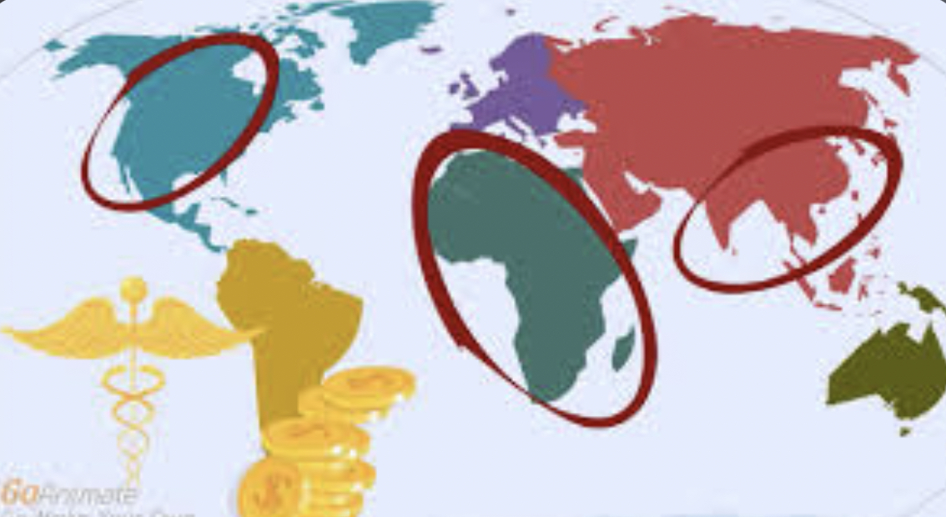
countries that use out of the pocket model :
Used by rural areas in India, China, Africa, South America, and uninsured or underinsured populations in the U.S.

Slide 5

The model that United states use
The US healthcare system does not provide universal coverage

Slide 6
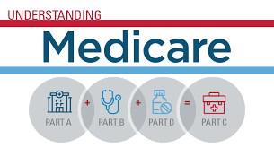
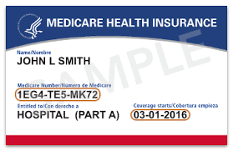
It can be defined as a (mixed system), where publicly financed government Medicare and Medicaid health coverage coexists with privately financed (private health insurance plans) market coverage. Out-of-pocket payments and market provision of coverage predominate as a means of financing and providing healthcare.2 As of 2019, around 50% of citizens received private insurance coverage through their employer (group insurance), 6% received private insurance through health insurance marketplaces (nongroup insurance), 20% of citizens relied on Medicaid, 14% on Medicare, and 1% on other public forms of insurance.

Slide 7
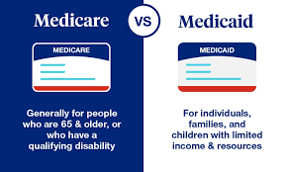

Slide 8
Advantges of out of the pocket model
There are several benefits which are as follows:
Such expenses can be used under tax deductions like charitable donations, a medical expense that has not been reimbursed, etc. It can help in reducing the tax burden
Out-of-pocket costs like taxes on cigarettes are used to change the behavior of consumers who smoke, as this causes harmful health effects.
It brings about a sharing factor between two parties where both parties contribute to an expense

Slide 9
disadvantges of out of the pocket model
Even though the medical insurance company promises to cover the health-related cost, there is a catch behind it where the 100% cost will never be covered as the concept of out-of-pocket expenses pitches in.
Some expenses, like the tax on smoking, may not prove fruitful for all when it comes to human behaviour, as a person addicted to smoking will still smoke and instead pay more money for it.
They are not predictable and can, at times, disrupt the planning and budget of the individual concerned.

Slide 10

Conclusion
Out-of-pocket expenses have both advantages and disadvantages. While some are reimbursed by the company or business, in health insurance cases, these are strictly non-reimbursable.
In this model, patients must pay for their procedures out of pocket. The reality is that the wealthy get professional medical care and the poor don't, unless they can somehow come up with enough money to pay for it. Healthcare is still driven by income.

Slide 11

References
GoodRx. (n.d.). The 4 types of healthcare system designs and structures. GoodRx. Retrieved January 6, 2023, from https://www.goodrx.com/hcp/providers/healthcare-system-designs
FAQs category: Medicare and Medicaid. HHS.gov. (n.d.). Retrieved January 6, 2023, from https://www.hhs.gov/answers/medicare-and-medicaid/index.html

