Slide 1
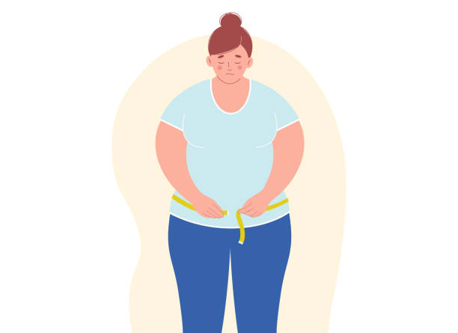



STU Name: Hamida Naji Ben Amer
Student NO:3452
Libyan Intentional Medical University Applied Medical Science First Year
Fighting the obesity epidemic

Slide 2
Objective
Causes of obesity
Obesity _ related risk factor
Obesity and its risk

Slide 3
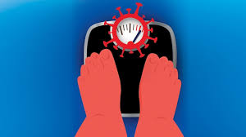
Definition of obesity
Overweight and obesity are defined as abnormal or excessive fat accumulation that presents a risk to health.

Slide 4
Causes of obesity
Poor diet Obesity does not happen overnight. It develops gradually over time, as a result of poor diet and lifestyle choices, such as:
Eating large amounts of fast food – that's high in fat and sugar
Eating larger portions than you need
Drinking too many sugary drinks

Slide 5
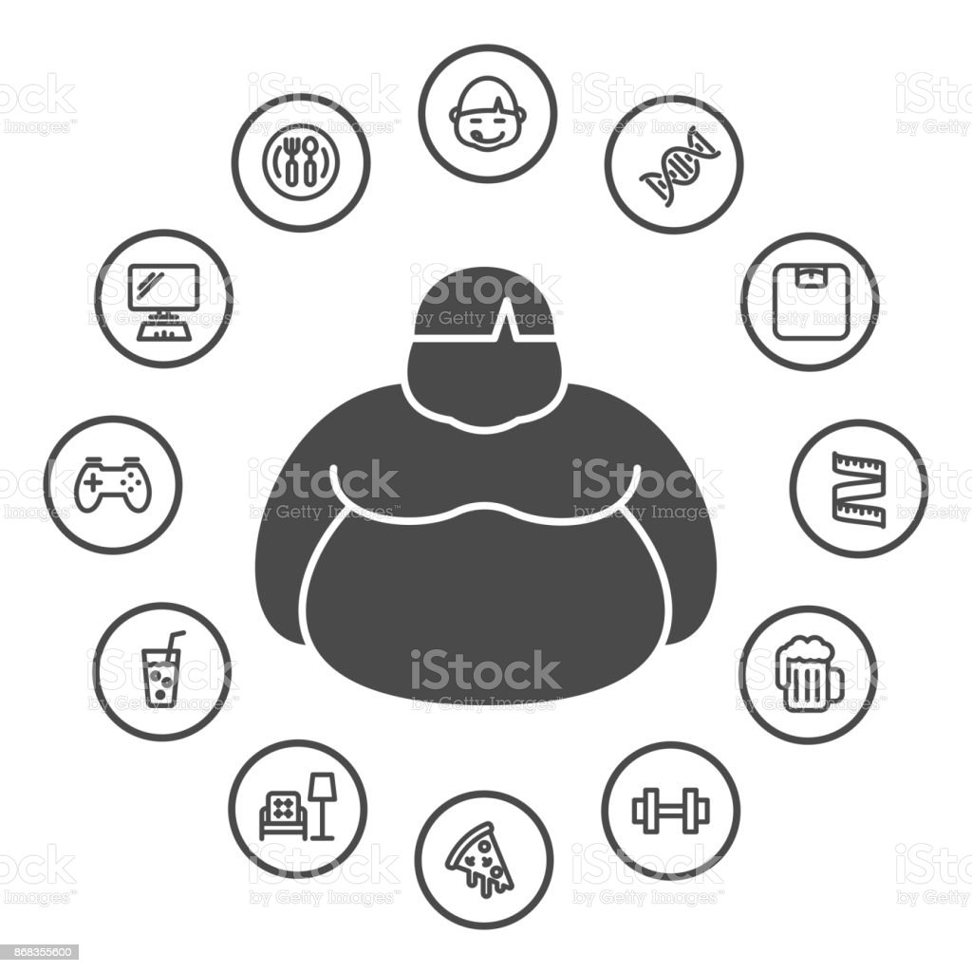
Causes of obesity
Inactivity
Pregnancy
Lack of sleep
Drugs
Genetics
Medical conditions
g

Slide 6
Obesity related risk factor
Unhealthy lifestyle habits such as:
Eating high-calorie, low-nutrient foods
Some people find that their weight goes up when they start taking medicine for another health condition such as:
diabetes, depression, or high blood pressures.

Slide 7
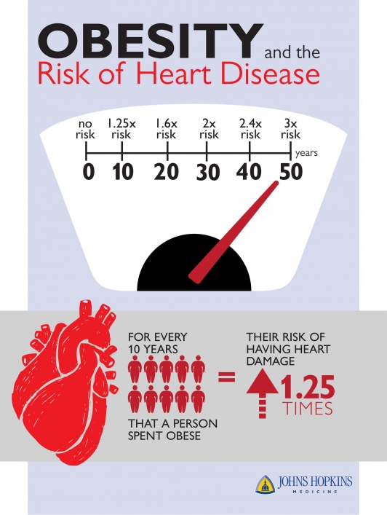
Obesity and it is risk
Heart disease and strokes.
Type 2 diabetes.
Certain cancers.
Disease of gallbladder
Disease of Bone
Sleep apnea

Slide 8
Conclusion
Many people do not realize how damaging obesity can be to the body and for your overall health. Obesity is something that is increasingly on the rise today and will continue to rise unless we do something about it like informing people of how bad it really is and encouraging people to live a health-enhancing lifestyle. A healthy diet and exercising two to three times a week is key to not becoming obese.

Slide 9
Reference
https://www.verywellhealth.com/obesity-causes-4014562#:~:text=The%20largest%20contributors%20to%20obesity,your%20likelihood%20of%20becoming%20obese.
vsearch.nlm.nih.gov
https://europepmc.org/article/med/10593521

