Slide 1


Libyan International Medical University
Faculty Of AMS
2021-2022
COVID-19 PANDEMIC .
GBMS2.
Fatima bubaker bushiba -3528
Dr: Muataz mazwghi
Date: 18.5.2022

Slide 2
Objectives:-
Definition the pandemic and COVID-19 pandemic.
Discussion the clinical manifestations of COVID-19.
Discussion origin of COVID-19 pandemic.
Outline the diagnostic techniques.
list Precautions and preventive measures.
List some vaccination of COVD-19.

Slide 3
INTRODUCTION.
Coronaviruses are important human and animal pathogens.
The virus that causes COVID-19 is designated severe acute respiratory syndrome.

Slide 4
What is a pandemic ?
When a disease affects many people in a community or other limited areas , its called an epidemic.
If the disease spreads to many countries or around the world its called pandemic.
.

Slide 5
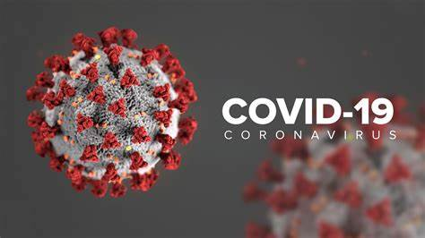

Slide 6
What is COVID_19 ?
At the end of 2019,a new type of coronavirus, called SARS-COV-19 began making people sick with flu-like symptoms.
The illness it causes is called coronavirus disease-19_COVID-19, for short.
The virus spreads easily and has affected people all over the world.

Slide 7
Clinical manifestations:
Incubation period:
The incubation period is a period from the time of exposure to infection until the onset of symptoms, is three to five days on average, partly depending on the variant, but it may be as long as 14 days.

Slide 8
m
Asymptomatic infection:
The clinical spectrum of SARS-COV-2 infection ranges from asymptomatic infection to critical and fatal illness.
Nevertheless, some estimates suggest that up to 40 percent of infections are asymptomatic.

Slide 9
h
Initial presentation:
cough .
Myalgias.
Headache.
Dyspnea (new or worsening)over baseline.
Sore throat and smell or taste abnormalities.
Diarrhea.
Nausea/vomiting.
Chills /rigors .
Confusion.
Chest pain or pressure.

Slide 10
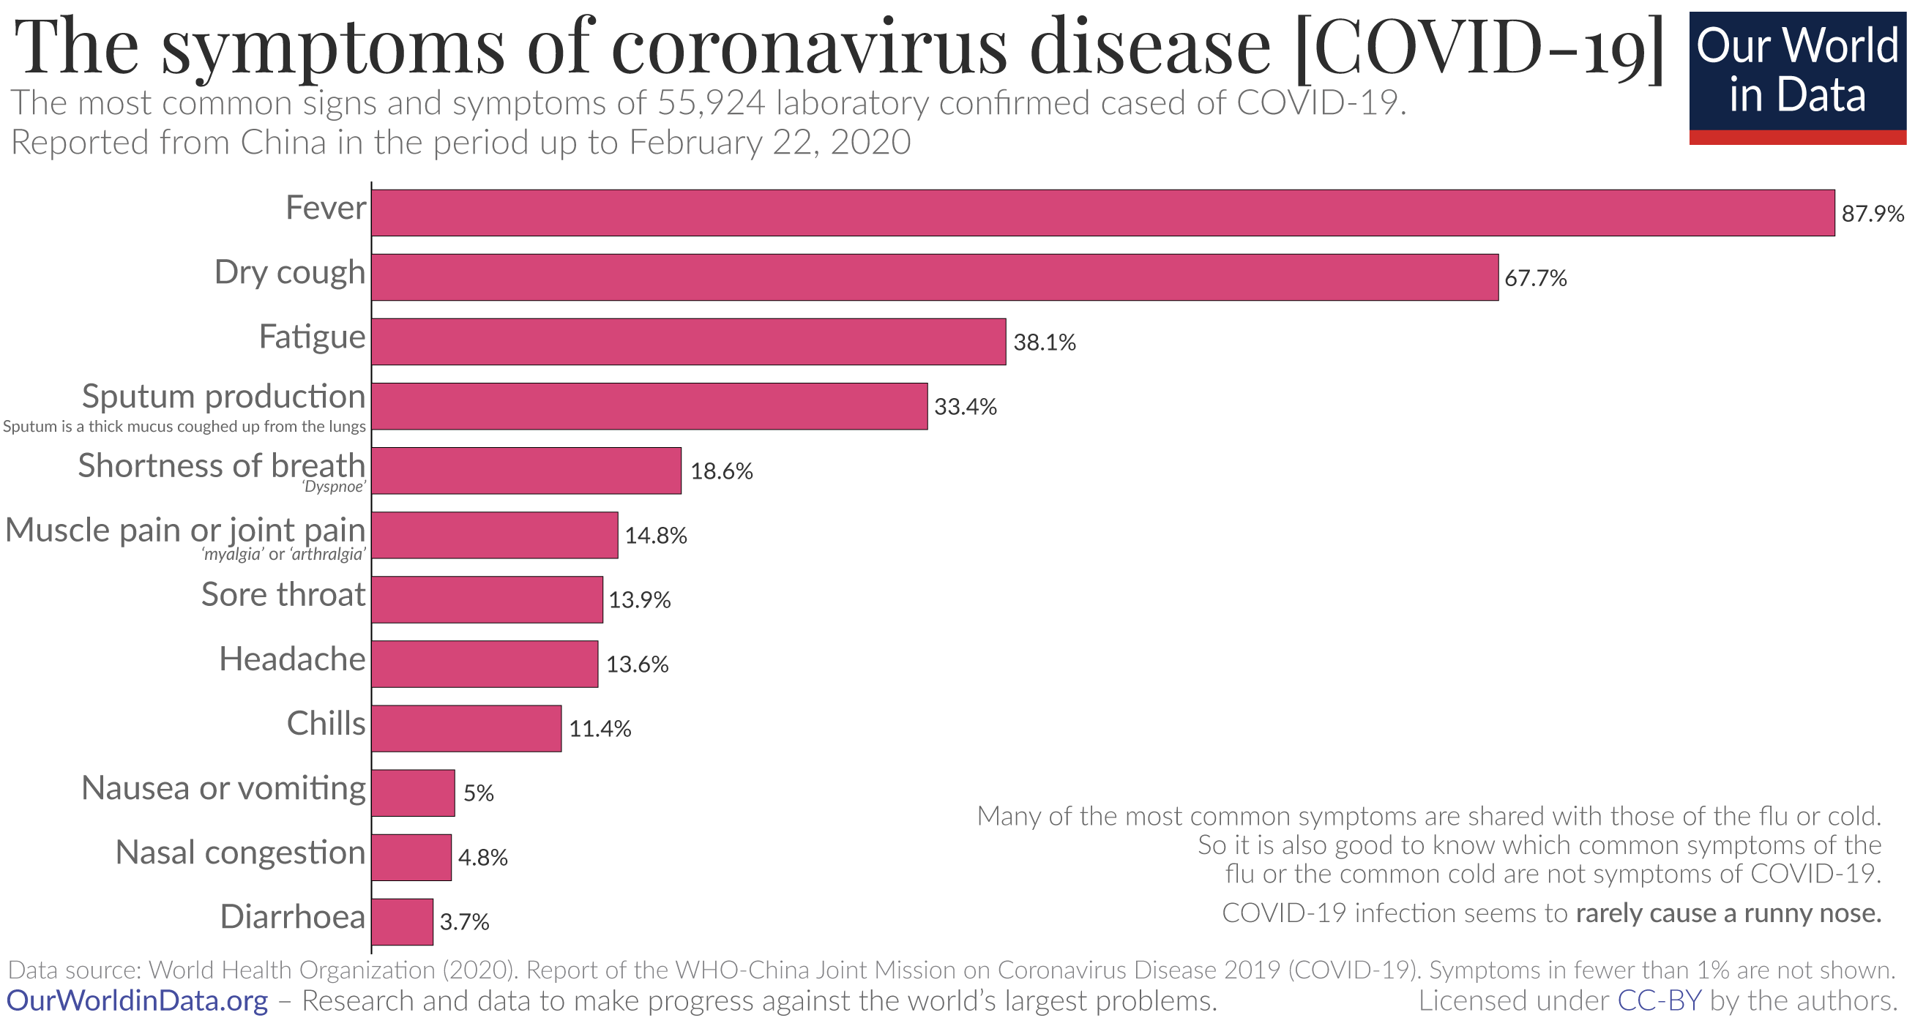

Slide 11
ل
Complications :
Acute respiratory distress syndrome (ARDS).

Slide 12
Origin of COVID-19:
Coronaviruses are a large family of viruses that are common in humans and many different species animals (e.g.: cats, bats).

Slide 13
There are four main genres of coronaviruses:
Alpha.
Beta.
Gamma.
Delta.

Slide 14
Diagnostic techniques:
The (PCR)for COVID-19:
polymerase chain reaction.
Serologic test:
is an enzyme-linking immunosorbent assay (ELIA).

Slide 15
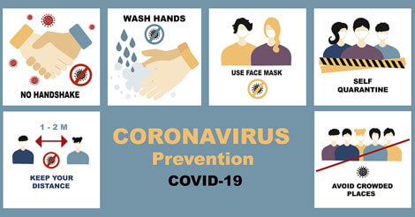

Slide 16
Vaccination:
Pfizer /biontech vaccine.
Moderna vaccine.
Oxford vaccine.
Spuynik V vaccine.

Slide 17
Conclusion.
So by the end of all of these information from the began, you need to understand how much it is a very serious disease! It killed more than a million human from the children to the old ages without mercy.. It is not an overrated! You have to protect your self and your family and all the people around you.

Slide 18
Refences.
Kidshealth.org. 2022. Coronavirus (COVID-19) (for Parents) - Nemours KidsHealth. [online] Available at: <https://kidshealth.org/en/parents/coronavirus.html> [Accessed 17 May 2022].
Uptodate.com. 2022. UpToDate. [online] Available at: <https://www.uptodate.com/contents/covid-19-clinical-features#!> [Accessed 17 May 2022].
Rahman, S., Montero, M., Rowe, K., Kirton, R. and Kunik, F., 2022. Epidemiology, pathogenesis, clinical presentations, diagnosis and treatment of COVID-19: a review of current evidence.

Slide 19

sxx

