Slide 1


Libyan International Medical University
Faculty of Business Administration
Liberal Theory
Presented By: Alaa Rashwan
ID:3313
E-mail:alaa_3313@limu.edu.ly
1

Slide 2
Table of Content
01
Introduction
Liberal theoretical debate
02
Principles of liberal theory
03
04
Conclusion
05
References
2

Slide 3
Introduction
According to John Locke, what we learn from a study of the state of nature is that human nature is characterized by freedom, equality, and reason. Humans are naturally free, born with the duty to submit to no one.
3

Slide 4

Liberal Theoretical Debate
The individual is more important than the state and becomes a citizen of the state only through consent.
The individual is rational and capable of making his or her own decisions; this makes the individual capable of autonomy and self-government.
Economic freedom (individual freedom to make economic choices) is more important than economic equality.
4

Slide 5
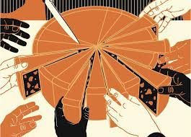
Principles of Liberal Theory
Preserve yourself
Do not harm others
Help others if possible
5

Slide 6
Conclusion:
Liberalism theory thinks that individual has a control of everything.
6

Slide 7
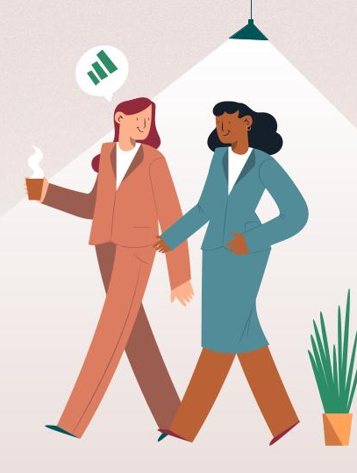
Reference:
Grigsby, E. (2015). Analyzing politics: An introduction to political science. Wadsworth, Cengage Learning.
7

Slide 8
Thanks
Alaa Rashwan
8

