Slide 1

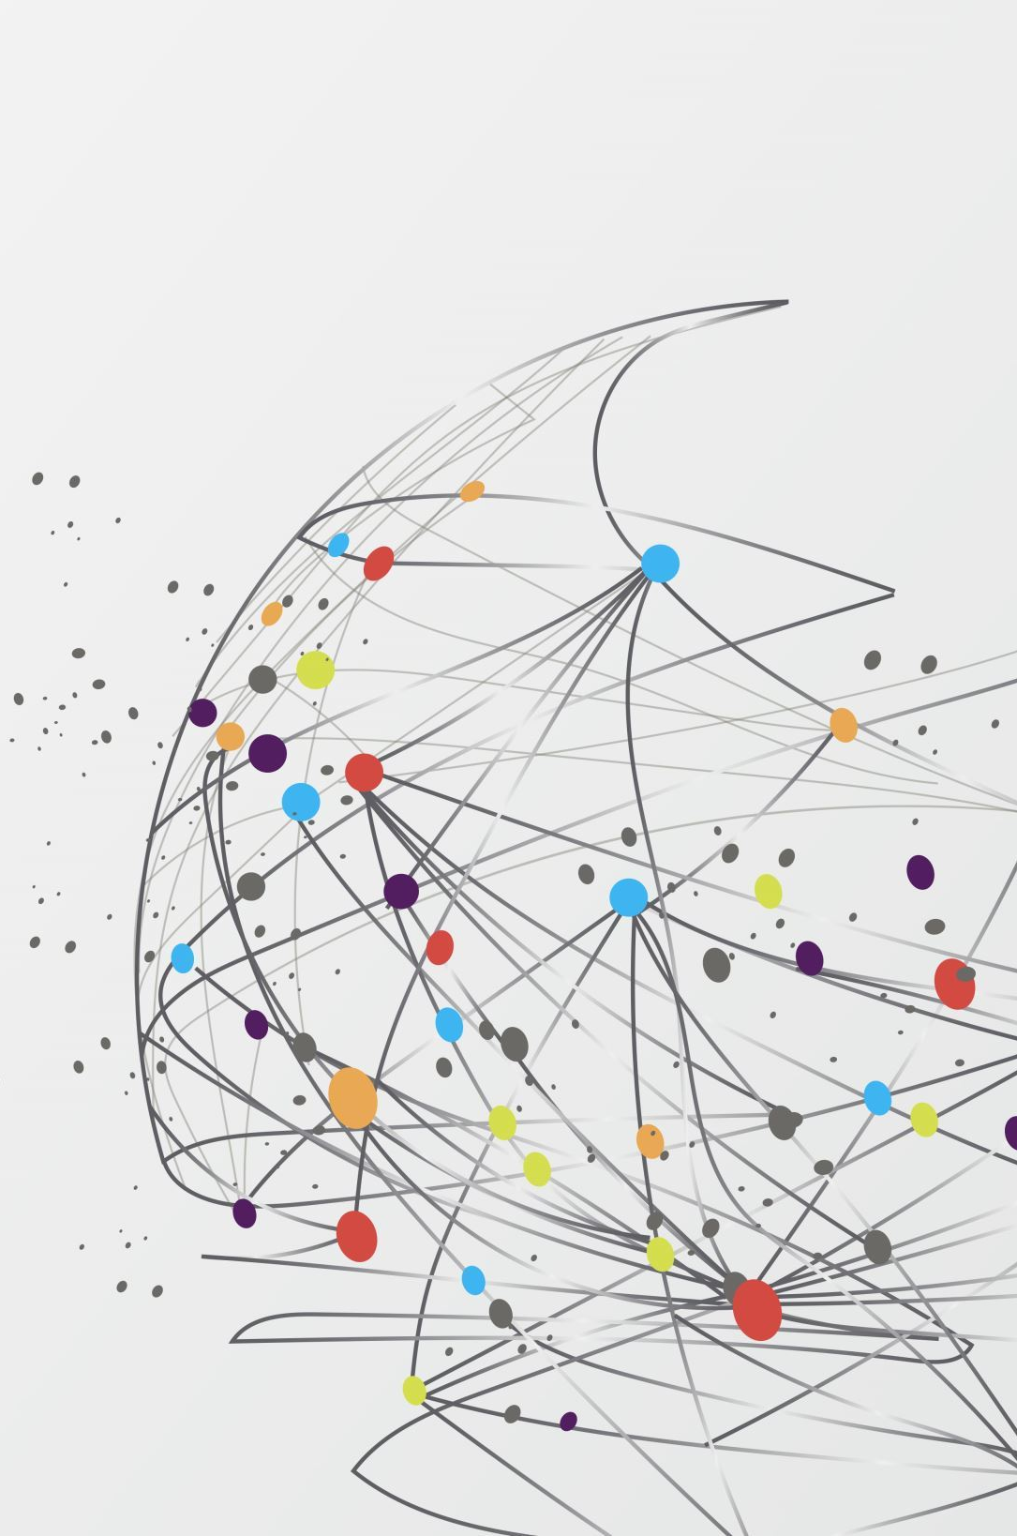


Food & water borne diseases
Nidal Elfazani 2751
Year 2
08/11/2022
PTS block

Slide 2
Objectives
Outline
Deadly food and water borne diseases
List
Discuss
Epidemiology
Symptoms
Treatment
Prevention

Slide 3
Introduction: Why are food and water borne diseases dangerous?
Food and water borne diseases are usually caused by toxins produced by toxic bacteria, viruses, and parasites.
There are numerous diverse organic, chemical, or radiological agents that when added to food and water can result in numerous distinctive sorts of disorders and diseases. A few can quickly lead to a fatal outcome, while others require to be exposed to long-term to result in serious complications.

Slide 4
Most common food and water borne diseases
Norovirus; a highly contagious virus spread via exposure of contaminated water and food, as well as person to person contact.
Salmonella; a bacterial disease that affects the intestinal tract. One of the most common pathogens found in food and water.
E.coli Infection; a bacterial that spreads after consuming feces contaminated food and water

Slide 5
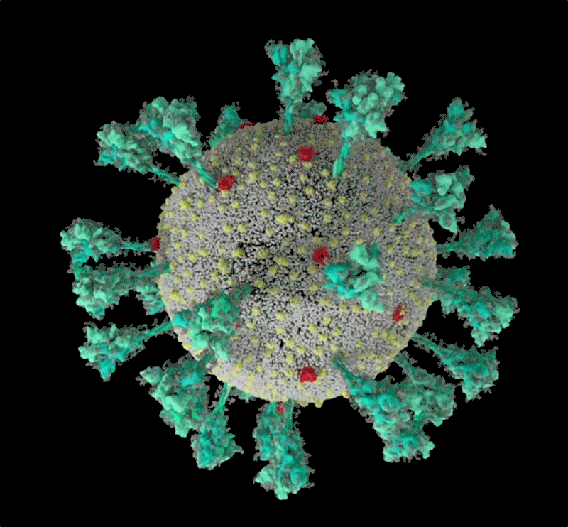
Symptoms
Headache, Lethargy, dizziness
Mild fever, chills
Vomiting, stomach cramps, diarrhea (sometimes bloody), anuria
Body aches, weight loss, loss of appetite

Slide 6
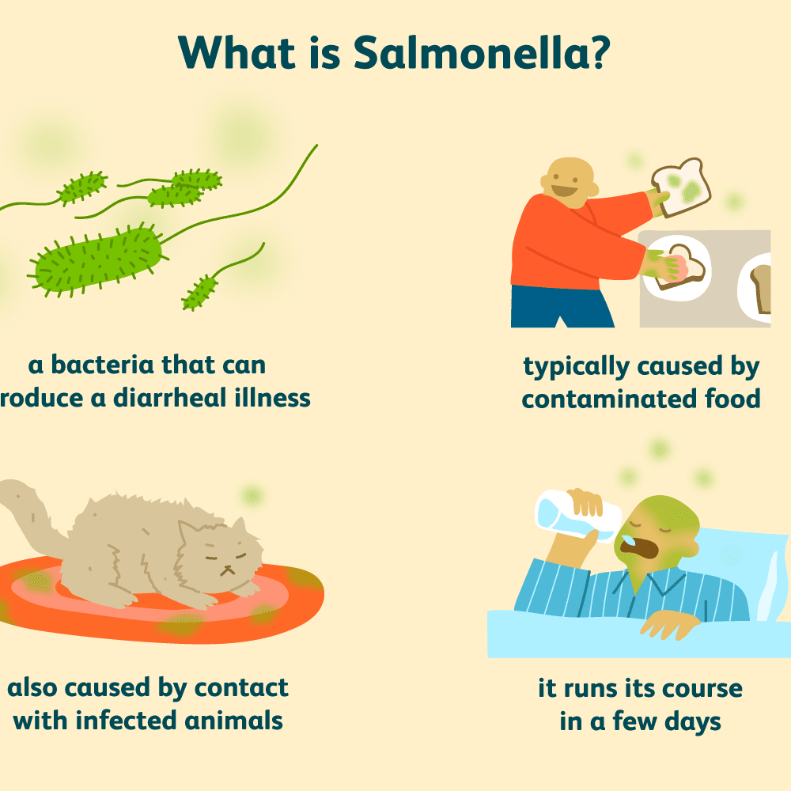
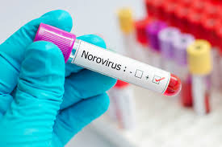
Image depicting a medical personnel holding a blood sample testing for norovirus
Image depicting information regarding salmonella

Slide 7
Treatment
Norovirus; There is no specific treatment or drug for this virus. It usually just runs its course. But, patients must consume fluids and avoid dehydration, and rest.
Salmonella; Antibiotics are used for this type of bacteria. For adults, fluroquinolones is used. And for children, azithromycin is used. Drugs such as loperamide can assist in relieving pain from diarrhea cramps.
E.coli infection; Antibiotics such as ciprofloxacin, and levofloxacin are used. Fluid intake and rest are encouraged

Slide 8
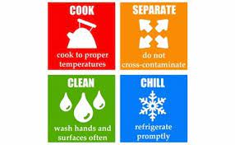
Prevention
Hand hygiene
Cook meat thoroughly to kill bacteria
Always make sure milk and eggs are pasteurized
Separate meat, poultry, and seafood from fruits and vegetables
Wash vegetables and fruit
Disinfect dishes, dishcloths, and cooking area

Slide 9
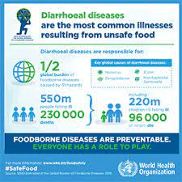
Epidemiology
Annually, approximately six-hundred million cases of norovirus outbreaks are reported to the world health organization. Leading to approximately fifty-thousand deaths, mostly in third world countries

Slide 10
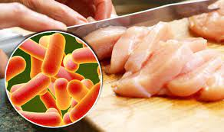
Epidemiology-Continued
Globally, there are approximately ninety-three millions cases of salmonella outbreaks each year, with two million reported in the United states alone.

Slide 11
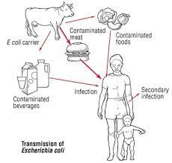
Epidemiology-Continued
Each year in the US, there is an estimate of seventy-three hundred cases of E.coli infection from food poisoning per year.

Slide 12
Conclusion
Although it is very rare to for salmonella, E.coli or norovirus to be fatal. It can still be dangerous. We must help protect those who are immunocompromised and elderly people by practicing hand hygiene, disinfecting after cooking, as well as cooking meat, poultry and seafood completely to kill ant harmful bacteria

Slide 13

Thank you for listening!

Slide 14
References
1. Centers for Disease Control and Prevention. (2022, May 4). Norovirus. Centers for Disease Control and Prevention. Retrieved August 11, 2022, from https://www.cdc.gov/norovirus/index.html
2. K;, M. (n.d.). Norovirus as a foodborne disease hazard. Advances in food and nutrition research. Retrieved August 11, 2022, from https://pubmed.ncbi.nlm.nih.gov/21504820/
3.Keogh AM;Kellow JE;Koorey DJ;Pritchard RC;Stiel D; (n.d.). Salmonella food poisoning. The Medical journal of Australia. Retrieved August 11, 2022, from https://pubmed.ncbi.nlm.nih.gov/6482757/
4.JY;, Y. S. C. L. C. H. A. I. A. F. (n.d.). Current pathogenic escherichia coli foodborne outbreak cases and therapy development. Archives of microbiology. Retrieved August 11, 2022, from https://pubmed.ncbi.nlm.nih.gov/28597303/
5.S;, E. O. J. A. K. J. (n.d.). Salmonella, food safety and food handling practices. Foods (Basel, Switzerland). Retrieved August 11, 2022, from https://pubmed.ncbi.nlm.nih.gov/33919142/

