Slide 1


HIV Associated Cancer
NAME : Aisha Ashraf Bader
STUDENT NO. : 2334
BLOCK : PTS 1
DATE : 16/5/2022

Slide 2
Objectives
Discuss Pathogenesis of HIV disease
Describe Association of cancer with HIV
Outline types of cancer associated with HIV patients
Prevelance of cancer in HIV patients
list Prevention of cancer in HIV patients

Slide 3
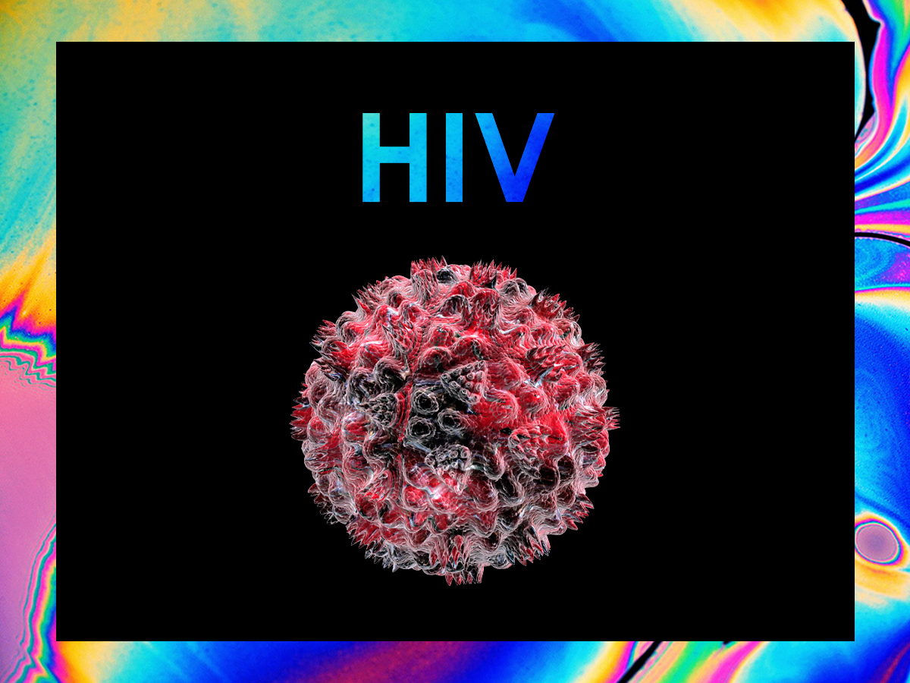
Introduction

Slide 4
Pathogenesis

Slide 5
Pathogenesis
Many are virally-induced cancers, but not all
Immune activation, immune dysregulation, inflammation and decreased immune surveillance
HIV may activate cellular genes or proto-oncogenes or inhibit tumor suppressor genes

Slide 6
Pathogenesis
Increase susceptibility to effects of carcinogens
Endothelial/epithelial cell abnormalities induced or facilitated by HIV may allow cancer development
There is population differences based on genetics and carcinogens exposure

Slide 7
ASSOCIATION OF HIV WITH CANCER
People infected with HIV have a substantially higher risk of some types of cancer compared with uninfected people of the same age . The general term for these cancers is “HIV-associated cancers”

Slide 8
7 Notable Cancers
Cancer | Etiologic agents
Kaposi sarcoma | KSHV
Non-Hodgkin lymphoma | EBV
Cervical cancer | HPV
Lung cancer | Tobacco
Hodgkin lymphoma | EBV
Anal cancer | HPV
Liver cancer | HCV, HBV, alcohol

Slide 9
Kaposi’s Sarcoma

Slide 10
Kaposi’s Sarcoma
One of the first recognized AIDS-defining illnesses
Vascular tumor that may involve mucocutaneous, lymphatic,
Tropism for B cells and endothelial cells with high titers in saliva
HIV- and Kaposi’s sarcoma-induced angiogenic and inflammatory cytokines stimulate cell growth
Associated with primary effusion lymphoma,

Slide 11
Anal and Cervical Cancer Incidence

Slide 12
Anal and Cervical Cancer Incidence
An estimated 29 000 persons, predominantly women, are diagnosed with anal squamous cell carcinoma (ASCC) every year
human papillomavirus (HPV) infection is considered a necessary cause
the rarity of anal cancer at a population level (1‐2 cases per 100 000 person‐years [py]

Slide 13
Lymphomas

Slide 14
Pathology of AIDS-Related Non-Hodgkin’s Lymphoma
Small noncleaved-cell lymphoma
Immunoblastic lymphoma (primary CNS)
Diffuse large-cell lymphoma (90% CD20+)
Burkitt’s lymphoma and Burkitt-like lymphoma

Slide 15
Pathology of AIDS-Related Non-Hodgkin’s Lymphoma
CD30+ anaplastic large B-cell lymphoma
Large noncleaved-cell lymphoma

Slide 16
Hodgkin’s Disease
Associated with HIV infection
>95% are EBV+
Incidence increases rapidly in post HAART
The exact cause of Hodgkin lymphoma is unknown.
The only way to confirm a diagnosis of Hodgkin lymphoma is by carrying out a biopsy.

Slide 17
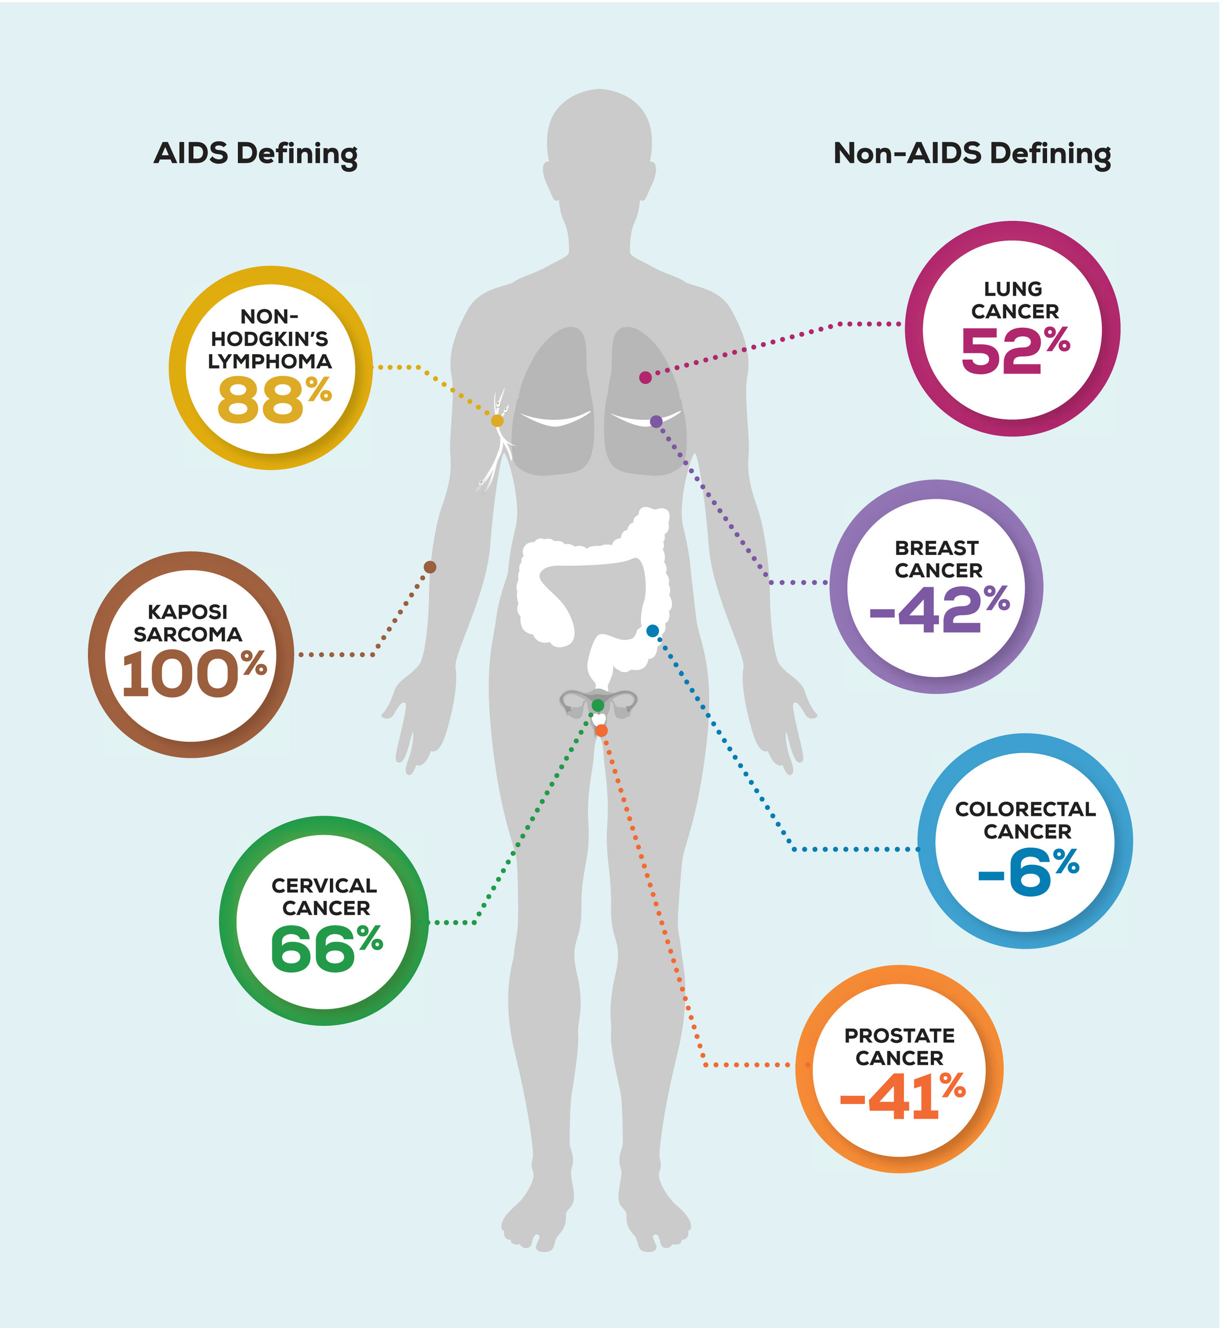
Prevealance of cancer in HIV patients
17

Slide 18

Cancer Prevention

Slide 19
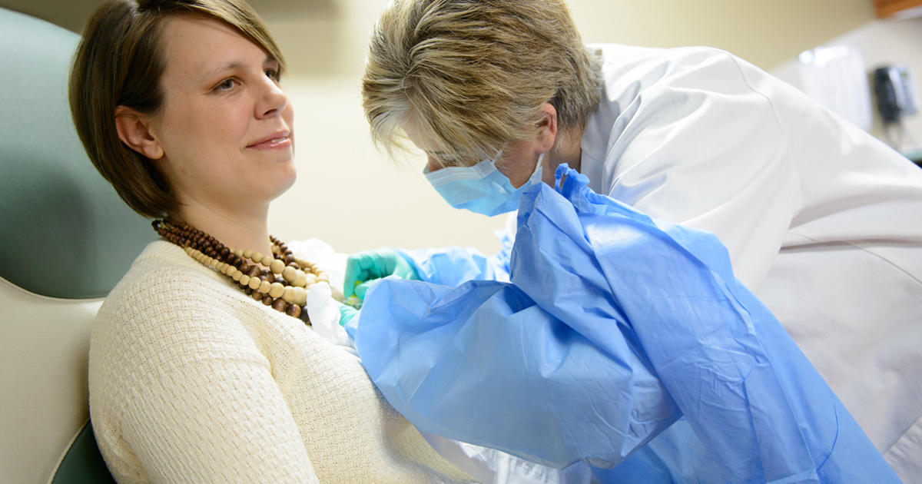

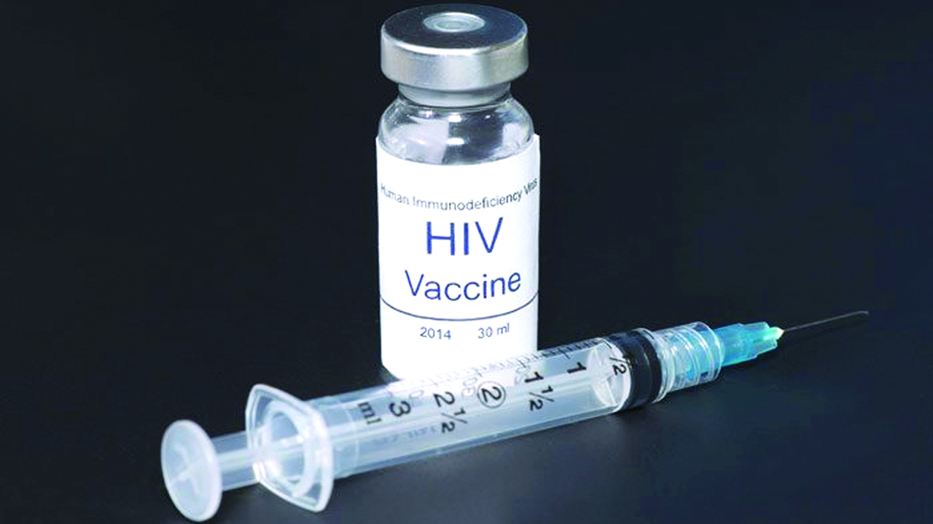
1. Smoking Cessation
2. Vaccination

Slide 20

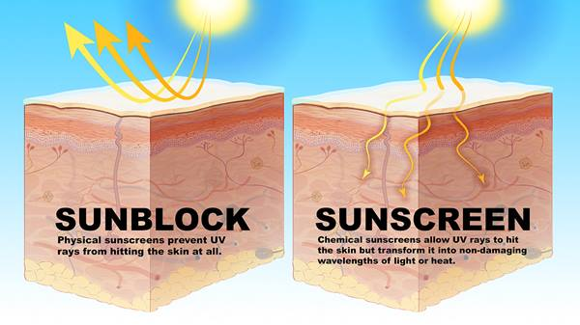
3. Early breast and prostate examination
4. Yearly cervical and anal Pap tests
5.Sunscreen and avoiding overexposure of sun

Slide 21
Conclusion
People living with HIV are much more likely to get certain types of cancer than people without HIV. Certain kinds of cancer are called AIDS-defining cancers or AIDS-defining malignancies.

Slide 22
References
HIV-Associated Cancers and Related Diseases | NEJM [Internet]. New England Journal of Medicine. 2022 [cited 28 March 2022]. Available from: https://www.nejm.org/doi/full/10.1056/NEJMra1615896
HIV Infection and Cancer Risk National Cancer Institute. 2022 [cited 28 March 2022]. Available from: https://www.cancer.gov/about-cancer/causes-prevention/risk/infectious-agents/hiv-fact-sheet

Slide 23


Slide 24

Thank You For Listening

