Slide 1
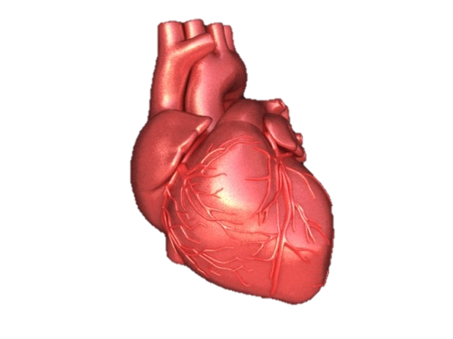
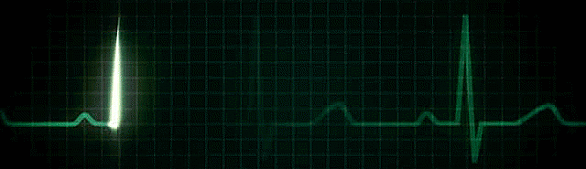
Reading the ECG
Dr. Zaki Bettamer,MD
Zikoecho @yahoo.com
29/12/2016

Slide 2
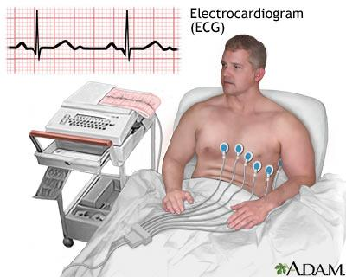

Slide 3
Introduction
• Electrocardiography is a graphic recording of the electrical activity (potentials) produced by the conduction system and the myocardium of the heart during its depolarization / re-polarization cycle.

Slide 4
ECG leads
• To ascertain the direction of a wavefront, the
ECG is recorded from different sites called lead
Recording 12 lead ECG:
• 6 horizontal bipolar leads( I,II, III, aVR, aVL,
aVF).
• 6 frontal leads unipolar leads(V1 – V6).

Slide 5
Reading normal ECG

Slide 6
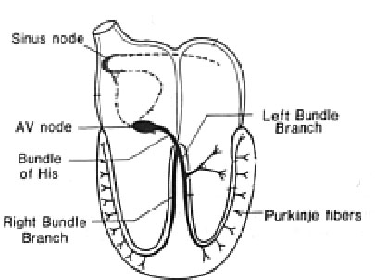
Normal Impulse Conduction
Sinoatrial node
AV node
Bundle of His
Bundle Branches
Purkinje fibers

Slide 7
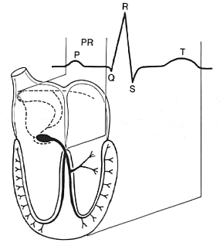
Impulse Conduction & the ECG
Sinoatrial node
AV node
Bundle of His
Bundle Branches
Purkinje fibers

Slide 8
The “PQRST”
P wave - Atrial depolarization
QRS - Ventricular depolarization
T wave - Ventricular repolarization

Slide 9
The PR Interval
Atrial depolarization
+
delay in AV junction
(AV node/Bundle of His)
(delay allows time for the atria to contract before the ventricles contract)

Slide 10
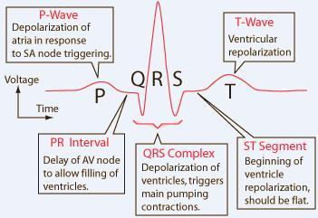
Anatomy of Heart and ECG signal

Slide 11
Pacemakers of the Heart
SA Node - Dominant pacemaker with an intrinsic rate of 60 - 100 beats/minute.
AV Node - Back-up pacemaker with an intrinsic rate of 40 - 60 beats/minute.
Ventricular cells - Back-up pacemaker with an intrinsic rate of 20 - 45 bpm.

Slide 12
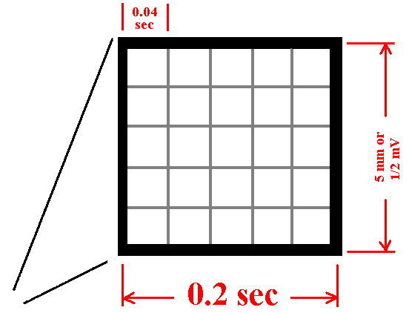
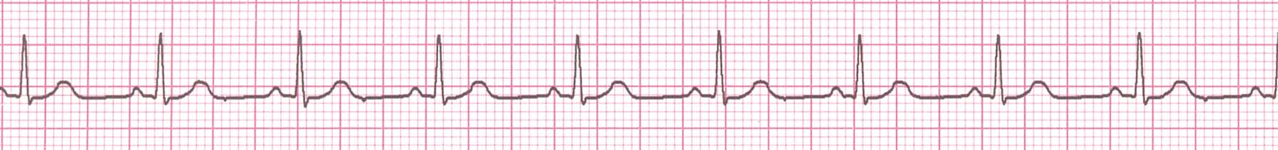
The ECG Paper
Horizontally
  One small box - 0.04 s
  One large box - 0.20 s
Vertically
  One large box - 0.5 mV

Slide 13
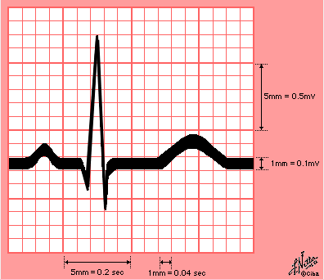

Slide 14
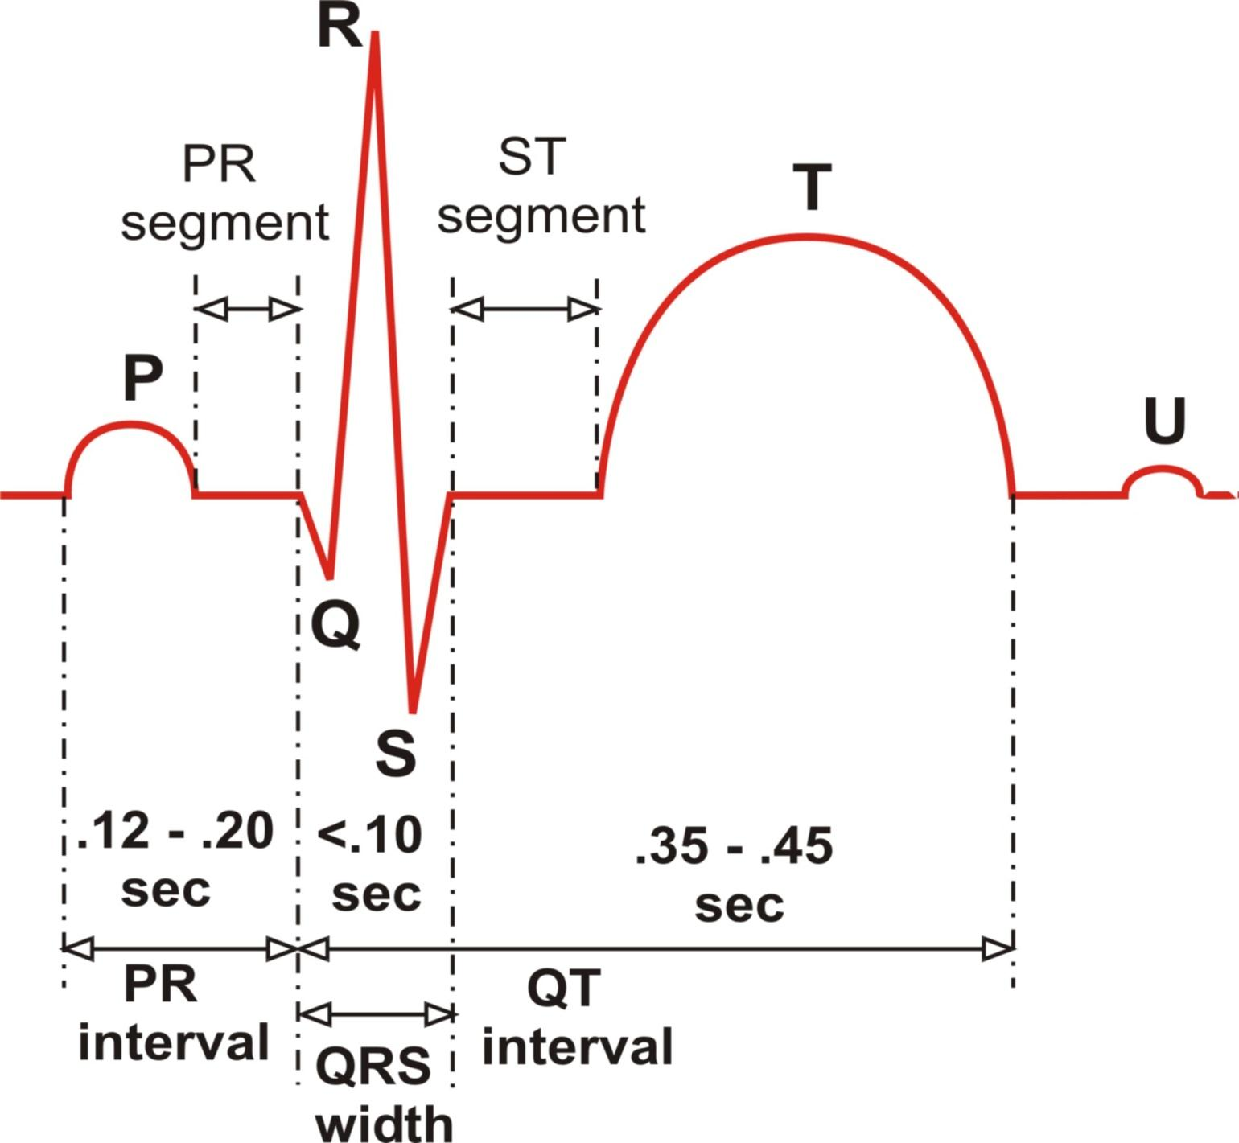
The ECG Complex with Interval and Segment Measurements

Slide 15
Remember This 3, 3, 3 and 5
P duration = 3 small sqs = 0.12 sec.
P height = 3 small sqs = 0.12 sec.
QRS duration = 3 small sq = 0.12 sec.
P-R interval = 5 small sqs = 0.2 sec.

Slide 16
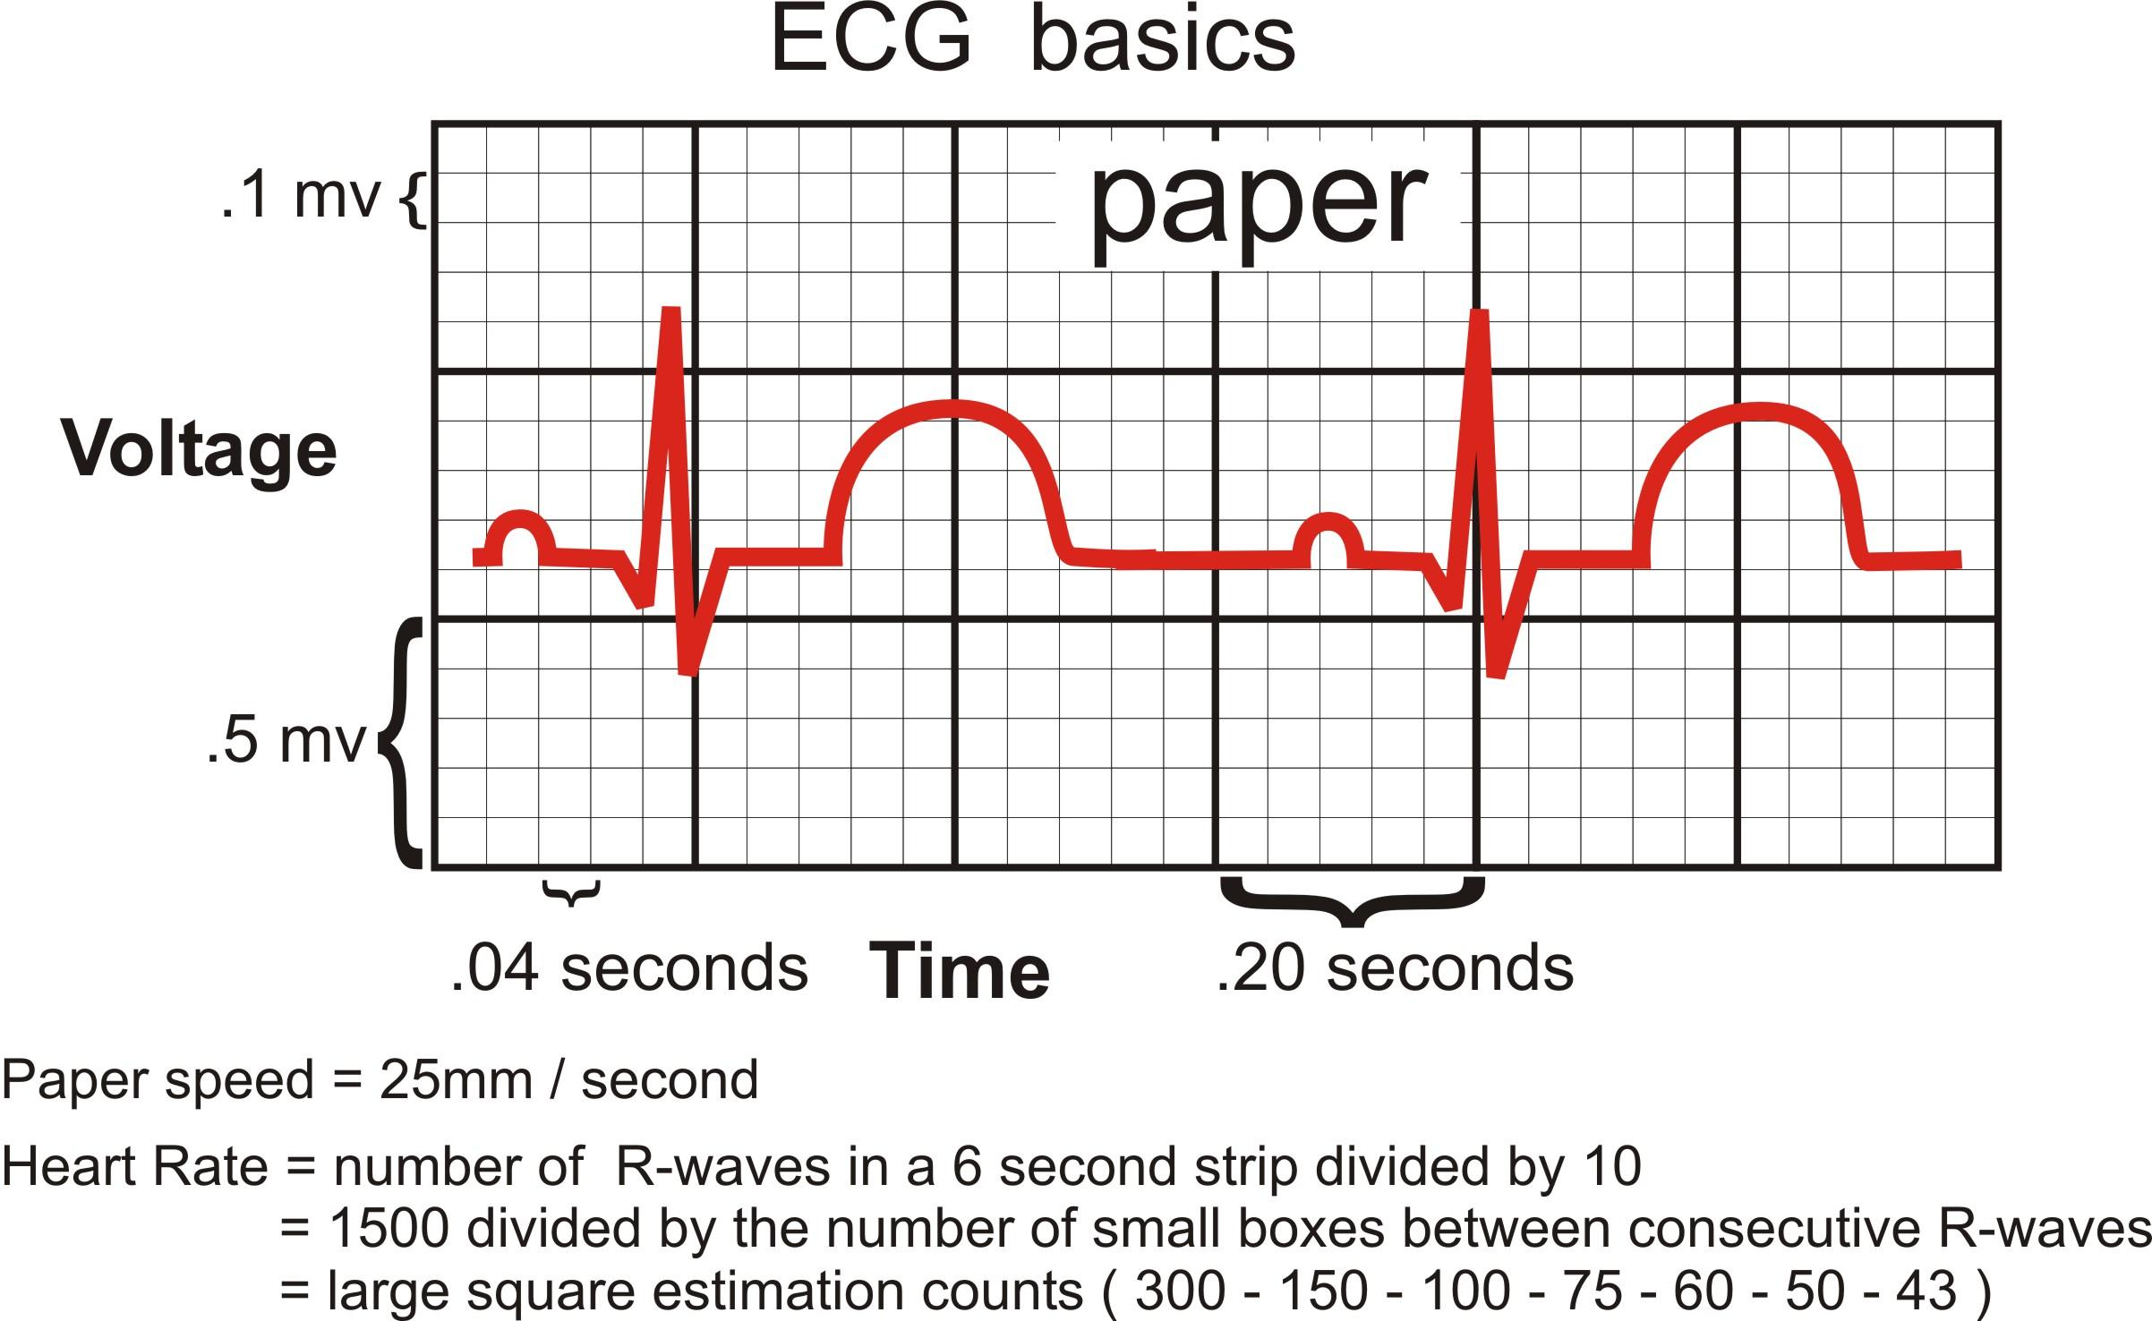
ECG Paper and related Heart Rate & Voltage Computations

Slide 17
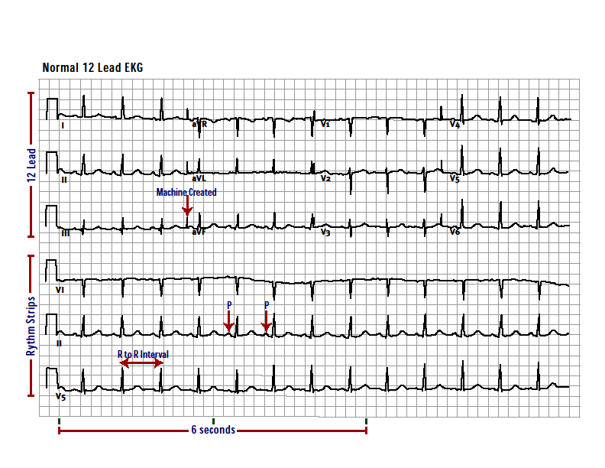

Slide 18
Rhythm Analysis
Step 1: Calculate rate.
Step 2: Determine regularity.
Step 3: Assess the P waves.
Step 4: Determine PR interval.
Step 5: Determine QRS duration.

Slide 19
The ECG Paper (cont)
3 sec
3 sec
Every 3 seconds (15 large boxes) is marked by a vertical line.
This helps when calculating the heart rate.

Slide 20
Step 1: Calculate Rate
3 sec
3 sec
Option 1
  Count the # of R waves in a 6 second rhythm strip, then multiply by 10.
Interpretation?
9 x 10 = 90 bpm

Slide 21
Step 1: Calculate Rate
300
150
100
75
60
50
Option 2 (cont)
  Memorize the sequence:
  300 - 150 - 100 - 75 - 60 - 50
Interpretation?
  Approx. 1 box less than 100 = 95 bpm

Slide 22
Rate:
If regular : Divide 300/ number of large squares between 2 Rs = HR
If irregular: Count number of complexes in 6 sec. and multiply by 10
RATE may be: P = Sinus
Normal 60 -100 No P = Non sinus
Bradycardia < 60
Tachycardia > 100

Slide 23
Step 2: Determine regularity
R
R
Look at the R-R distances (using a caliper or markings on a pen or paper).
Regular (are they equidistant apart)? Occasionally irregular? Regularly irregular? Irregularly irregular?
Interpretation?
Regular

Slide 24
Step 3: Assess the P waves
Are there P waves?
Do the P waves all look alike?
Do the P waves occur at a regular rate?
Is there one P wave before each QRS?
Interpretation?
Normal P waves with 1 P wave for every QRS

Slide 25
Step 4: Determine PR interval
Normal: 0.12 - 0.20 seconds.
(3 - 5 boxes)
Interpretation?
0.12 seconds

Slide 26
Step 5: QRS duration
Normal: 0.04 - 0.12 seconds.
(1 - 3 boxes)
Interpretation?
0.08 seconds

Slide 27
Rhythm Summary
Rate 90-95 bpm
Regularity regular
P waves normal
PR interval 0.12 s
QRS duration 0.08 s
Interpretation?
Normal Sinus Rhythm

Slide 28
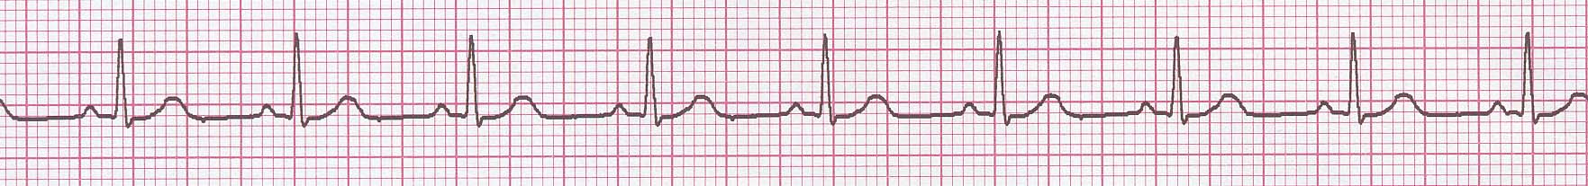
NSR Parameters
Rate 60 - 100 bpm
Regularity regular
P waves normal
PR interval 0.12 - 0.20 s
QRS duration 0.04 - 0.12 s
Any deviation from above is sinus tachycardia, sinus bradycardia or an arrhythmia

Slide 29
The QRS Axis
The QRS axis represents the net overall direction of the heart’s electrical activity.
Abnormalities of axis can hint at:
Ventricular enlargement
Conduction blocks (i.e. hemiblocks)

Slide 30
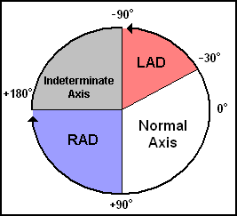
The QRS Axis
By near-consensus, the normal QRS axis is defined as ranging from -30° to +90°.
-30° to -90° is referred to as a left axis deviation (LAD)
+90° to +180° is referred to as a right axis deviation (RAD)

Slide 31
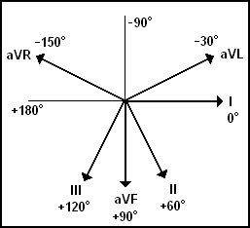
Determining the Axis

Slide 32
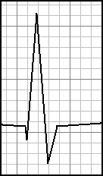
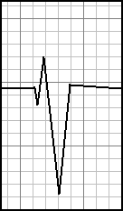
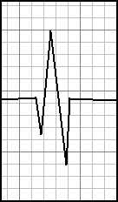
Determining the Axis
Predominantly Positive
Predominantly Negative
Equiphasic

Slide 33
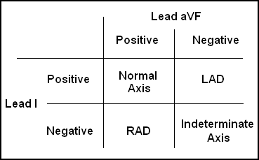
The Quadrant Approach
1. Examine the QRS complex in leads I and aVF to determine if they are predominantly positive or predominantly negative. The combination should place the axis into one of the 4 quadrants below.

Slide 34
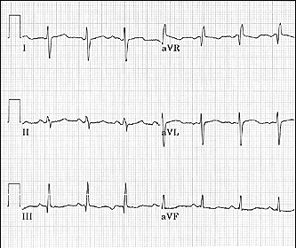
Quadrant Approach: Example 1
The Alan E. Lindsay ECG Learning Center http://medstat.med.utah.edu/kw/ecg/
Negative in I, positive in aVF → RAD

Slide 35
Arrhythmia Formation
Arrhythmias can arise from problems in the:
  Sinus node
  Atrial cells
  AV junction
  Ventricular cells

Slide 36
Sinus Rhythms
Sinus Bradycardia
Sinus Tachycardia

Slide 37
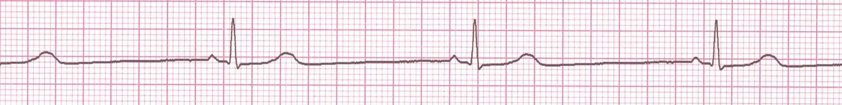
Rate?
30 bpm
Regularity?
regular
P waves?
normal
PR interval?
0.12 s
QRS duration?
0.10 s
Interpretation?
Sinus Bradycardia

Slide 38
Sinus Bradycardia
Deviation from NSR
- Rate < 60 bpm

Slide 39

Rate?
130 bpm
Regularity?
regular
P waves?
normal
PR interval?
0.16 s
QRS duration?
0.08 s
Interpretation?
Sinus Tachycardia

Slide 40
Sinus Tachycardia
Deviation from NSR
- Rate > 100 bpm

Slide 41
Premature Beats
Premature Atrial Contractions (PACs)
Premature Ventricular Contractions (PVCs)

Slide 42
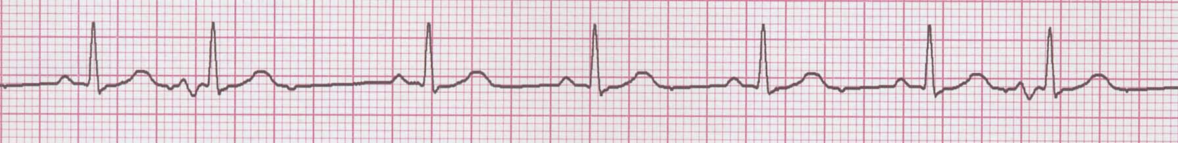
Rate?
70 bpm
Regularity?
occasionally irreg.
P waves?
2/7 different contour
PR interval?
0.14 s (except 2/7)
QRS duration?
0.08 s
Interpretation?
NSR with Premature Atrial Contractions

Slide 43
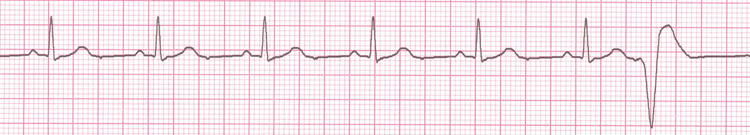
Rate?
60 bpm
Regularity?
occasionally irreg.
P waves?
none for 7th QRS
PR interval?
0.14 s
QRS duration?
0.08 s (7th wide)
Interpretation?
Sinus Rhythm with 1 PVC

Slide 44
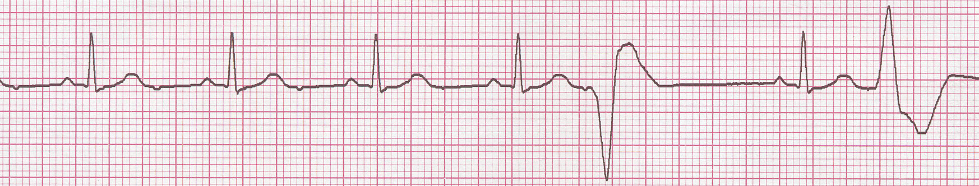
Teaching Moment
When an impulse originates in a ventricle, conduction through the ventricles will be inefficient and the QRS will be wide and bizarre.

Slide 45
Supraventricular Arrhythmias
Atrial Fibrillation
Atrial Flutter
Paroxysmal Supraventricular Tachycardia

Slide 46
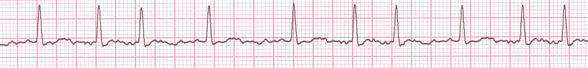
Rate?
100 bpm
Regularity?
irregularly irregular
P waves?
none
PR interval?
none
QRS duration?
0.06 s
Interpretation?
Atrial Fibrillation

Slide 47
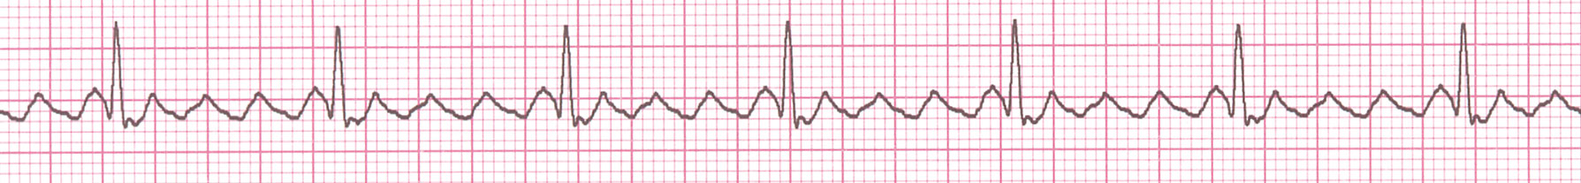
Rate?
70 bpm
Regularity?
regular
P waves?
flutter waves
PR interval?
none
QRS duration?
0.06 s
Interpretation?
Atrial Flutter

Slide 48
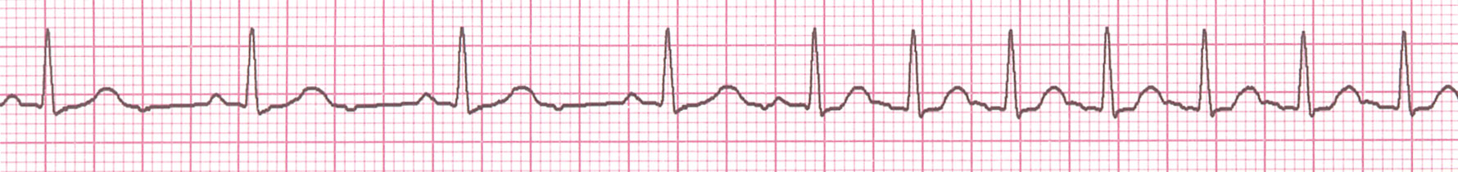
Rate?
74 →148 bpm
Regularity?
Regular → regular
P waves?
Normal → none
PR interval?
0.16 s → none
QRS duration?
0.08 s
Interpretation?
Paroxysmal Supraventricular Tachycardia (PSVT)

Slide 49
Ventricular Arrhythmias
Ventricular Tachycardia
Ventricular Fibrillation

Slide 50
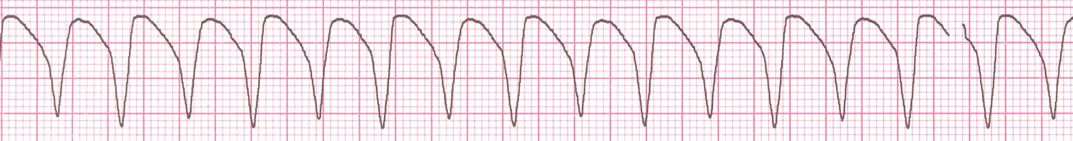
Rate?
160 bpm
Regularity?
regular
P waves?
none
PR interval?
none
QRS duration?
wide (> 0.12 sec)
Interpretation?
Ventricular Tachycardia

Slide 51
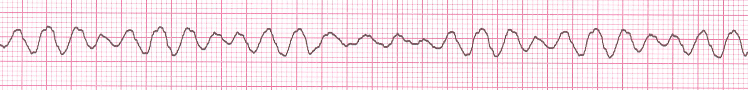
Rate?
none
Regularity?
irregularly irreg.
P waves?
none
PR interval?
none
QRS duration?
wide, if recognizable
Interpretation?
Ventricular Fibrillation

Slide 52
AV Nodal Blocks
1st Degree AV Block
2nd Degree AV Block, Type I
2nd Degree AV Block, Type II
3rd Degree AV Block

Slide 53
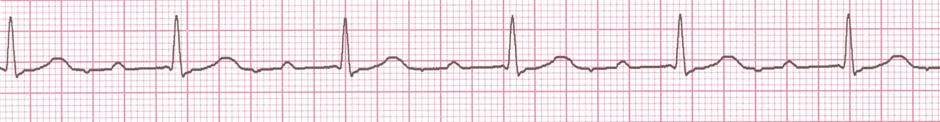
Rate? 60 BPM
Regularity? Regular
P waves? Normal
PR interval? 0.36 s
QRS duration? 0.08 s
Interpretation? 1st Degree AV Block

Slide 54
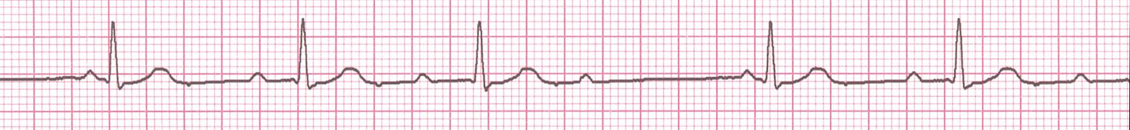
• Rate? 50 bpm
• Regularity? regularly irregular
P waves? nl, but 4th no QRS
• PR interval? Lengthens
QRS duration? 0.08 s
Interpretation? 2nd Degree AV Block, Type I
(Wenckebach, Mobitz type I)
PR interval progressively lengthens, then the impulse is completely blocked (P wave not followed by QRS)

Slide 55
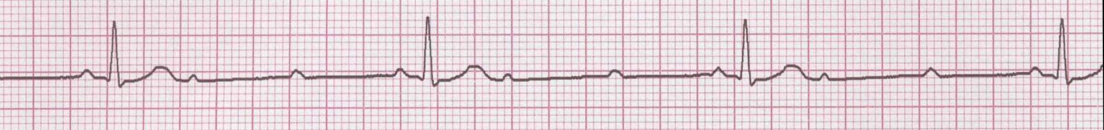
• Rate? 40 bpm
• Regularity? Regular
• P waves? nl, 2 of 3 no QRS
• PR interval? 0.14 s
• QRS duration? 0.08 s
Interpretation? 2nd Degree AV Block, Type II
Occasional P waves are completely blocked (P wave not followed by QRS).

Slide 56
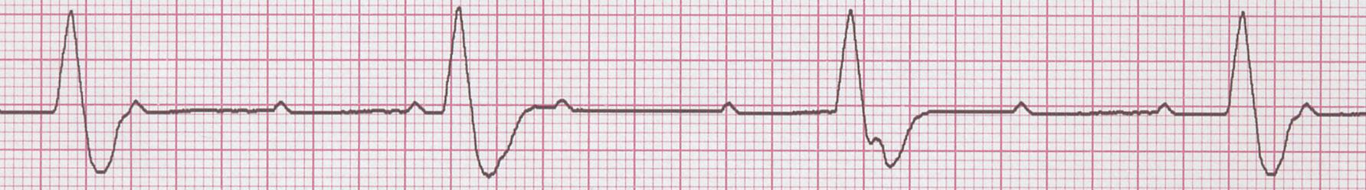
↑
↑
↑
↑
↑
↑
↑
↑
↑
• Rate? 40 bpm
• Regularity? regular
• P waves? no relation to QRS
• PR interval? None
• QRS duration? wide (> 0.12 s)
Interpretation? 3rd Degree AV Block

Slide 57
Acute Myocardial Infarction

Slide 58
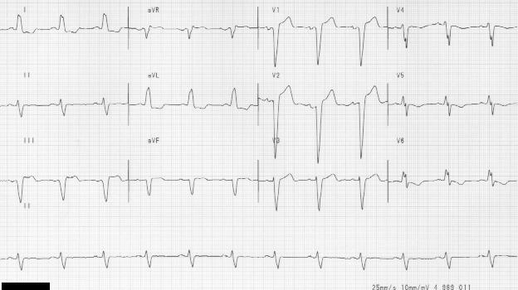
Diagnosing a MI
To diagnose a myocardial infarction you need to go beyond looking at a rhythm strip and obtain a 12-Lead ECG.
12-Lead ECG
Rhythm Strip

Slide 59
The 12-Lead ECG
The 12-Lead ECG sees the heart from 12 different views.
Therefore, the 12-Lead ECG helps you see what is happening in different portions of the heart.
The rhythm strip is only 1 of these 12 views.

Slide 60
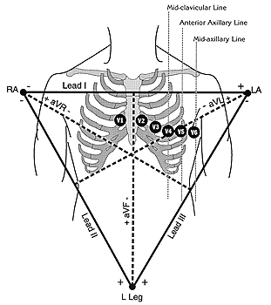
The 12-Leads
The 12-leads include:
  3 Limb leads (I, II, III)
  3 Augmented leads (aVR, aVL, aVF)
  6 Precordial leads (V₁- V₆)

Slide 61
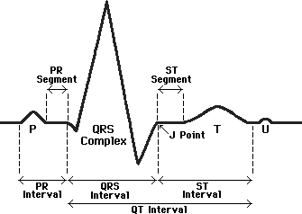
ST Elevation
One way to diagnose an acute MI is to look for elevation of the ST segment.

Slide 62
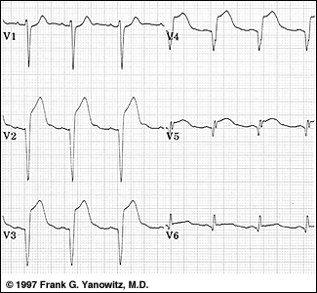
ST Elevation (cont)
Elevation of the ST segment (greater than 1 small box) in 2 leads is consistent with a myocardial infarction.

Slide 63
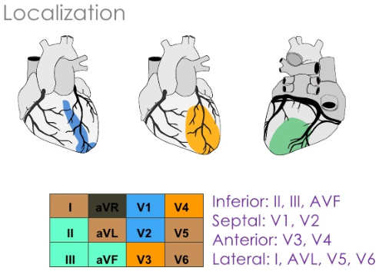
What part of the heart is affected ?
• II, III, aVF = Inferior Wall
Leads V1, V2, V3, and V4 = Anterior Wall MI
I, aVL, V5 and V6 Lateral wall of left ventricle

Slide 64
Putting it all Together
Do you think this person is having a myocardial infarction. If so, where?

Slide 65
Interpretation
Yes, this person is having an acute anterior wall myocardial infarction.

Slide 66
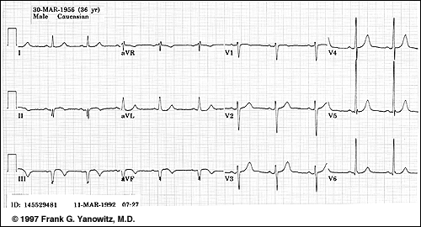
Putting it all Together
Now, where do you think this person is having a myocardial infarction?

Slide 67
Inferior Wall MI
This is an inferior MI. Note the ST elevation in leads II, III and aVF.

Slide 68
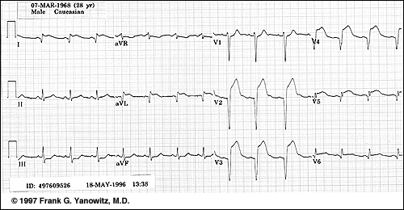
Putting it all Together
How about now?

Slide 69
Anterolateral MI
This person’s MI involves both the anterior wall (V₂-V₄) and the lateral wall (V₅-V₆, I, and aVL)!

Slide 70
Right Bundle Branch Block (RBBB)
Diagnostic criteria for right bundle branch block
  QRS duration >0.12 s
  A secondary R wave (R') in V1 or V2
  Wide slurred S wave in leads I, V5, and V6
Associated feature
  ST segment depression and T wave inversion in the right precordial leads

Slide 71
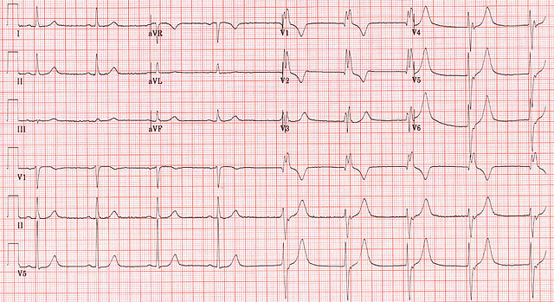
Right Bundle Branch Block (RBBB)

Slide 72
Left Bundle Branch Block (LBBB)
Diagnostic criteria for left bundle branch block
  QRS duration of >0.12 s
  Broad monophasic R wave in leads 1, V5, and V6
  Absence of Q waves in leads V5 and V6
  Associated features
    Displacement of ST segment and T wave in an opposite direction to the dominant deflection of the QRS complex (appropriatediscordance)
    Poor R wave progression in the chest leads
    RS complex, rather than monophasic complex, in leads V5 and V6
    Left axis deviation—common but not invariable finding

Slide 73
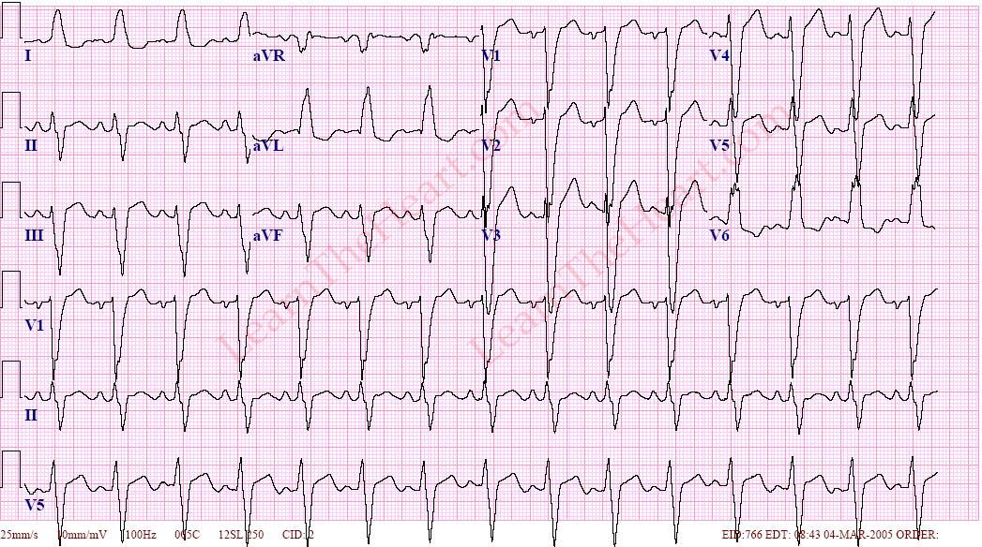
Left Bundle Branch Block (LBBB)

Slide 74
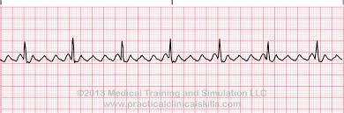

Slide 75
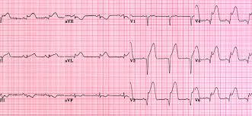

Slide 76
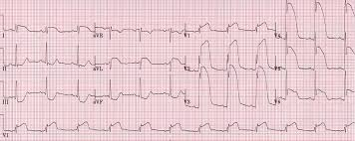

Slide 77
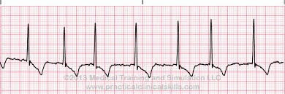

Slide 78
Q & A
Thanks

