Slide 1
Leprosy [ Hansen` s disease ]
Hanan mustafa kamal kalfa
Libyan Board, MSc

Slide 2
Objective
Introduction
Classification of leprosy
Diagnosis
Treatment
Reaction of leprosy

Slide 3
Introduction
Leprosy is a chronic granulomatous disease, principally affecting the skin and peripheral nervous system, caused by Mycobacterium leprae.

Slide 4
Etiology
The causative agent of leprosy is Mycobacterium leprae
M. leprae is obligate intracellular acid fast bacillus
Weakley gram positive and stained by Ziehl-Neelsen method.
Has never been grown in artificial media.
It grow in nine- banded armadillo.

Slide 5
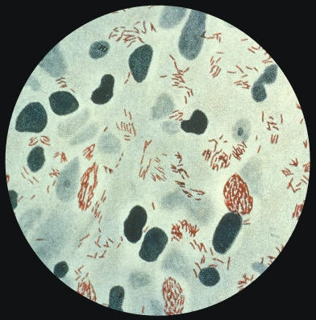
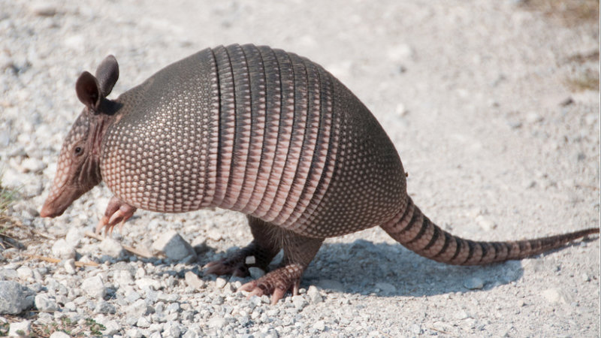
Mycobacterium leprea Armadillo
(skin smear)

Slide 6
Etiology
Replicate very slow [ 12day\once] .
It grow at 27-30 c .
Hence predilection for cooler areas of the body, e.g. skin, peripheral nerves, anterior chamber of eyes, upper respiratory tract and testes.

Slide 7
Mode of transmission
The exact rout of transmission of leprosy is not fully known.
The spread of leprosy is believed to via nasal discharge [ Droplets infection] .

Slide 8
Epidemiology
The incubation period range from 2-5 years. It occurs in all age groups with the average age onset between 10-20 years, children are at greater risk .
The estimated number of leprosy cases in world decreased after introduction of multidrug therapy, from 12 million in 1980 to 2.7 million in1994.
80% of the worldwide cases are found in India, Indonesia, Brazil and Nigeria.

Slide 9
Classification of leprosy
Once the bacilli gets the body its fate will be determined by the cell mediated immunity [CMI ].
The cell mediated immunological response to M. leprae determines not only whether the disease will develop or no, but also the clinical presentation of leprosy.
Individuals with high CMI will develop the Tuberculoid leprosy [ TT] while those with low CMI will develop Lepromatous leprosy [ LL] .

Slide 10
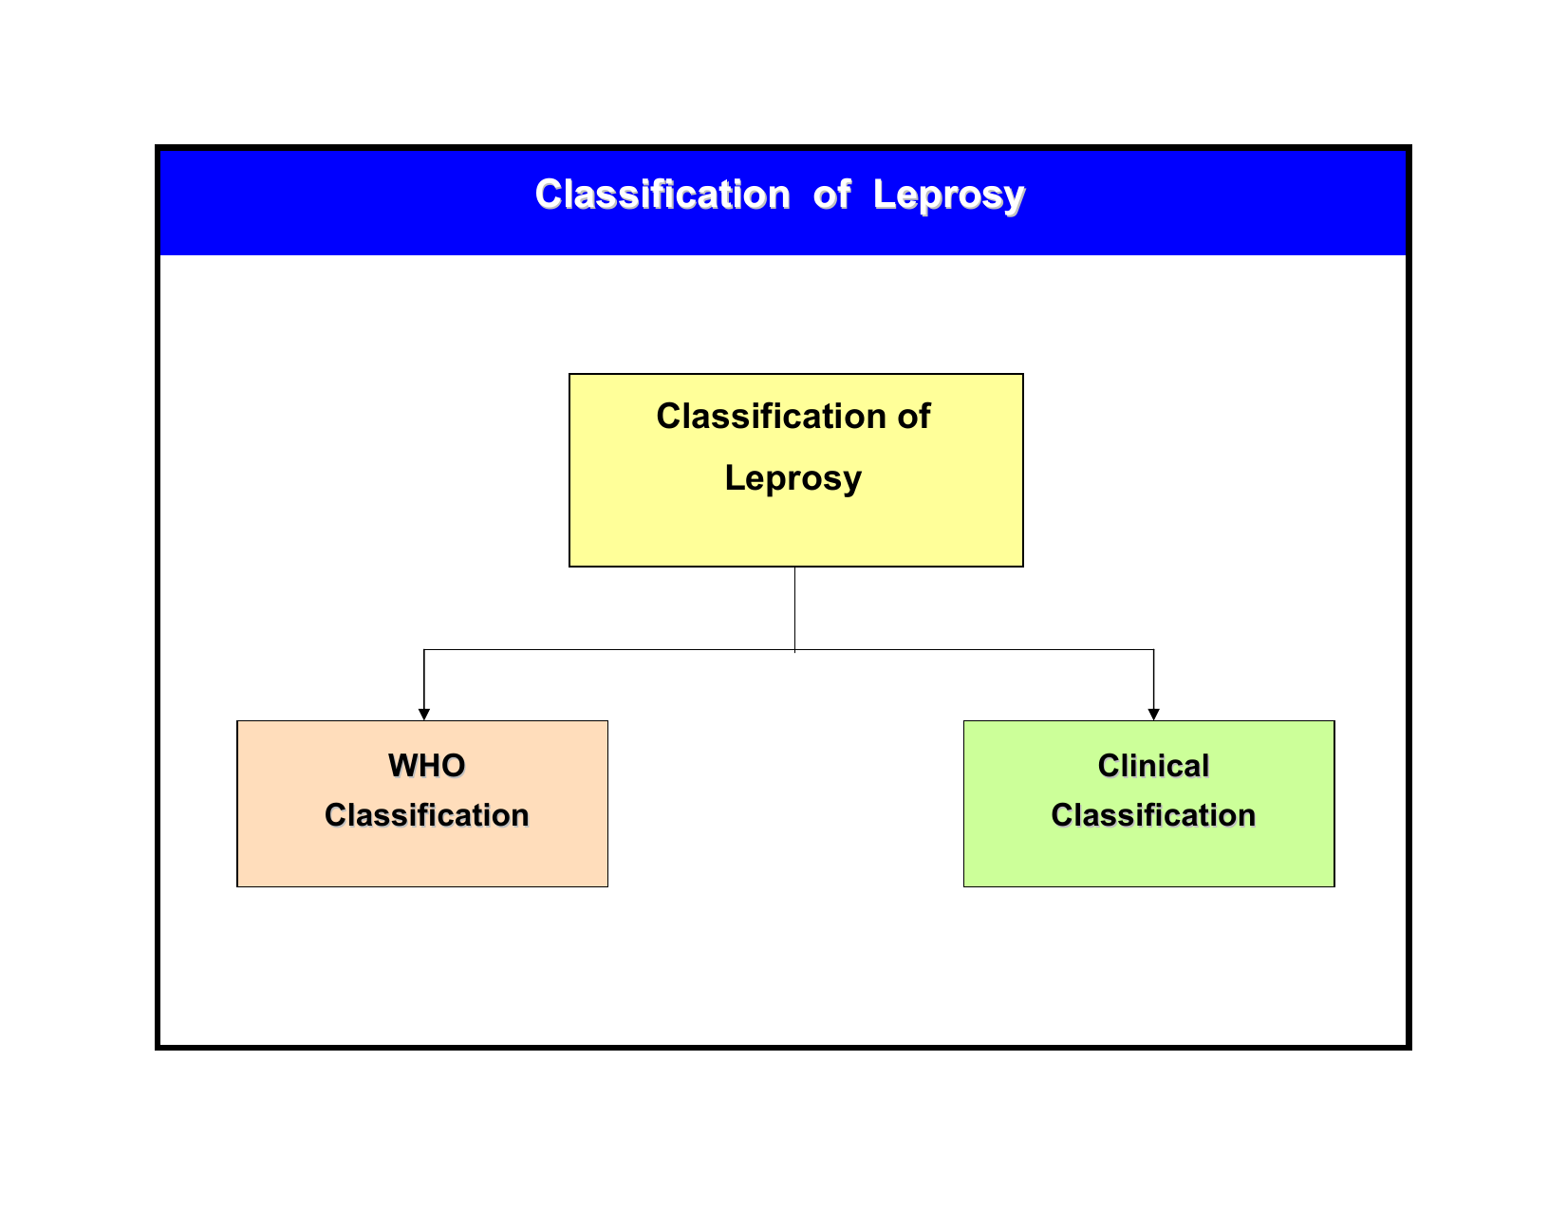

Slide 11
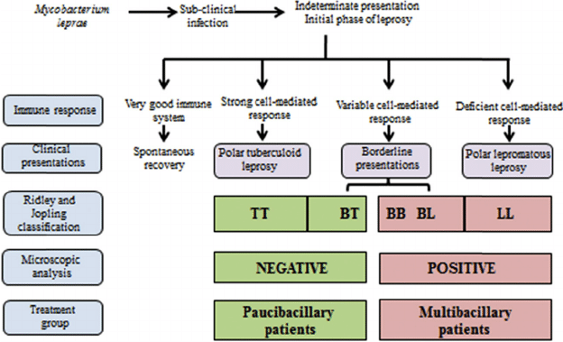
Classification of leprosy

Slide 12
Clinical features of different types of leprosy
1. Indeterminate leprosy [IL] .
Usually single [ if multiple less than 5] macule/ patch .
Hypopigmented or faintly erythematous .
Sensation normal but some time impaired
The peripheral nerves normal .
Slit skin smear negative.

Slide 13
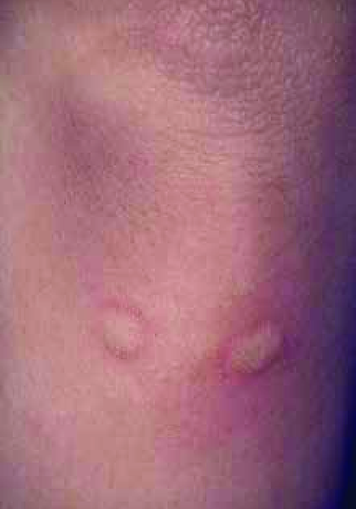
Indeterminate leprosy

Slide 14
Clinical features of different types of leprosy
2. Tuberculoid leprosy [ TT ]
Usually single but may be few [ less than 5 ]
Hypopigmented or erythematous plaque/ patch .
Well defined border .
Varying in size from few mm to several cm .
The lesion is dry and hair density is low.
Sensation markedly impaired .
SSS is negative .

Slide 15
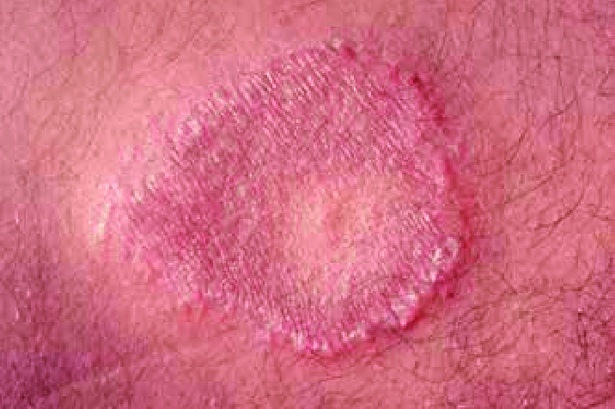
Tuberculoid leprosy

Slide 16
Clinical features of different types of leprosy
3. Borderline leprosy [ B L ] includes borderline tuberculoid [ BT], borderline borderline [BB ], borderline Lepromatous [BL] .
If the skin lesions toward TT will be BT. If it toward LL will be BL. An in between the two is BB.
Partly well-defined borders .
Sensory impairments range from slight to marked.
few / many asymmetrical patches / plaques.
Slit skin smear, usually positive [ but in BT is negative] .

Slide 17
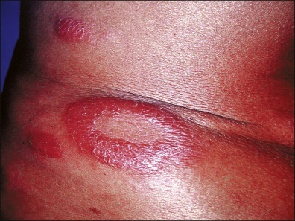
Borderline leprosy

Slide 18
Clinical features of different types of leprosy
4. Lepromatous leprosy [LL ]
Very numerous various types skin lesions, macules, patches, plaques, papules, nodules.
Thinning or loss of eyebrow and eye lashes. Leonine faces may occur late the disease.
symmetrically distributed all over the body.
Peripheral nerves symmetrically enlarged and tender.
No sensory impairment in the skin lesions
SSS , always positive.
Mycobacteria bacilli very abundant.

Slide 19
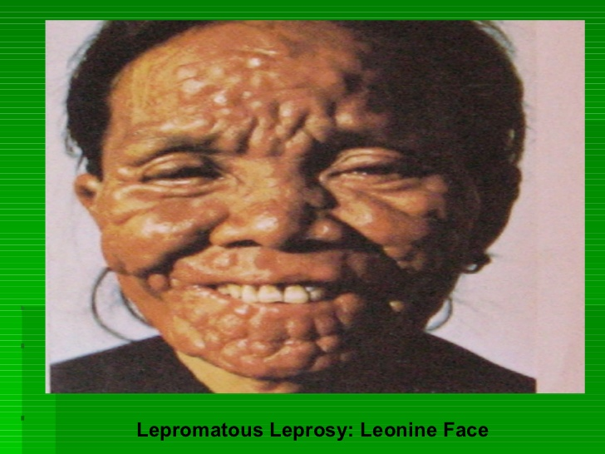

Slide 20
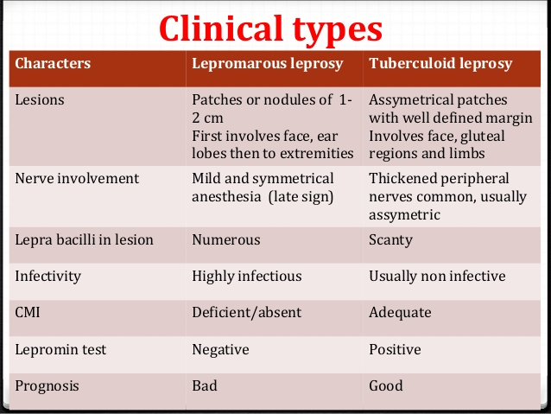

Slide 21
Diagnosis
1. clinical examination.
2. Slit skin smear
3. Skin biopsy

Slide 22
Treatment of leprosy
The three drugs are used in leprosy treatment are
1. Dapson
2. Rifampicin
3. Clofazimine
The combination of these drugs is known as Multi Drug Therapy [ MDT ] .

Slide 23
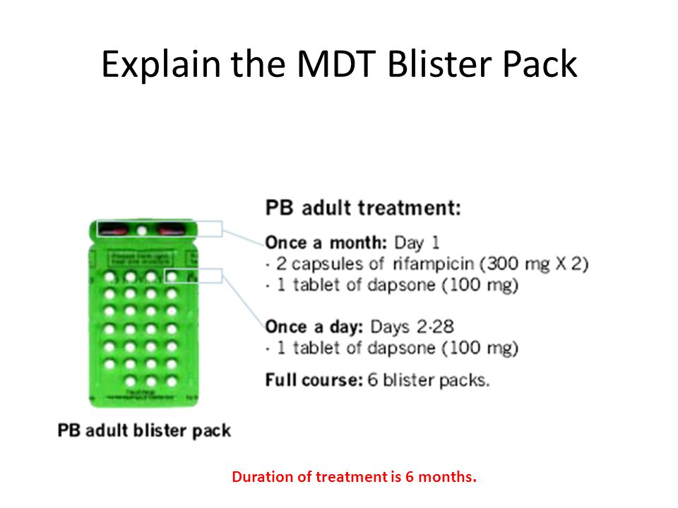
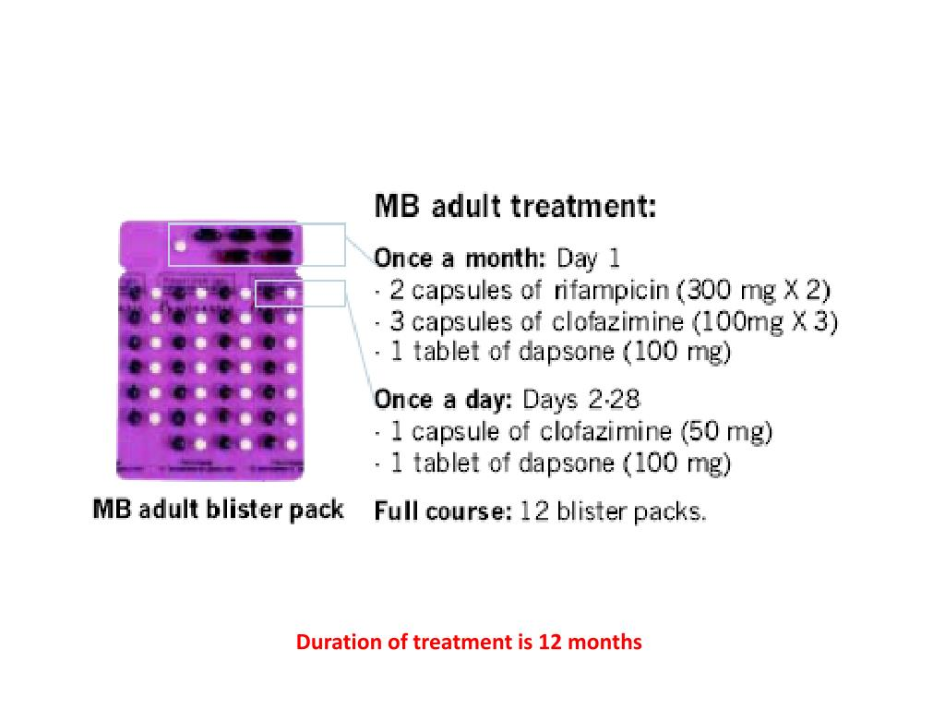

Slide 24
Complication of leprosy
1. Reaction of leprosy.
2. Complications of peripheral nerves.
3. Complications of eyes .
4. Complications of bones .

Slide 25
Reaction of leprosy
There are two types of leprosy
1. Type I leprae reaction [ Reversal Reaction]
2. Type II leprae reaction[ erythema Nodosum Leprosum] [ ENL].

Slide 26
Type I Reversal reaction
1. Seen borderline leprosy [ BT, BB. BL ].
2. Because of changes in CMI of the host. 3. Sudden onset.
4. Erythematous & edematous changes in the old skin lesions.
5. Appearing new skin lesions.
6. Tenderness & swelling of peripheral nerves.

Slide 27
Type II ENL
1. This type of reaction is seen in LL and BL.
2. It is immune- complex reaction .
3. Acute onset of constitutional symptoms.
4. Appearance of EN –like skin lesions .
5. Visceral manifestation include , iridocyclitis, hepatosplenomegaly, nephritis, pleuritis, neuritis.

Slide 28
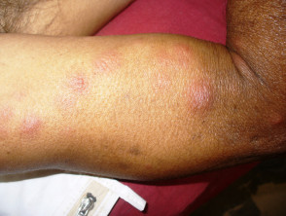
Erythema nodosum leprosum

Slide 29
ENL
Erythematous tender nodules
Appear in crops.
Occur anywhere.
May be vesicular , pustular & may ulcerate.

Slide 30
Treatment
Complete bed rest [ continue MTD]
NSAID
Systemic corticosteroid .
Thalidoamide.

Slide 31
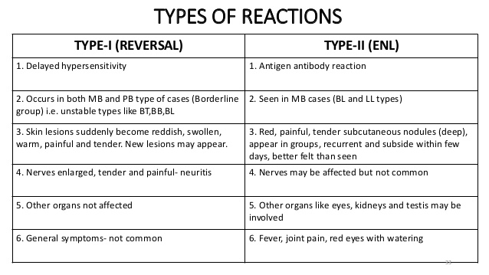

Slide 32


