Slide 1


Money flow in supply chain management
And Currency in the Central Bank of Canada
Libyan International Medical University
Faculty of Business Administration
Logistics and Supply Chain Management
Instructor name : Dr. Mohammed Alzwawi
Prepared by : Sara Elmograbi 955
Asria Khalel 1982
Date: 30.12.2021

Slide 2
CONTENTS
01
04
02
05
03
Introduction
Conclusion
flow in supply chain management
Refrences
Currency in the Central Bank of Canada

Slide 3
01
Introduction

Slide 4
Introduction
The systematic flow of materials, goods, and related information among suppliers, companies, retailers, and consumers is referred to as supply chain management.
In supply chain management, there are three types of flow.
Flow of materials
Flow of information/data
Flow of Money
The term central bank currency refers to the virtual form of a fiat currency. it is an electronic record or token of a country's official currency.

Slide 5
02
flow in supply chain management

Slide 6
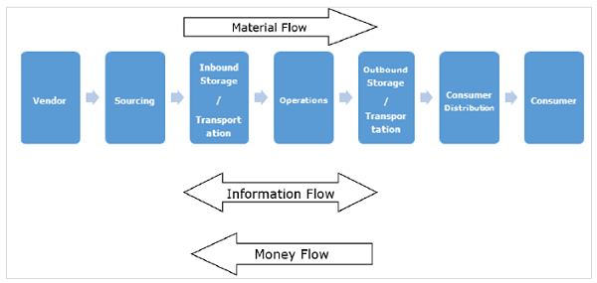
To achieve an efficient and effective supply chain, it is critical to properly manage all three flows with minimal effort.

Slide 7

Material Flow
A smooth flow of an item from the producer to the consumer is referred to as material flow.
This is possible thanks to a network of warehouses shared by distributors, dealers, and retailers.
The main challenge we face is ensuring that material flows as inventory quickly and without interruption through various points in the chain. The faster it moves, the better it is for the enterprise because it shortens the cash cycle.
The item can also flow from the consumer to the manufacturer for repairs or exchange for a decommissioned material.
Finally, finished goods are transferred from customers to their end users via various agencies.

Slide 8

Information Flow
The request for quotation, purchase order, monthly schedules, engineering change requests, quality complaints, and supplier performance reports are all examples of information/data flow from the customer to the supplier.
The information flow from the producer to the consumer includes the presentation of the company, offer, confirmation of purchase order, reports on action taken on deviation, dispatch details, inventory report, invoices, and so on.
Regular interaction between the producer and the consumer is required for a successful supply chain. Other partners, such as distributors, dealers, retailers, and logistic service providers, can be seen participating in the information network in many cases.

Slide 9
Money Flow
The clients check the order for accuracy based on the invoice raised by the producer.
If the claims are true, money is transferred from the clients to the respective producer. The flow of money from the producer side to the client side is also observed in the form of debit notes.

Slide 10
03
Currency in the Central Bank of Canada

Slide 11
Currency in the Central Bank of Canada
It is the country's sole banknote-issuing authority - to provide Canadians with banknotes they can use with confidence and pride. They also conduct research on cash and cryptocurrencies.

Slide 12
Issuance of bank notes in central bank of Canada
Design and production
Through ongoing research and development, they do issue bank notes with improved security features to stay ahead of counterfeiting threats.
It takes several years to design and issue a new bank note. guided by a set of design principles that ensures new notes:
offer enhanced security
are functional and usable in cash-handling machines
are recognizable, accessible and bilingual
reflect Canada

Slide 13
Issuance of bank notes in central bank of Canada
Distribution and quality
Through Canada’s Bank Note Distribution System, they do supply financial institutions with the bank notes they need to satisfy public demand.
the control the flow and quality of notes. From printing new bank notes to monitoring those that are already in circulation, ensure that notes handled in day-to-day transactions are of good quality so that they are easy for Canadians to verify and use.
All bank notes received at our operations center's are inspected on high-speed note-processing equipment. When they become worn or damaged, polymer notes are shredded and then recycled.

Slide 14
Issuance of bank notes in central bank of Canada
Education and awareness
They encourage the routine verification of bank notes. To do this, they deliver currency training and education to law enforcement, financial institutions, retailers and the public.
Counterfeit deterrence
They advocate counterfeit deterrence through law enforcement and the courts. Often, we partner with police to teach Canadians why it’s important to check their bank notes.
Legal tools are also available to help Crown prosecutors bring counterfeiters to justice.

Slide 15
Issuance of bank notes in central bank of Canada
Research on cash and digital currencies
They undertake research to understand the Canadian payments landscape.
The research includes ongoing work to understand the demand for and use of cash, as well as the use and evolution of digital currencies and fintech .

Slide 16
04
Conclusion

Slide 17
Conclusion
For an efficient and effective supply chain, it is important that all three flows are managed properly with minimal effort.
The BoC can change the supply of printed money and credit in the economy. To increase the money supply, the BoC buys federal government bonds from individuals and investors in the marketplace.

Slide 18
R e f e r e n c e s
Adekanye C. (2002); Elements of Banking in Nigeria 3rd
Edition F.A Publishers Ltd Lagos. Nigeria.
Al-Omiri M.and Drury C.(2007)A Survey Of the factors
Influencing the Choice Of Product Costing System in
U.K. Organizations .Management Accounting
Research 18(4)
Bower P. (2005) 12 Most common threats to sales and
operation planning process. The Journal of Business
forecasting methods and system 23(3).4
Chen J.M Chen L.T. and Liu J.D (2006) Development
Optimization Models for Cross Functional Decision-
Making Integrating Marketing and production Planning
OR Spectrum 28(2), 223-240.

Slide 19
THANKS!

