Slide 1


Ethical Behavior in Business
Libyan International Medical University
Faculty of Business Administration
Student : Yousef Mohamed Abdelbasset Buargub
Email:Yousef-3851@limu.edu.ly
Instructor:Loalloah Albeira
Student number:3851
Session:2

Slide 2
What are ethics
What is ethical behavior
Example and utilitarianism
conclusion

Slide 3
Ethical behavior is an important aspect of running any successful business but To explain what is ethical behavior we need to understand what are ethics
Ethical Behavior

Slide 4
Ethics
Are a branch of philosophy called moral philosophy that involves a lot of concepts such as: ( systemization , value , defending , majority , truth , right or wrong …etc.) with different approaches to each of them but always having a general definition

Slide 5

Ethics
They are a set of values and principles that define a persons moral views, decisions and actions in any moral given situation

Slide 6

Ethics
Ethics are usually determined by society as they govern a persons moral behavior as what is morally correct and what action to take

Slide 7

Ethical Behavior
Is working in an accepting manner according to social view

Slide 8
Some of the ethical practices that are beneficial in a working environment:
Honesty
Setting rules and boundaries
Supporting Your Suppliers
Aiding your employs
Listening to your customers
Giving rewards
Having clear values
Creating a healthy environment

Slide 9

Ethical Behavior
Its important to note that not all ethical approaches are beneficial to the business that is being run for an example:

Slide 10
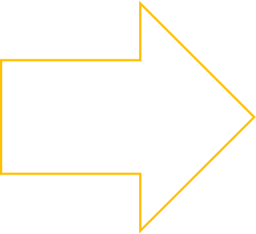



One of your employs had an accident and he is incapable of doing his job and you are losing profit for you to preserve your business you are required to fire him but in a society that cares for people of special need that is considered ethically wrong now you are stuck in a dilemma

Slide 11

There are multiple approaches one of these ethical approaches that you can take is the ethical approach of utilitarianism which defined as:
The belief that all actions should be done for the benefit of the majority

Slide 12
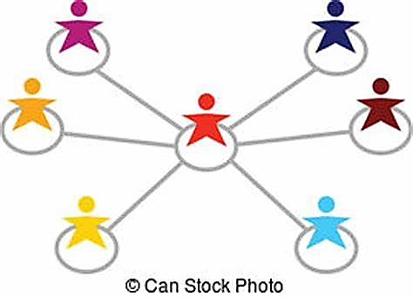
As the benefit of the whole firm is more important and having it lose profit well affect all of its components

Slide 13
In conclusion
Its important to have ethical behavior inside a firm but its also important to have clear to what is beneficial to your business and creating a balance between the two so that you can preserve your image while not putting your work at risk

Slide 14
Holton, L. (2021) Top 8 ethical business practices to follow, MYVA360. Available at: https://myva360.com/blog/ethical-business-practices#:~:text=Top%20Ethical%20Business%20Practices%201%201.%20Define%20Your,Employees%20...%208%208.%20Monitor%20Your%20Suppliers%20 (Accessed: November 8, 2022).
Verst, Ludger; Kampmann, Susanne; Eilers, Franz-Josef (July 27, 2015). Die Literaturrundschau. Communicatio Socialis. OCLC 914511982.
Internet Encyclopedia of Philosophy ""Ethics"". Archived from the original on January 18, 2018. Retrieved January 7, 2012
Duignan, Brian. [1999] 2000. "Utilitarianism" (revised). Encyclopædia Britannica. Retrieved 5 July 2020.
"Utilitarianism". Ethics Unwrapped. Austin, TX: McCombs School of Business. Retrieved 27 May 2020

Slide 15
Thanks for listening

