Slide 1

Climate change
The effect of air pollution on respiration
Name: faraj Ibrahim aldurssi
Student number: 3258
Date:4/6/2022
Block : PTS
1

Slide 2
OBJECTIVES:
1-Discuss Air pollution and its major source .
2-Describe Air pollution respiratory effects.
3-Define link between Pollution and asthma.
4-Discuss Pollution and respiratory infections.
5-Define the effect of physical exercise on patient of pollution.
2

Slide 3
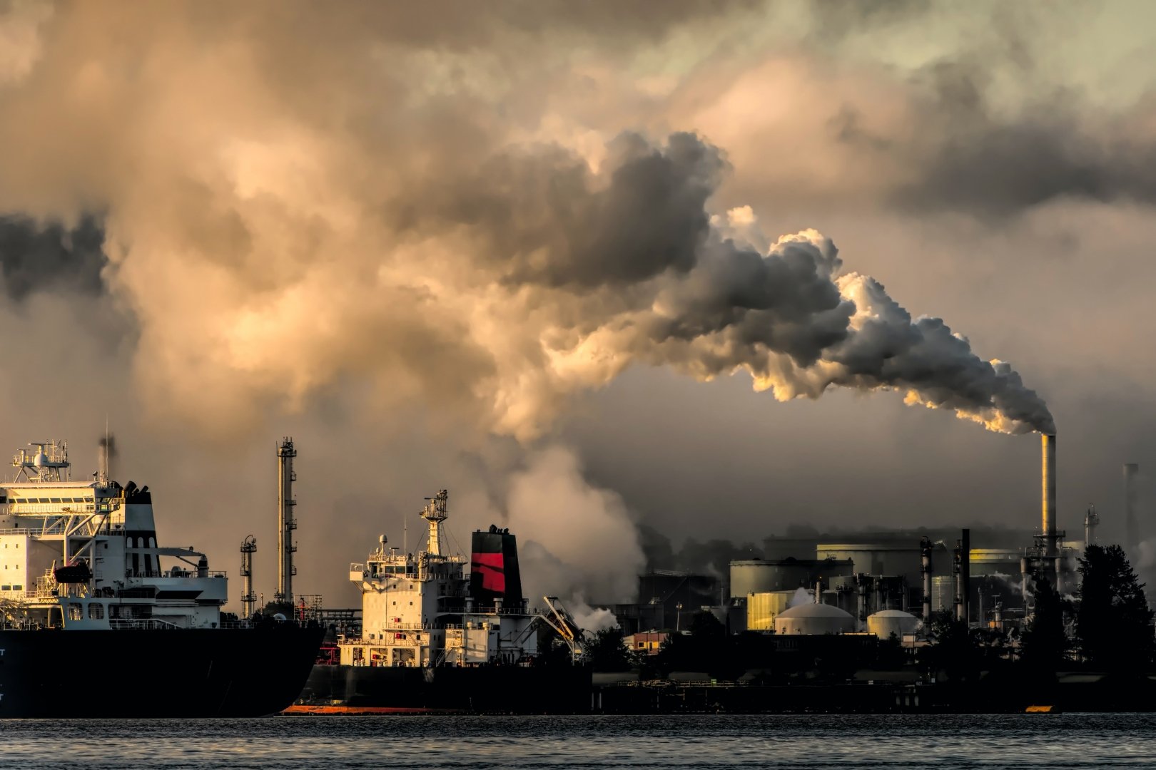
Introduction :
A major problem in the world today is air pollution, not only because of its impact on climate change but also because of its impact on public and individual health, being an important risk factor for increased Death.
3

Slide 4
1-Discuss Air pollution and its major source:
-The majority of pollution are result of human activity. Currently, the main sources of pollution are cars and industries .
- Natural emissions, such as those from storms in large desert areas, nitrogen oxides (NO₂) emissions from lightning, may contribute to the generation of air pollutants .
4

Slide 5
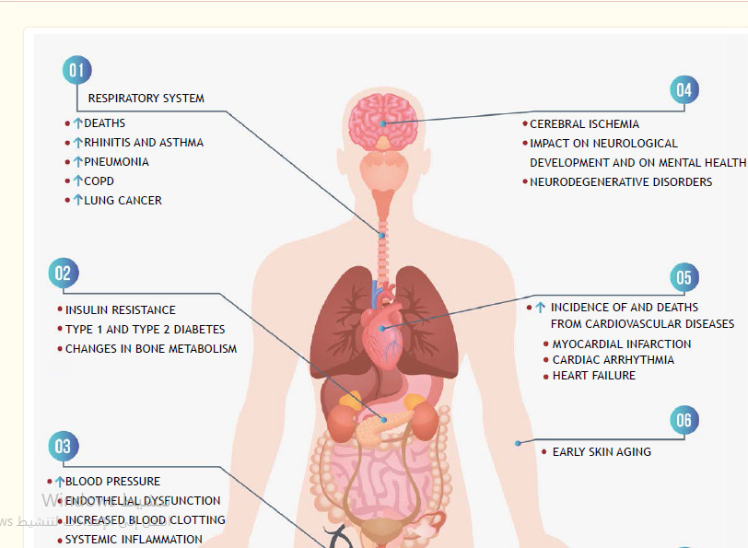
2- Discuss Air pollution respiratory effects:
5

Slide 6
3- Define link between Pollution and asthma:
- Exposure to pollutants such as , NO2, ozone, and carbon, is associated with a higher number of deaths in patients with asthma. ( that effect on the lung ).
6

Slide 7
4- Discuss Pollution and respiratory infections:
-Exposure to air pollutants increases the risk of airway infections. Exposure to pollution was responsible for 433,000 deaths from respiratory infections globally in 2017, especially affecting children individual .
-The effect of pollution will increase the patients chance to effected by covid-19.
7

Slide 8
5-Define the effect of physical exercise on patients of pollution:
-Low physical activity is an important risk factor for mortality and was associated with 1.26 million deaths in 2017.
- Regular mild- exercise contributes to reducing or delaying the onset of chronic diseases by up to 10 years .
8

Slide 9
Conclusion:
the main source of pollution is human activity.
the pollution have an effect on Respiration, brain function and blood pressure.
the pollution increase the effecting patients by Asthma.
the pollution increase the death specially for children.
the physical exercise decrease the effect of air pollution.
9

Slide 10


Slide 11
1- the main effect of air pollution on the body on :
A- brain function.
B- respiration function.
C- GIT function.
D- other than.
ANSWER (B)
2-the pollution can increase to effect by:
A- malaria.
B- cholera.
C- Covid-19.
D- other than.
ANSWER (C)
11

Slide 12
References
Santos UP;Arbex MA;Braga ALF;Mizutani RF;Cançado JED;Terra-Filho M;Chatkin JM; (n.d.). Environmental air pollution: Respiratory effects. Jornal brasileiro de pneumologia : publicacao oficial da Sociedade Brasileira de Pneumologia e Tisilogia. Retrieved June 3, 2022, from https://pubmed.ncbi.nlm.nih.gov/33567063/
For further reading
1. Stanek LW, Brown JS, Stanek J, Gift J, Costa DL. Air pollution toxicology--a brief review of the role of the science in shaping the current understanding of air pollution health risks. Toxicol Sci. 2011;120:S8–S27. doi: 10.1093/toxsci/kfq367.
2. Bell ML, Davis DL. Reassessment of the lethal London fog of 1952: novel indicators of acute and chronic consequences of acute exposure to air pollution. Environ Health Perspect. 2001;109(Suppl 3):389–394. doi: 10.1289/ehp.01109s3389.
12

Slide 13


