Slide 1
Health Education & communication
Dr. Nuha Bodaboos, MD, MPH

Slide 2

Contents
Introduction
Definition
Objectives
Approaches to achieve health
Principles of health education
Practice of health education
Educational aids
Communication

Slide 3

INTRODUCTION
Health education is the process of imparting information about health in such a way that the recipient is motivated to use that information for the protection or advancement of his own, his family’s or his community’s health.
Health Education is an active learning process.

Slide 4

DEFINITION
“ Health education comprises consciously constructed opportunities for learning involving some form of communication designated to improve health literacy, including improving knowledge, and developing skills which are conductive to individual and community health”
WHO health promotion glossary

Slide 5

OBJECTIVES
Informing People:
People are informed about the different diseases, their etiology and how to prevent them.
Motivating people: Concerned with clarifying, changing or forming attitudes, beliefs, values or opinions.
Guiding into action: Concerned with development of skills and action.

Slide 6

Approaches to achieve health
Legal or regulatory approach: Make use of the law to protect health of the public such as Epidemic disease act, environmental act, etc..
Administrative or service approach: Provide all health facilities to all the people with the hope that they will use it.
Educational approach: Mostly be motivation, communication and decision making. The result is slow, but permanent.
Primary health care approach: It is achieved by providing the guidance to help people identify their health problems and to find solutions to these problems.

Slide 7

Principles of Health Education
Credibility
Interest
Participation
Motivation
Comprehension
Reinforcement
Learning by doing
Known to unknown
Setting an example
Good human relations
Feedback
Community leaders
Soil, seed, sower

Slide 8
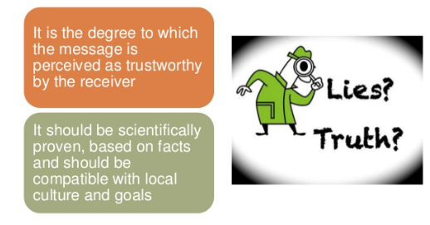

Credibility

Slide 9
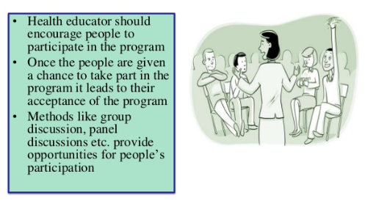
Participation

Slide 10
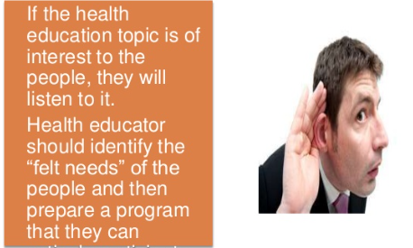
Interest

Slide 11
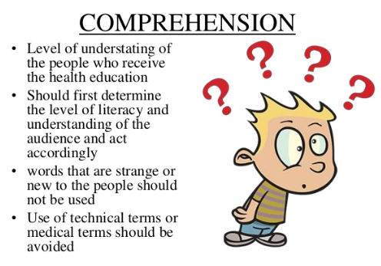
Comprehension

Slide 12
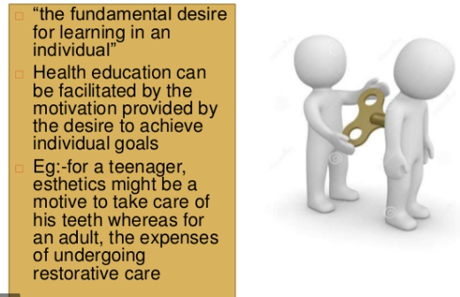
Motivation

Slide 13
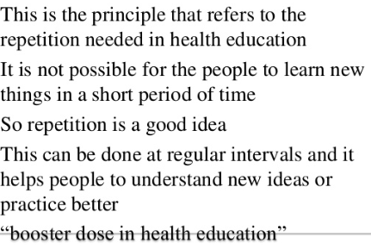
Reinforcement

Slide 14
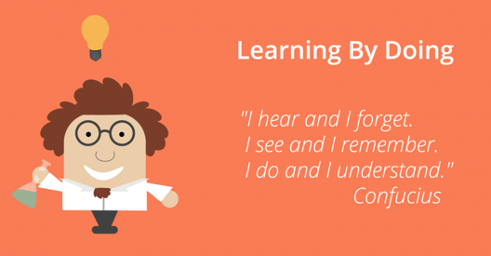
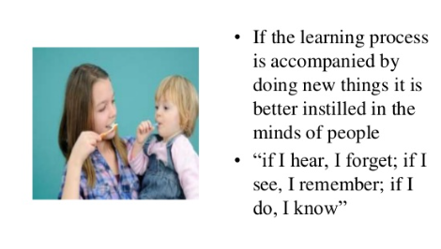
Learning by Doing

Slide 15
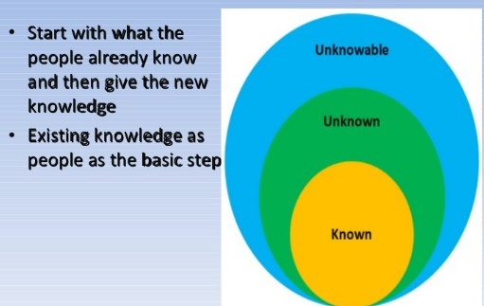
Known to unknown

Slide 16
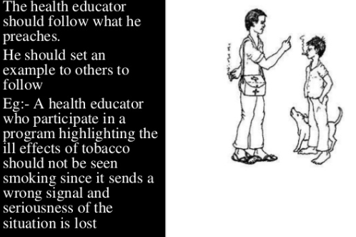
Setting an example

Slide 17
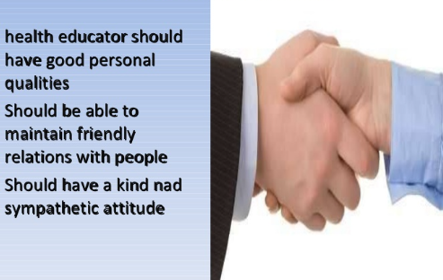
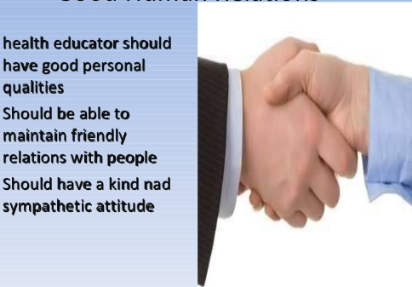
Good Human relations

Slide 18
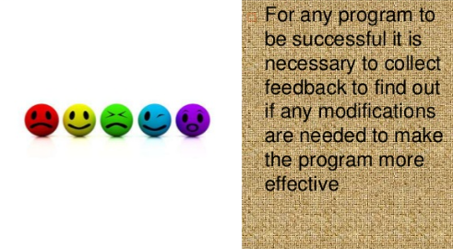
Feedback

Slide 19
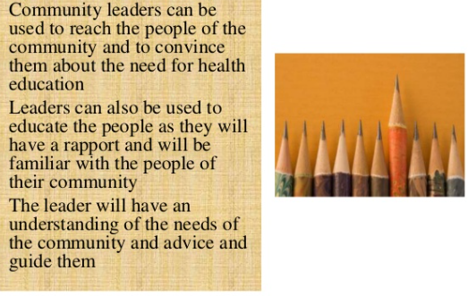
Community Leaders

Slide 20

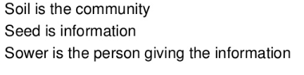
Soil, Seed, Sower

Slide 21
Practice of Health Education (Methods)
A single or combination of methods must be used to bring about the required effect.
Methods can be classified as:
1- Individual approach: Such as personal contact or home visits.
2- Group approach: Lectures, discussion, conference and workshops
3- Mass approach: Such as TV, newspaper, posters and internet

Slide 22
Educational Aids
1- Auditory aids: Microphone, radios, tape records and sound amplifiers.
2- Visual aids:
Projected aids such as films or cinema
Non projected aids such as pictures, flash cards and brochures
3- Combination of Audi-visual aids: Such as televisions

Slide 23
Communication
Health Communication is defined as a key strategy to inform the public about health concern and to maintain important health issues on the public agenda.
Components of communication:
1- Sender: The originator of the message
2- Receiver: The audience
3- Message: The information
4- Channels of communication: The media used for communication
5- Feedback: Opinion, Questionnaire survey

Slide 24
Doctor- Patient Relationship:
1- Communication on an emotional plane: The doctor must give a sympathetic ear to what the patient and his/her relative want to say.
2- Communication on a cultural plane: The doctor must understand the cultural concepts of the community.
3- Communication on an intellectual plane: The doctors usually come from well-to-do or rich families, there is a wide social gap between the doctors and their patients called “intellectual gap”. A successful doctor can win the confidence of the patient by reducing this gap and talk freely with the patient. Humor is the best ice-breaker for the patient frozen by fear and anxiety.

Slide 25
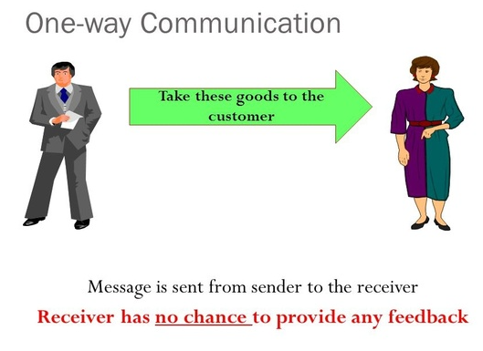
Types of communication:
1- One Way communication:
There is no room for feedback

Slide 26

2- Two Way communication:
The Audience may give feed back

Slide 27

3- Verbal communication
This is “ word of mouth”

Slide 28
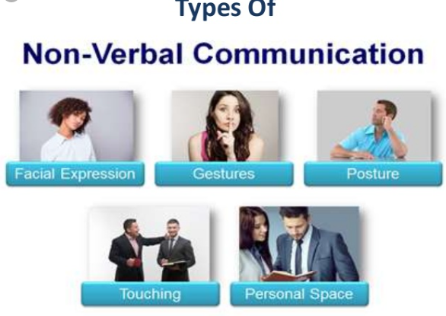
4- Nonverbal Communication:
It includes body movements

Slide 29

5- Formal and informal communication
Communication which follows line of authority are formal e.g, meetings..; however, the gossip/ rumors that goes on in organizations are the informal type of communication.

Slide 30

6- Visual communication:
Charts and posters

Slide 31
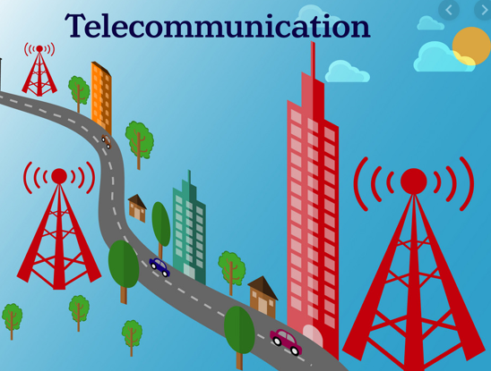
7- Telecommunication and internet

Slide 32

Reference
1- Essential of public health denistary- Soben Peter
2- Health Education, World health organization, WWW.WHO.Org
online accessed on 11/24/2019

Slide 33


