Slide 1


Seasonal Influenza
PRESENTED BY:
STUDENT NAME: DALIA HISHAM ELGHORI
Student number: 3590
Supervised by: Fatma eltarhony
Y1 / Block: PTS

Slide 2
Objectives:-
Seasonal influenza definition.
Seasonal Influenza types.
Seasonal Influenza causes.
Seasonal Influenza symptoms.
protection Seasonal Influenza.

Slide 3
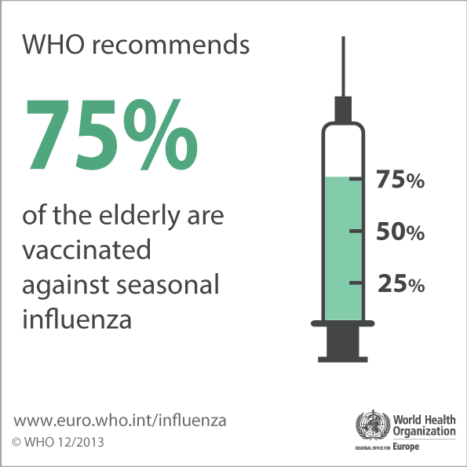
Definition:-
Is an acute respiratory infection caused by influenza viruses which circulate in all parts of the world. It represents a year-round disease burden. It causes illnesses that range in severity and sometimes lead to hospitalization and death.

Slide 4
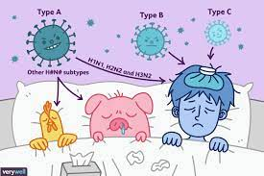
How many types of influenzas in the world?
There are 4 types of seasonal influenza viruses, types A, B, C and D. Influenza A and B viruses circulate and cause seasonal epidemics of disease.
Influenza A viruses.
Influenza B viruses.
Influenza C viruses.
Influenza D viruses.

Slide 5
Causes!
Seasonal epidemics occur mainly during winter, while in tropical regions, influenza may occur throughout the year, causing outbreaks more irregularly.

Slide 6
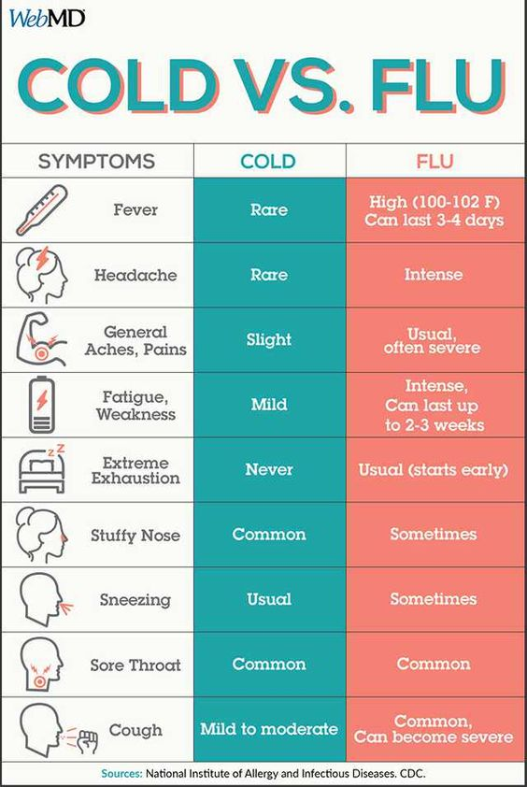
The different between cold and the influenza

Slide 7
Symptoms!
Sudden onset of fever.
Cough (usually dry).
Headache.
Muscle and joint pain.
Severe malaise (feeling unwell).
Sore throat and a runny nose.
The cough can be severe and can last two or more weeks.

Slide 8

How to protect our self from seasonal flu?!
The most effective way to prevent the disease is vaccination.
Regular hand washing with proper drying of the hands.
Good respiratory hygiene – covering mouth and nose when coughing or sneezing, using tissues and disposing of them correctly.
Early self-isolation of those feeling unwell, feverish and having other symptoms of influenza.
Avoiding close contact with sick people.
Avoiding touching one’s eyes, nose or mouth.

Slide 9
REFRENCES:-
Who.int. 2022. Influenza. [online] Available at: <https://www.who.int/teams/health-product-policy-and-standards/standards-and-specifications/vaccines-quality/influenza#:~:text=Influenza%20occurs%20all%20over%20the,more%20unpredictably%20in%20tropical%20regions.> [Accessed 11 May 2022].
Who.int. 2022. Influenza (seasonal). [online] Available at: <https://www.who.int/health-topics/influenza-seasonal#tab=tab_1> [Accessed 11 May 2022].
https://www.who.int/news-room/fact-sheets/detail/influenza-(seasonal)

Slide 10


