Slide 1


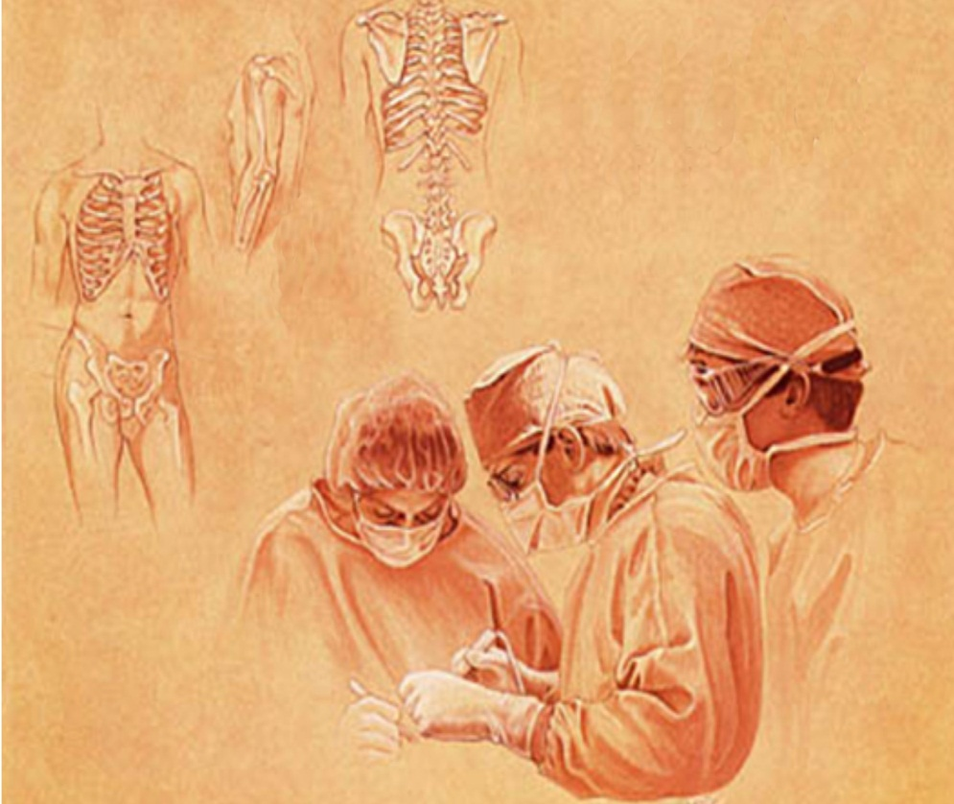
Preoperative assessment of surgical patient
Preoperative assessment
of
surgical patient
HAITHAM R. ELMEHDAWI

Slide 2
Surgical operation
Preoperative assessment
of
surgical patient
Preoperative phase : Assessment & preparation
Intraoperative phase : Anesthesia & Surgery
Postoperative phase : Postoperative care & follow up

Slide 3
Preoperative assessment
of
surgical patient
Pre-operative
Assessment and Preparation
Why ?
How ?
When ?
What ?

Slide 4
WHY ?
Preoperative assessment
of
surgical patient
To obtain satisfactory results in general surgery requires a careful approach to preoperative preparation of patients.
Specific patient groups have specific needs.
High risk patients should be identified early and appropriate measures taken to reduce complications.

Slide 5
Preoperative assessment
of
surgical patient
Emergency : life-threatening condition requiring immediate action ( e.g. ruptured aneurysm, penetrating trauma, peritonitis)
Urgent : surgery required within few hours ( e.g. intestinal obstruction, appendicitis, abscess )
Elective : ( e.g. hernia, cholecystectomy , colorectal malignancies, breast malignancy )

Slide 6
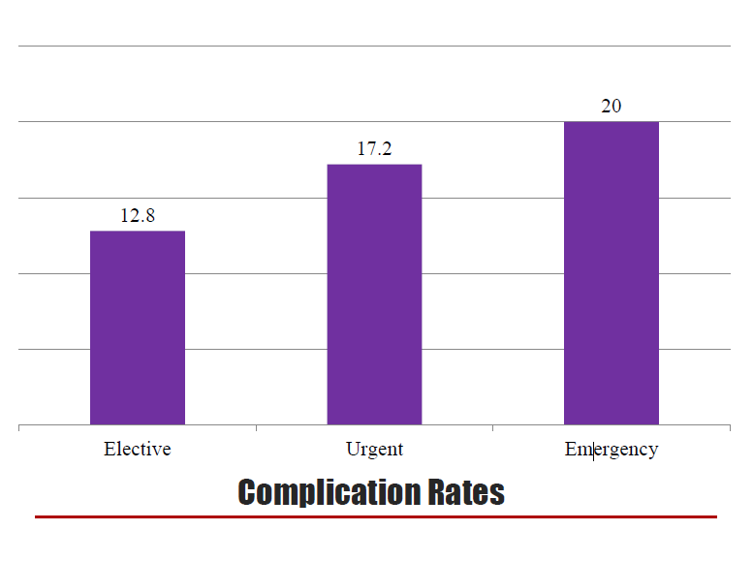
Preoperative assessment
of
surgical patient

Slide 7
HOW ?
Preoperative assessment
of
surgical patient
Assessment
History
Physical exam
Investigation
preparation
Informed consent
Marking the site/side of operation
Medications
Thromboembolic prophylaxis
Antibiotic prophylaxis
Essential
Keep NPO (Nil per Oral)
Prepare area for surgery
Cleaning
Shave
Enema

Slide 8
WHEN ?
Preoperative assessment
of
surgical patient
Out patient visit
Pre-operative ward round
ER

Slide 9
WHAT TO DO ?
Preoperative assessment
of
surgical patient
To assess the fitness of the individual for anesthesia and surgery.
A well‐conducted history and physical examination answer several important questions:

Slide 10
Preoperative assessment
of
surgical patient
Is this a healthy patient?
What is the indication for surgery?
Is the surgical procedure low risk, intermediate or high risk?
What is the functional status of the patient?
What is the effect of the present condition on the patient?
What improvement is expected after surgery?

Slide 11
Preoperative assessment
of
surgical patient
Answers to these questions should then direct preoperative testing and management

Slide 12
HISTORY TAKING
Preoperative assessment
of
surgical patient
personal details
Chief complaint
History of present illness
Past medical history
Systemic enquiry
Family history
Drug history
Social history

Slide 13
personal details
Preoperative assessment
of
surgical patient
– Name
– Age
– Address
– Sex
– Occupation
– Religion
– Marital status
– Date of examination

Slide 14
Chief complaint & present illness
Preoperative assessment
of
surgical patient
The main reason push the pt. to seek for visiting a physician or for help.
Single or multiple symptoms with good analysis regarding onset , duration , frequency , associated symptoms , relieving & aggravating factors .

Slide 15
System Review
Preoperative assessment
of
surgical patient
Carefully assess each body system about its function to rule out if any other system is involved
CVS
Respiratory
GIT
CNS
Urogenital
Endocrinal

Slide 16
Past medical & surgical history
Preoperative assessment
of
surgical patient
IHD/Heart Attack/DM/Asthma/HNT/TB, etc.
Past surgical/operation history
time/place/ what type of operation.
Note any blood transfusion.
Post operative complications .

Slide 17
Drug History
Preoperative assessment
of
surgical patient
Drugs and Allergic
interaction with anesthesia
Related with sudden withdrawal(steroids)
Drugs for HTN, IHD to be continued over perioperative period
Anticoagulant drugs (aspirin , warfarin)

Slide 18
Family History
Preoperative assessment
of
surgical patient
Any familial disease/running in families
e.g. breast cancer, IHD, DM, schizophrenia, asthma, albinism.
Infections running in families as TB, Leprosy.

Slide 19
Social History
Preoperative assessment
of
surgical patient
Smoking history - amount, duration & type.
• A strong risk factor for IHD
• Alcohol history - amount, duration & type.
• Occupation, social & education background, family social support& financial situation.
• Social class.
• Home conditions as:
• Water supply.
• Sanitation status in his home & surrounding.
• Animals / birds in his/her house.

Slide 20
Physical Examnaton
Preoperative assessment
of
surgical patient
Including
Vital sing .
Cardiac ex. ( JVP, HS)
Respiratory Ex.
Abdominal Ex.
CNS
Musculoskeletal system
Peripheral vasculature
Local Ex

Slide 21
Investigations
Preoperative assessment
of
surgical patient
General
Full blood count ( CBC )
RFT and electrolytes
Blood Glucose
Liver function tests
Blood group/ cross match
Chest X-ray
ECG
Specific
Amylase
Ca
TFT
Uss
CT
MRI

Slide 22
Assessment of risk of surgery
Preoperative assessment
of
surgical patient
APACHE SYSTEM
“Acute Physiology And Chronic Health Evaluation”
ASA SYSTEM
“ American Society of Anaesthesiologist”

Slide 23
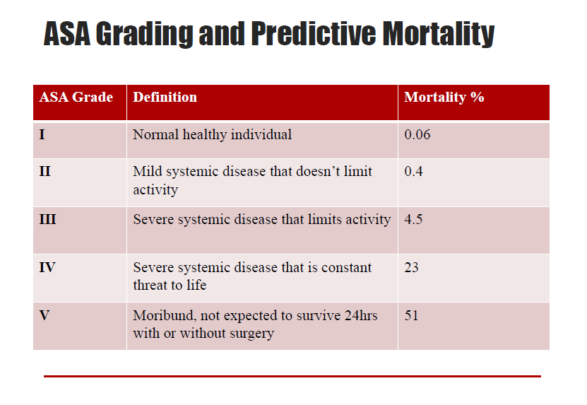
Preoperative assessment
of
surgical patient

Slide 24
preparation
Preoperative assessment
of
surgical patient
Consent for surgery
An informed consent in writing from the patient and/or his relatives is essential before any procedure is undertaken

Slide 25
Preoperative assessment
of
surgical patient
Patients must receive sufficient accurate information about their illness, the proposed treatment and its prognosis.
Describe the procedure itself, including information about its practical implications and its prognosis
Outline other surgical or medical alternatives to the proposed treatment, including non‐treatment, along with their general advantages and disadvantages

Slide 26
Prevention of CVS & respiratory complications
Preoperative assessment
of
surgical patient
Prophylaxis of Postoperative Deep Vein Thrombosis.
SC heparin 5000 IU 2 hours preoperatively and 8 hours postoperatively.
Respiratory complications can be prevented and also improved through:
Cessation of smoking
Treating bronchospasm
Reducing secretions
Chest physiotherapy

Slide 27
Aspiration prevention
Preoperative assessment
of
surgical patient
Prevention of aspiration is the most important aspect of perioperative care.
Starving the patient for 6-8 hours prior to surgery NGT tube aspiration during surgery
Fasting times for children are age dependent

Slide 28
Antibiotic prophylaxis
Preoperative assessment
of
surgical patient
Prophylaxis against wound infection according to the type of operation
Clean
Clean contaminated
Contaminated
Dirty

Slide 29
Preoperative assessment
of
surgical patient
Prepare area for surgery
Cleaning
Shave
Enema
Marking the site/side of operation

Slide 30

Preoperative assessment
of
surgical patient

