Slide 1


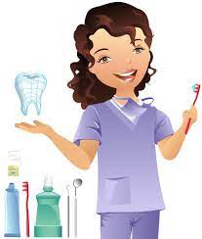
Relation of ABO blood groups with some oral diseases
The effect ABO blood types on periodontal disease
Name : Malk Fouzi Elmansory
Student Number: 3132
2 dental year
Block : PTS
Date: 5/may/2022

Slide 2
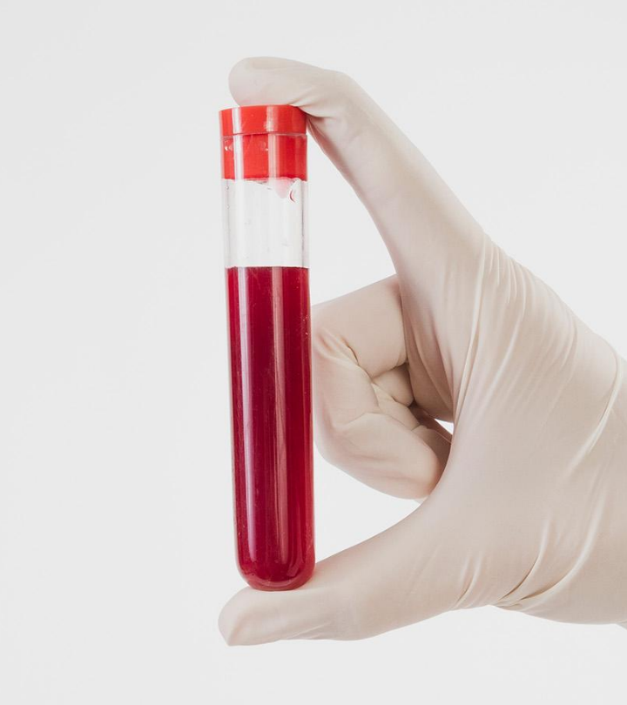
Introduction
Although several studies have investigated the relationship between ABO blood group and medical diseases, few reports have explored the association with oral diseases including periodontal disease (PD)

Slide 3
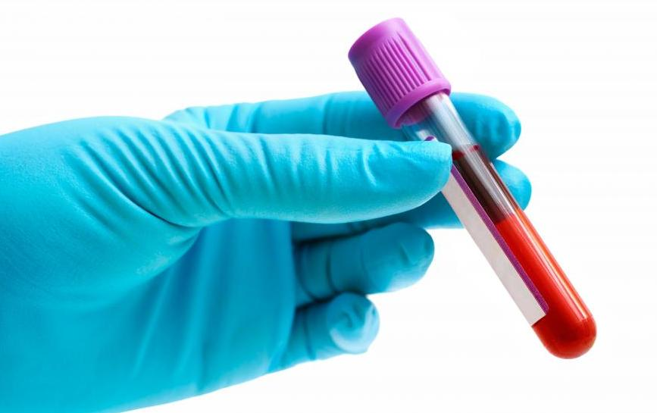
Objectives
Definition of ABO blood group and periodontitis.
List the Classifications of periodontitis.
Discuss Association between aggressive periodontitis and ABO blood group.
Discuss Association between chronic periodontitis and ABO blood group.

Slide 4
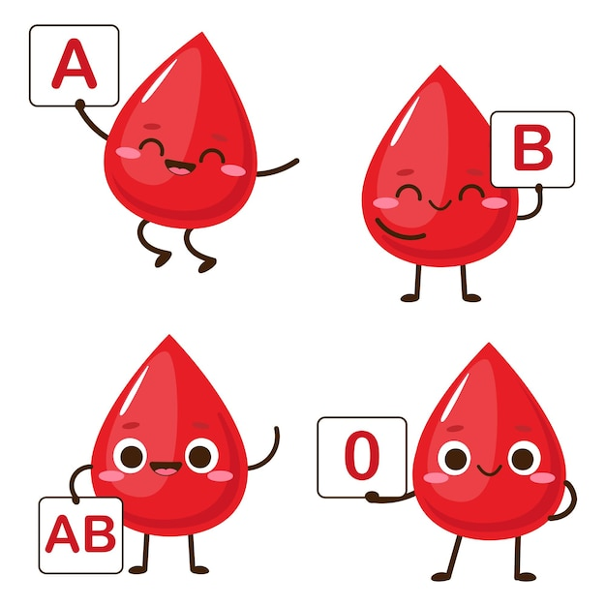
Definition of ABO blood group
Used to denote the presence of one, both, or neither of the A and B antigens on erythrocytes.
Blood is essential for transporting oxygen, nutrients, wastes, and hormones in the body.

Slide 5
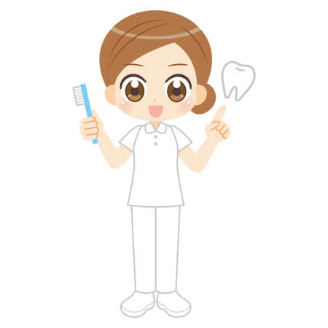
Definition of Periodontitis
PD is a broad term that refers to many chronic inflammatory conditions affecting the gingiva bone and ligament that supports the teeth.

Slide 6
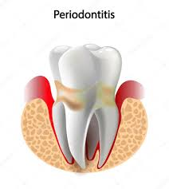
Classifications of Periodontitis
1. Chronic periodontitis
4. Abscesses of periodontal diseases.
2. Aggressive periodontitis.
5. Periodontitis is associated with endodontic lesions.
3. Necrotizing periodontal diseases.
6.Developmental or acquired deformities and conditions.

Slide 7
Association between aggressive periodontitis and ABO blood group
It has been speculated that human leukocyte antigen HLA A9 and/or B15 is a potential markers for AP.
The risk of AP was 1.5 to 3.5 times higher comparing those who do not carry HLA antibodies.

Slide 8
Association between aggressive periodontitis and ABO blood group
The association of the AP and ABO blood types, which analyzed an improved incidence of AP in B blood group, while in blood group O there was a decreased incidence of AP.
A study, association of ABO with juvenile periodontitis (JP).

Slide 9
Association between aggressive periodontitis and ABO blood group
Another paper of 45 individuals discovered that 15 of the patients had AP which was most usually detected in patients
The studies suggest that there is a possible genetic reason for the association of PD with ABO blood groups.

Slide 10
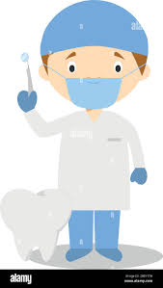
Association between chronic periodontitis and ABO blood group
The - kD bacterial adhesion protein is a key receptor for the blood type antigen H
In precursor antigen H in blood group O, the antigen H is higher because not converted to antigens A and B and accumulation in the gingival sulcus, causes attraction to gram-negative bacteria, leading to periodontitis

Slide 11
Studies on the relationship between periodontitis with ABO blood types
Title | Year of publication | Location | Prominent blood group
Blood groups: link to periodontal diseases. | 2017 | India | B
The effect of ABO blood types on periodontal status. | 2007 | Turkey | O
ABO blood group a possible risk factor for periodontal disease. | 2015 | Iran | O
Effects of rhesus factor and blood group type on gingival health status. | 2014 | Egypt | A

Slide 12
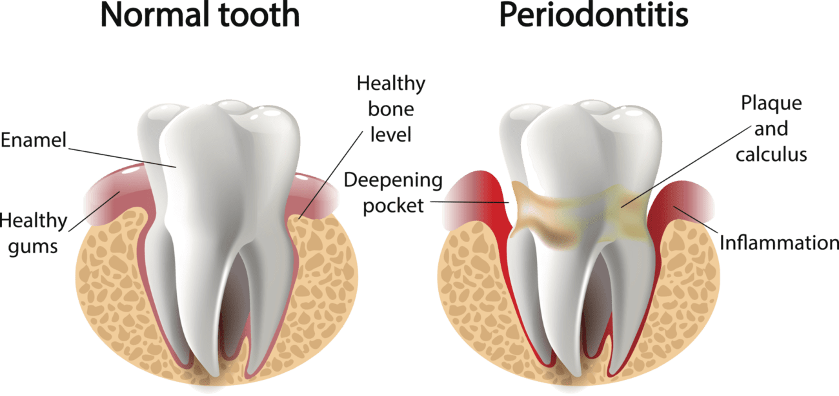

Slide 13
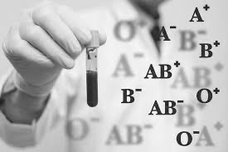
Conclusion
It could be concluded that the ABO blood types and Rhesus factor can be risk factors for the development of PD.
It could be concluded that Periodontal disease is amongst the top ten most common diseases to affect humans and the leading cause of tooth loss for adults

Slide 14
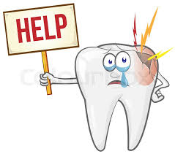
References
Kinane DF, Stathopoulos PG, Pappano PN. Periodontal diseases. Nat Rev Dis Primers 2017;3(01):1-14
Kundu D, Bandyopadhyay P, Nair V, Chowdhury M, Mukherjee S, Nayok M. Aggressive periodontitis: a clinic-hematological appraisal. J Indian Soc Periodontal 2014;18(02):166–171
Demir T, Tezel A, Orbak R, Elates A, Kara C, Kavrut F. The Effect of ABO Blood Types on Periodontal Status. Eur J Dent. 2007 Jul;1(3):139-43. PMID: 19212557; PMCID: PMC2638241.
Mostafa D, Elkhatat EI, Koppolu P, Mahgoub M, Dhaifullah E, Hassan AH. Correlation of ABO Blood Groups and Rh Factor with The Severity of Generalized Chronic Periodontitis: Across Sectional Study in Riyadh, Saudi Arabia. Open Access Maced J Med Sci. 2019 Feb 15;7(4):617-622. doi: 10.3889/oamjms.2019.044. PMID: 30894924; PMCID: PMC6420957.

Slide 15
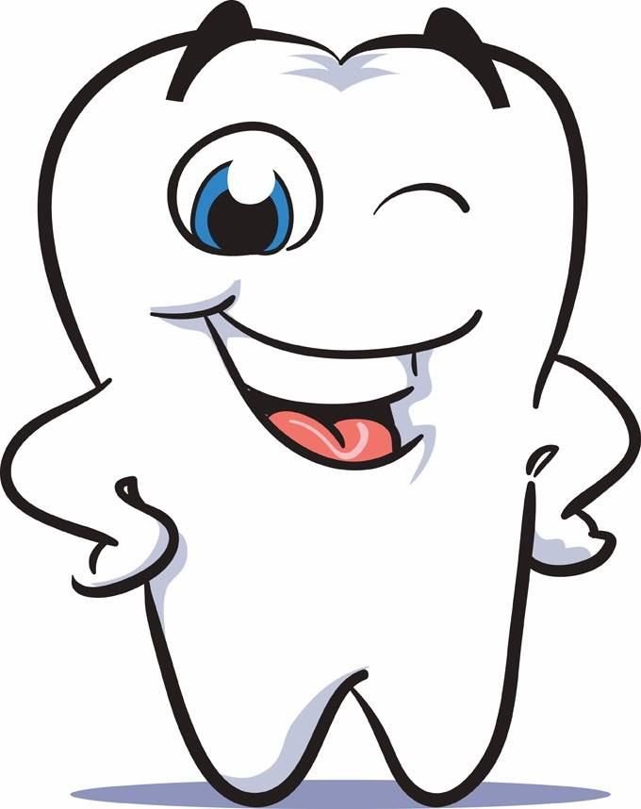
Thanks a lot

