Slide 1




The Various Ways to Be Culturally Aware
Presented by : Dana Elgheriani
Student number: 3792
Email: dana_3792@limu.edu.ly

Slide 2

01
The various ways to be culturally aware
2

Slide 3


Table of contents
01
02
The various ways to be culturally aware
03
04
References
3

Slide 4
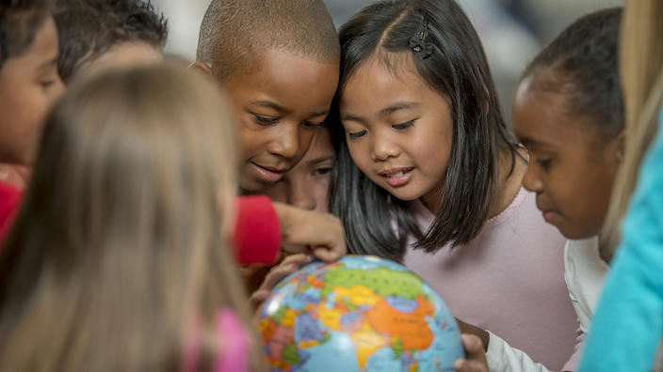
Introduction
Cultural awareness means being sensitive to the differences and similarities between two cultures when communicating or interacting with members of other cultural groups.
4

Slide 5

How Do You Become More Culturally Aware
5

Slide 6
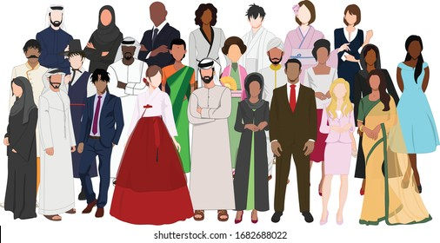
1.Think beyond race and ethnicity.
A person's culture is shaped by more than the color of their skin or the way that they dress. ...
5

Slide 7
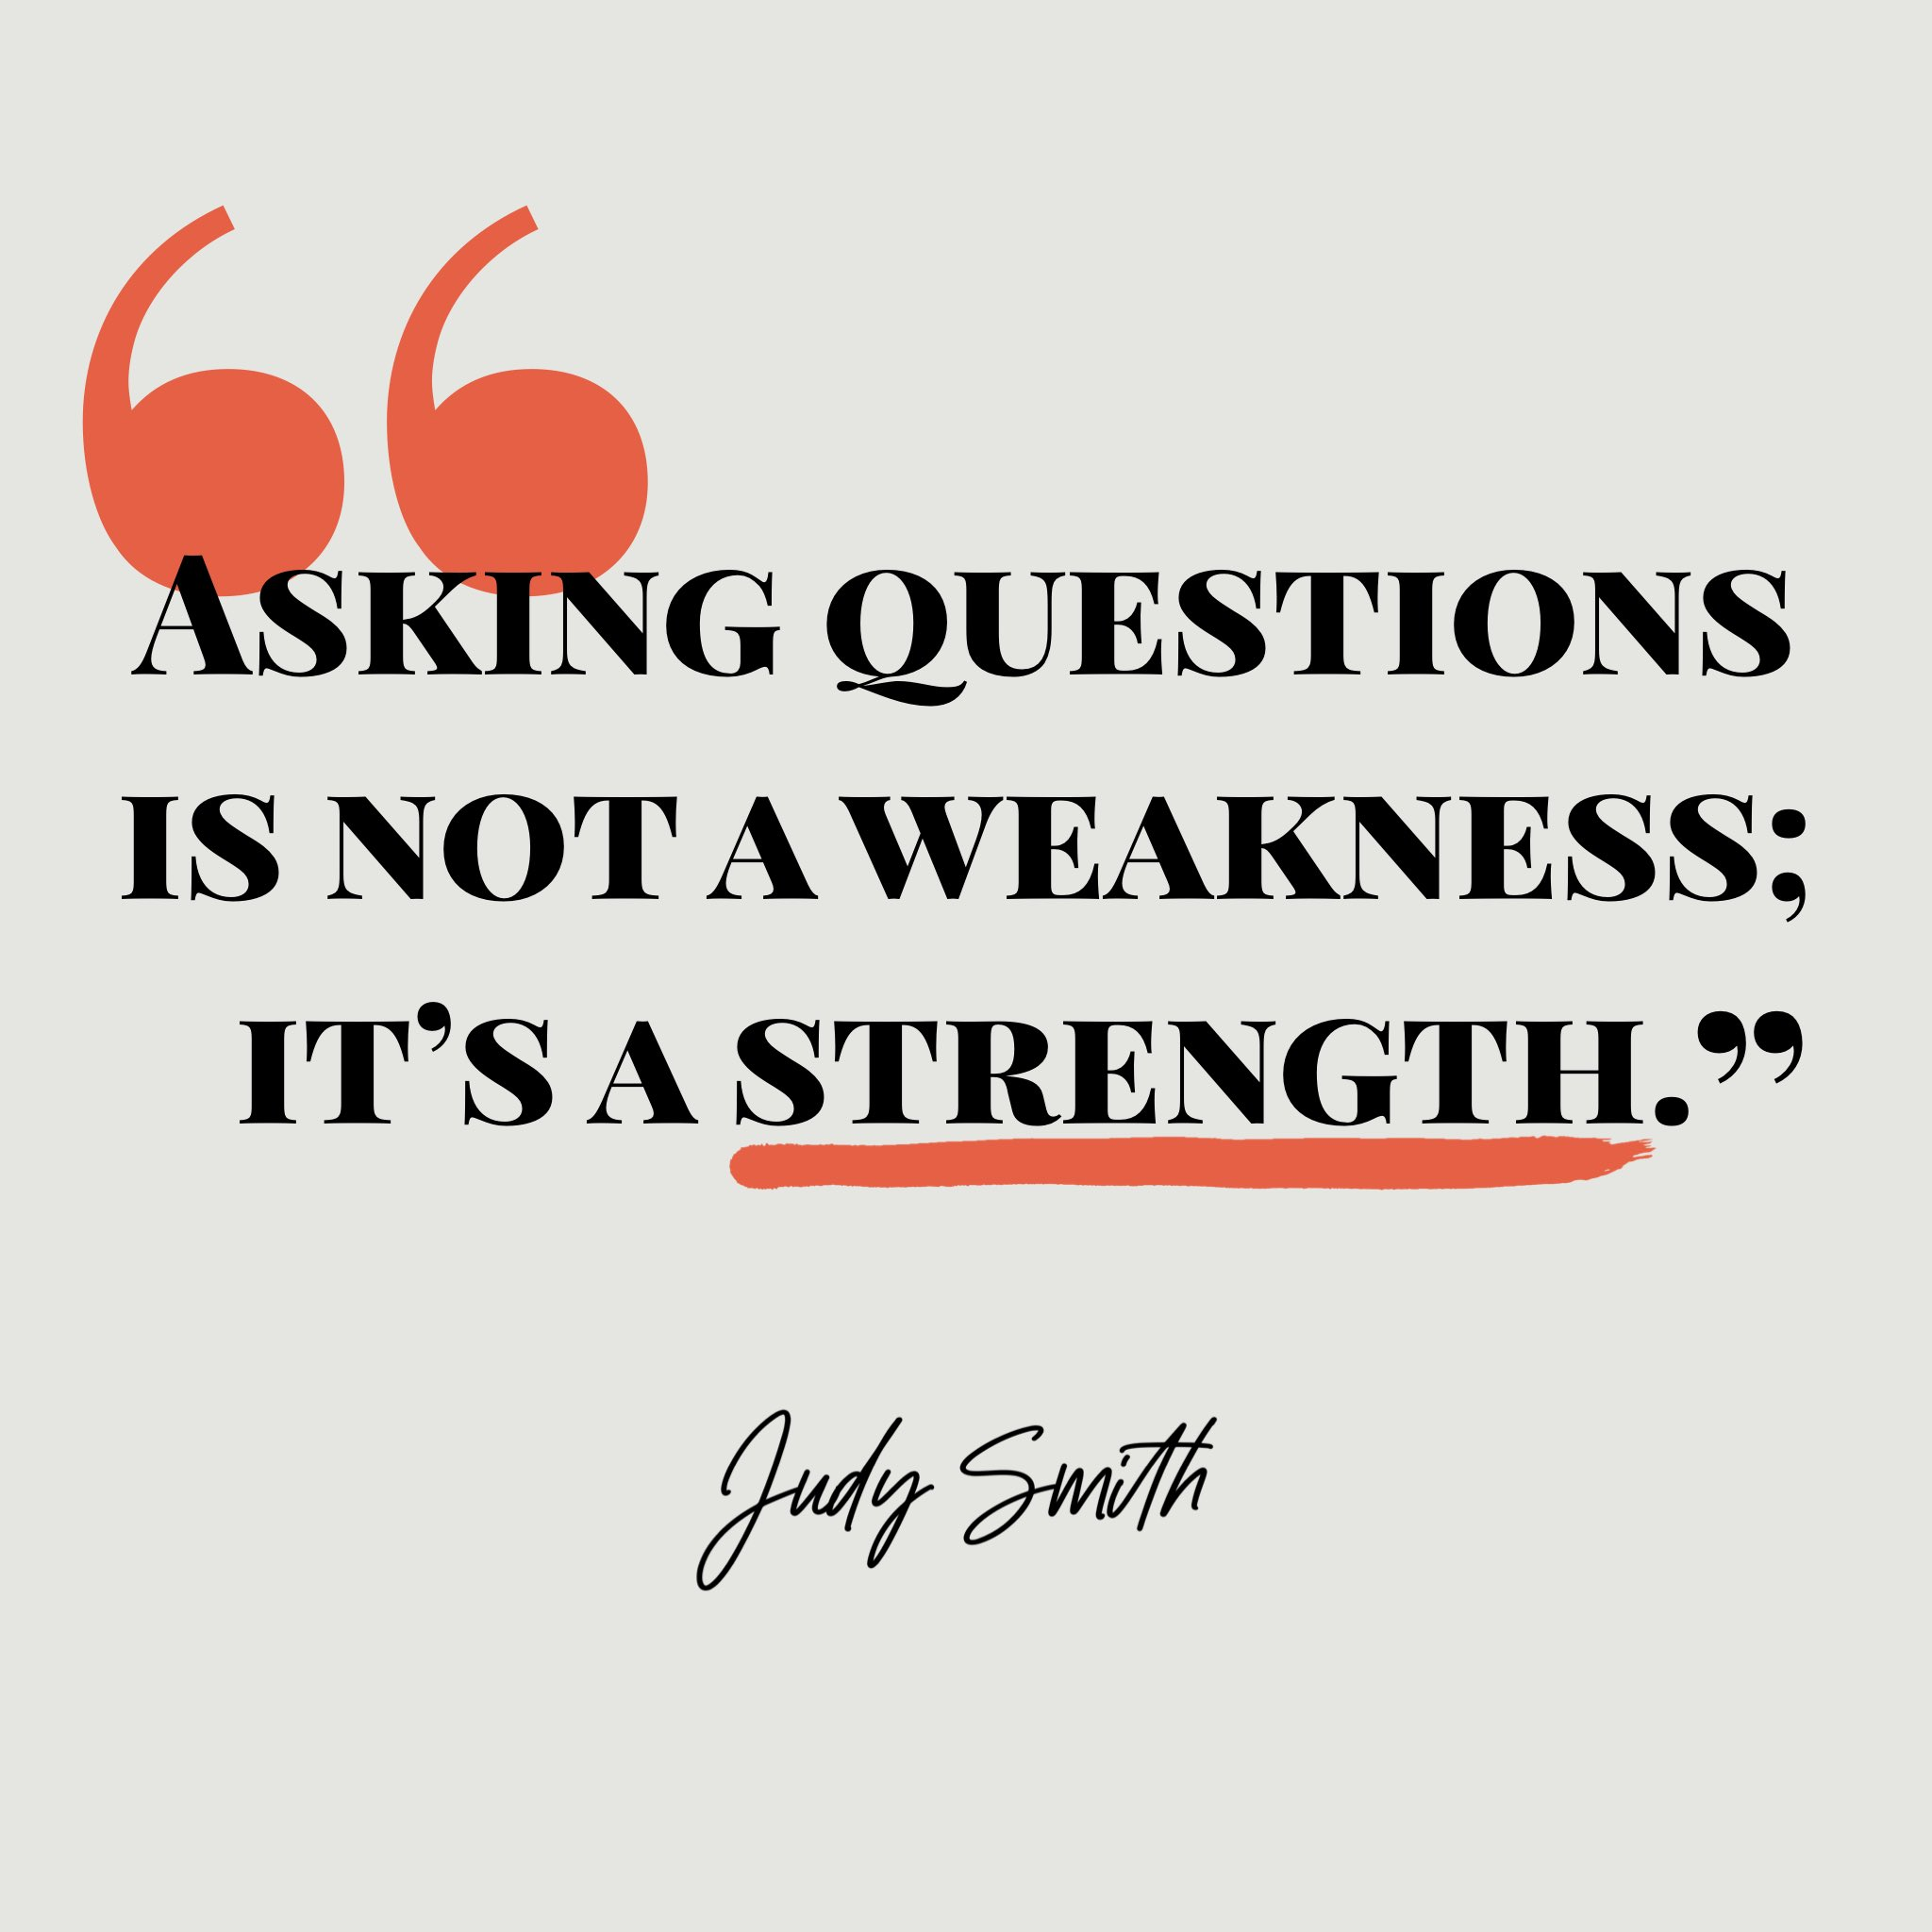
2. Learn by asking. ...
Don’t be afraid to ask questions. People feel respected and appreciated when others take a genuine interest in who they are .
7

Slide 8

3. Make local connections. ...
Organizations like advocacy groups, religious institutions, colleges and social clubs are a great place to learn more and make connections
8

Slide 9
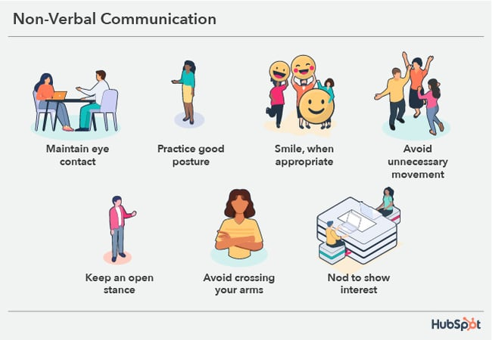
4. Pay attention to non-verbal behaviors. ...
Meaning behind body language can sometimes differ based on cultural norms. Pay attention to how your body language is being perceived by those around you.
9

Slide 10
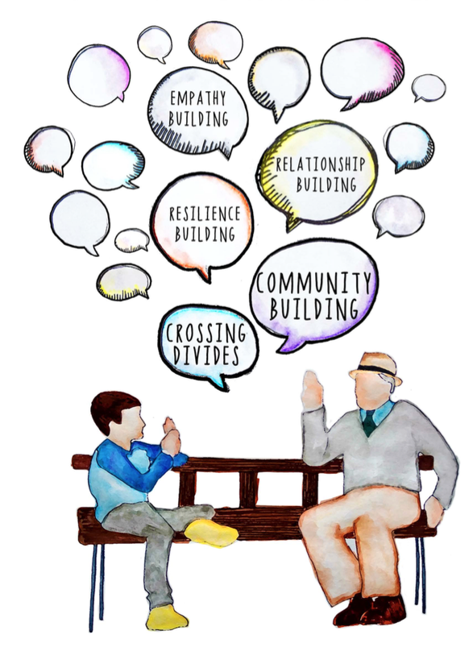
5. Exchange stories.
Storytelling is a great way to share experiences that go beyond culture. Initiate an open conversation by sharing a personal story or experience.
9

Slide 11
Summary :
Cultural awareness is a major element of cultural competence as defined by the National Center for Cultural Competence (NCCC). It is the first and foundational element because without it, it is virtually impossible to acquire the attitudes, skills, and knowledge that are essential to cultural competence.
11

Slide 12
References :
1- Kapil, R. (2019, July 23). Five ways to be more culturally aware. Mental Health First Aid. Retrieved November 1, 2022, from https://www.mentalhealthfirstaid.org/2019/07/five-ways-to-be-more-culturally-aware/
2- Curricula enhancement module series. NCCC. (n.d.). Retrieved November 1, 2022, from https://nccc.georgetown.edu/curricula/awareness/index.html
11

Slide 13
Thank you

