Slide 1


Tuberculosis in immunosuppressed patients
Presented by: Ahmed Hasan Alsahili.
Student number: 2805.
Year : 2Med.
Date : ( 16th/May/2022).
Course : P.T.S

Slide 2
Objective .
01
Define tuberculosis.
02
Risk of infection by Tuberculosis in an immunosuppressed patient.
03
Association between tuberculosis and HIV.
04
Treatment of tuberculosis in HIV patient.

Slide 3
Introduction
3

Slide 4
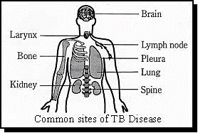
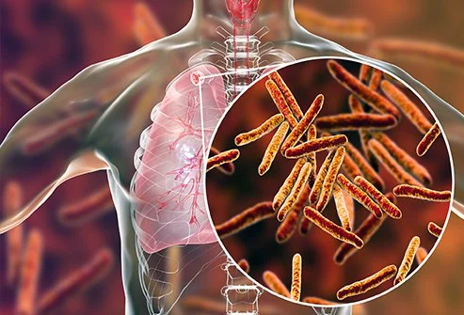
Tuberculosis definition
Tuberculosis is a communicable chronic granulomatous disease caused by Mycobacterium tuberculosis.
4

Slide 5

Risk of tuberculosis in immunosuppressed patient
Who are the immunosuppressed?
5

Slide 6
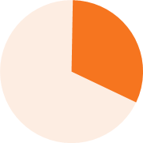





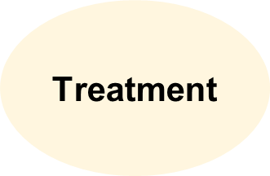
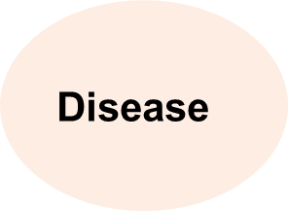
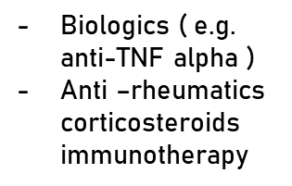
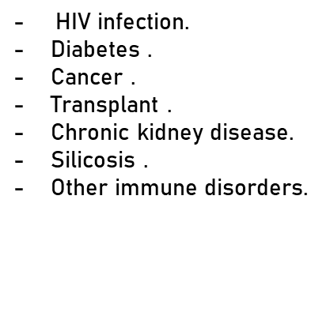
The immunosuppressed patient :
Of the patients all over the world are immunosuppressd
-Homeless
-Elderly
-Children
-Underweight
-Overweight
-High stress
levels.
-High alcohol
consumption.
-Smokers .
6

Slide 7
Tuberculosis in People With HIV
HIV serves as the most important risk factor for active TB.
TB is a leading cause of death for people with HIV, around the world.
32%
Of HIV deaths occurred in patient with TB co- infection
7

Slide 8
Tuberculosis progression from latent to active TB
TB bacteria become active if the immune system can't stop them from growing .
The risk of progression increases with conditions that suppress the immune system.
8

Slide 9
The difference between latent TB and active TB
LATENT
ACTIVE
01
01
TB lives but doesn’t grow in the body .
Tb is active and grows in the body.
02
02
Makes a person feel sick and have symptoms.
Doesn’t make a person feel sick or have symptoms.
03
03
Can’t spread from person to person.
Can spread from person to person.
04
04
Cant advance to TB disease.
Can cause death if not treated.
9

Slide 10
Treatment of tuberculosis in HIV patient
1ST Regimen
4-months rifapentine-moxifloxacin TB treatment.
6- to 9-months RIPE TB treatment .
2nd Regimen
10

Slide 11
Conclusion
The risk of progression in immunosuppressed patients from LTB to active TB can be much higher than in healthy patients.
TB infection can increase the progression of comorbid conditions, such as HIV.
Treatment of TB can be complicated by drug interactions and cumulative toxicities.
11

Slide 12
References
Tuberculosis (TB) in the immunocompromised | T-SPOT.TB [Internet]. T-Spot International. 2022 [cited 20 January 2022]. Available from: https://www.tspot.com/uk/why-the-t-spot-tb-test/tb-in-the-immunosuppressed/
Kumar V, Abbas A, Aster J, Perkins J. Robbins basic pathology. Philadelphia: Elsevier; 2018.
Tuberculosis in People With HIV [Internet]. WebMD. 2022 [cited 3 April 2022]. Available from: https://www.webmd.com/hiv-aids/guide/aids-hiv-opportunistic-infections-tuberculosis.
Tuberculosis deaths among people living with HIV are declining globally, but worrying gaps in TB care persist [Internet]. Unaids.org. 2022 [cited 4 April 2022]. Available from: https://www.unaids.org/en/resources/presscentre/featurestories/2021/march/20210324_tuberculosis-deaths-people-living-with-hiv
12

Slide 13
Thank you

