Slide 1



Principles of Emotions Messages
Libyan International Medical University
Faculty of Business Administration
Name: Roua El.frgani
ID: 3169
Roui_3169@limu.edu.ly

Slide 2

TABLE OF CONTENTS
01
02
Introduction
Principles of emotions
03
04
Conclusion
References
2

Slide 3


Objectives!
Understand the Principles of emotions.
3

Slide 4
Introduction
Emotions are reactions to person, obgect or event and expressed in a varitry ways such as frar, love, hate, happiness, sadness, surprise.
4

Slide 5
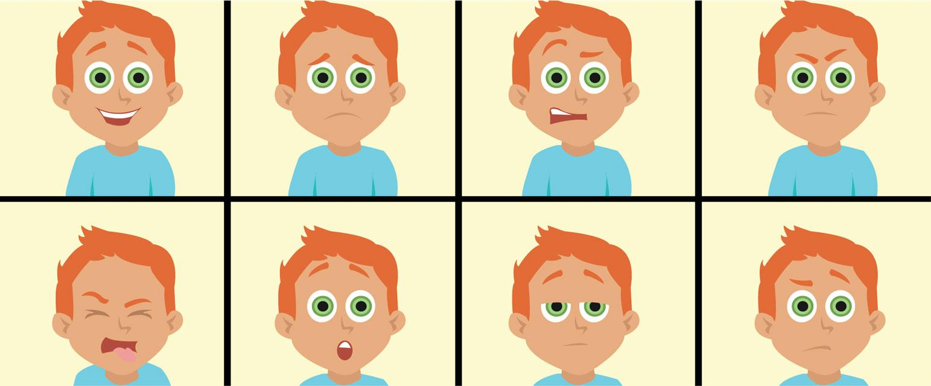
5

Slide 6

Principles of emotions
6

Slide 7
Emotions May Be Primary or Secondary
How would you feel in each of the following situations?
You would feel very differently in each of these situations, in fact, each feeling is unique and unrepeatable.
• You got the job you applied for.
• Your parents tell you they are getting divorced.
Primary emotion is your very first reaction to a situation.
Secondary emotion is an emotional response to a primary emotion, which emotion about what you feel.
7

Slide 8

Emotions involve Both Body and Mind
Body: the reactions from your body.
Because we can easily perceive them, they are the most visible part of our emotional experience, for example, the blush of embarrassment, the sweating palms that accompany nervousness, and the gestures (such as playing with your hair or touching your face).
8

Slide 9
Mind: involves the evaluations and interpretations you make on the basis of what you experience.
which is your evaluations of what happens have a greater influence on your feelings than what actually happens, for instant, your friend ignore you in the college, you may feel pity by thinking that depressed because his family issue, in other way, you may feel anger if you think he is rude and ignore you on purpose.
9

Slide 10
Factors Affect on Emotions
The emotions you feel at any one time and the ways in which you interpret the emotions of others are influenced by a variety of factors.
Some factors:
Culture: constrains how emotions are felt and expressed in a given cultural context.
Gender: at the most women show stronger emotional expressivity, whereas men have stronger emotional experiences with angry and positive stimuli.
Personality : Your personality influences the emotions you feel, the extent to which you feel them, the ways in which you express or conceal these emotions.
10

Slide 11
Emotions Expression Uses Multiple Channel
Channels have specific impact in communicate your emotions.
In a face-to-face situation, we show emotions not just with words, but also with our facial expressions, body posture and gestures, eye movements, touching, and even the distance we keep from others.
In text-based messages, you would not be able to express by this channels.
There are two major substitutes:
Use words that describe the nonverbal that you would normally express. (describe you feeling).
The emoticon or the Japanese emoji .
11

Slide 12

Conclusion
As we are dealing with people in every day you have to be more responsible about your emotions especially in business work situations.
12

Slide 13
RESOURCES
DeVito, J.A,(2015). The Interpersonal communication Book, Global Edition. Pearson Education.
Primary and secondary emotions. The Emotion Compass. (2018, August 18). Retrieved November 30, 2021, from https://emotioncompass.org/information/primary-secondary-emotions/.
.
13

Slide 14
THANKS
Do you have any questions?

