Slide 1
ARTERIAL DISEASE
LIBYAN INTERNETIONAL MEDICAL
UNIVERSITY
DEPARTMENT OF SURGERY
DR.MAREI JAHANY

Slide 2
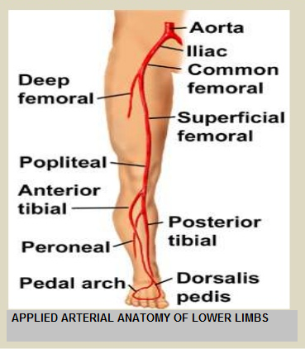
APPLIED ANATOMY

Slide 3
ACUTE LIMB ISCHEMIA
: DEFINITION
It is a sudden decrease in the limb perfussion that threatens limb viability & requires urgent management.
CAUSES:
A- EMBOLUS:
*COMMOM AT THE POINTS OF ARTERIAL BRANCHING (BIFURCATIONS(
COMMOM SOURCES ARE - :
-1 HEART: As in auricular thrombus in A.F ; M.I and valvular heart disease.
- 2 Proximal atherosclerotic plaque.
- 3Proximal aneurysm .

Slide 4
B-THROMBOSIS: *Usually occurs in area of arteriosclerotic narrowing ( atherosclerotic occlusive disease) with Hx of claudication prior to acute event. *Thrombosis in a relatively normal vessels can be in a patient with hypercoagulability status as in ; Malignancy , protein C &S deficiency and in polycythemia. C- TRAUMA : *Penetrating as in stab wounds ; following limb fractures (popliteal A. damage following supracondylar fracture of the femur ) . *Blunt trauma . *Iatrogenic trauma ( interventional vascular procedures) ; as in arterial catheterization.

Slide 5
CLINICAL DIFFRENTIATION BETWEEN EMBOLIS AND THROMBOSIS
EMBOLISM
* Obvious cardiac source.
* No Hx of claudication.
*Normal pulses in contra lateral limb.
* Few collaterals.
*Angiogram shows minimal atherosclerosis.
THROMBOSIS
* No obvious cardiac source.
* Hx of claudication.
*Abnormal pulses in the contra lateral limb.
* Well developed collaterals.
* Angiogram shows diffuse atherosclerosis.

Slide 6
SYMPTOMS AND SIGNS . ( 6 Ps )
1- Pain: according to the site of obstruction.
2- Pallor: at early stage, then later changes to cyanosis , then mottling which will be fixed at later stage ( sign of irreversibility)
3-Pulselesness .
4-Perishing Cold ( POIKILOTHERMIA) .
5-Paraesthesia .
6- Paralysis : these neurological manifestations are the most reliable symptoms & indicates extreme emergency.
*the 1st 8 hours from the start of the acute event are the GOLDEN HOURES .

Slide 7
MANAGEMENT OF ACUTE LIMB ISCHEMIA
* Symptoms and Signs .
* Establish the exact time of the onset of the symptoms.
* Hx of previous ischemic heart disease , valvular heart disease , intermittent claudications or previous vascular surgery.
*Investigations:
FBC, RFT, BI. GLUCOSE, CROSS MATCHING,CLOTTING SCREEN, ECG & ? URGENT ANGIOGRAPHY.
* Treatment:
- Good analgesia .
- anticoagulation with Heparin.
- If Embolism was suspected in a previously normal arterial tree, EMBOLICTOMY using Fogerty's Catheter should be undertaken.
( Angiography will delay the Mx and the limb will be threatened .)

Slide 8
- If Thrombosis was suspected ( on table Angiography is appropriate ). >In acute Thrombosis : on table angiography with THROMBECTOMY is appropriate. > In acute on chronic Thrombosis, in absence neurological symptoms: Intra-arterial Thrombolytic therapy may appropriate ( STREPTOKINASE & UROKINASE) . >Both procedures should be followed by Angioplasty or Bypass grafting . - Following Revascularization , FASCIOTOMY is appropriate to prevent COMPATMENT SYNDROM.( release of the free radicals with Myoglobine and other toxic substances will cause acute renal failure & will be the leading cause of death.)

Slide 9
prognosis
Ideally surgery should undertaken within 8 hours from onset of
symptoms if a good results to be obtained.
Delay in treatment will increase the incidence of Amputations and Mortality.

Slide 10
CHRONIC LIMB ISCHEMIA
• Definition:
decrease in limb perfusion that causes a potential threat to limb viability in patients who present > 2weeks.
• most often seen when two or more levels of the arterial tree .
• Theinternational practice guidelines suggested the following distribution of outcomes at one year in these patients:
• Alive with two limbs – 50%
• Amputation – 25%
• Cardiovascular mortality – 25%

Slide 11
Chronic Arterial Insufficiency
.• Asymptomatic to gangrenous tissue loss
• Intermittent claudication; most common presentation .
Features of chronic lower limb arterial stenosis or occlusion:
• Intermittent claudication .
• Rest pain.
• Dependent rubor.
• Ulceration.
• Gangrene.
• Arterial pulsation diminished or absent.
• Arterial bruit.
• Slow capillary refilling.

Slide 12
Intermittent claudication
Cramp-like pain felt in the muscles that is:
- Brought on by walking.
- Not present on taking the first step (unlike osteoarthritis).
- Relieved by standing still (unlike nerve compression from a lumbar inter vertebral disc prolapse or osteoarthritis of the spine or spinal .stenosis)

Slide 13
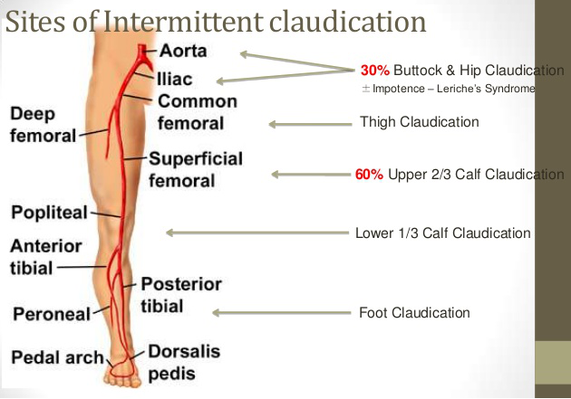

Slide 14
Critical limb Ischemia (CLI)
• Most severe form of PVD
• Can have acute or chronic presentation
• Chronic CLI is defined as >2 weeks of rest pain, ulcer or tissue loss and characterized by:
**Ankle–brachial index ≤ 0.4
**Ankle systolic pressure ≤ 50 mmHg
**Toe systolic pressure ≤ 30 mmHg

Slide 15
Work up
. Lab tests *
*Physiological tests like ankle brachial index.
-: Imaging*
.**Doppler ultrasonography
.**Duplex ultrasonography
.**Angiography
**CT angiography
.**MR angiography

Slide 16
. Lab Tests in PVD
• CBC: secondary polycythemia in smoker or elevated platelet in thrombotic disease.
• Renal function test: elevated in DM,HTN. No contrast study if deranged • Lipid profile: hyperlipidemia.
• FBS and HbA1c .
• ECG.
• ESR: elevated in collagen vascular disease .
• CRP: marker of worsening PVD.
• Hypercoagulable state and Homocysteine: prothrombin time, partial thromboplastin time, thrombin time, lupus anticoagulant, anti-cardiolipin antibody, activated protein C resistance, factor V Leiden.

Slide 17
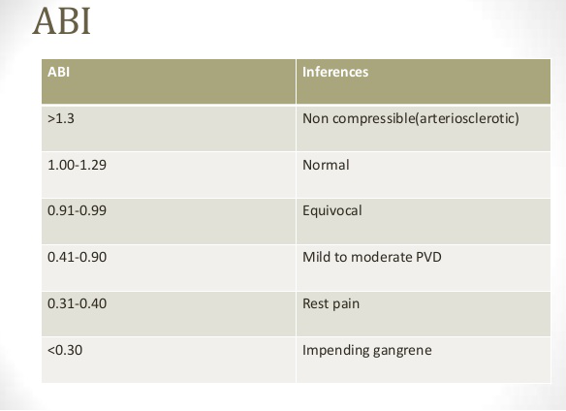
Ankle Brachial Index (ABI)

Slide 18
-: Imaging
DOPPLER ULTRASONOGRAPHY
Detection of blood velocity using ultrasonography .
Duplex Ultrasonography
• Non invasive, cheap has largely replaced routine use of conventional arteriography.
• B mode imaging information about vessel wall and peak systolic velocity
( PSV. )

Slide 19
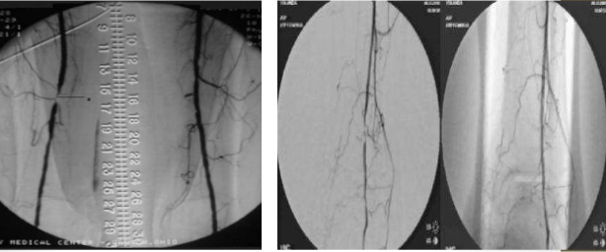
Angiography • Used to be gold standard test for road mapping before surgery • Safer in recent years due to fine 3-4 F catheters • Hematoma, arterial spasm, sub intimal dissection, infection, pseudoaneurysm, AV fistula and embolization • Slowly being replaced by CTA and MRA.

Slide 20
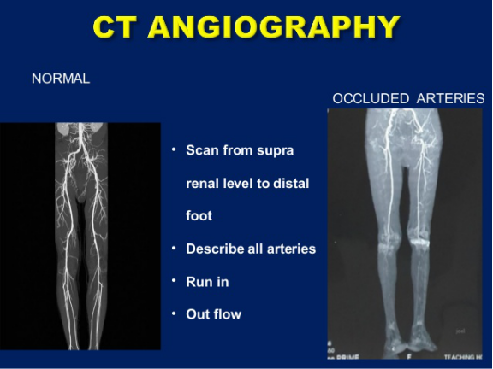

Slide 21
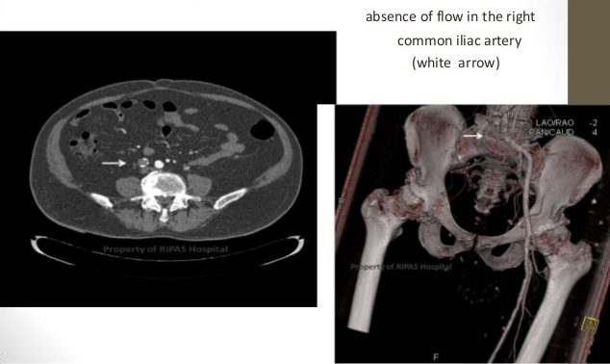
CT Angiography
.• Non invasive
• Still uses ionizing radiation and iodinated contrast agent .

Slide 22
MR Angiography
. • Shift of imaging modality due to Gd-MRI
• Better for distal small and pedal vessels as compared to angiography .
• Sensitivity 81% and specificity 92%.
• Gd worsens CKD patients and precipitates nephrogenic systemic fibrosis.

Slide 23
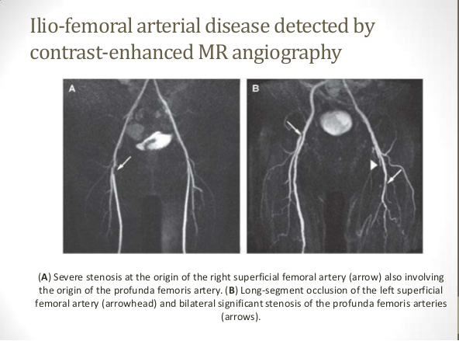

Slide 24
Treatment of Chronic arterial insufficiency
. **Risk factor modification
. **Exercise therapy
. Drugs; Pentoxifyline, Cilostazole, **Naftidrofuryl
. **Intermittent pneumatic compression
. **Revascularization by Open surgery or endovascularization

Slide 25
A. Risk factor modification
1. Smoking: cessation.
2. Diabetes: each 1% rise in HbA1c associated with 28% risk for PVD. <7% treatment goal .
3. Hypertension goal bp <140/90 and <130/80 if DM and renal insufficiency ACE inhibitors.
4. Hyperlipidemia: diet modification Statins, niacin or fibrates.
5. Antiplatelet therapy Aspirin 75-325 mg/day or clopidrogel 75mg/day or both.

Slide 26
B. Exercise therapy
• Aids in improvement in pain free ambulation, working performance and cardiac status • Minimum 30-45 min/session, 3-4 times/week, for at least 12 weeks.
C. Drugs:
** Pentoxifylline :
• Xanthine derivative
• Rheolytic effects on RBC wall deformability and flexibility thus reducing viscosity and improving oxygen delivery, decreases platelet aggregation
• Dose; 400 mg TDS (max 1800mg/day)

Slide 27
Cilostazol :
- Phosphodiesterase III inhibitors increases c AMP, Inhibits smooth muscle cell proliferation and contraction, Inhibits platelet aggregation.
- Decreases TG and increases HDL.
Dose; 50mg/day X 1 wk then 50 mg BD X 1 week then 100mg BD. .

Slide 28
D-Intermittent pneumatic compression
Inflated for 2-3 seconds, rate 3 cycle/minute.
E. Revascularization
Failed medical therapy.
Severe claudication .
If a proximal stenotic lesion is present .
Revascularization by open surgery or endovascular technique.

Slide 29
Angioplasty Vs Bypass surgery
The general guidelines for PAD recommend the following:
•For patients with an estimated life expectancy < 2 years or those who do not have autogenous vein available as a conduit, balloon angioplasty is reasonable as the initial procedure .
•For patients with an estimated life expectancy of ≥ 2 years, and who have available autogenous vein conduit, a bypass surgery is reasonable to perform as the initial treatment .

Slide 30
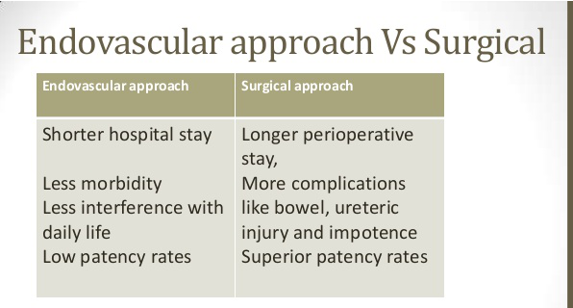

Slide 31
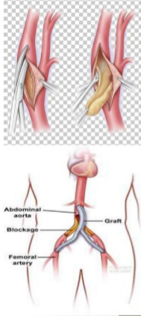
Surgical repair option for aorto-iliac disease
Endarterectomy
• Opening of diseased segment and removing plaque
B. Aorto Bifemoral Bypass (ABFB) • Using PTFE grafts or Dacron grafts ,iliac, distal aortic segment and proximal femoral segment can be bypassed by placing graft between infrarenal aorta and B/L femoral
• End to end anastomosis better
• Patency are 90% at 5 yrs and 75-85% at 10 yrs

Slide 32
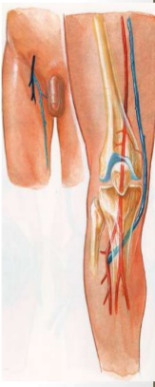
Surgical repair options for infra-inguinal disease
• Autogenous grafts as great saphenous vein preferred .
• Others: short saphenous vein, cephalic or basilic vein.
• Very low success rate in below knee bypass if synthetic grafts (PTFE or Daccron) used.

Slide 33
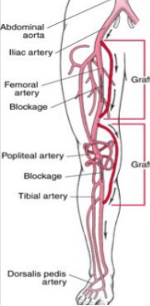

Slide 34
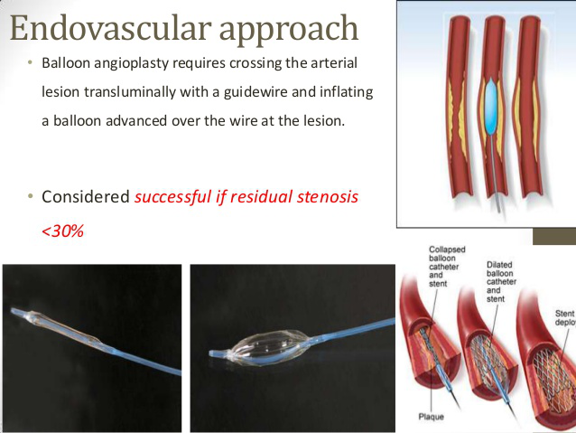

Slide 35
THROMBOLYTIC THERAPY
Catheter-based intra-arterial thrombolytic therapy is an alternative to surgery or percutaneous intervention in the management of acute thrombosis superimposed on chronic stenosis or occlusion in patients with critical limb ischemia.

Slide 36
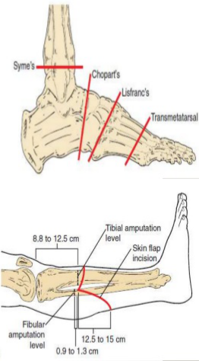
Amputation
Recommended in :
**Severe symptoms not amenable to
or failed revascularization.
**Gangrenous tissue/ nonfunctional
**Life threatening infection.
• 25% patient of CLI require
amputation/yr and 25% die
within 1 yr due to
. cardiovascular involvement

Slide 37
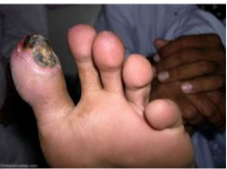
OTHER VASCULAR DISEASES
Thromboangiitis Obliterans ( Buerger’s Disease )
This affect s small vessels of the extremities.
It occurs almost exclusively in young males who are heavy cigarette smokers.
It may be associated with migratory
thrombophlebitis.
Symptoms and Signs:
Claudication in the muscles of the foot.
Digital pain, cyanosis,coldness progressing to necrosis and gangrene.
Ankle and wrist pulses disappear first and the proximal pulses remain normal. Progressive digital ischaemia occurs with eventual loss of feet and hands. .

Slide 38
Investigations:
Arteriography reveals discrete foci of occlusions alternating with apparently uninvolved arterial segments in the distal circulation. Collateral vessels are classically described as ‘corkscrew’
Treatment :
It is essential to stop smoking to avoid progression of the disease.
Sympathectomy is only of temporary benefit – if the patient continues smoking, amputation is necessary for rest pain or gangrene.
Reconstructive surgery is rarely possible because the disease involves the small distal vessels.
Repeated prostacyclin infusions(iloprost) may be beneficial .

Slide 39
Raynaud’s Phenomenon
This is a vasospastic condition of diverse aetiology.
The following conditions have been implicated :
• Systemic diseases or conditions, e.g. collagen diseases (scleroderma),cryoglobulinaemia, myxoedema, macroglobulinaemia
• Compression syndromes, e.g. carpal tunnel syndrome, cervical rib, thoracic outlet syndrome.
• Occupational trauma, e.g. hand–arm vibration syndrome, previously called
vibration- induced white finger (pneumatic drill, chainsaw, grinders), piano
playing, typing, cricket.

Slide 40
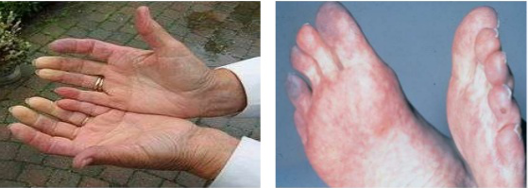
Symptoms and Signs :
Sequential changes of pallor, cyanosis and rubor, particularly
after exposure to cold. This represents vasoconstriction followed by reflex vasodilatation .
In severe long-standing cases tissue necrosis may occur involving nonhealing ulcers and gangrene of the extremities. Tissue necrosis always denotes underlying pathology, i.e. the patient has secondary Raynaud’s as opposed to primary Raynaud’s disease .

Slide 41
Investigations .
• FBC.
• Platelets.
• ESR .
• CXR (cervical rib).
• Cold agglutinins .
• Serum protein electrophoresis.
• Autoantibody screen .
• Rheumatoid factor .
• LE cells .
• Arteriography .

Slide 42
Treatment :
• Treatment of underlying disorder, e.g. excise cervical rib.
• Avoidance of cold exposure – heated gloves and boots.
• Stop smoking.
• Advice from Raynaud’s & Scleroderma Association .
• Drugs, e.g. calcium channel blockers(nifedipine) , i.v. prostaglandins(iloprost) .
• Plasmapheresis.
• Sympathectomy (relatively ineffective).
• Very rarely amputation may be required .

Slide 43
DIABETIC FOOT (DF)
DEFINITION :
A wide spectrum of clinical conditions affecting the foot of diabetic
pt. ,which ranges from simple infection and cellulites to gangrene and sepsis.
PATHOPHYSIOLOGY :
There are 3 distinct processes involved in the etiology of what's called D.F.
1- ISCHEMIA : in the form of :–
* Microangiopathy : thickening of the basement membrane of the smaller vessels and affecting the arterioles and capillaries ( mostly responsible for the renal, ophthalmic and the neural complications of the diabetes) .
* Macroangiopathy: atherosclerosis affecting the large vessels.

Slide 44
2-NEUROPATHY :
- Sensory ; lack of the protective sensation leading to repeated trauma which is the usual cause of ulcerations.
-Motor ; changing in the foot anatomy leading to appearance of pressure points
-Autonomic ; lack of sweating leading to dry and cracked foot.
3-SEPSIS :
Glucose rich media that favors , bacterial overgrowth , decrease immune defense and poor wound healing.

Slide 45
CLINICAL FEATURES:
D.F usually presents mainly with neuropathic or
a combination of neuropathic and ischemic features .
Neuropathic D.F :
presented with sensory disturbance ,atrophic skin lesions , planter ulcerations and degenerative arthropathy .
Neuropathic ulcer are deep , painless ulcers mainly situated on the planter aspect of the foot and big toe.
pedal pulses usually presents .
There is obvious sensory deficit in the foot .
Worm foot as a manifestation of autonomic neuropathy.

Slide 46
Ischemic D.F :
* Presents with rest pain and usually there is Hx of intermittent claudications .
* Ischemic ulcers are painful ulcers over the toes or the pressure areas
( medial aspects of the 1st and 5th metatarsal bones ) .
* Foot may be cold .
* Reduced or abscent pulses .
* Foot may be cold .

Slide 47
** Both neuropathic and Ischemic D .F may be complicated by sepsis , started as cellulites , deep tissue abscess , osteomylitis and if unchecked gangrene will develop .
** Sepsis may start as a fungal infection in between the toes wit 2ry bacterial infection ( the usual organisms are staph., strepto., colonic organisms, anaerobic bacteria and gas gangrene may usually occurs)

Slide 48
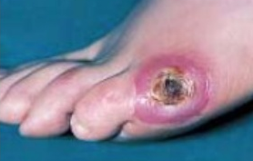
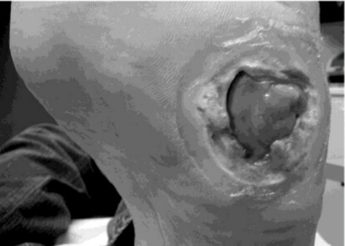
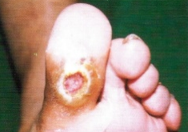
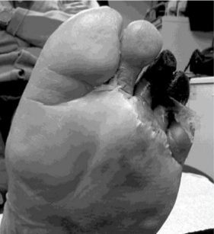
COMPARE NEUROPATHIC AND ISCHEMIC ULCERS
Neuropathic D.F
Ischemic D.F

Slide 49
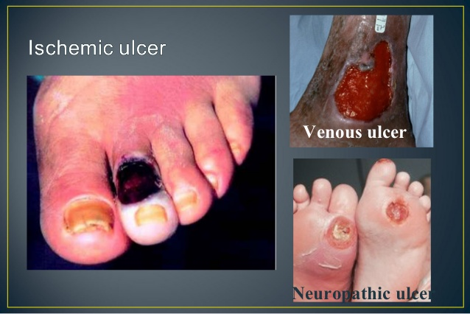

Slide 50
MANAGEMENT ( Mx ) OF D.F
INVESTIGATIONS:
Non-invasive vascular test :
Ankle brachial ( A / B )index :
* normally is 1 , if < 0.5ulcer will not heal .
* may be falsely elevated due to medial calcification .
Segmental pressure .
Digital pressure .
X- Ray foot : ? Osteomylitis .
Arteriography : indicates when non- invasive tests indicates inadequate perfusion,So the entire vascular tree from the aorta to the dorsalis vessels should be demonstrated .

Slide 51
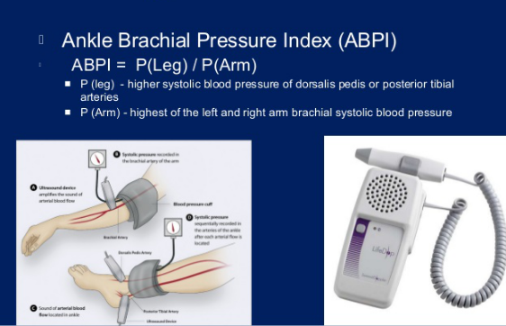
ANKLE BRACHIAL INDEX

Slide 52
ANKLE BRACHIAL INDEX
A B I Value
Indicates
1
< 0.9
0.8 - 0.9
0.5 - 0.8
< 0.5
< 0.25
The ABI has a limited use in
are not compressible as in
MORMAL
ABNORMAL
MILD PAD .
MODERATE PAD.
SEVER PAD, ulcer will not heal with the local treat.
VERY SEVER PAD.
evaluating calcified vessels that
diabetes ( gives reading > 1)

Slide 53
TREAMENT :
** Should be undertaken jointly by surgeon and physician as D.F may precipitate D.K.A.
** The presence of a palpable pedal pulses in a worm, pink foot , is a good indicator of adequate perfusion and the ulcer in this situation will heal with local treatment .

Slide 54
NEUROPATHIC FOOT :-
* Control D.M .
* Stop smoking.
* Loss weight : to decrease the pressure on the foot.
* Control infection with antibiotics against both aerobe and an aerobe , antiseptic and dressing may be required for ulcers .
* ?? minor amputations with removal of the dead tissues until healthy bleeding tissue is obtained .
*These measures will usually result in healing .

Slide 55
ISCHEMIC FOOT : -
* If non- invasive measures indicates adequate blood supply ,
So treat as for neuropathic ulcer , i.e. , formal assessment of the vascular tree by angiography and the construction of the blood supply to the foot( either by Bypass surgery OR Angioplasty ) has to be achieved before local measures will work .

Slide 56
PREVENTION:
* The old adage that preventing is better than cure is better illustrated in the Mx of D.F than else where in the medicine.
*Advices as foot care for diabetic pt. : -
DO :
* Carefully wash and dry feet daily .
* Inspect feet for injury daily .
* Take meticulous care of the toenail .
* Aplly antifungal powder to the foof daily .
Do not :
*Walk bare foor .
*Wear ill-fitted shoes.
*Use a hotwaterbottles.
*Ignore any foot injury .

Slide 57
AORTIC ANEURYSMS
DEFINITION : abnormal permanent localized dilatation of an artery ( 1.5 times or more of its normal diameter ), it is either :
True aneurysm :- contain all the layers of the vessel wall and appear to be sacular or fusiform in shape.
False (Pseudo) aneurysm: - is a pulsating hematoma situated in between the vessel wall layers & it is contained by a fibrous capsule .
*** Abdominal Aortic Aneurysm ( A.A.A ) is the commonest form of aortic aneurysm & it is most commonly infra-renal in position and it is fusiform in shape.

Slide 58
ETIOLOGY :
It is multi-factorial and there is increased risk of A.A.A in smokers and atherosclersis .
Thoracic aneurysms tend to be sacular and commonly caused by Syphilis.
Mycotic aneurysms are caused by bacterial aortitis.
Pseudo or false aneurysm develops after penetrating trauma and it is an expanding pulsating hematoma.

Slide 59
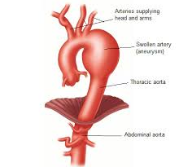
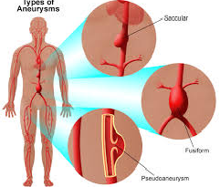
SITES OF AORTIC ANEURYSMS

Slide 60
SYMPTOMS AND SIGNS OF A.A.A:
Asymptomatic :
vast majority ( about 75% ) are a symptomatic and discovered by a routine USS axam. for other reasons.
There may be an expansile epigastric pulsatile mass on exam.
Symptomatic :
Symptoms often results from pressure on the adjucent structures ( Backache by pressure on the adjucent lumber vertebral bodies or abd. pain from pressure on the abd. organs) .
Examination may reveals expansile abd. mass just above the umbilicus.
Complications:
* sever back pain due to erosion of the lumber vertebral bodies.
* eroding to I.V.C ( A.V fistula)
* distal embolus.
* thrombosis with distal ischemia .
* rupture A.A.A which is fatal .

Slide 61
SYMPTOMS AND SIGNS OF A.A.A:
Asymptomatic :
vast majority ( about 75% ) are a symptomatic and discovered by a routine USS axam. for other reasons.
There may be an expansile epigastric pulsatile mass on exam.
Symptomatic :
Symptoms often results from pressure on the adjacent structures (Backache by pressure on the adjacent lumber vertebral bodies or abd. pain from pressure on the abd. organs) .
Examination may reveals expansile abd. mass just above the umbilicus.

Slide 62
Complications:
* sever back pain due to erosion of the lumber vertebral bodies.
* eroding to I.V.C ( A.V fistula)
* distal embolus.
* thrombosis with distal ischemia .
* rupture A.A.A which is fatal .

Slide 63
MANAGEMENT OF A.A.A :
Invx. :-
USS to assess the maximum diameter of the aneurysm and itis relation to the renal arteries.
X- Ray may shows calcifications.
CT with or without contrast provides more informations than USS .
Angiography is not a routine for A.A.A .

Slide 64
Treatment :-
Asymptomatic A.A.A < 5 cm in diameter may be treated conservatively especially if the patient of poor operative risk , with routine follow up with yearly USS .
A.A.A > 5 cm in diameter should be repaired electively as they have a higher risk for rupture .
Surgical repair with inlay of synthetic graft is the standard method of repair .
Endovascular repair with a graft or stent devices is indicated in selected cases .

Slide 65
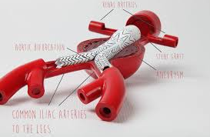
INLAY SYNTHETIC GRAFT FOR INFRARENAL A.A.A

Slide 66
RUPTURED AORTIC ANEURYSM
**Sudden rupture of aneurysm due to rapid increase in the size
( > 7 cm ).
**It is may be retroperitoneal with a flank pain and expanding hematoma or may be intra peritoneal which is characterized by a sudden sever abd. pain , collapse and rapid death .
**It requires immediate surgical repair .
**The overall peri operative mortality is 85% . .

Slide 67

THANK YOU

