Slide 1


NAME:ABDALLAH ELZWAWI ID:2826 EMAIL:Abdullah_2826@limu.edu,ly
Libyan International
Medical University
Faculty of
Business Administration
the nature of
Interpersonal communication

Slide 2
Contents
Introduction.
Elements Of Interpersonal
Communication.
Example.
Conclusion.
References.

Slide 3

Introduction
Interpersonal communication is the method of trade of information, thoughts and sentiments between two or more individuals through verbal or non-verbal methods.

Slide 4
Elements Of Interpersonal Communication
The Communicators
The Message
Noise
Feedback
Context
Channel

Slide 5

The Communicators
The sender
The sender is the individual who initiates a message and is also called the source of communication.
The receiver
is the listener, reader, or observer, that is, the individual to whom a message is directed.

Slide 6

The message
The message
A message is defined as information conveyed by words, The sender conveys the message to a receiver.

Slide 7

Noise
Noise
Noise refers to anything that interferes with the communication process between a speaker and an audience.

Slide 8
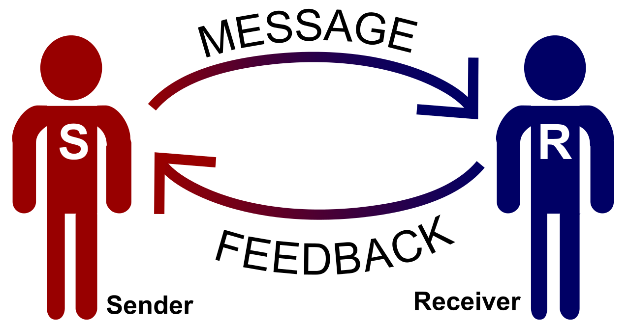
Feedback
Feedback
feedback refers to a response from the receiver which gives the communicator an idea of how the message is being received.

Slide 9
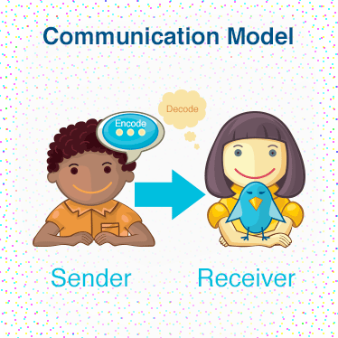
context
Context
Context refers to the setting in which communication takes place. The context helps establish meaning and can influence what is said and how it is said.

Slide 10

Channel
Channel
A communication channel is the medium, it's the method through which a message is sent to its intended receiver.

Slide 11
Conclusion
Interpersonal communication is both a useful tool and a joy in itself. Communication with another person and sharing thoughts and feelings with them can give us plenty of positive feelings and can also help to relieve our troubles and worries. In addition, interpersonal communication is also very useful for holding society together.

Slide 12
References
https://www.skillsyouneed.com/ips/interpersonal-communication.html
https://www.thoughtco.com/feedback-communication-term-1690789
https://courses.lumenlearning.com/wm-principlesofmanagement/chapter/channels-of-business-communication/
https://humancommkj.weebly.com/context.html
https://www.thoughtco.com/receiver-communication-1691899
https://www.thoughtco.com/noise-communication-term-1691349
https://www.thoughtco.com/sender-communication-1691943

Slide 13
THANK YOU!
Abdallah Zwawi

