Slide 1


Covid-19 in schools
Presented by:
Student name: Farah Mohammed
Role no : 3608
Year: one
Date: 4/6/2022
Supervisor: DR Fatma Eltarhoni

Slide 2
Objectve:
Definition of covid-19
Role of children in transmission
The risk of covid-19 between children and adult
the incubation period children
The risk of covid-19 in staff member health in school

Slide 3
Definition of covid-19
Corona viruses are a family of viruses that can cause diseases such as the common cold and acute respiratory infection
In 2019 a new type of corona virus was that caused an outbreak of a disease that originated in China
And its most common symptoms:
Fever
Cough
Fatigue
Loss of sense of taste or smell

Slide 4

Role of students in the transmission of covid-19
This breed of covid within educational settings maybe limited
Highschool students must be very carful because the symptoms of disease maybe mild to moderate for them but they are strongly able transmit the infection.

Slide 5
Your The risk of covid_19 between children and adult
So far date suggests that children under the age of 18 years represent about 8.5% of reported cases with relatively few deaths compared to other age groups and usually mild disease

Slide 6


the incubation period children
The incubation period for children is the same as in adults
The time between exposure to Covid-19 and when symptoms start is commonly around 6 to 5 days and ranges from 1 to 14 days

Slide 7
The risk of covid-19 in staff member health in school
Adults 60 years and older and people with underlying health conditions are at greater risk of contracting and dying from the corona virus
The decision to return to a teaching environment depends on the individual and should include consideration of local disease trend

Slide 8
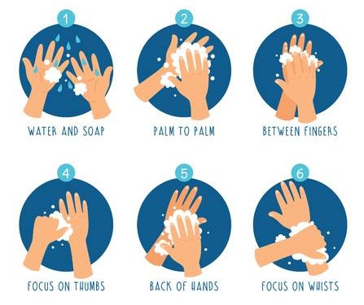
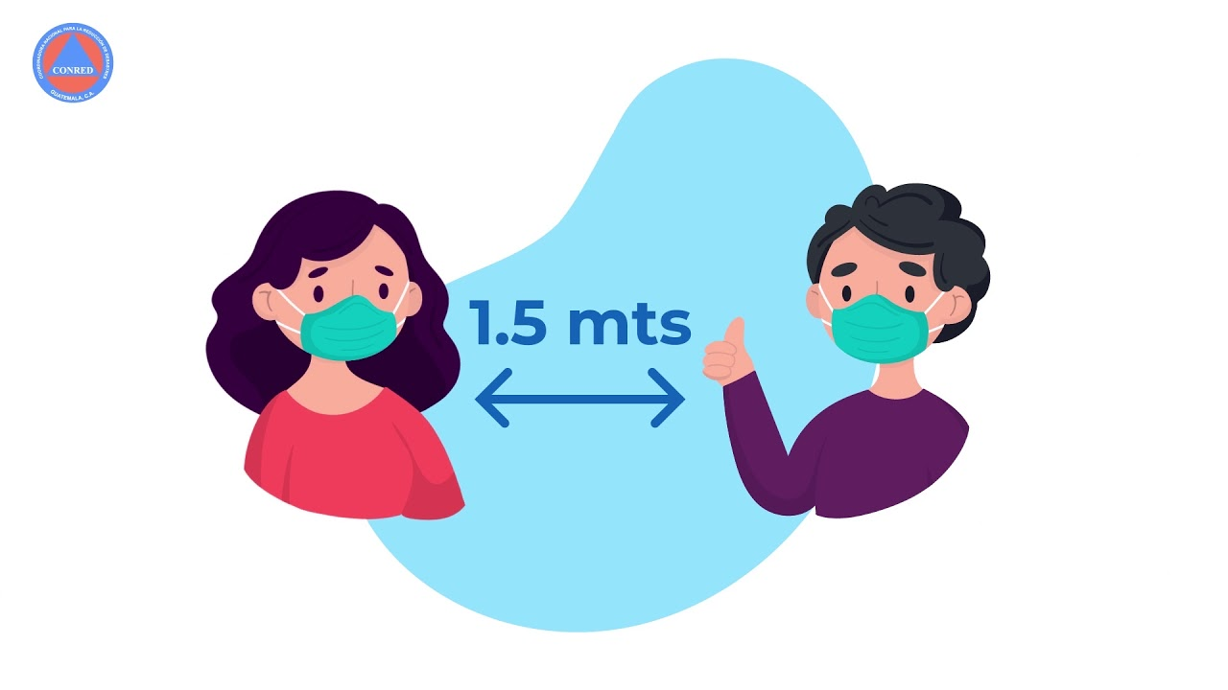

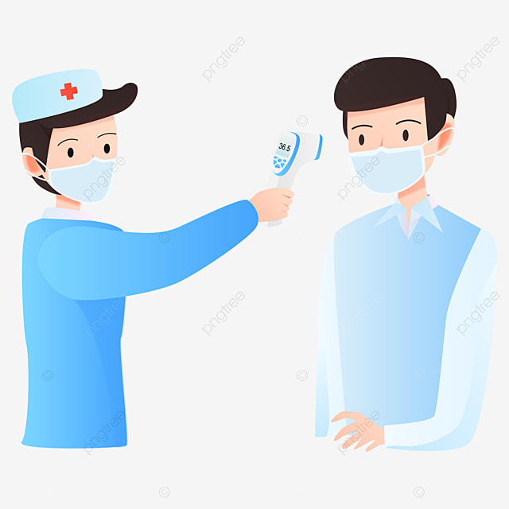

Prevention method after re opening of school

Slide 9

summary

Slide 10
Reference
WHO Based on guidance Considerations for school-related public health measures in the context of COVID-19
https://www.who.int/emergencies/diseases/novel-coronavirus-2019/question-and-answers-hub/q-a-detail/coronavirus-disease-covid-19-schools#

Slide 11
Thanks for your attention.

