Slide 1


1
Libyan International
Medical University
Faculty of
Business Administration
Ethical Behavior and It’s Practices
Prepared and presented by:
Heba N Bushiha
ID Number:
3285
Notes:
Download more minimal templates here: https://crmrkt.com/GK9Dwa

Slide 2
Introduction.
01
02
Ethical Practices in workplace.
03
Views Of Ethical Behavior.
TABLE OF CONTENTS
04
05
Why Is Ethical Behavior Important In Business?
2
What Are Some Consequences of Unethical Business Practices?
Conclusion.
06
References.
07

Slide 3
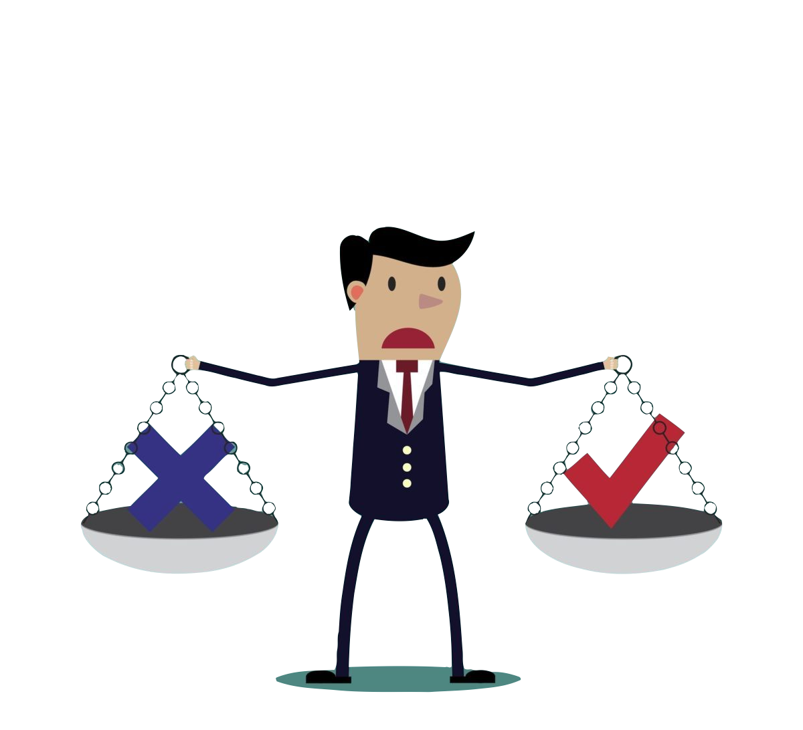
3
Introduction
Ethical behavior is the application of moral principles in a given situation.
This behavior is proven by certain values, standards or principles that are maintained in relationships such as:
Transparency.
Honesty.
Fairness.

Slide 4
Ethical Practices in workplace
4
Ethical practices in the workplace are the set of rules and regulations that must be followed by all staff in the workplace including managers, employers and employees.
Obeying the company's rules
Effective communication
Taking responsibility
Trust and respect for your colleagues at work

Slide 5
5
Views Of Ethical Behavior
Utilitarian
Individualism
It considers ethical behavior to be that which delivers the greatest good to the greatest number of people.
It is based on the belief that one’s primary commitment is to long-term advancement of self-interests.
Moral Rights
Justice
Ethical behavior under a moral rights view is that which respects and protects the fundamental rights of people.
It is based on the belief that ethical decisions treat people impartially and fairly, according to legal rules and standards.
Notes:
Download more minimal templates here: https://crmrkt.com/GK9Dwa

Slide 6

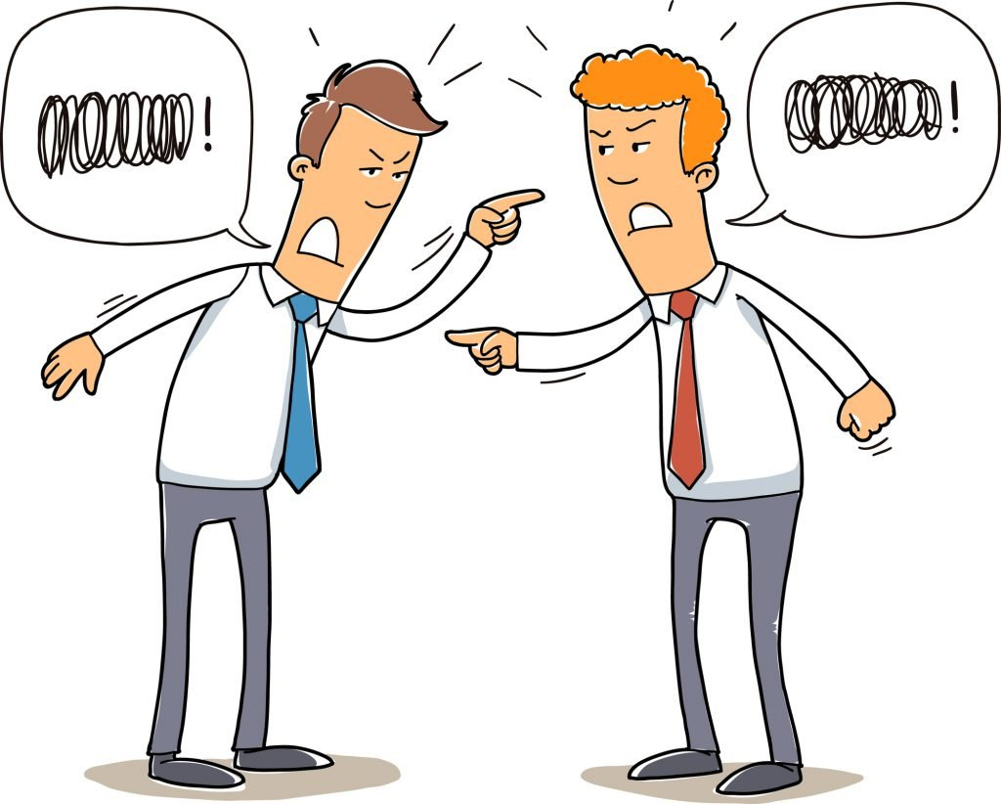
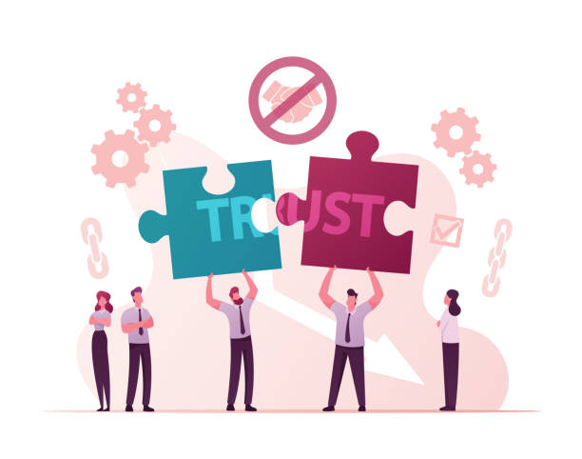
Employees’ relationships are affected.
Loss of your job and reputation.
Loss of company credibility and trust.
6
What Are Some Consequences of Unethical Business Practices?

Slide 7

Why Is Ethical Behavior Important
In Business?
7
Every organization has an ethical code that guides its decision making and activities to achieve successful productivity and maintain its reputation.
Ethical behavior ensures that employees complete work credibly and achieve the organization's goal by following rules and policies.

Slide 8
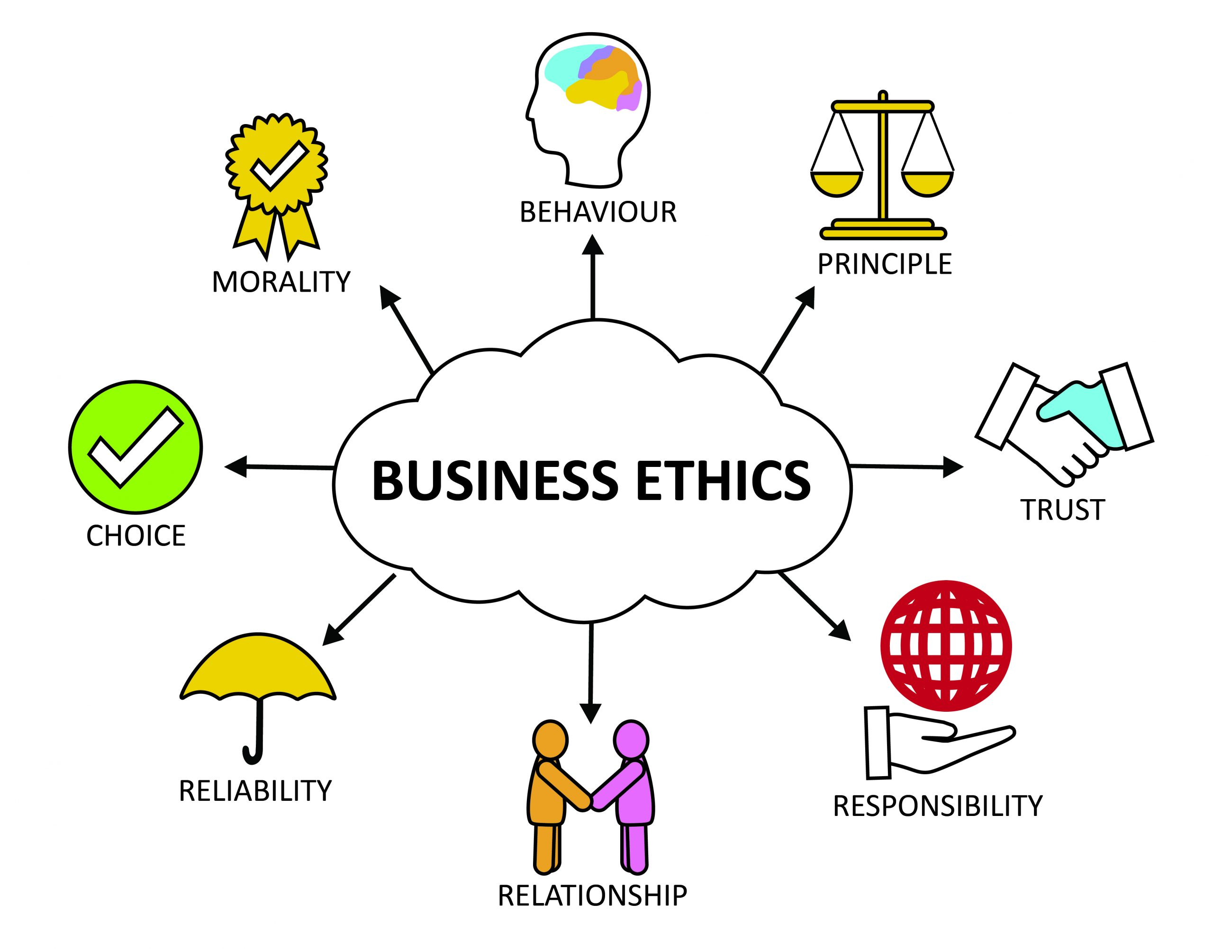
Conclusion
8
Ethical behavior is one of the most important aspects in business in which implementing them in organizations can increase employee performance, job satisfaction, organizational commitment, trust and organizational citizenship behaviors.

Slide 9
REFERNCES
9
Blog, Formplus. “23 Ethical & Unethical Behavior Examples in Workplace.” Https, 25 June 2020, www.formpl.us/blog/workplace-ethics.
Mahan, William. “How to Define Ethical Behavior & Why It’s Important in the Workplace.” Work Institute, 17 Oct. 2019, workinstitute.com/how-to-define-ethical-behavior-why-its-important-in-the-workplace-2/.
“What Is Consequences of Unethical Business Practices?” Career Cliff, 24 Aug. 2019, www.careercliff.com/what-is-consequences-of-unethical-business-practices/.
Bowes, Barbara. “Aug 2017: Unethical Actions Have Serious Consequences.” Winnipeg Free Press, 12 Aug. 2017, www.winnipegfreepress.com/business/unethical-actions-have-serious-consequences-439985623.html.
“What Is Ethical Behavior? - Definition | Meaning | Example.” My Accounting Course, 2019, www.myaccountingcourse.com/accounting-dictionary/ethical-behavior.
“Alternative Views of Ethics.” Www.linkedin.com, www.linkedin.com/pulse/alternative-views-ethics-majid-arabi.
‌
‌

Slide 10
10
THANK YOU
Heba N Bushiha
Notes:
Download more minimal templates here: https://crmrkt.com/GK9Dwa

