Slide 1


Libyan International Medical University
Faculty of Business Administration
Customer Driven Strategy
Dana Elgheriani
dana_3792@limu.edu.ly
3792

Slide 2
contents
1. Introduction
2. Definition “customer need”
3. Customer driven strategy
4. Conclusion
5. References
1

Slide 3
Introduction
Trying to create a need for a new product or service is risky. Satisfying a need that customers say they have reduces the chances of finding little or no demand for what you sell. Reviewing consumer needs in your space helps you create more sales and revenues .
2

Slide 4

Definition “customer need”
Customer needs are the things that customers require when purchasing a product or service.
There are four main customer needs that an entrepreneur or small business must consider.
3

Slide 5




Quality
Price
Customers want a fair price when purchasing a product or service. low prices will draw in many customers, although people ultimately want value for money
relates to the standard of the product or service being offered. Customers always expect some level of quality
Choice
Convenience
Customers have different needs and desires when buying items. They might want different styles or sizes
Convenience relates to something being easier, quicker or generally less hassle for customers
4

Slide 6
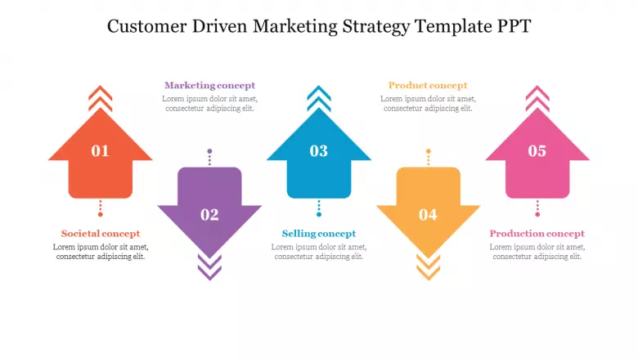
Customer Driven Strategy
Companies must make a commitment to having a customer orientation. The steps in becoming customer-driven include involving all levels of the firm, training the work force and being flexible.
5

Slide 7
Does your business need a customer driven marketing strategy?
Every business needs a customer-centric marketing strategy.Thanks to it, it is known what steps the company should take in the field of marketing to meet the needs.
6

Slide 8
Summary :
1.
Customer needs are the things that customers require when purchasing a product or service.
2.
A customer driven marketing strategy is a strategy of marketing activities of a given company, which as its main goal.
7

Slide 9
References :
1.
BBC. (n.d.). What are customer needs? - customer needs - edexcel - GCSE business revision - edexcel - BBC bitesize. BBC News. Retrieved March 30, 2022, from https://www.bbc.co.uk/bitesize/guides/zn3847h/revision/1
2.
Customer Driven Marketing Strategy. LiveAgent. (2021, December 7). Retrieved March 30, 2022, from https://www.liveagent.com/customer-support-glossary/customer-driven-marketing-strategy/
8
Notes:
`

Slide 10
Thank You For Your Attention
Any Questions ?

