Slide 1



The Faculty of Business Administartion The Important Elements that Shape the State
By: fatima alzahraa agneaber
ID.3212 E-mail:fatemaalzahraa_3212@limu.eduly

Slide 2
Table of Contents
01
02
03
04
Definition of state.
The important elements that shape the state.
Conclusion.
References.
1

Slide 3
Definition of state
State is a territorial society divided into government and subjects whose relationships are determined by the exercise of supreme coercive power.
2

Slide 4
The Important Elements That Shape the State
01
02
Population
Territory
The state is a human institution. So population is its primary element. There is no hard and fast rule about population.
In territory, no limit can be laid down. Small states and large ones exist side by side.
3

Slide 5
The Important Elements That Shape the State
03
04
Government
Sovereignty
A people occupying a definite territory cannot form a state unless they are politically organized i.e., unless they possess a government.
The most important characteristic of the state is its sovereignty. It is the characteristic which distinguishes the state from all other associations.
4

Slide 6
Conclusion
I believe that if you miss one of those four elements you will have a big political problem in terms of forming a state or even developing it.
5

Slide 7
References
Kumar, A. (2011, October 4). What are the important elements of the State? PreserveArticles.Com: Preserving Your Articles for Eternity. Retrieved November 22, 2021, from https://www.preservearticles.com/political-science/what-are-the-important-elements-of-the-state/12783
Meaning and Definition of State. (n.d.). BrainKart. Retrieved November 22, 2021, from https://www.brainkart.com/article/Meaning-and-Definition-of-State_34258/
5

Slide 8
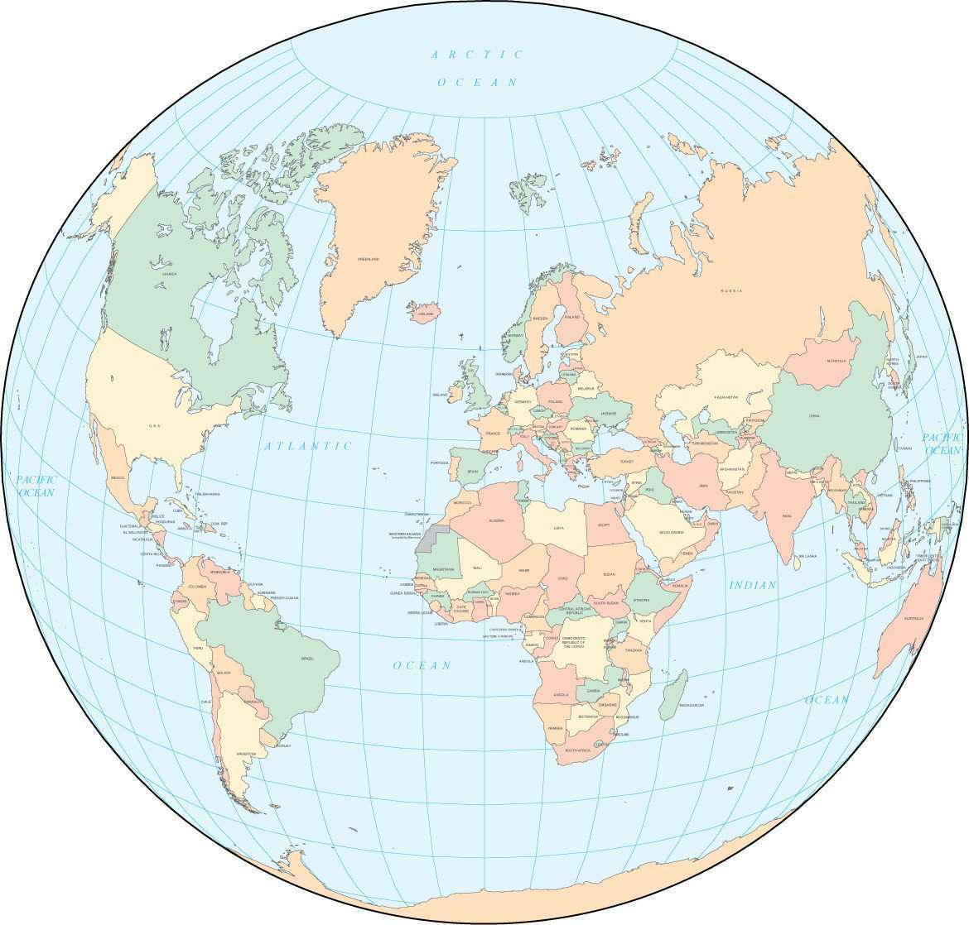
Thank you
Any questions?
6

