Slide 1


The association between Childhood Trauma
and Bipolar disorder
Name : Mohammed Fathi
Roll No : 3145
Date : 15 - may - 2022

Slide 2
Objectives
Define bipolar disorder and mention the types
Outline the symptoms
discuss the Risk factors of Bipolar disorder
define the meaning of childhood Trauma
Describe the relation between childhood trauma and bipolar disorder

Slide 3
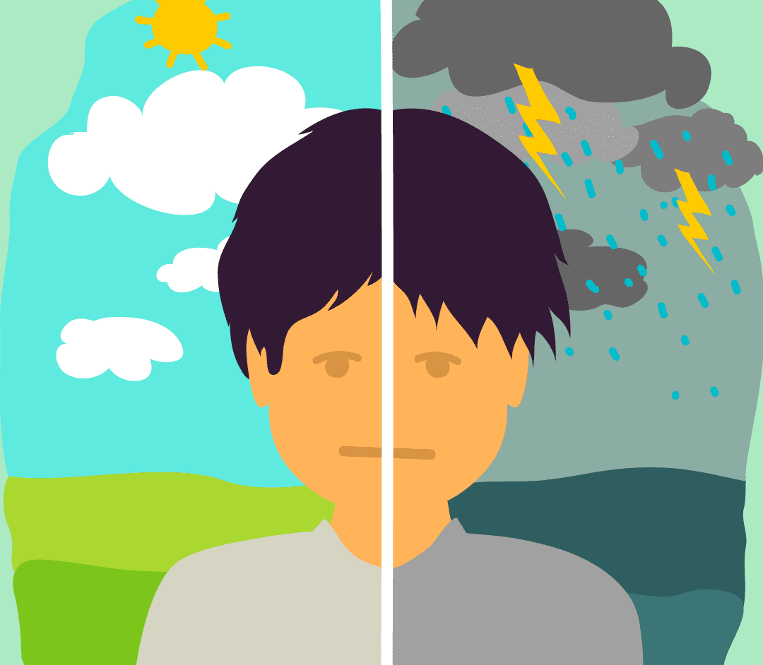

Introduction to bipolar disorder

Slide 4
According to the WHO
It is a mental disorder consists of both manic and depressive episodes separated by periods of normal mood.
Prevalence : 45 million people worldwide
There is three types of bipolar disorder
1-) Bipolar disorder type 1
2-) Bipolar disorder type 2
3-) Cyclothymia
Not common !!

Slide 5
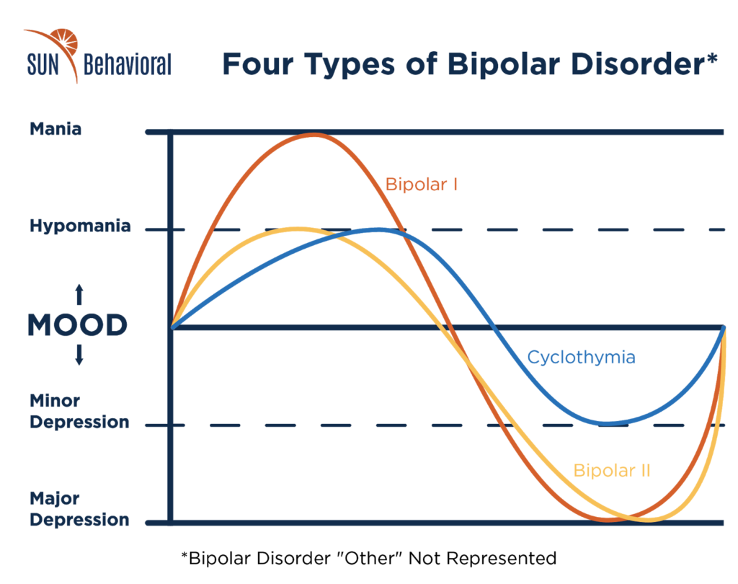
Types of bipolar disorder

Slide 6
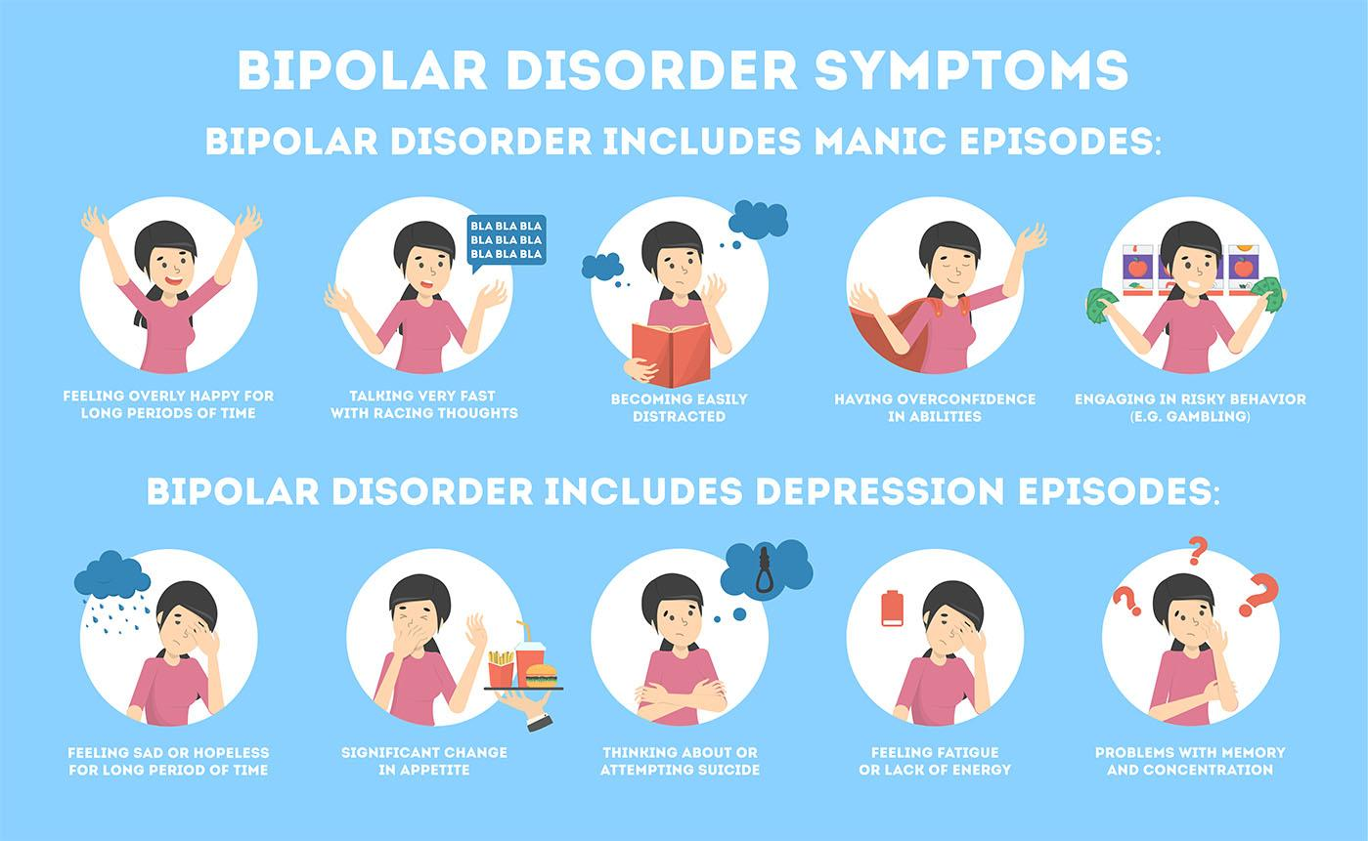
Symptoms

Slide 7
Risk factors of Bipolar disorder
Having first-degree relative
Periods of high stress
Drug or alcohol abuse
traumatic life event

Slide 8
childhood trauma
Any scary, dangerous, violent, or life threatening event that happens to a child (0-18 years of age)
They include :
Shooting, war
Car or plane crashes
Witnessing murder
Sexual abuse
Physical abuse

Slide 9
The incidence of childhood trauma
In Australia, about 2.5million people had at least one trauma in their childhood.
In the united states:
Each day, more than 1000 youth are brought to emergency for physical assault-related injuries.
Each day, about 14 youth die from homicide
The WHO estimates :
quarter of all adults report having been physically abused as a child.
one in five women has been sexually abused

Slide 10
The impact of childhood trauma
Physical disorders
heart diseases
headaches and migraines
COPD
Mental disorders :
BP
PTSD
Depression
Sleep disturbance
Anxiety

Slide 11
what is the relationship between Childhood trauma and Bipolar disorder ?

Slide 12
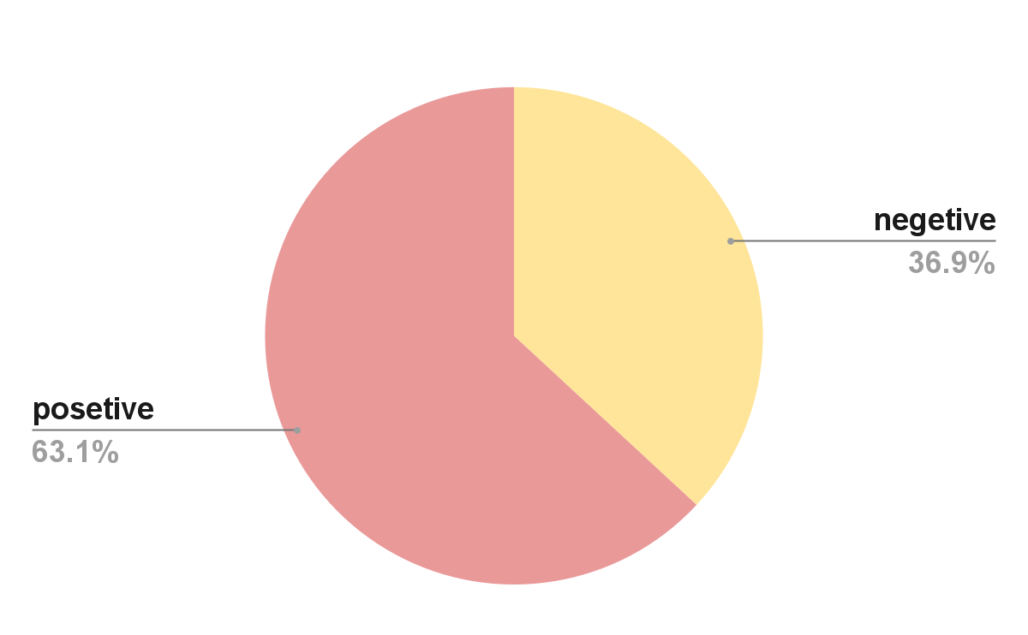
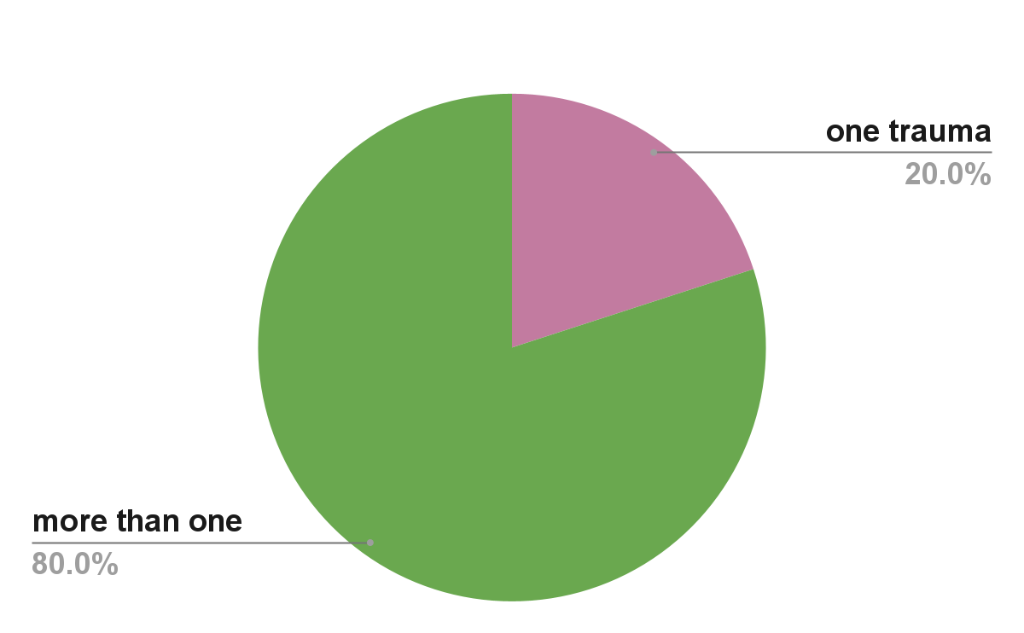
a study among 206 patients with BD using the Childhood Trauma Questionnaire (CTQ) shows that
63% of the patients has at least single trauma
Patients who has multiple traumas, has 80% risk of developing BP

Slide 13
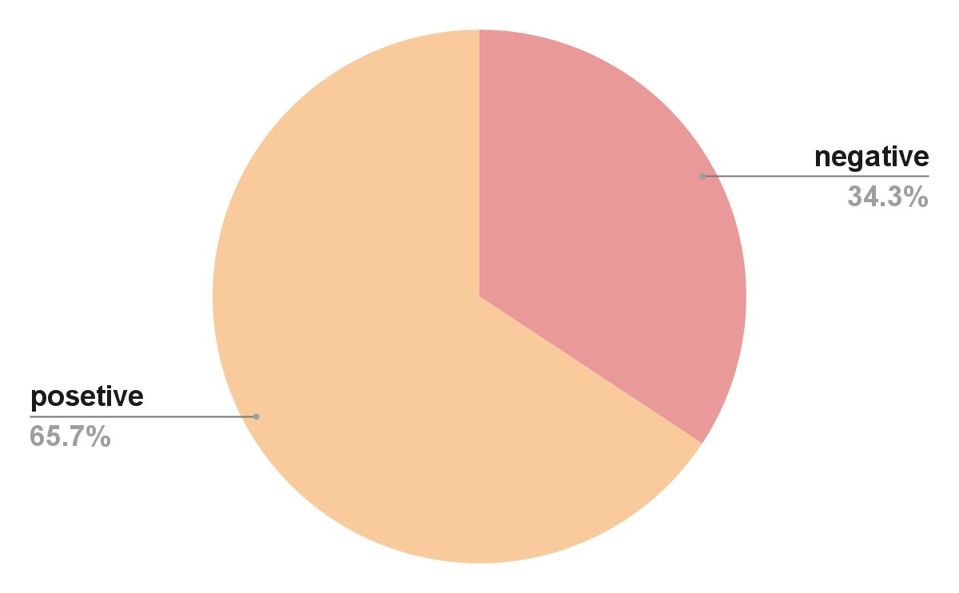
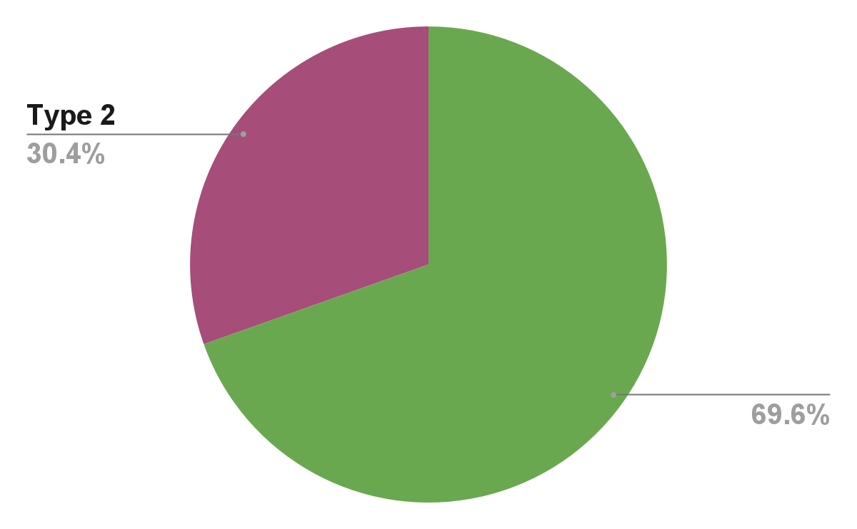
Another study has been made in two centers, north-east england and New zealand, included 60 patients who is taking treatment for bipolar disorder.

Slide 14
Conclosin
Bipolar disorder is a severe mental illness, and its incidence is in growing
Childhood trauma has severe impact in the individuals future health.
Multiple studies has been done and gave the same result, childhood trauma can trigger BP in the patient’s adulthood.

Slide 15
REFERENCES
Etain B, Aas M, Andreassen OA, Lorentzen S, Dieset I, Gard S, Kahn JP, Bellivier F, Leboyer M, Melle I, Henry C. Childhood trauma is associated with severe clinical characteristics of bipolar disorders. J Clin Psychiatry. 2013 Oct;74(10):991-8. doi: 10.4088/JCP.13m08353. PMID: 24229750.
Angst J, Gamma A, Endrass J. Risk factors for the bipolar and depression spectra. Acta Psychiatrica Scandinavica. 2003;108:15-19
Understanding Child Trauma. (n.d.). SAMHSA - Substance Abuse and Mental Health Services Administration. https://www.samhsa.gov/child-trauma/understanding-child-trauma
Aas M, Aminoff SR, Vik LT, Etain B, Agartz I, Andreassen OA, Melle I. Affective lability in patients with bipolar disorders is associated with high levels of childhood trauma. Psychiatry Res. 2014a;218:252–5.
Watson S, Gallagher P, Dougall D, et al. Childhood trauma in bipolar disorder. Aust N Z J Psychiatry. 2014;48(6):564-570. doi:10.1177/0004867413516681

Slide 16


