Slide 1



Libyan International Medical University
Faculty Of AMS
2021-2022
Tobacco control.
Tobacco leaf farming.
Student name : Lama Osama Elsharif
Student number :3529
Date : 18.5.2022
First year student2021-2022.
1

Slide 2


Slide 3
Objectives
Outline the production of Tobacco leaves.
Discuss Environmental health impacts of tobacco farming.
Discuss the disease related to tobacco farming.
Outline the Treatment of GTS and Prevention.
3

Slide 4
Introduction.
The widespread farming of tobacco leaf has generated
many challenges— including health hazards for farmers
and environmental degradation.
4

Slide 5

Outline the production of Tobacco leaves.
In 2012 it produced almost 7.5 million metric tonnes of tobacco leaf on 4.3 million hectares of farm land in at least 124 countries.
5

Slide 6
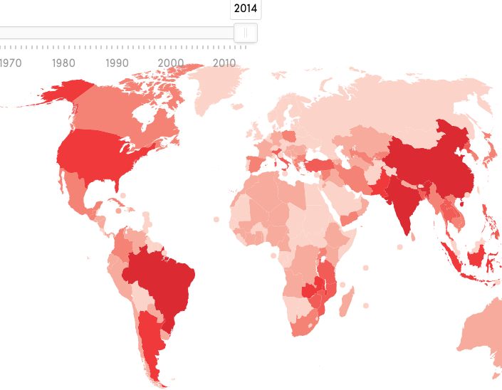
Production of Tobacco.
China 2,995,400metric tonnes
United States 397,535
Brazil 862,396
India720,725
Zambia 112,049
Indonesia 196,300
6

Slide 7
Discuss environmental health impact of tobacco farming.
Deforestation : losses of trees and other plant species caused by tobacco farming.
Soil degradation: tobacco field production it naked the earth from nutrients faster and more extensively, than other major food and fields.
7

Slide 8
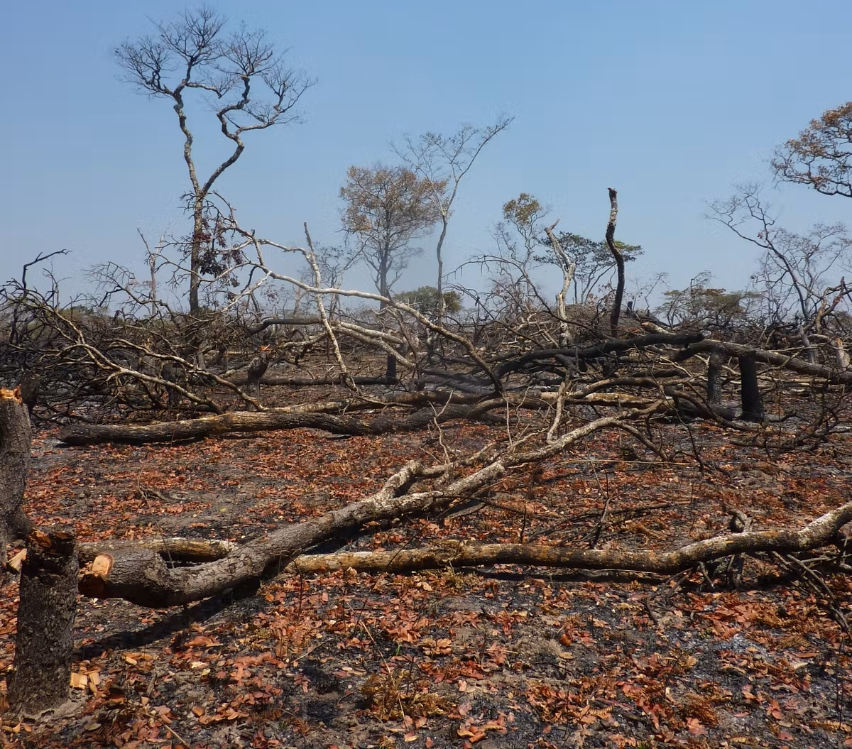

Slide 9
Discuss the disease related to tobacco farming.
9
Health effects from chronic exposure to certain pesticides.
Tobacco farmer who cultivates and harvests tobacco may absorb as much nicotine as found in 50 cigarettes in a single day.

Slide 10
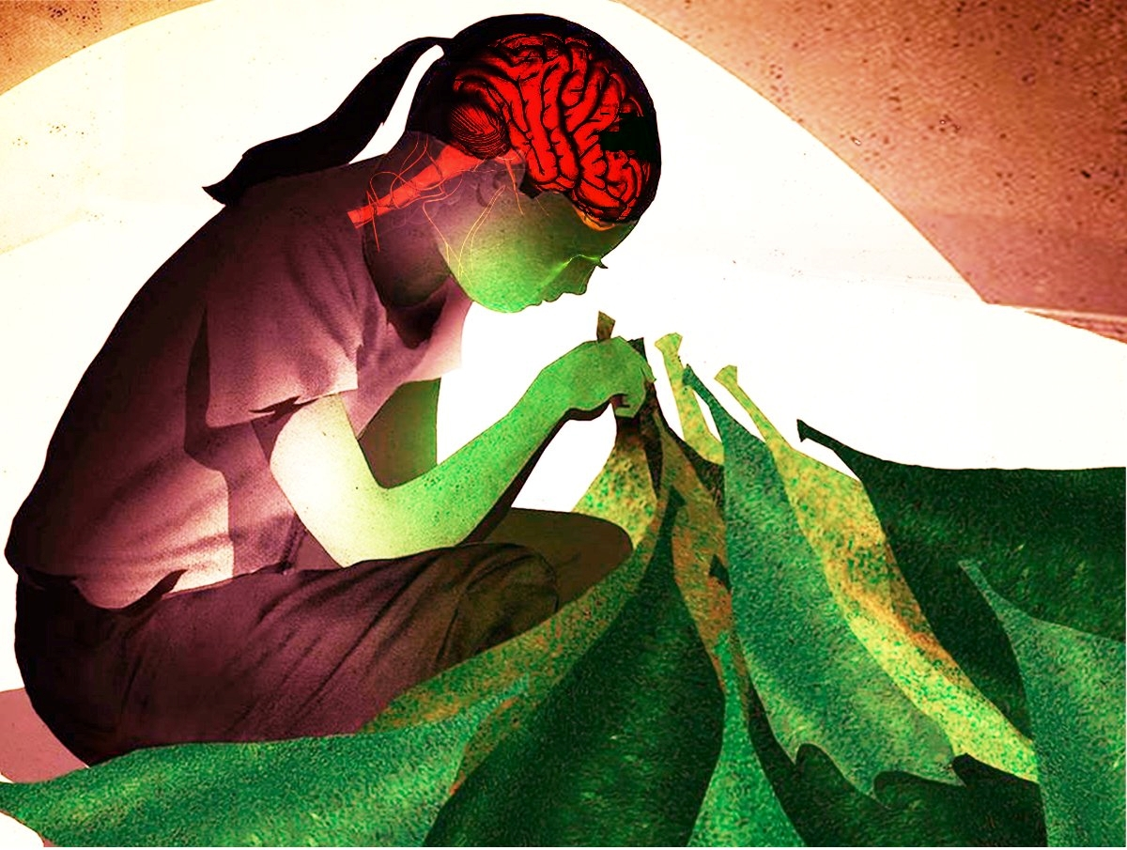
Green tobacco sickness ( GTS )
Is a type of nicotine poisoning.
Caused by the dermal absorption of nicotine from the surface of wet tobacco plants .
10

Slide 11
Symptoms of GTS
Breathing Difficulty
Nausea
and
Vomiting
Headache and dizziness,
Abnormal
temperature
Diarrhoea and Weakness
11

Slide 12
Treatment of GTS
increase fluid intake.
Rest.
intravenous hydration.
anti-emetics.
ingest dimenhydrinate (Dramamine).
12

Slide 13
Prevention
Personal protective equipment.
Avoid harvesting in the rain.
Use Mechanisation of tobacco harvesting.
13

Slide 14
conclusion
With worldwide increasing of tobacco farming, this will
increase harmful impact of tobacco on the environment.
Environmental impacts have huge reflection on human health.
So It is important to provide education to tobacco workers
about a health problems related to tobacco farming(GTS).
14

Slide 15
References
1. Apps.who.int. 2017. [online] Available at: <https://apps.who.int/iris/bitstream/handle/10665/255574/9789241512497eng.pdf>[Accessed 12 May 2022].
2. Lecours N, Almeida GEG, Abdallah JM, et alEnvironmental health impacts of tobacco farming: a review of the literatureTobacco Control 2012;21:191-196.
3. McBride JS, Altman DG, Klein M, et al Green tobacco sickness Tobacco Control 1998;7:294-298
4. Atlas Tobacco. growing. 2018. Available at https://tobaccoatlas.org/topic/growing/
5. Fctc.who.int. 2017. The environmental impact of tobacco: a concern that demands multisectoral action. [online] Available at: <https://fctc.who.int/newsroom/news/item/11-12-2017-the-environmental-impact-of-tobacco-a-concern-that-demands-multisectoral-action > [Accessed 12 May 2022].
6. Who.int. 2022. Say no to tobacco farming. [online] Available at: <https://www.who.int/news-room/feature-stories/detail/say-no-to-tobacco-farming> [Accessed 12 May 2022].
15

Slide 16
Thank you
Do you have any questions?
16

