Slide 1


E-government Approaches and The Problems of E-government
Libyan International Medical University
Faculty Of Bussines Adminstration
By:Ahmed Jadalla Hamad
Email;ahmed_2726@limu.edu.ly
Id:2726
Date/15/12/21

Slide 2
Table of Content:
01
02
03
04
What is E-government.
Introduction about e-government.
Types of e government .
Examples of countries that use e- government.
What is (ICT|).
Meaning of ICT.
The relation between ICT and government.
Problems of e-government.
Conclusion & References.
1

Slide 3
01
E-government
2

Slide 4
E-government
It is the use of technological communications devices, such as computers and the Internet, to provide public services to citizens and other persons in a country or region. E-government offers new opportunities for more direct and convenient citizen access to government, and for government provision of services directly to citizens.
3

Slide 5
Types of E-government
(G2C)
(G2B)
01
02
Government to Citizen.
Government-to-business.
(G2G)
(G2E)
03
04
Government-to-Employee.
Government-to-Government .
4

Slide 6
1.Government to Citizen.
1.G2C
The Government-to-citizen mentions the government services that are acquired by the familiar people. Most of the government services come under G2C. Similarly, the primary aim of Government-to-citizen is to supply facilities to the citizens. It also helps the ordinary people to minimize the time and cost to carry out a transaction. A citizen can retrieve the facilities anytime from anywhere.
5

Slide 7
2.Government-to-business (G2B):
The Government-to-business is the interchange of services between Government and Business firms. It is productive for both government and business firms. G2B provides access to pertinent forms needed to observe. It also contains many services interchanged between business sectors and government.
Similarly, the Government-to-business provides timely business information. A business organization can have easy and easy online access to government agencies. G2B plays a important role in business development. It upgrades the efficiency and quality of communication and transparency of government projects.
6

Slide 8
3.Government-to-Employee (G2E):
The Government-to-Employee is the internal part of G2G section. It aims to bring employees together and improvise knowledge sharing. It provides online facilities to the employees. Similarly, applying for leave, reviewing salary payment record and checking the balance of holiday. The G2E sector yields human resource training and development. So, G2E is also the correlation between employees and government institutions.
7

Slide 9
Government-to-Government (G2G):
The Government-to-Government mentions the interaction between different government departments, firms and agencies. This increases the efficiency of government processes. In G2G, government agencies can share the same database using online communication. The government departments can work together. This service can increase international discretion and relations.
G2G services can be at the local level or at the international level. It can convey with both global government and local government. It also provides safe and secure inter-relationship between domestic or foreign government. G2G builds a universal database for all members to upgrade service.
8

Slide 10
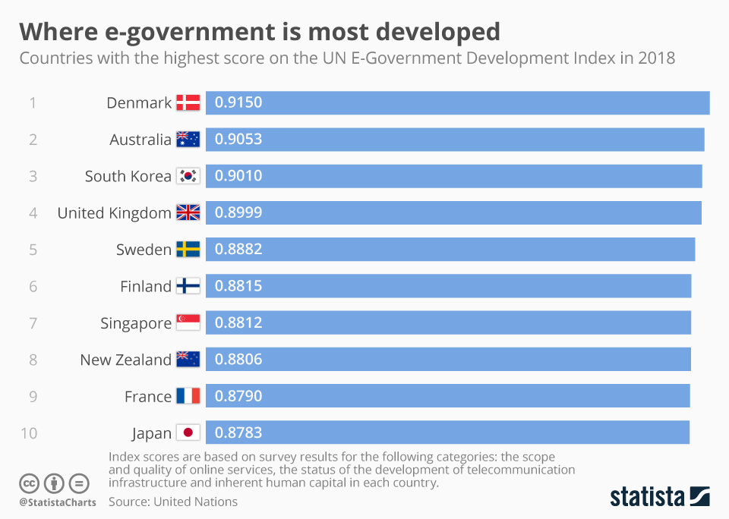
Examples of countries that use e- government
9

Slide 11
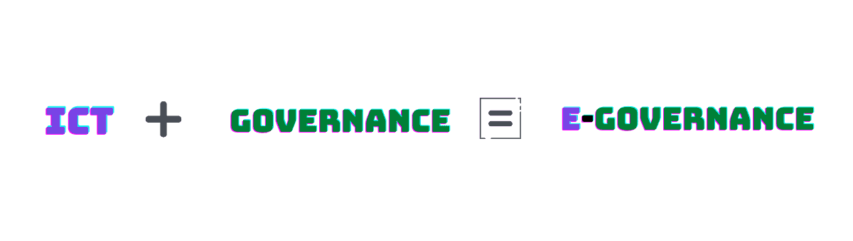
Information and Communication Technology
(ICT)
ICT stands for Information and Communication Technologies. It refers to several sets of technological tools that can help to provide right to information and equal services to the people by minimal cost, time and effort.
What is the Relation Between ICT and Governance?
10

Slide 12
PROBLEMS OF E-GOVERNMENT
11

Slide 13
PROBLEMS OF E-GOVERNMENT
Technical problems
Cultural problems
1
2
3
4
Political problems
Legal problems
12

Slide 14
CONCLUSION
E-governance is about the use of ICT for steering the citizens and promoting the public service. It includes the usage of ICT for delivering efficient and cost effective services and information and knowledge to the citizens being governed. It made correlations between state and society, government and people, people to people, governance and society.
13

Slide 15
References
Hwang, M., Li, C.-T., Shen, J.-J., & Chu, Y. (1970, January 1). [PDF] challenges in e-government and security of information: Semantic scholar. undefined. Retrieved December 13, 2021, from https://www.semanticscholar.org/paper/Challenges-in-E-Government-and-Security-of-Hwang-Li/ee18772d0a66617e3915530ec6619bf2b88dff28
E-governance. Geeks for Geeks . (2019, August 8). Retrieved December 13, 2021, from https://www.geeksforgeeks.org/e-governance/
14

Slide 16
Thanks!
Do you have any questions?
15

