Slide 1




Executing APA In-Text Citation
Presented by : Dana Elgheriani
Student number: 3792
Email: dana_3792@limu.edu.ly

Slide 2
Objectives
01
How to execute APA in-text citation
2

Slide 3




TABLE OF CONTENTS
01
02
03
04
3

Slide 4
INTRODUCTION
When using APA format, follow the author-date method of in-text citation. This means that the author's last name and the year of publication for the source should appear in the text, One complete reference for each source should appear in the reference list at the end of the paper.
4

Slide 5

If you are referring to an idea from another work but NOT directly quoting the material, or making reference to an entire book, article or other work, you only have to make reference to the author and year of publication .
for example (Jones, 1998).
5

Slide 6
02
On the other hand, if you are directly quoting or borrowing from another work
you should include the page number at the end of the parenthetical citation. Use the abbreviation “p.” (for one page) or “pp.” (for multiple pages) before listing the page number(s). Use an en dash for page ranges. For example, you might write (Jones, 1998, p. 199) or (Jones, 1998, pp. 199–201). This information is reiterated belo .
6

Slide 7
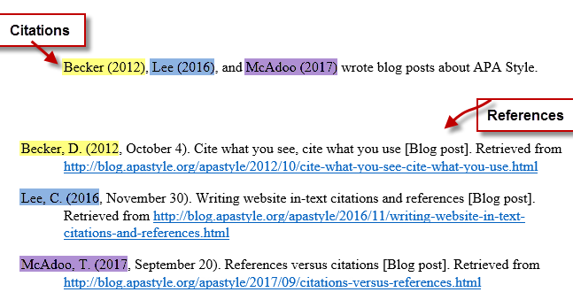
7

Slide 8
Missing information
Author
Publication year
Page number
Example
(Primary colors, 1996)
( wenson, n.d.)
(McCombes, 2016, para 4)
8

Slide 9
Summary :
In-text citations briefly identify the source of information in the body text. They correspond to a full reference entry at the end of your paper.
APA in-text citations consist of the author’s last name and publication year. When citing a specific part of a source, also include a page number or range, for example (Johnson, 2017, pp. 39–41).
9

Slide 10
References :
1. Lab, P. (2022). In-Text Citations: The Basics // Purdue Writing Lab. Retrieved 27 April 2022, from https://owl.purdue.edu/owl/research_and_citation/apa_style/apa_formatting_and_style_guide/in_text_citations_the_basics.html#:~:text=When%20using%20APA%20format%2C%20follow,the%20end%20of%20the%20paper.
2. Beginner's guide to APA in-text citation. (2022). Retrieved 27 April 2022, from https://www.scribbr.com/apa-style/in-text-citation/
10

Slide 11


