Slide 1


Libyan International Medical University Faculty of Business Administration
The Non-verbal Communication Competence.
Name: Mohamed Fathi
ID:3761 Email:mohammed_3761@limu.edu.ly

Slide 2
Table of contents
01
02
03
04
05
06
Introduction
Objective
5 Examples of Non-Verbal Com.
Non-Verbal Com.
Defines Non-Verbal
Conclusion
References
2

Slide 3
Introduction
Nonspeaking autism is the term used to describe autism in those who cannot talk it may also be referred to as autism without verbalization the label nonverbal, though, isn't entirely accurate.
3

Slide 4
5 Examples of Non-Verbal
OUR LOGO
Body movement and posture. ...
Gestures. ...
Eye contact. ...
Touch. ...
Space. ...
Voice. ...
Pay attention to inconsistencies.
4

Slide 5
Define Non-Verbal
Body language is a potent form of non-verbal communication there are tests in verbal and non-verbal reasoning not able to talk or use words he has cerebral palsy and is non-verbal
5

Slide 6
Non-Verbal Words
Something that's nonverbal doesnt use spoken words Nonverbal communication might consist of hand gestures or facial expressions. Use the adjective nonverbal when you talk about a method of communicating without spoken language, or a person who isn't able to use speech
6

Slide 7
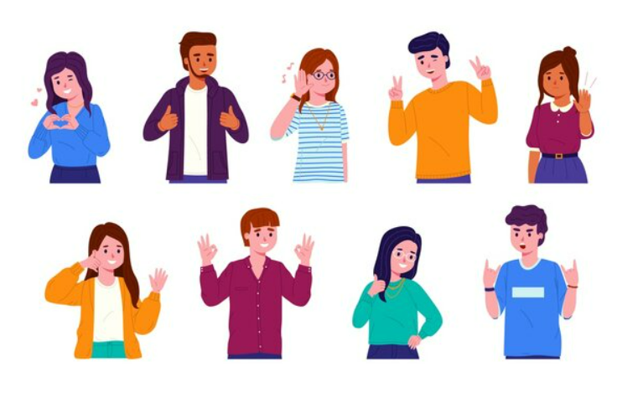
7

Slide 8
Conclusion
A knowledge of the several factors involved with nonverbal communication, and an awareness of its power will improve our ability to communicate with others.
8

Slide 9
References
Nonverbal communication and body language. HelpGuide.org. (n.d.). Retrieved November 22, 2022, from https://www.helpguide.org/articles/relationships-communication/nonverbal-communication.htm
8 types of nonverbal communication that can help to improve your speech. 8 Types of Nonverbal Communication That Can Help to Improve Your Speech. (n.d.). Retrieved November 22, 2022, from https://www.betterup.com/blog/types-of-nonverbal-communication
Non-verbal. NON-VERBAL | definition in the Cambridge English Dictionary. (n.d.). Retrieved November 22, 2022, from https://dictionary.cambridge.org/us/dictionary/english/non-verbal
Nonverbal communication. GoodTherapy.org Therapy Blog. (n.d.). Retrieved November 22, 2022, from https://www.goodtherapy.org/blog/psychpedia/nonverbal-communication
9

Slide 10

Thank you
Any question?

