Slide 1



Name: MONTHER-GARGOUM Email: Munther4024@limu.ly ID: 4024
Libyan International Medical University
Faculty of Business Administration
The Meaning of the Constitution of Civil Society

Slide 2
Table of contents
01
02
03
04
05
06
What is civil society examples?
What are the three principles of civil society?
What is the full meaning of civil society?
the role of the civil society organization
Conclusions
The five basic principles of society
2

Slide 3

What is the full meaning of civil society?
The collective of non-governmental organizations and institutions known as civil society includes a variety of cultural, religious, and special interest groups that uphold social norms and represent the interests of citizens.
3

Slide 4
What are the three principles of civil society?
Various cultural, religious, and special interest groups that defend social norms and represent the interests of citizens make up the collective of non-governmental organizations and institutions known as civil society.
4

Slide 5
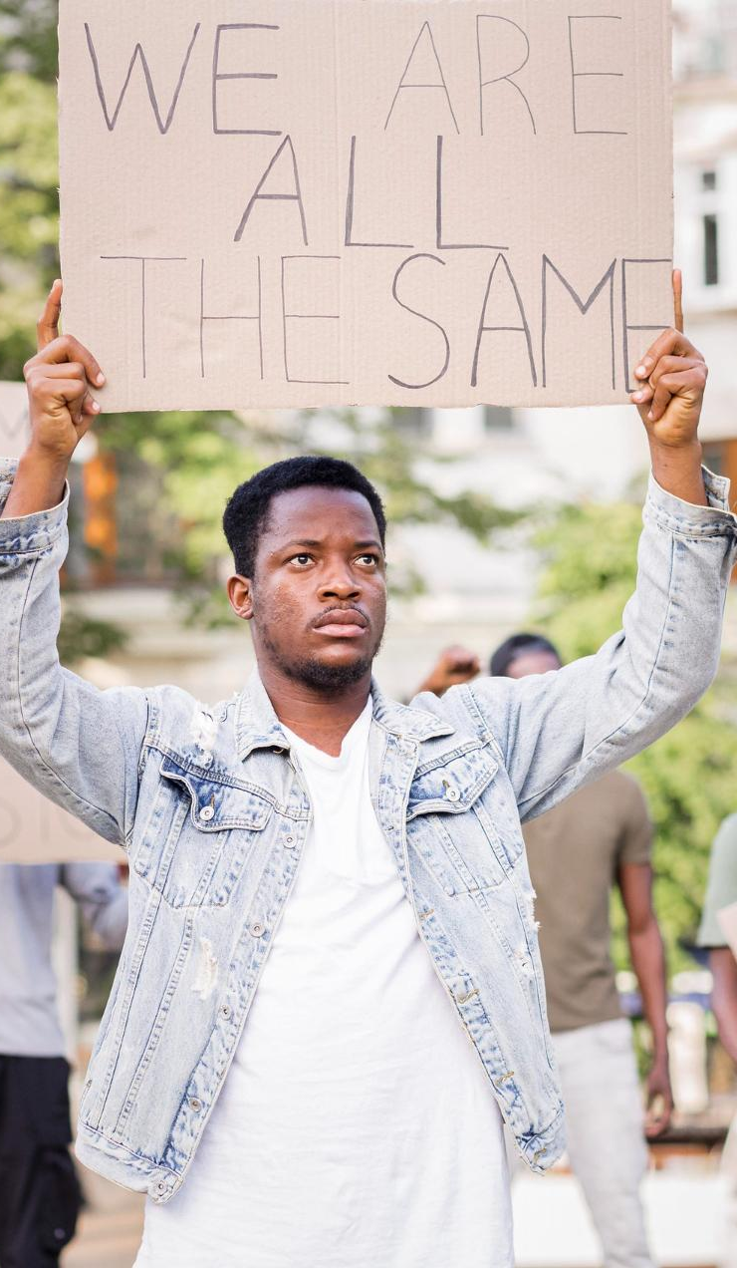
What is civil society examples?
Civil society comprises organizations that are not associated with government—including schools and universities, advocacy groups, professional associations, churches, and cultural institutions .
5

Slide 6
What is the role of the civil society organization?
advocating for human rights, for the needs and priorities of their constituency (especially of marginalized groups) and advocating against government deficiencies. contributing to mediating and resolving conflict, contribute to social innovation. influencing government policy and lobbying for change.
6

Slide 7

The five basic principles of society
1.access to resources 2.equity
3.participation
4.diversity
5.human rights.
7

Slide 8
Conclusions
.Civil society” remains an ideologem rather than a rigorous scientific concept.
. A critical interpretation of civil society discourse needs placing it in the context of contingent policy regimes defined by institutional factors.
8

Slide 9
Reference
The roles of civil society and business. FDSD. (2022, March 14). https://www.fdsd.org/ways-forward/roles-civil-society-business/
9

Slide 10

Thanks!
Do you have any questions?
10

