Slide 1
Arterial disorders
Haitham R Elmehdawi

Slide 2
Arterial disorders represent the most common cause of morbidity and death in Western societies.
Much of this is due to the disorders of the arteries supplying the heart muscle (coronary thrombosis and myocardial infarction) and brain (stroke) .
Others are due to peripheral vascular diseases .

Slide 3
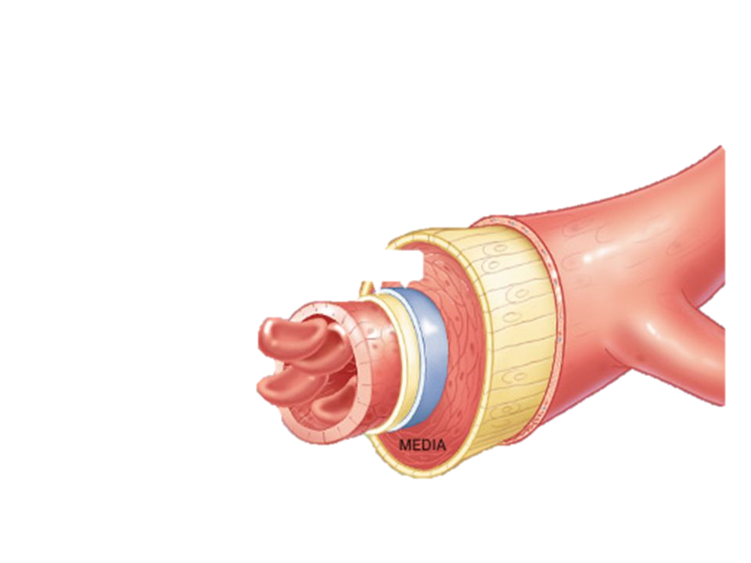
3 Layers of Arterial wall
inner layer of endothelium (intima)
middle layer of connective tissue, smooth muscle and elastic fibers (media)
outer layer of connective tissue (adventitia)
Tunica intima
Tunica adventitia

Slide 4
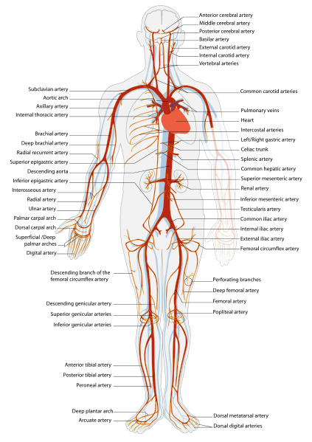
Anatomy

Slide 5
ARTERIAL DISEASES
Stenosis
01
due to trauma, atherosclerosis, emboli and vasospasm .
02
Dilatations
aneurysms..
03
Inflammation
Arteritis.
04
Small vessel abnormalities.

Slide 6
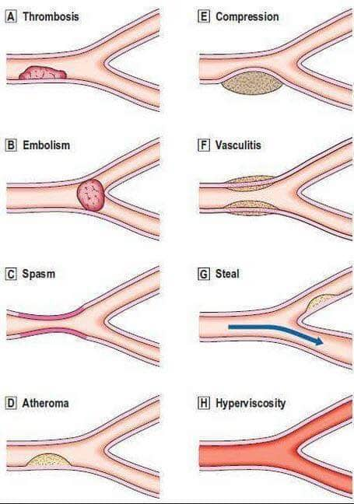
ARTERIAL DISEASES

Slide 7
ISCHEMIA
a restriction in blood supply to tissues, causing a shortage of oxygen that is needed for cellular metabolism and also reduced availability of nutrients and inadequate removal of metabolic wastes , which cause damage to or dysfunction of tissue.

Slide 8
ISCHEMIA
The type of artery
If the artery has a very efficient collateral circulations well decrease the risk of ischemia .
The effects of ischemia
The rate of occlusion of the artery
Acute ischemia is much more serious than chronic .
Depend upon
The state of collateral vessels
If the collateral vessels get thrombosed the effect of ischemia will be disastrous .
The general condition of the patient
The presence of myocardial insufficiency or anemia will exacerbate the effects of ischemia .

Slide 9
TYPES OF ISCHEMIA
01
Acute ischemia
02
Chronic ischemia

Slide 10
ACUTE ISCHEMIA
Sudden total occlusion of the artery

Slide 11
AETIOLOGY
Embolism
Most common cause .
Trauma
Increasing now a day
Including intra arterial drug injection .
Acute arterial thrombosis .
Arterial compression ( bone # , tourniquet , ligation ).
Dissecting aortic aneurism .
Phlegmasia alba dolens .

Slide 12
PATHOPHSYOLOGY
OF ACUTE ISCHEMIA
Gangrene
(moist aseptic)
Tissues loaded with blood.
Muscles get swollen.
Compartment syndrome
Reflex spasm of near by veins
Deep vein thrombosis
Sudden artery occlusion
2nd arterial thrombosis
Even in the proximal site of obstruction
4
3
2
1
Irreversible muscle damage occurs within 6 hr.
While that of the skin within 24hr.

Slide 13
CLINICAL PICTURES
Pain
Pallor
Paralysis
Pulseless
Progressive Coldness
Parasthesia

Slide 14
IRREVERSIBLE LOWER LIMB ISCHEMIA
Fixed color changes
( blue staining )
Acute paraplegia in case
of saddle aortic embolism .
Fixed plantar flexion of the foot .
Irreversible
lower limb
ischemia
Bulging anterior leg compartment .
Tense calf .

Slide 15
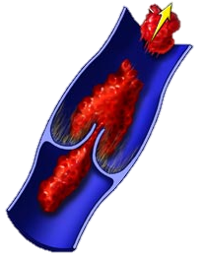
ARTERIAL EMBOLISM
EMBOLUS
is an abnormal mass of undissolved material that has detached
from its initial site And traveled via blood stream to distant site.
May be composed of :
Air , thrombus , foreign body ,
micro organism , and tumor cells .

Slide 16
CAUSES OF
ARTERIAL EMBOLISM
01
03
Cardiac arrhythmia
AF
Bacterial endocarditis prostatic valve
02
Recent
Myocardial infarction
04
Thrombus in an aneurysms

Slide 17
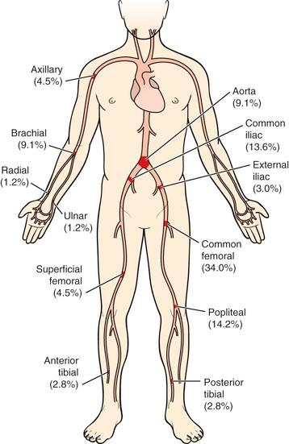
SITES

Slide 18
IMAGING STUDIES
Doppler & Duplex ultrasound
Arteriography
CT Angiography
Digital Subtraction Angiography
MR Angiography

Slide 19
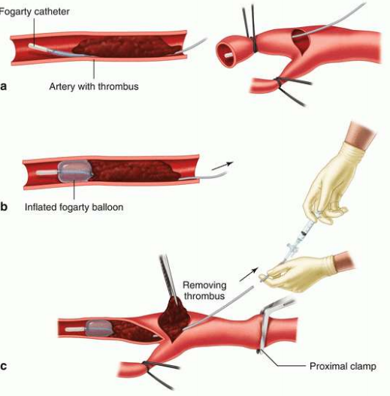
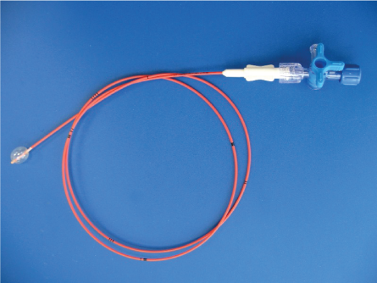
TREATMENT
Empolectomy
Urgent empolectomy with fogarty catheter

Slide 20
TREATMENT
Empolectomy
Complications
    Sudden death.
    Reperfusion injury.
    Compartment syndrome .
    Iatrogenic vascular injury .

Slide 21
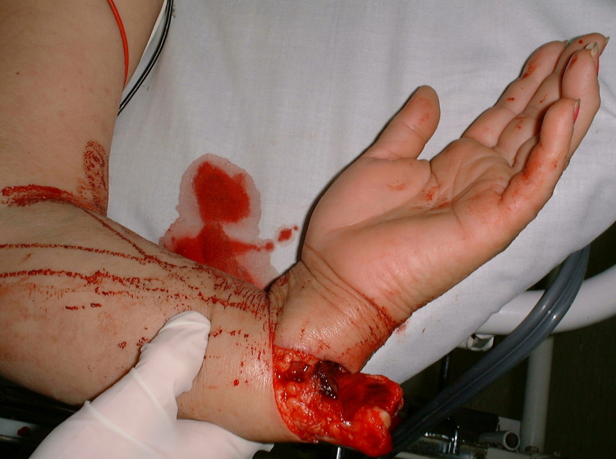
Trauma
Vascular injuries
Penetrating injuries
      Low velocity injuries
      High velocity injuries
      Close range shotgun blasts
Blunt injuries
      Direct injury to major vessels
      Fractures & dislocations
Iatrogenic injuries
Intra arterial drug injection

Slide 22
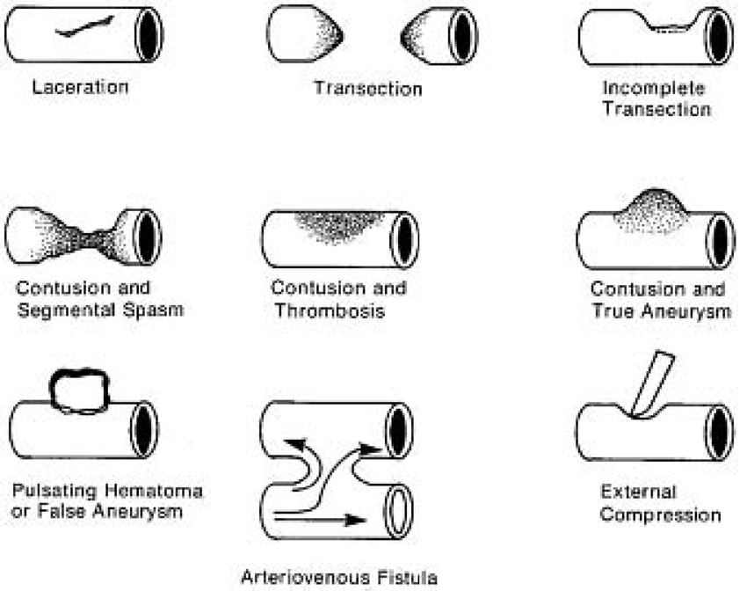
Trauma
Vascular injuries

Slide 23
CLINICAL PICTURE
Hard Signs of vascular injury
• Absent or diminished distal pulses
• Active hemorrhage
• Large, expanding or pulsatile hematoma
• Bruit or thrill
• Distal ischemia

Slide 24
CLINICAL PICTURE
Soft Signs of vascular injury
• Small, stable hematoma
• Injury to anatomically related nerve
• Unexplained hypotension
• hemorrhage no longer present
• Proximity of injury to major vessel

Slide 25
INVESTIGATIONS
In patient with hard signs
Immediate surgical exploration.
In patient with soft signs
Urgent investigation are needed
            Plain x ray to detect foreign body and fractures.
            Arteriography
            Duplex Uss .

Slide 26
TREATMENT
Immediate treatment
    Control the bleeding.
    IV fluid & blood transfusion .
    Prophylactic antibiotics .
Definitive treatment
    Restoring the normal perfusion with in 6hr .
    Reduction of displaced fracture will return the pulses .
    Surgical repair .
    Local heparin should be used .
    Fasciotomy is done in :
        Late cases.
        Muscle edema.
        Swelling or paralysis after revascularization.

Slide 27
CHRONIC LIMB ISCHAEMIA
It is a slowly progressive arterial obstruction that gives enough time
for collaterals to develop therefor gangrene does not occur rapidly .

Slide 28
AETIOLOGY
Atherosclerosis
Most common cause ( DM , Old age ).
Raynaud’s disease
In upper limbs .
bureger’s disease
In lower limbs .

Slide 29
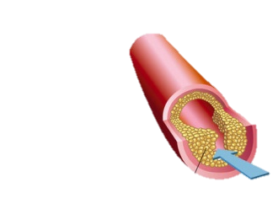
ATHEROSCLEROSIS
It is a chronic, complex degenerative inflammatory condition of elastic and muscular arteries, involving large and medium size artery mainly .

Slide 30
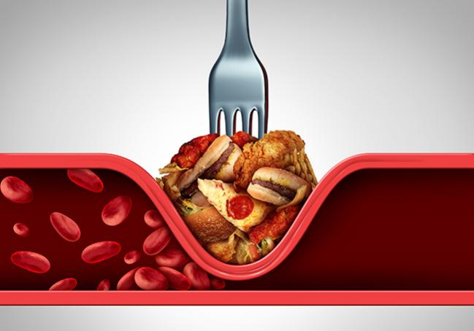
Risk factors
Definitive
Relative
Hypercholesterolaemia, and hyperlipidemia cholesterol > 200 mg% high LDL >100 mg%
low HDL < 35 mg%).
Cigarette smoking.
Hypertension.
Diabetes mellitus
Age—elderly
Common in males
Sedentary life, obesity
Family history

Slide 31
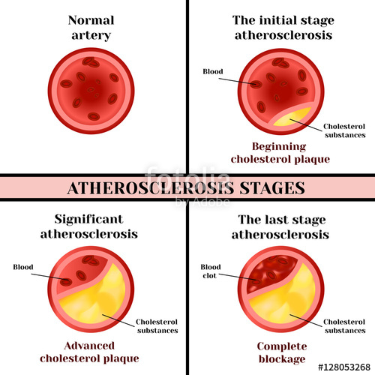
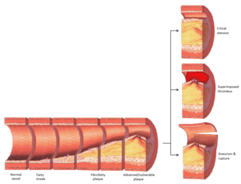
Pathophysiology

Slide 32
CLINICAL PICTURES
Pain
Pallor
+
Capillary refilling time
Trophic changes
Paralysis
Pulseless
Progressive Coldness
Parasthesia

Slide 33
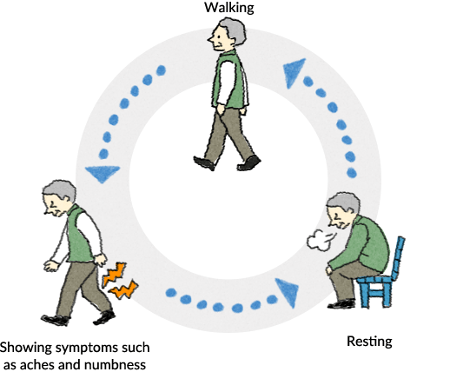
CLINICAL PICTURES
Pain
INTERMITTENT CLAUDICATION
It is a crampy pain in the muscle seen in the limbs.
Due to arterial occlusion, metabolites like lactic acid accumulate in the muscle and cause pain.

Slide 34
CLINICAL PICTURES
Pain
INTERMITTENT CLAUDICATION
The site of pain depends on site of arterial occlusion.
The most common site is calf muscles.
Pain in foot is due to block in lower tibial and plantar vessels.
Pain in the calf is due to block in femoropopliteal segment.
Pain in the thigh is due to block in the superfi cial femoral artery.
Pain in the buttock is due to block in the common iliac or aortoiliac segment,
often associated with impotence and is called as Leriche’s syndrome.

Slide 35
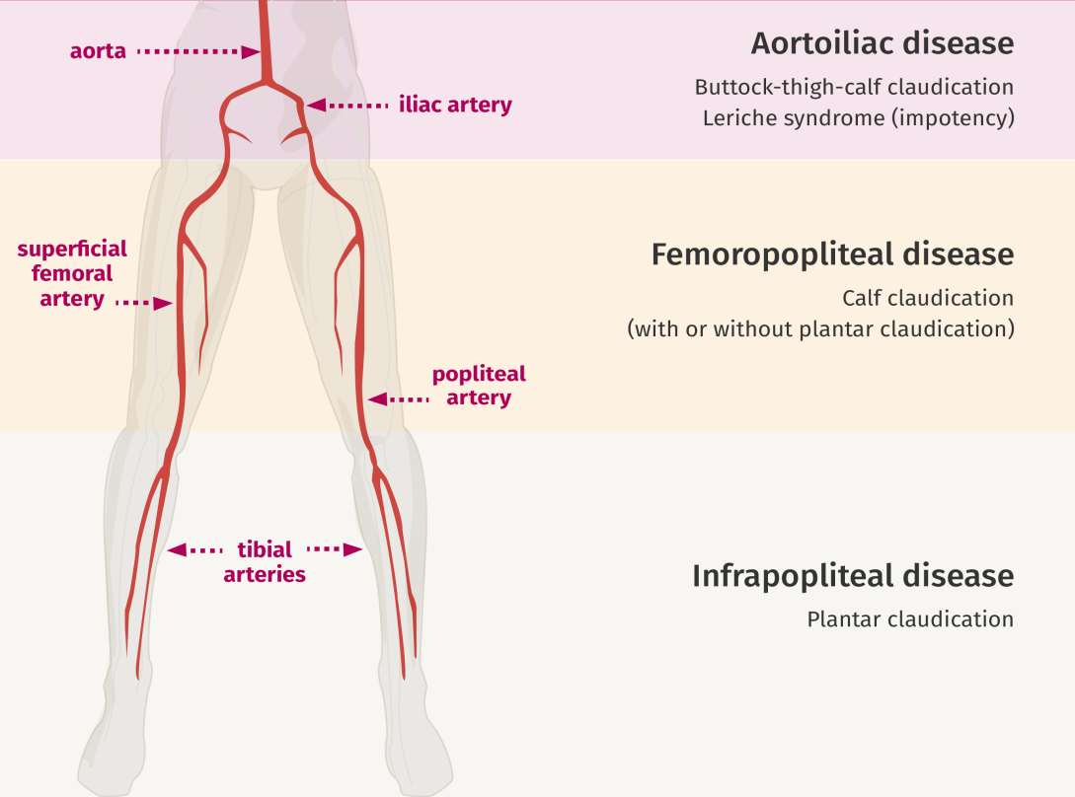
CLINICAL PICTURES
INTERMITTENT CLAUDICATION

Slide 36
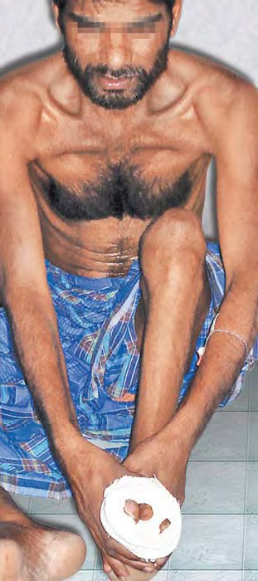
CLINICAL PICTURES
Pain
REST PAIN
It is continuous aching in calf or feet and toes even at rest.
It is ‘cry of dying nerves’ due to ischemia of the somatic nerves.
Pain gets aggravated by elevation and is relieved in dependent position of the limb.
Rest pain is worst at night and so patient is sleepless at night.
Rest pain is apparently reduced by holding the foot with hand.

Slide 37
CLINICAL PICTURES
Fontaine classification of limb ischemia
Stage 1: No clinical symptoms
Stage 2: Intermittent claudication
      – 2a: Well compensated—can walk > 200 metres
      – 2b: Poorly compensated—walk only < 200 metres
Stage 3: Rest pain
Stage 4: Gangrene, ischemic ulcer

Slide 38
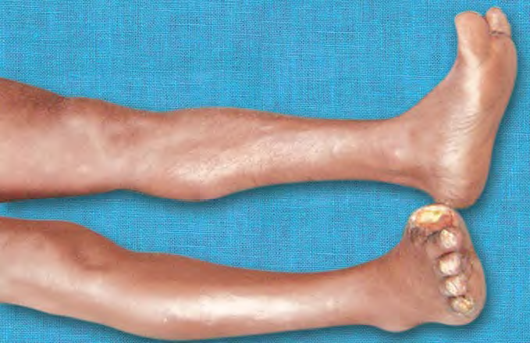
CLINICAL PICTURES
Trophic changes
Thinning of skin
Diminished hair
Loss of subcutaneous fat
Brittle nails, with transverse ridges
Ulceration in digits
Wasting of muscles

Slide 39
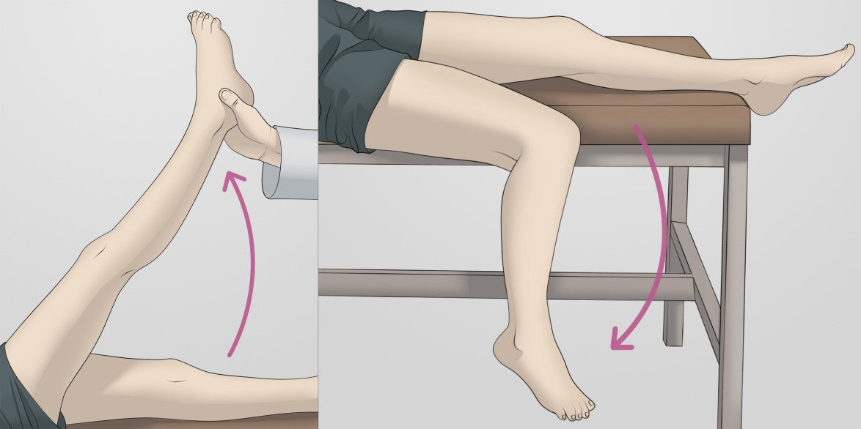
CLINICAL PICTURES
Pallor ( color changes )
Normal color : mild ischemia
Postural changes ( buergar’s test ):
        Pallor at elevation
        Cyanosis at lowering
If this angle is < 30°
it indicates severe ischemia.
Buergar’s angle

Slide 40
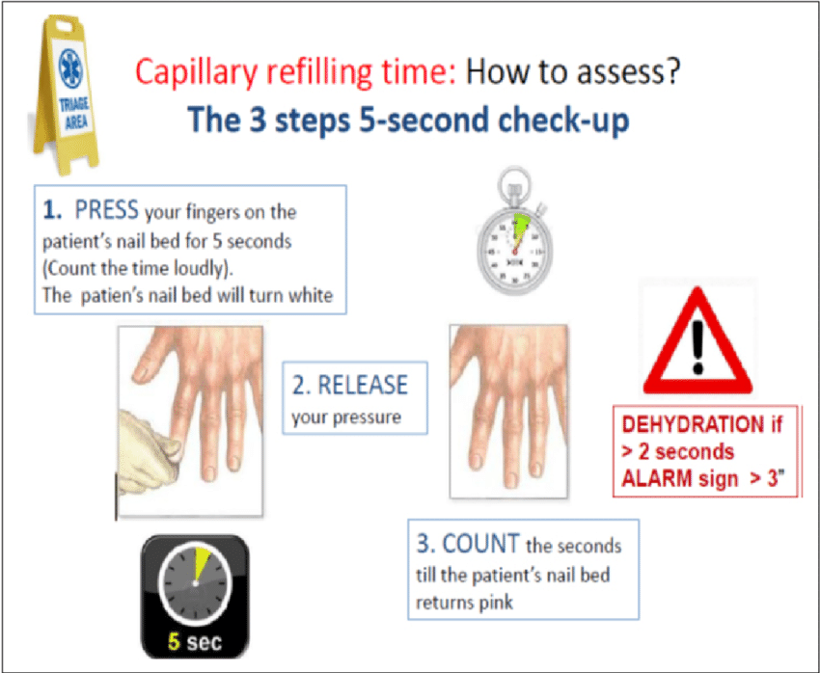
CLINICAL PICTURES
< 2 seconds normal
> 3 seconds ischemia

Slide 41
STAGING OF
CHRONIC LIMB ISCHEMIA
Functional ischemia
      the patient presents with
      Claudication
      Ischemic ulcers
Critical ischemia
      It means the stage of impending limb loss or pregangrenous stage
      Persistent rest pain for more than 2 week .
      Intermittent claudication < 50 m
      Fixed color changes
      Ulcers
      Beruger’s angel < 30
      ABI < 0.7

Slide 42
IMAGING STUDIES
Doppler & Duplex ultrasound
Arteriography
CT Angiography
Digital Subtraction Angiography
MR Angiography

Slide 43
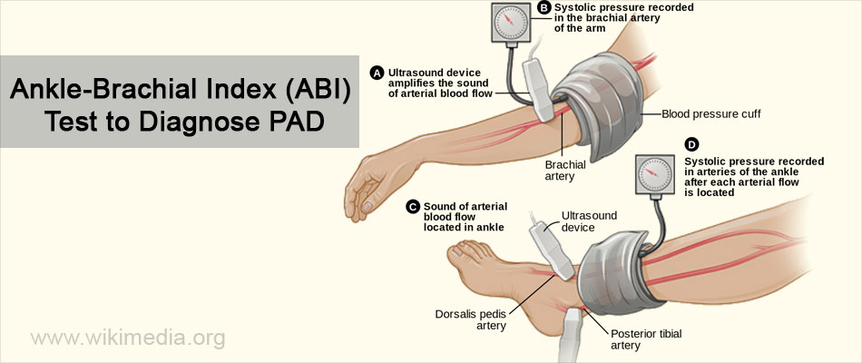
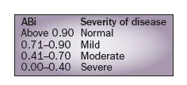
INVESTIGATIONS

Slide 44
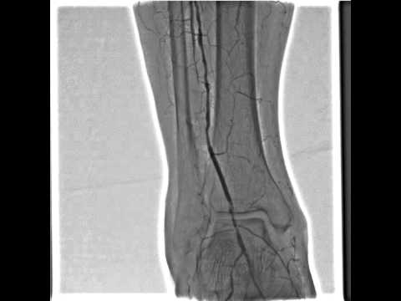
INVESTIGATIONS
Arteriography

Slide 45
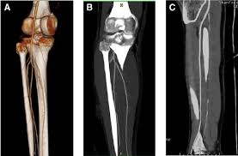
INVESTIGATIONS
CT Angiography

Slide 46
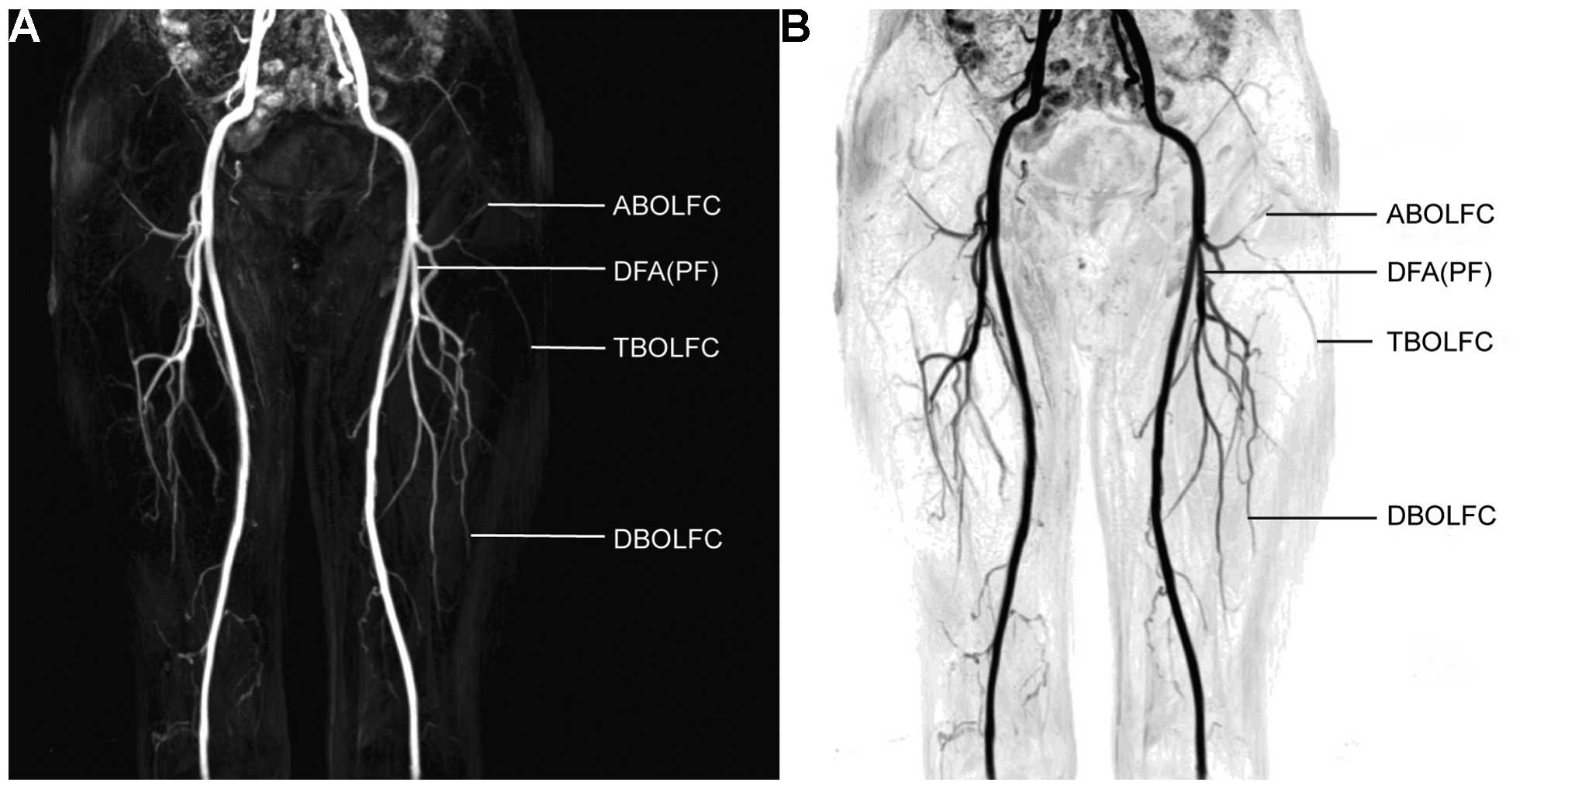
INVESTIGATIONS
Digital Subtraction Angiography

Slide 47
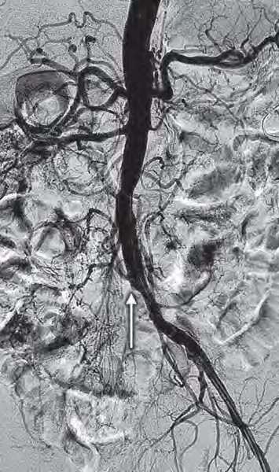
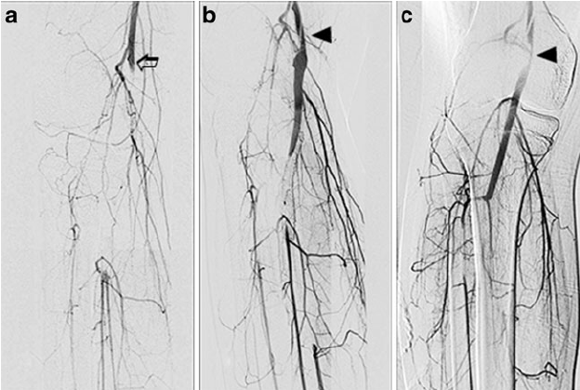
INVESTIGATIONS
Digital Subtraction Angiography

Slide 48
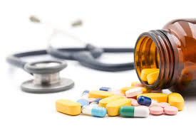
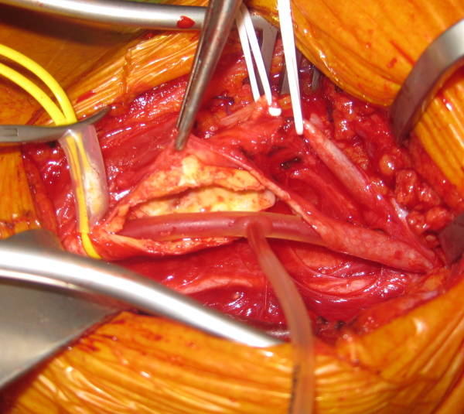
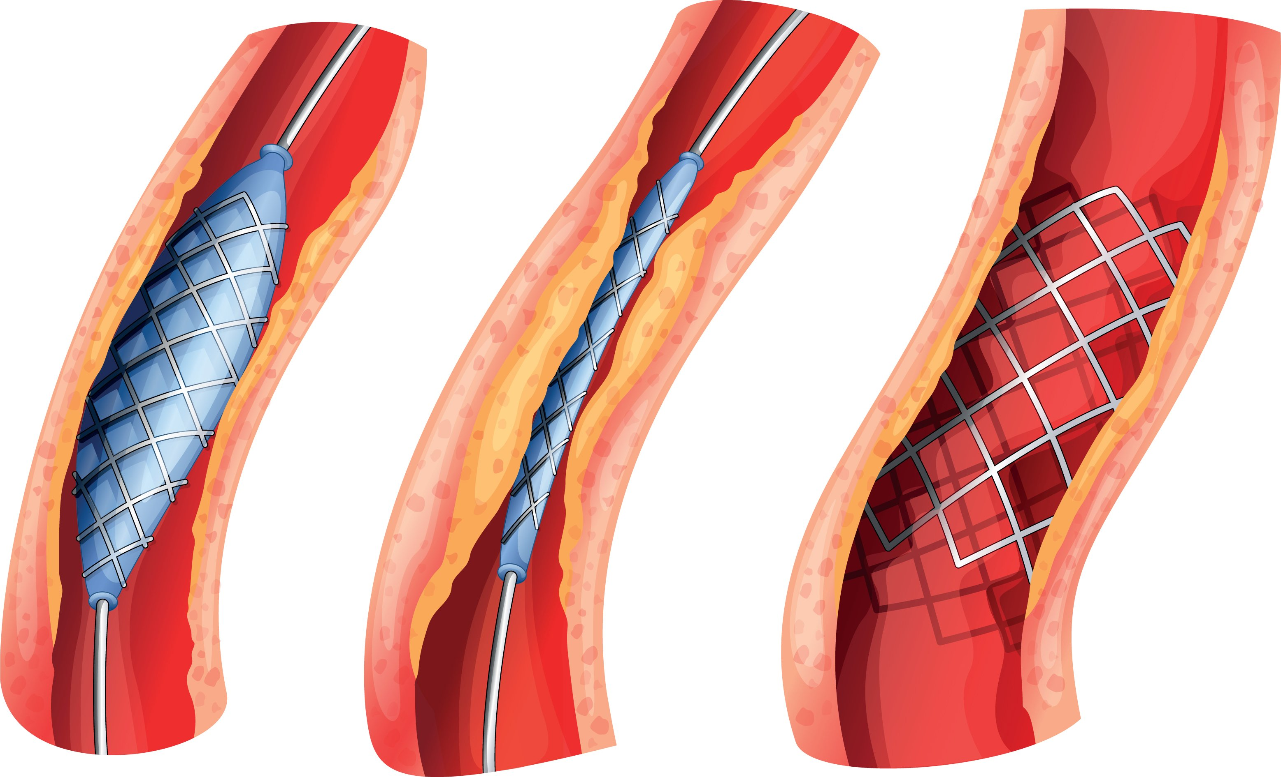
TREATMENT
Conservative
Surgery
Treatment
Endovascular

Slide 49
TREATMENT
Conservative
for mild ischemia & unfit patient
Stop smoking
Mild exercises
Correct anemia
Control DM, HTN , etc.
Care of feet
Medications , eg: aspirin , trental

Slide 50


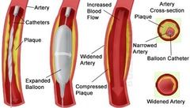
TREATMENT
Endovascular
for localized obstruction < 10cm in large or medium sized arteries
Arterial stent
Laser angioplasty
Percutaneous Transluminal balloon Angioplasty ( PTA )

Slide 51
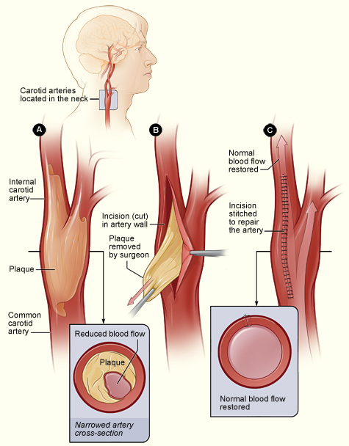
TREATMENT
Surgery
Thromboendarterctomy

Slide 52
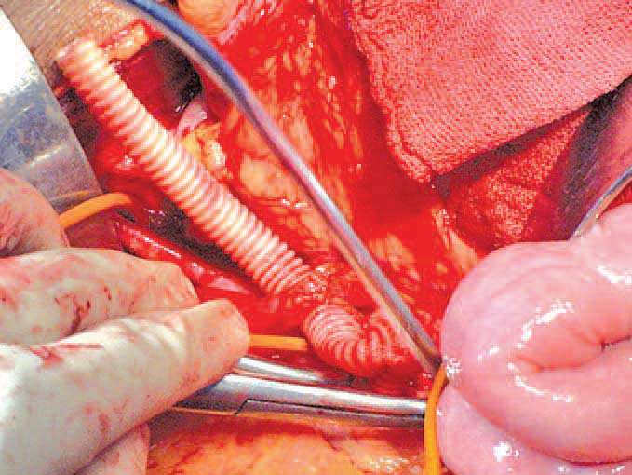
TREATMENT
Surgery
B. Arterial bypass

Slide 53
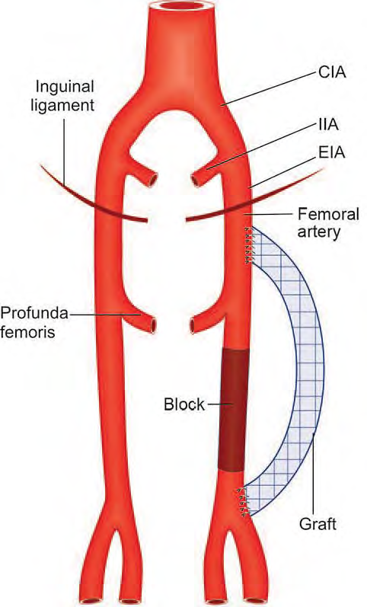
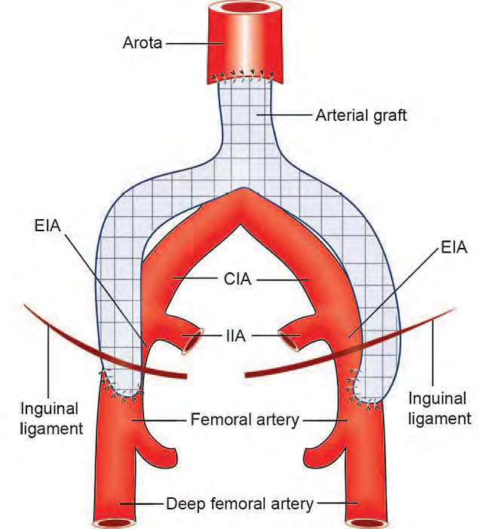
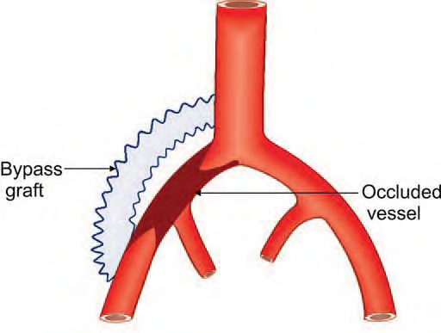
TREATMENT

Slide 54
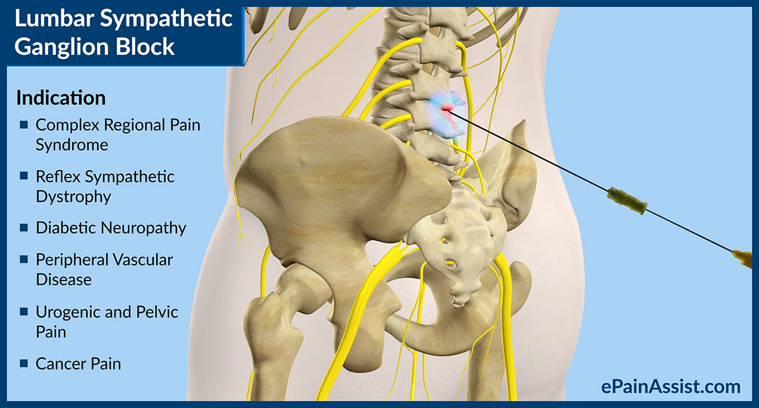
TREATMENT
Surgery
C. Lumbar sympathectomy

Slide 55
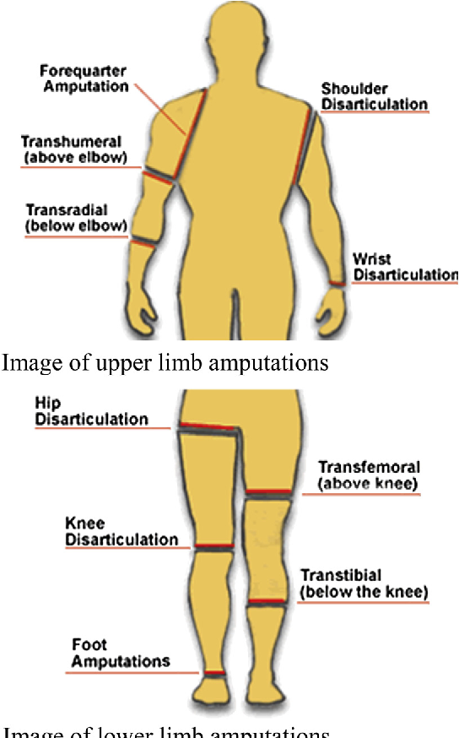
TREATMENT
Surgery
C. Amputation

Slide 56
Break

Slide 57
ARTERIAL DISEASES
Stenosis
01
due to trauma, atherosclerosis, emboli and vasospasm .
02
Dilatations
aneurysms..
03
Inflammation
Arteritis.
04
Small vessel abnormalities.

Slide 58
ANEURYSMS
It is an abnormal permanent dilatation of localised segment of arterial system.
Diameter will be 50% more than expected
normal diameter of that artery in aneurysm.

Slide 59
ANEURYSMS
Classifications
True aneurysm
Congenital Berry’s aneurysm
Acquired :
  pathological : atherosclerosis 90%
  Traumatic
.
Structure
False aneurysm
Etiology
Shape
Fusiform Secular Dissecting

Slide 60
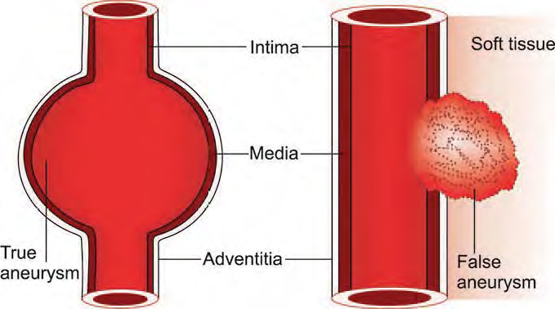
ANEURYSMS

Slide 61
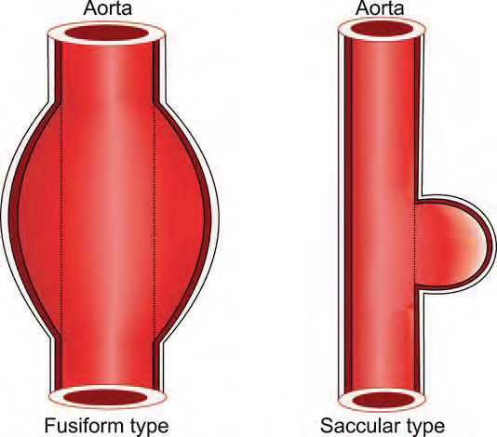
ANEURYSMS

Slide 62
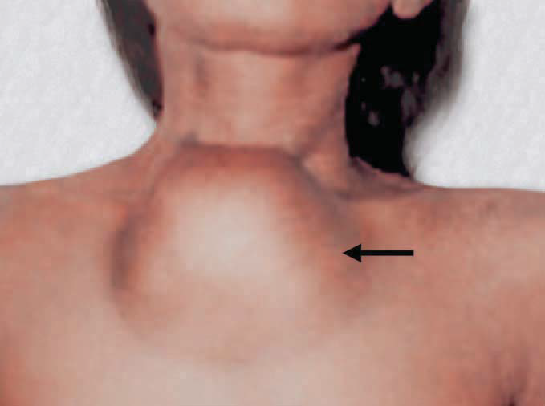
ANEURYSMS
Sites
Aorta.
Femoral.
Popliteal.
Subclavian.
Cerebral, mesenteric, renal, splenic arteries.
THE MOST COMMON IS TRUE, FUSIFORM, ATHEROSCLEROTIC, AORTIC ANEURYSMS

Slide 63

ANEURYSMS
Epidemiology
> 32000 in USA every year .
75 % of aneurysms positively linked to Smoking .
Men are at 4-6 times greater risk .
Incidence increase with Age >50 yr.
Positive Family history can double the risk .

Slide 64
ANEURYSMS
Clinical Features
Usually a symptomatic
Swelling with expansile pulsations
Pulsations diminish with proximal pressure
Aneurysm is compressible
Palpable thrill
Auscultation : bruit.
Move from side to side .

Slide 65
ANEURYSMS
Completions
Rapture & shock .
Infection
Embolus causing gangrene of toes, digits
Pressure effects:-
    On veins: Distal Edema
    On Nerve: Parasthesias.
    On bone :Back pain, chest pain.
    On bowel obstruction or fistula .

Slide 66
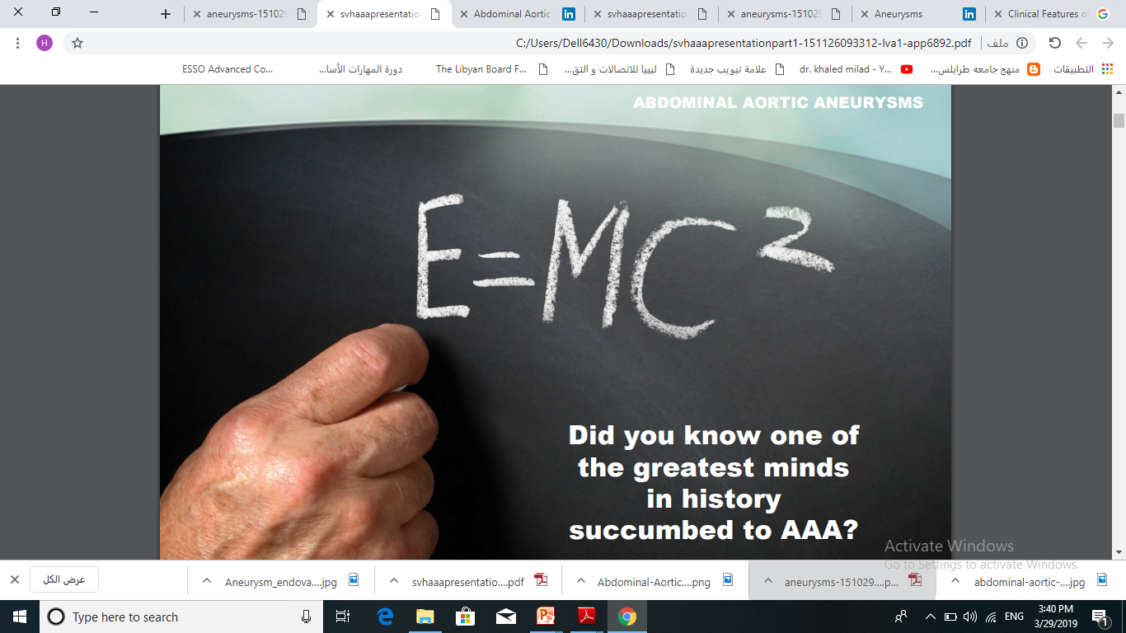

Slide 67
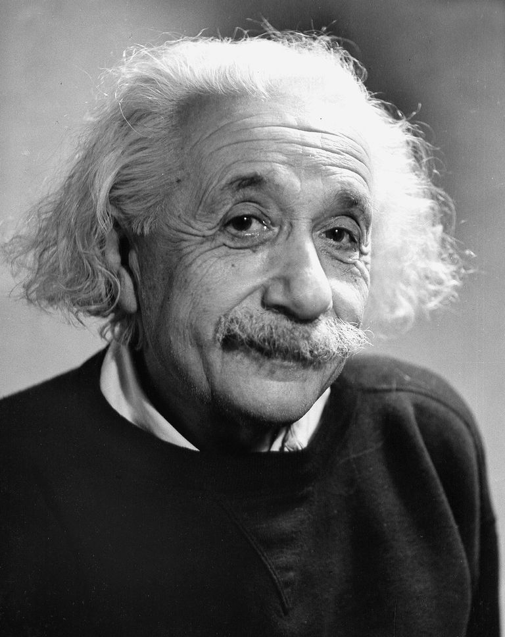
Abdominal
Aortic Aneurysm
Albert Einstein died from an abdominal aortic aneurysm

Slide 68
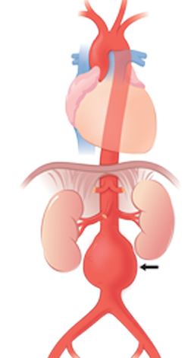
Abdominal
Aortic Aneurysm
• Commonest aortic aneurysm
• Found in 2% of population at autopsy
• Mostly due to Atherosclerosis
• Most common below the origin of renal arteries.

Slide 69
Abdominal
Aortic Aneurysm
• 80% rupture posteriorly into retro peritoneum.
• 20% rupture anteriorly into peritoneal cavity : High mortality

Slide 70
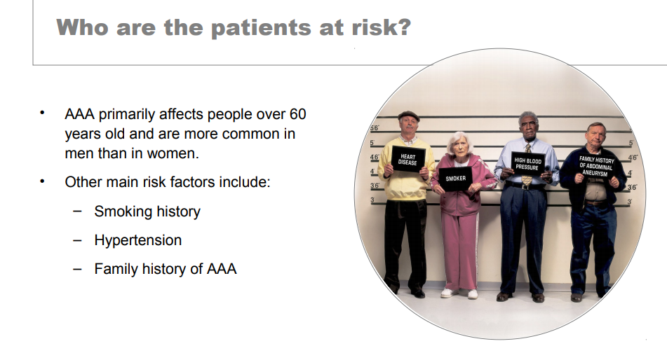
Abdominal
Aortic Aneurysm

Slide 71
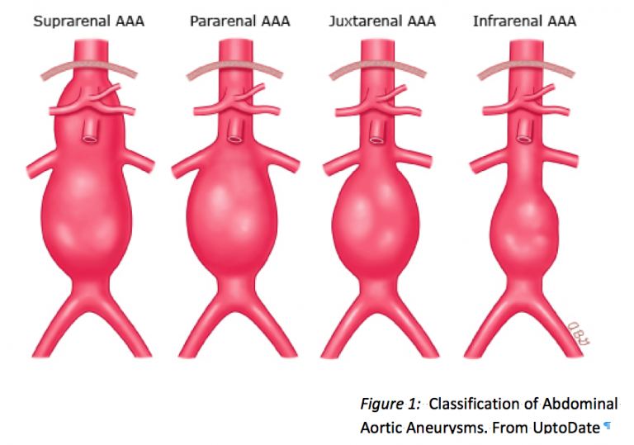
Abdominal
Aortic Aneurysm

Slide 72
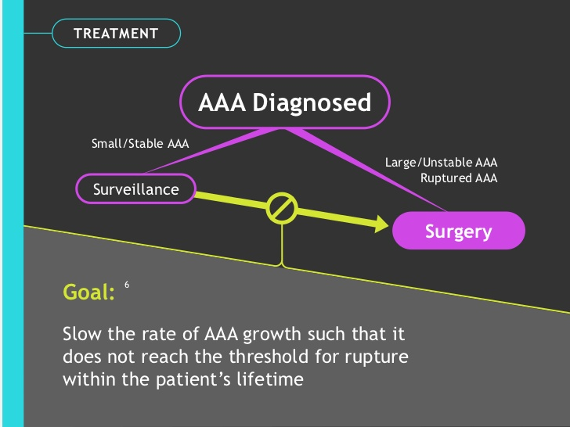
ANEURYSMS

Slide 73
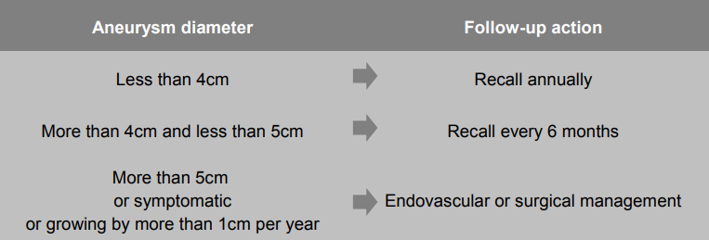
Abdominal
Aortic Aneurysm

Slide 74
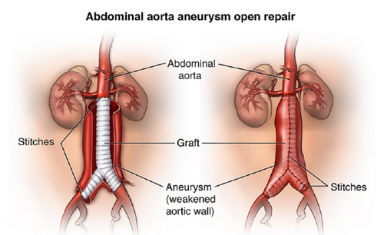
Abdominal
Aortic Aneurysm
Open surgical repair

Slide 75
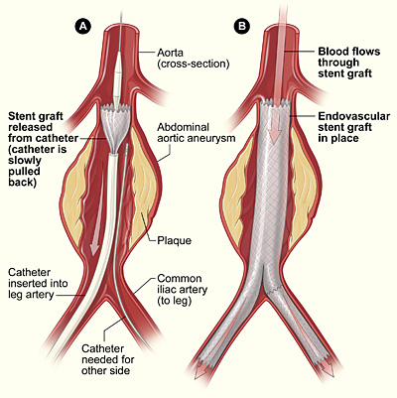
Abdominal
Aortic Aneurysm
Endovascular repair

Slide 76
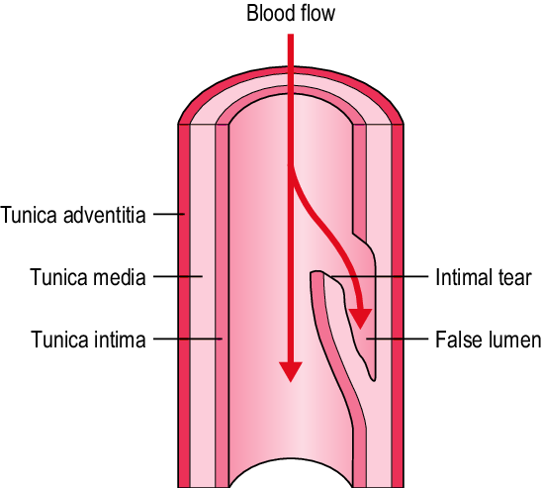
DISSECTING ANEURYSM
It is a misnomer.
It is not an aneurysm, only an aortic dissection.
It is the dissection of media of the aorta after splitting through intima creating a channel in the media of the vessel wall.

Slide 77

DISSECTING ANEURYSM
It is always seen in thoracic aorta, common in ascending aorta (70%).
It is uncommon in other parts of aorta or other vessels.
It can occur in aortic arch or thoracic descending aorta.
This dissected aortic channel gets lined by endothelium,
Often reopens distally into the aorta causing double- barrelled aorta which, in fact , prevents complications.

Slide 78

DISSECTING ANEURYSM

Slide 79
DISSECTING ANEURYSM
Causes
Hypertension (It is associated in 80% of dissecting aneurysms).
Marfan’s syndrome and collagen diseases.
Trauma.
Weakening of the elastic layers of the media due to shear forces.

Slide 80

DISSECTING ANEURYSM
Complications
Acute: Rupture into the pericardium or pleura—dangerous type
Chronic: Blockage of coronary vessels and major vessels like carotid and subclavian arteries with aortic insufficiency

Slide 81


DISSECTING ANEURYSM
Treatment
Surgery
Endovascular

Slide 82


Buerger’s Disease
THROMBOANGIITIS OBLITERANS
(TAO)

Slide 83

Buerger’s Disease
It is an acute inflammatory lesions and occlusive thrombosis of the arteries & veins with perivascular fibrosis to the adjacent nerves .
has a very strong assoc. with cigarette smoking .
commonly occurs in male 20-40 yr. .
usually affect the lower leg. toes, feet .
may involve the arteries of the upper extremities (wrists) .
Patient compline of rest pain and claudication.

Slide 84

Buerger’s Disease
advise the person to stop smoking
vasodilators
prevent progression of disease
avoid trauma to ischemic tissues
relieve pain
provide emotional support
Amputation of the leg is done only when
        gangrene extends well into the foot
        pain is severe and cannot be controlled
        severe infection or toxicity occurs

Slide 85


Buerger’s Disease

Slide 86


Buerger’s Disease

Slide 87

Buerger’s Disease

Slide 88

Raynaud’s
Phenomenon
If spasm persists more than ischemic time then digits go for ulceration and gangrene.

Slide 89
Raynaud’s
Phenomenon
Causes of Raynaud’s Phenomenon
Raynaud’s disease:
Working with vibrating tools: Like pneumatic road drills, chain saws, wood cutting, fishermen travelling in machine boats—vibration white finger.
Collagen vascular diseases: Like scleroderma, rheumatoid diseases causing vasculitis (all autoimmune diseases).
Other causes: Cervical rib, Buerger’s disease, Scalene syndrome.

Slide 90

Raynaud’s disease
It is an episodic vasospastic disease affecting bilateral digital arterioles of young female as a result of abnormal sensitivity to cold.

Slide 91
Raynaud’s
Phenomenon
Treatment
Treat the cause.
Avoid precipitating factors—protect from cold/proper dress/ hand warmer/hand gloves.
Avoid smoking even though it is not direct etiological cause but it may possibly aggravate the disease.
Avoid vibrating tools.
Vasodilators.
Cervical sympathectomy—is used for nonhealing digital ulceration.

Slide 92
Thank you

