Slide 1

LIMU/AMS
2021-2022
INFECTION DISEASE PREVENTION
Hepatitis B Prevention
Presented by … Najat Ahmed Roll number … 2756
Second years student
Block … PTS
Date … 13/3/2022

Slide 2
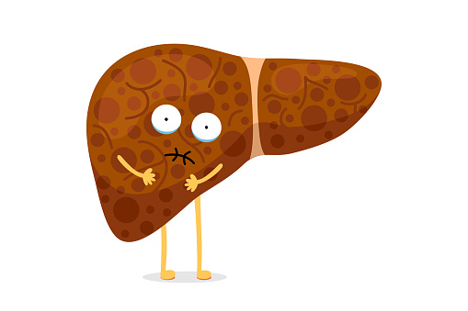
INTRODUCTION

Slide 3
OBJECTIVE
Overview of hepatitis B.
List Symptoms of Hepatitis B.
Outline Transmutation of hepatitis B virus .
Discuss Prevention of hepatitis B.

Slide 4
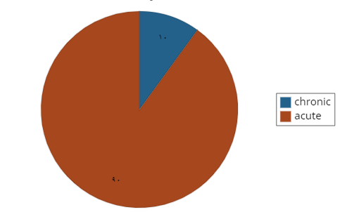
Overview of hepatitis virus
Hepatitis B is a contagious liver infection caused by the hepatitis B virus (HBV) .
The first phase is called acute hepatitis B infection .
it is occur during the first 6 months after a person becomes infected
many people show no symptoms at all .
The second phase is called chronic hepatitis B infection .
this infection persists past 6 months, usually for the rest of the person’s life .
10%
90 %

Slide 5
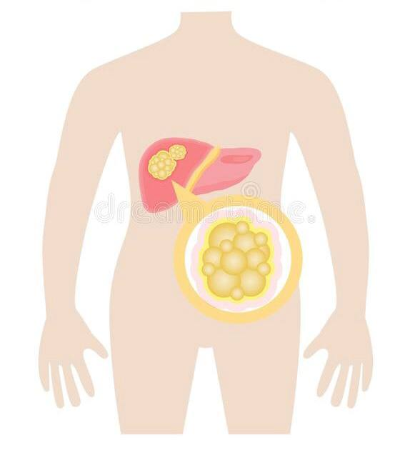
symptoms of hepatitis B virus
acute phase
Chronic phase
Jaundice
Dark-colored urine
Fatigue
Abdominal pain
Loss of appetite
Nausea
Diarrhea
Fever
Ascites
Star-shaped vein pattern
Jaundice
Itching
Easy bruising and bleeding
can lead to:
Cirrhosis
other Liver disease

Slide 6
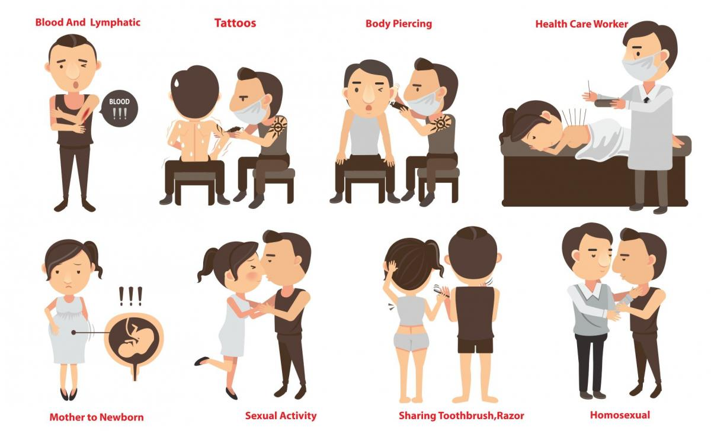
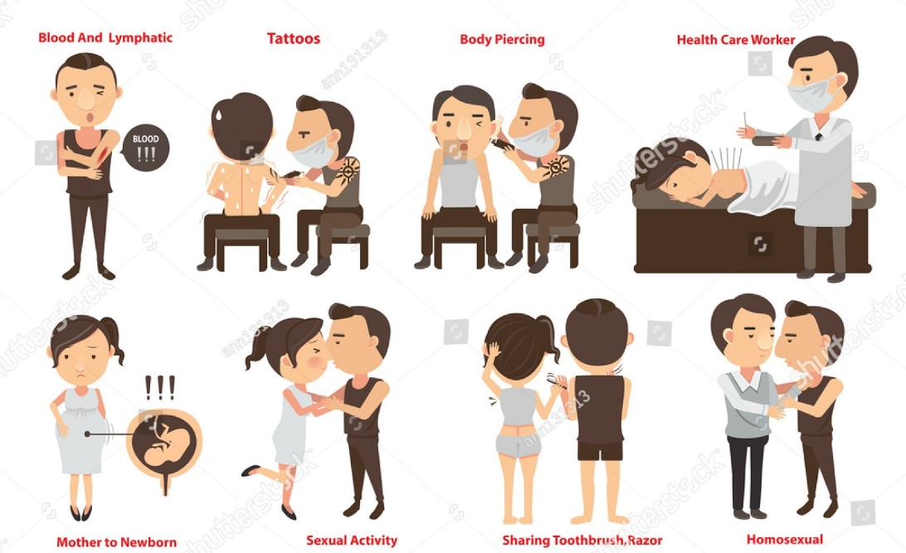
Transmutation of hepatitis B virus

Slide 7
Who is at Risk for Infection?
Health care and public safety workers who may have contact with blood .
Those living in the same household with an HBV-infected person .
Person who Travelers to places where hepatitis B infection is common .

Slide 8
PREVENTION OF HEPATITIS B VIRUS
Vaccine
is safe and highly effective .
consists of 3 doses of vaccine (shots) at 0 . 1 . 6 months .
Giving the infant HBIG and vaccine right away will reliably prevent infection of the infant
Immunodeficient patients require higher doses of vaccine administered at 0 . 1.2.6 months .
health care workers administered at 0, 1 and 2 . 12 months .
vaccination is not contraindicated in pregnant or lactating women .
Protection lasts for 30 years to life .

Slide 9
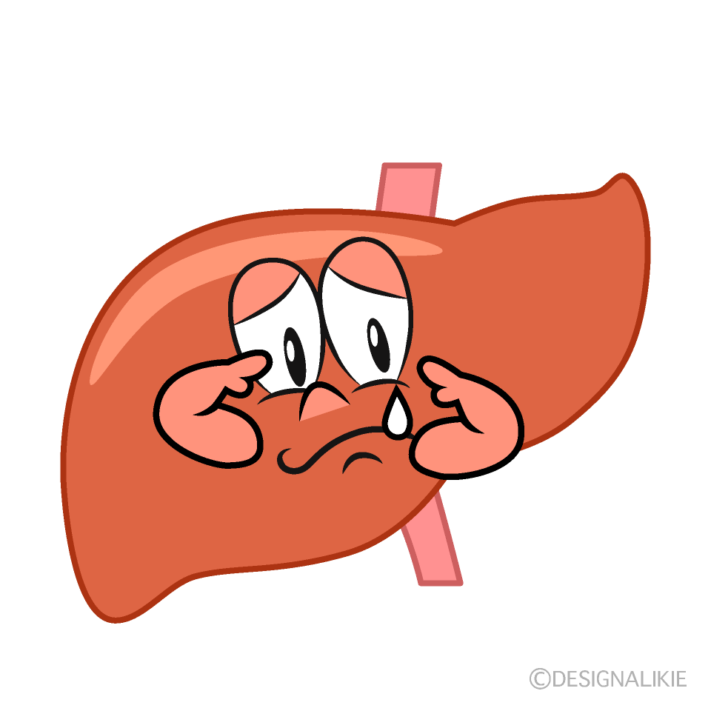
To reduce your risk of getting hepatitis B
modifying behavior.
improving individual education.
If you are a health care or public safety worker, follow universal blood/body fluid precautions and safely handle needles and other sharps .
If you have one or more risk factors for hepatitis B infection, you should get a simple
HBV blood test .
After Exposure to Hepatitis B
There is no specific treatment for acute hepatitis B .
Chronic hepatitis B can be treated with antiviral drugs .

Slide 10

CONCLUSIONS
1 Hepatitis B is a disease of the liver that can be prevented and treated but not cured .
2 all adult and children should be vaccinated for Hepatitis B especially people most at risk.
3 Hepatitis B can separated in many ways such as from mother to her baby and through shared needles for drugs .
4 the majority of people infected with Hepatitis B DON’T die from it , get tested and see a doctor for the best treatment plan for you .

Slide 11

Reference
1 Beasley RP 2009. Rocks along the road to the control of HBV and HCC. Ann Epidemiol 19: 231–234
2 Beasley RP, Hwang LY, Lee GC, Lan CC, Roan CH, Huang FY, Chen CL 1983c. Prevention of perinatally transmitted hepatitis B virus infections with hepatitis B immune globulin and hepatitis B vaccine. Lancet 2: 1099–1102.
3 Chang MH, Chen CJ, Lai MS, Hsu HM, Wu TC, Kong MS, Liang DC, Shau WY, Chen DS, Taiwan Childhood Hepatoma Study Group. 1997. Universal hepatitis B vaccination in Taiwan and the incidence of hepatocellular carcinoma in children. N Engl J Med 336: 1855–1859.
4 . WHO. Department of Communicable Diseases Surveillance and Response. Hepatitis B.

Slide 12


