Slide 1
Clinical approach to renal patient
Mohamed Osama Ezwaie, MD
Associate Professor of medicine and nephrology
Consultant nephrologist at BMC
mohamed.ezwaie@uob.edu.ly

Slide 2
History
Recognize presenting feature:
  Symptom (s); leg swelling, red-colored urine, etc
    OR
  Clinical syndrome;
    Nephritic or nephrotic
    AKI or CKD

Slide 3
Physical examination
Covers the following:
  Related general and regional examination
  Renal system examination

Slide 4
Formulating problem list
Proper analysis; of the patient problems to cover the following:
  Active renal problem;
    presenting complaint ( lesion); system or disease
    Possible etiology
    Functional status, complications, and possible risk factors
  Inactive medical conditions

Slide 5
General examination ( related)
General look:
  Complexion ( retained urinary pigments; urochromes )
  Smell ( uremic )
  Concentration and cognitive functions
  Built ( BMI ); weight gain due to fluid retention, or wasting in advanced renal failure
  Breathing pattern
  Vital signs; blood pressure, postural drop, and hydration status

Slide 6
Regional examination (related)
Face:
  Uremic frost ( fine white powder , that precipitated out of sweat)
  pallor
Neck:
  JVP
Hands:
  Leukonychia ( hypoalbuminia )
  Pallor
  Half and half nails ( chronic renal failure )
  Hand tremors
  Bruising
  Swelling arms ; arteriovenous fistula
Legs:
  Pitting edema; extent
  Scratch marks
  Muscle wasting ( uremic state)

Slide 7
Renal system (physical assessment)
Palpation-
  Costovertebral angle tenderness
  Palpable kidney ( bimanual , ballotment );
    Polycystic kidney
    Hydronephrosis
    Renal mass ( unilateral may indicate carcinoma )
  Palpable bladder
  Role out ascites; due fluid retention
Percussion: Tenderness in the flank may be detected by fist percussion, indicate a kidney infection

Slide 8
Renal system (physical assessment)
Auscultation: The abdominal aorta & renal arteries are auscultated for a bruit, which indicates impaired blood flow to the kidney
  Renal artery stonsis:
    Renal bruit best heard above umbilicus, 2 cm to left or right of midline with diaphragm of stethoscope
    Usually systolic, but presence of systolic and diastolic components makes it Hemodynamically significant
    Heard in about 50% of RAS patients
    The absence of hypertension makes diagnosis of RAS unlikely

Slide 9
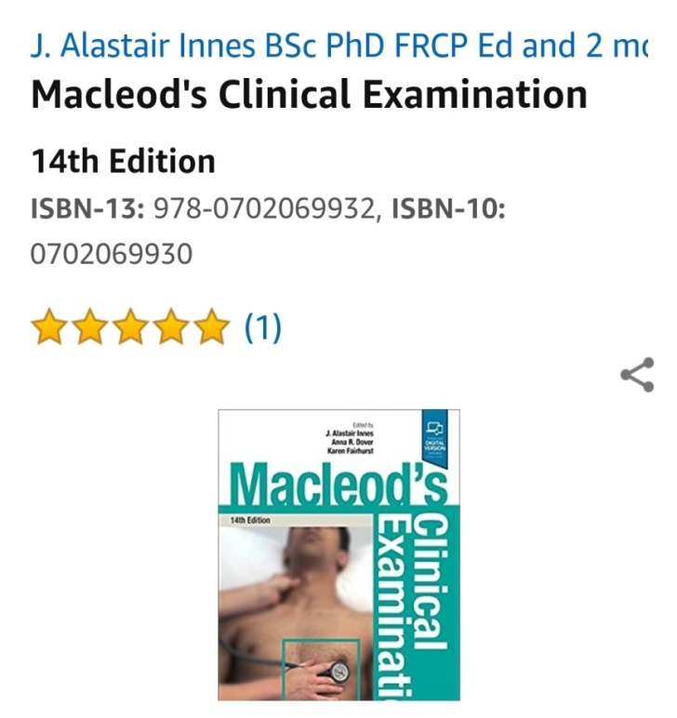
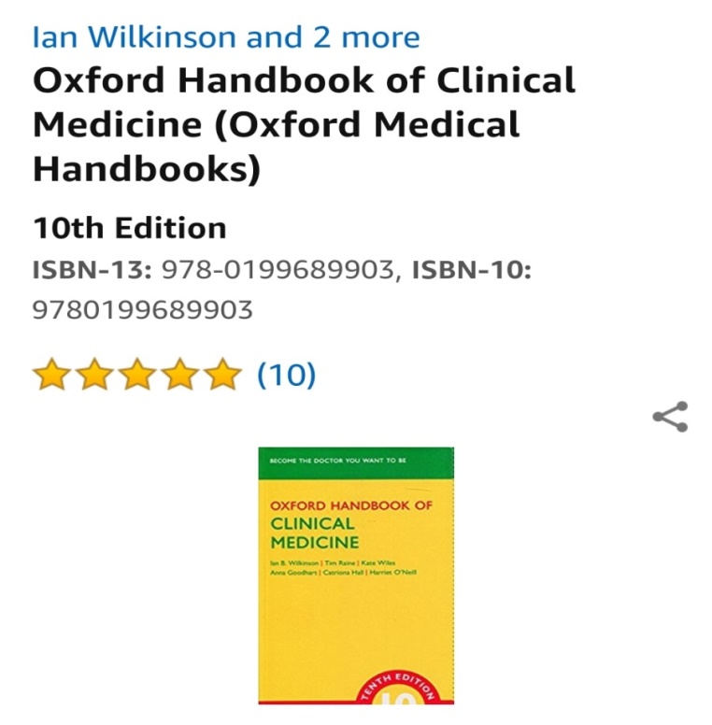
Selected references

Slide 10


Additional references

Slide 11


