Slide 1


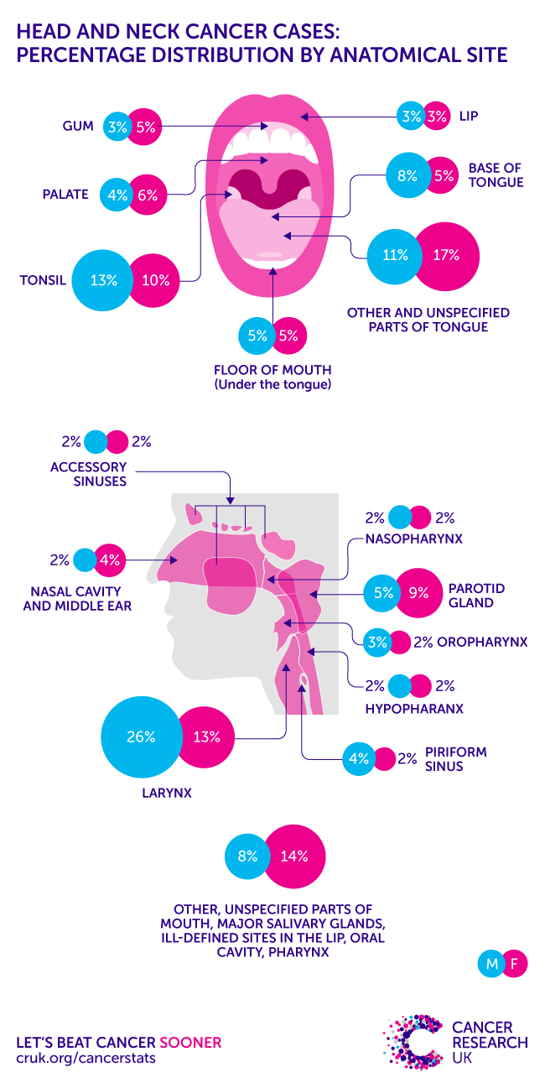
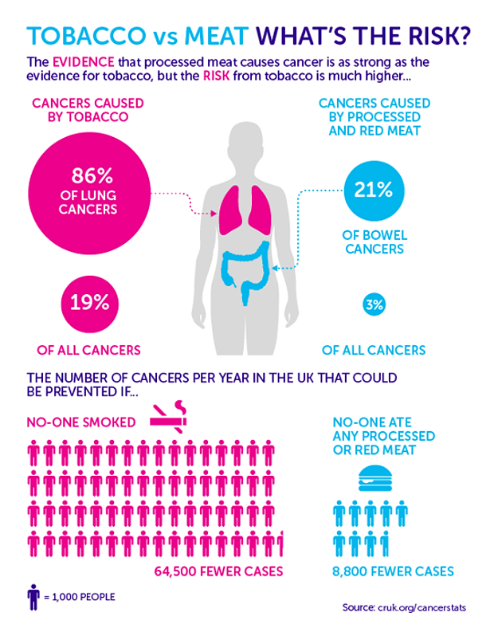
Tobacco Smoker and oral cancer
Al farsi , Athar, 2600
Supervised By Dr. Asma El shaikhy
Faculty of Applied Medical Science – LIMU
Introduction
RESULTS
DISCUTION
Smoking and use of chewed forms of tobacco are the most common
causes of oral cancer,Patients present with a persistent non-healing ulcer in the mouth or a growth, and may have impaired speech and chewing as a result Encourage those who use tobacco to attend an annual oral visual examination to detect early lesions such as white or red patches in the mouth or fibrosis limiting opening of the mouth, Immediately refer patients with a suspicious lesion and history of tobacco
use to a specialist for imaging and biopsy to confirm diagnosis, Surgical excision of the tumour is warranted in most patients, and
reconstructive surgery can minimise disruption of facial features and function to an extent
The analysis of this research explained of smoker its more dangerous risk factor cancer in general and to effect oral cancer
Oral cancer is a disease whose principal
etiological factors are tobacco consumption, which if controlled could help avoid many tumors, consumption has continued to grow for years, risk of the principal factors established in the development of oral cancer and the in¯uence of the oral hygiene level on the appearance of these tumors,The Odds Ratio (OR) for consumption of 6±20 cigarettes/day is 3.1 and 7.96 for more than 20 cigarettes/day.
case-control
study
In the analysis of these variables, measured tobacco consumption as
the number of cigarettes consumed per day found the tobacco consumption statistically significant , OR of 5.03 (95% CI, 2.42±10.45) of smokers compared to non-smokers.
The analysis was based on responses to survey forms received from 1082 individuals (52.6% females), with a mean age of 44.5 SD (18–86 years). Almost one-third of the respondents lived in rural areas.
The most identified risk factor for HNC was smoking cigarettes/tobacco (63.1%)
Cross-Sectional
Survey
Methods
Aim of this research to explain the related tobacco smoker to Cause oral cancer
1st We searched Medline, PubMed, Embase, and the Cochrane Library for randomized trials, meta-analyses, observational studies, and reviews on tobacco related oral cancers.
2nd . 2021 Nationwide Cross-Sectional Survey in (Poland )
third case-control study in Madrid, Spain 2020 (in three hospitals)
Systaltic revue
Six cross-sectional studies
Three cross section was significantly associated with the risk of Oral cancer
(OR = 1.57, 95% CI = 1.47–1.67, I2 = 0)
the overall meta-analysis of longitudinal studies also showed a
(RR = 1.26, 95% CI = 1.07–1.48, I2=67.2%;)
Conclusion &
Recommendation
There is a significant correlation of smoking and oral cancer . However, the causal relationship between them cannot be determined.
More prospective and extensive studies on this theme is needed for
verification.
REFERENCE
Pinkas W, Jankowski M, Wierzba W. Awareness of Head and Neck Cancers: A 2021 Nationwide Cross-Sectional Survey in Poland. J Clin Med. 2022;11(3):538. doi:10.3390/jcm11030538
Eberl M, Tanaka L, Kraywinkel K, Klug S. Incidence of Smoking-Related Second Primary Cancers After Lung Cancer in Germany: An Analysis of Nationwide Cancer Registry Data. Journal of Thoracic Oncology. 2022;17(3):388 398. doi:10.1016/j.jtho.2021.11.016
Rumrich I, Viluksela M, Vähäkangas K, Gissler M, Surcel H, Hänninen O. Maternal Smoking and the Risk of Cancer in Early Life – A Meta-Analysis. PLoS One. 2016;11(11):e0165040. doi:10.1371/journal.pone.0165040

