Slide 1


Breast Cancer Management
By: Sumer Tuwahni
3478
First year student
LIMU
May18,2022

Slide 2
Objectives
Define what is breast cancer?
What are the stages of breast cancer?
List the risk factors that effect breast cancer?
Discuss how breast cancer is diagnosed?
What are the management options for breast cancer?

Slide 3

What is Breast cancer?
It is a cancer that develops in the breast cells
it can grow larger in the breast and spread to nearby lymph nodes or through the patients bloodstream to other organs.
The cancer cell make a group and can invade surrounding tissues or spread ( metastasize) to other areas of the body and causing a tumor in the breast.

Slide 4
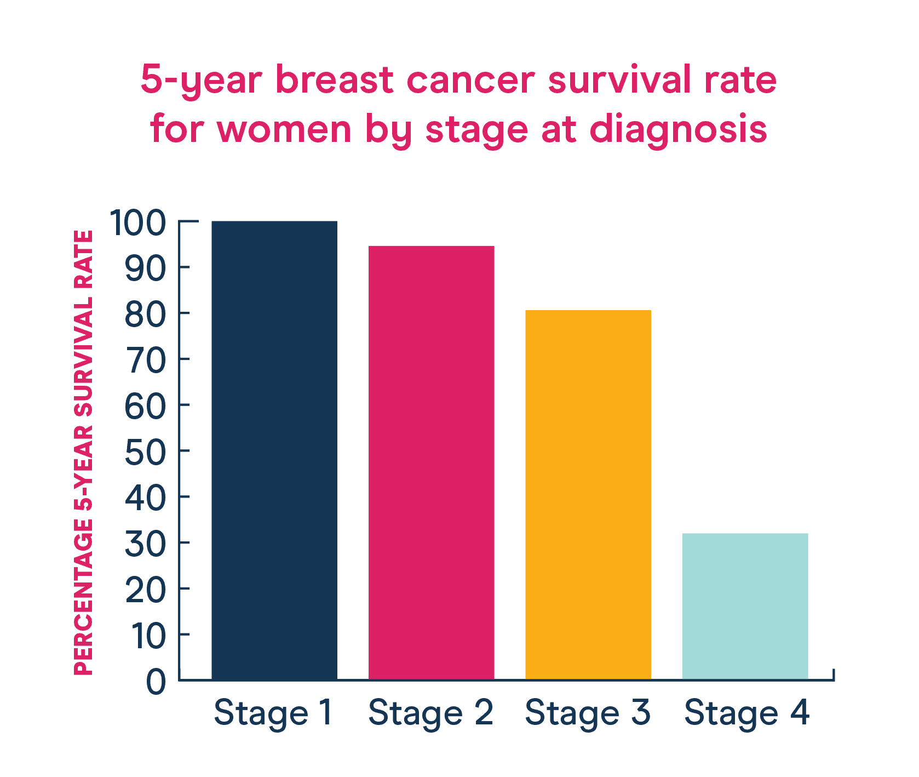
Stages of breast cancer:
Stage 0:- disease is non-invasive
Stage 1:- Cancer cells spread to nearby breast tissue
Stage 2:- tumor at this stage is measured to be between 2-5 cm and does not affect nearby lymph nodes.
Stage 3:- cancer is spread to nearby
tissues and lymph nodes only
Stage 4:- cancer is spread to distant organs such as bones, lungs, brain, and liver

Slide 5
Risk factors
Cannot be changed | Can be changed
Family history and genetic factors | Lack of physical activity
Age | Poor Diet
Race | Being overweight or obese
Gender | Drinking alcohol
Personal health history | Radiation to the chest

Slide 6
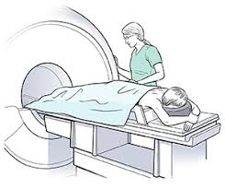
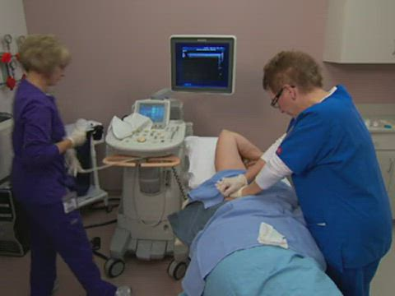
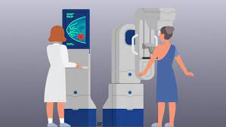
How is breast cancer diagnosed?
Mammogram- a detailed X-Ray that gives the doctor a better vison of the lump and other problems
Magnetic resonance imagine (MRI)- A body scan that uses magnets linked to a computer to create detailed imaging of the patients breast
Biopsy – it is a type of test that the doctor removes tissue or fluid from the breast

Slide 7
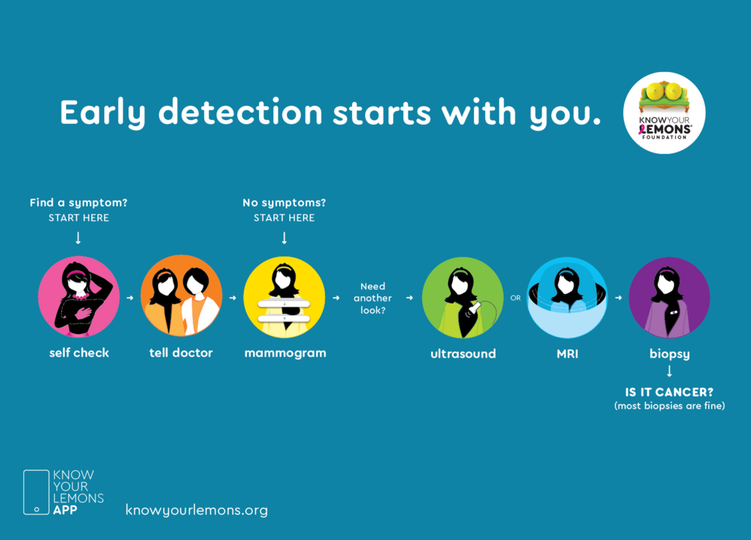

Slide 8
Management options
Surgery: A procedure removing the tumor, depending on what stage of breast cancer, but the tumor could always grow back.
Chemotherapy- is a type of breast cancer method that uses a mixture of drugs to try too demolish the cancer cells from continuing to grow, or slow down the growth
Radiation therapy: it uses high energy rays to try to kill the cancer cell. It affects the area where the radiation is given surrounding skin or cells.
Hormone therapy: some cancers grow in reaction to certain hormones. Certain medication stops the hormones from attaching to the cancer cells, results in stopping its growth.
Target drugs- certain drugs that stop the cells from grow out of control.

Slide 9
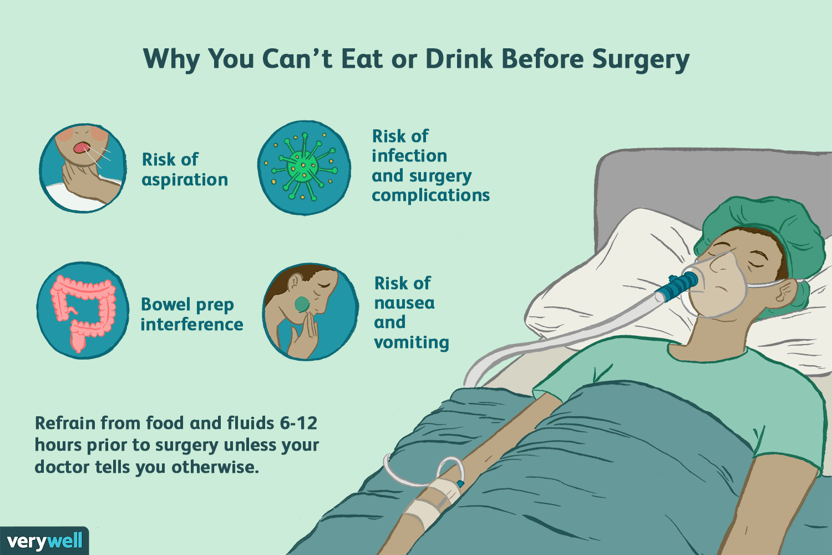

Follow-up care- after surgery the patient will need regular checkups after treatment for breast cancer. This help ensure that a if there are any changes or new symptoms the will be noted and treated.

Slide 10
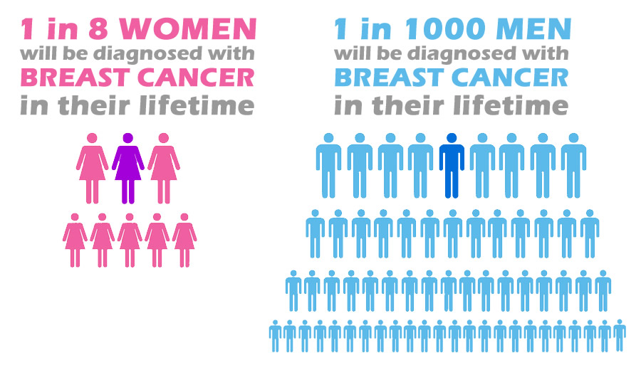
Did you know?
Women who get regularly screened for breast cancer have a 47% lower risk of dying from this disease compared to those who don’t.
Breast cancer is the first leading cause of cancer deaths among women globally.
Breast cancer deaths have been declining since 1990 due to early detections, better screening, increase awareness, and new management options.

Slide 11
References:
Breast Cancer [Internet]. WebMD. 2022 [cited 10 May 2022]. Available from: https://www.webmd.com/breast-cancer/understanding-breast-cancer-basics#091e9c5e80010b06-1-2
Breast Cancer Overview: Causes, Symptoms, Signs, Stages & Types [Internet]. Cleveland Clinic. 2022 [cited 10 May 2022]. Available from: https://my.clevelandclinic.org/health/diseases/3986-breast-cancer
Everything You Need to Know About Breast Cancer [Internet]. Healthline. 2022 [cited 10 May 2022]. Available from: https://www.healthline.com/health/breast-cancer#survival-rate
11 Facts About Breast Cancer [Internet]. DoSomething.org. 2022 [cited 10 May 2022]. Available from: https://www.dosomething.org/us/facts/11-facts-about-breast-cancer

Slide 12


