Slide 1


Importance of Writing Correct Punctuation and Grammar in Research
Libyan International Medical University
Faculty of Business Adminstration
Amal Ibrahim Edbey 2789
amal_2789@limu.edu.ly

Slide 2
Contents of this template
Here’s what you’ll find in this template:
Introduction.
Why is it necessary to write correct grammar and punctuation?
Create an impression
Good reputation
Avoid miscommunication and misunderstanding
Make communication more effective
Keep competitive edge.
3. an example.
4.How can I improve my grammar and punctuation?
5. Conclusion.
6. References.
1

Slide 3
1
Objectives
2
Why it is necessary to write correct grammar and punctuation?
How can I improve my grammar and punctuation?
2

Slide 4
Introduction
With correct grammar and punctuation, a writer can make a good impression among their readers written communication is also required when you have to write an email or blog or article or info graphic or a complete website for the company
3

Slide 5
Why it is necessary to write correct grammar and punctuation?
Create an impression
Good reputation
Avoid miscommunication and misunderstanding
Make communication more effective
Keep competitive edge
4

Slide 6
Why it is necessary to write correct grammar and punctuation?
Create an impression
Every reader wants to create an impression, which can only be possible when you write correct English as a writer.
Good reputation
Writer who use to write correct English with proper grammar and punctuation creates a good reputation.
Avoid miscommunication and misunderstanding
The reader needs to guess what you want to say and in many cases, it is seen that silly punctuation mistakes change the meaning of the sentence.
5

Slide 7
Why it is necessary to write correct grammar and punctuation?
Make communication more effective
If your writing has a lot of punctuation or grammatical mistakes your reader will get distracted from the message that you want to convey to your reader. Moreover, punctuation and grammatical mistakes make your writing harder to read for the reader.
Keep competitive edge
Bad punctuation and grammar not only affect your writing but also cause serious damage to the business you are writing for. There are many customers who hesitate to make a purchase from that type of website which makes silly punctuation, grammar, or spelling mistakes.
6

Slide 8
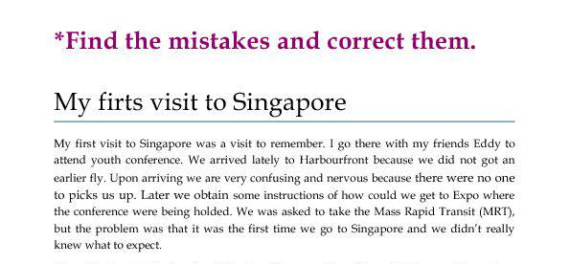
An example
7

Slide 9
How can I improve my grammar and punctuation?
One of the easiest, most effective, and most enjoyable ways to improve your use of grammar and punctuation is to read. Every time you read, pay attention to grammar conventions.
it helps to learn effective proofreading strategies. Reading your essay out loud can help you identify awkward constructions or places where you may need to revise your grammar.
8

Slide 10
Conclusion
Every writer or company should keep in mind the importance of grammar and punctuation in the written communication and should never give any chance to lose your reputation because of silly mistakes in writing. Hence, if you do not want your reader or customer to lose interest in your writing you must use the grammar and punctuation checker tool so that you can make sure your writings are error-free before they get published.
9

Slide 11
References
iCrowdNewswire. (2021, May 24). Importance of writing correct grammar and punctuation. Business
The importance of punctuation in the English language. Lingoda. (2021, October 27).
What are some strategies for improving my grammar and punctuation? What are some strategies for improving my grammar and punctuation? - University of Louisville Writing Center.
10

Slide 12
Thank you!
Any questions?
11

