Slide 1
History taking & Examination of the Skin
Ali M. Gargoom Professor of Dermatology Faculty of Medicine Benghazi University

Slide 2
Objectives of Lecture
1. History taking.
2. Morphology of skin lesions.
Primary skin lesions
Secondary skin lesions
Specific skin lesions
3. Configuration of skin lesions
4. Distribution of skin lesions

Slide 3
History taking:
What is your compliant ? Where it started ?
When it started ? ( i.e. duration of the problem).
If chronic disease is it progressive, regressive or stationary.
Is it associated with remission and relapses.
What is the relieving and aggravating factors ?
Subjective symptoms:
Local symptoms e.g. itching, pain, burning sensation….
General symptoms e.g. fever, joint pain……………….
Drug history. Topical or systemic, patient & their response.
Past medical history.
Allergy to any medication.
History of atopy. Allergic rhinitis, bronchial asthma, atopic dermatitis.
Family history.
Appearance of same problem in one or more family member(s).
History of consanguinity.

Slide 4
Dermatological Examination
Who studies skin diseases and fail to study the lesions first, will never learn dermatology Siemens (1891-1969)

Slide 5
Dermatological Examination
Morphology of Lesions
Configuration of Lesions
Distribution of Lesions

Slide 6
A. Morphology of Skin Lesions
Primary Skin Lesions.
Secondary Skin Lesions
Specific Skin Lesions

Slide 7
Primary Skin Lesions
Macule
Patch
Papule
Nodule
Plaque
Vesicle
Bullae
Pustule

Slide 8
Secondary Skin Lesions
Crust
Scales
Erosion
Ulcer
Atrophy
Scar
Fissuring
Lichenification

Slide 9
Specific Skin Lesions
Wheal
Burrow
Comedon
Target Lesion

Slide 10
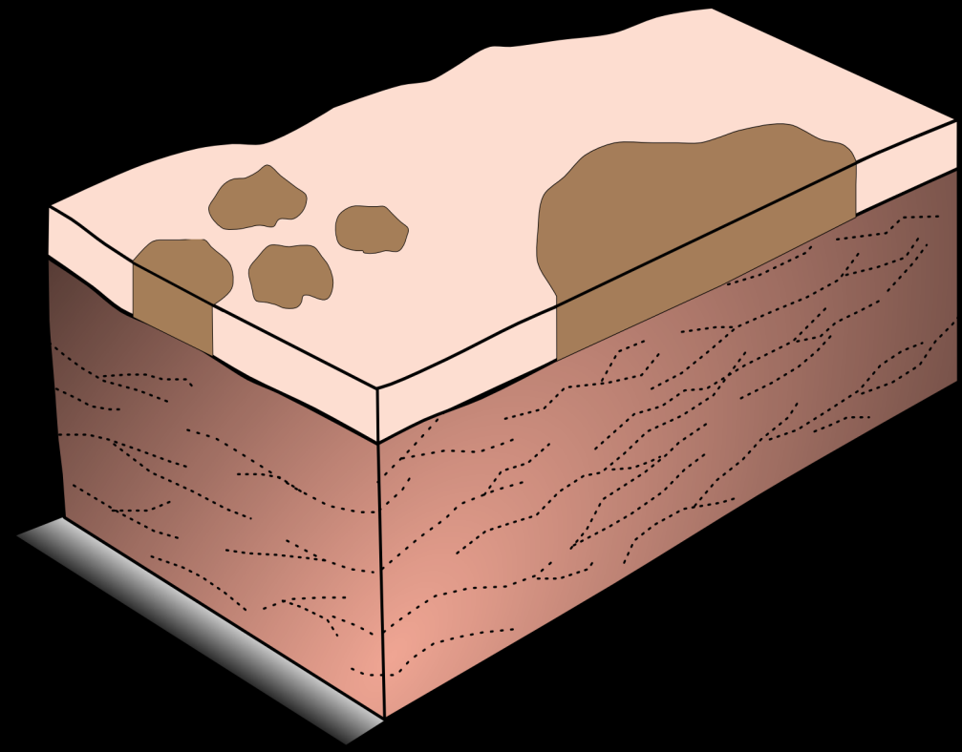
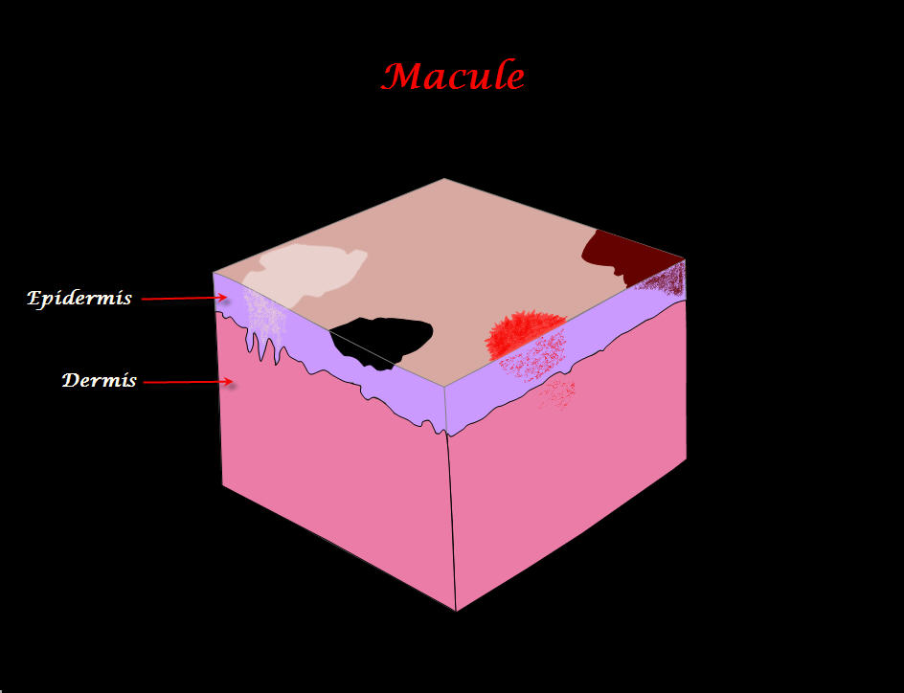
Primary Skin Lesions
Macule / Patch
Size <0.5cm or >0.5cm

Slide 11
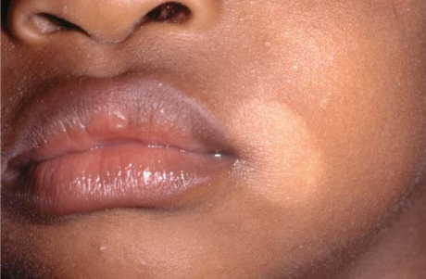
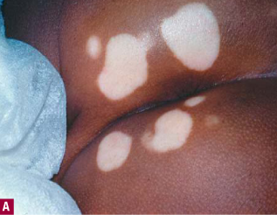
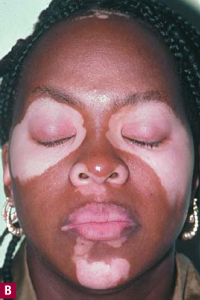
Primary Skin Lesions
Macule / Patch

Slide 12
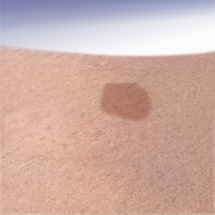
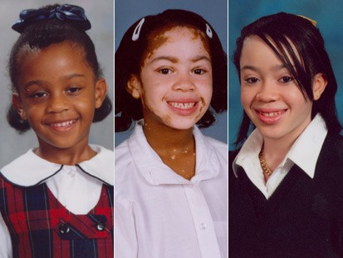
Primary Skin Lesions
Macule / Patch

Slide 13
Primary Skin Lesions
Erythema / Purpura

Slide 14
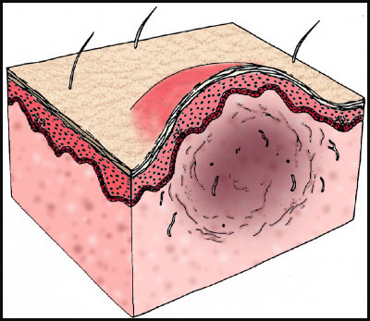
Primary Skin Lesions
Papule / Nodule
Size <0.5cm or >0.5cm

Slide 15
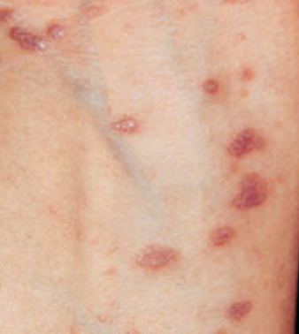
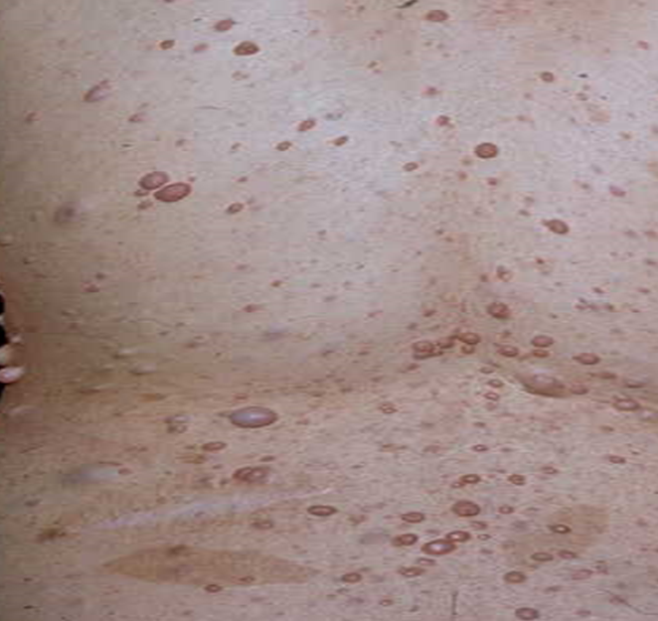
Primary Skin Lesions
Papule / Nodule

Slide 16
Primary Skin Lesions
Vesicle(s) / Bulla(e) / Pustule(s)
Size <0.5cm or >0.5cm

Slide 17
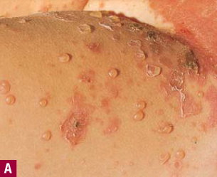
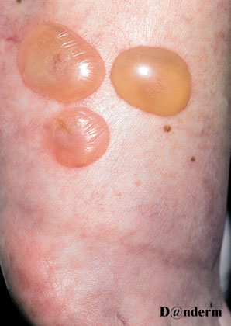
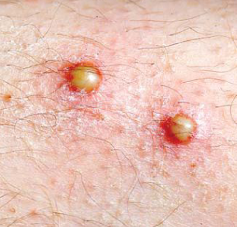
Primary Skin Lesions
Vesicle(s) / Bulla(e) / Pustule(s)

Slide 18
Primary Skin Lesions
Plaque

Slide 19
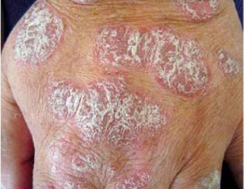
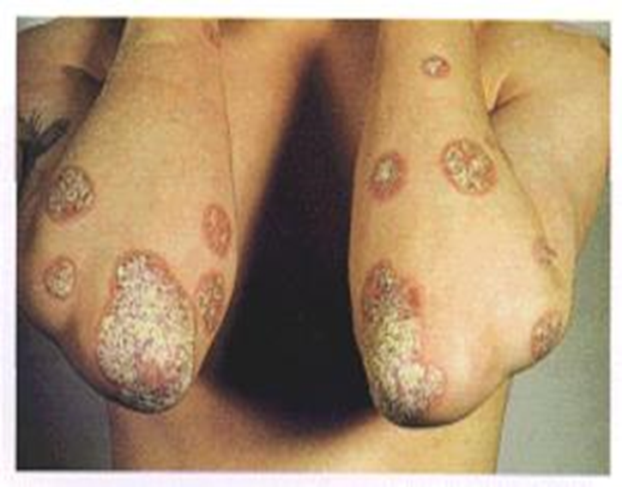
Primary Skin Lesions
Plaque

Slide 20
Primary Skin Lesions
1. Macule.
2. Patch.
3. Papule.
4. Nodule.
5. Plaque.
6. Vesicle.
7. Bulla.
8. Pustule.

Slide 21
Secondary Skin Lesions
Crust
Scales
Erosion
Ulcer
Atrophy
Scar
Fissuring
Lichenification

Slide 22
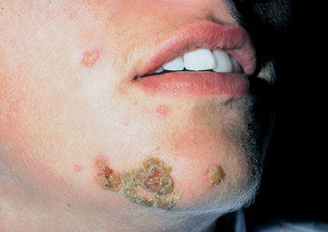
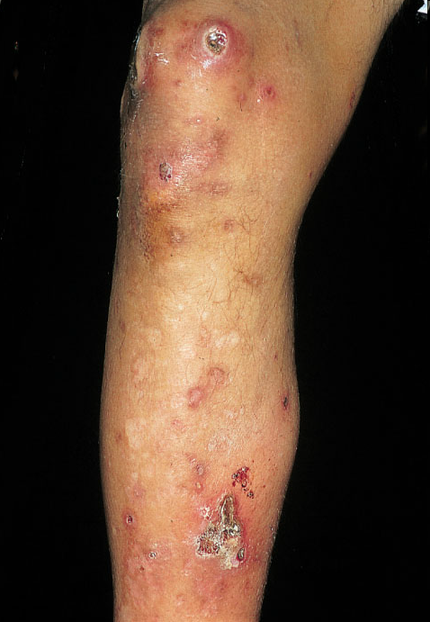
Secondary Skin Lesions
Crust

Slide 23
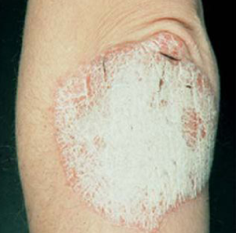
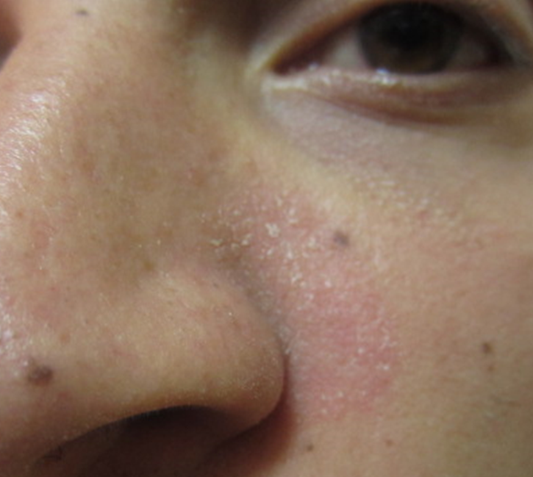
Secondary Skin Lesions
Scales

Slide 24
Secondary Skin Lesions
Erosion / Ulcer

Slide 25
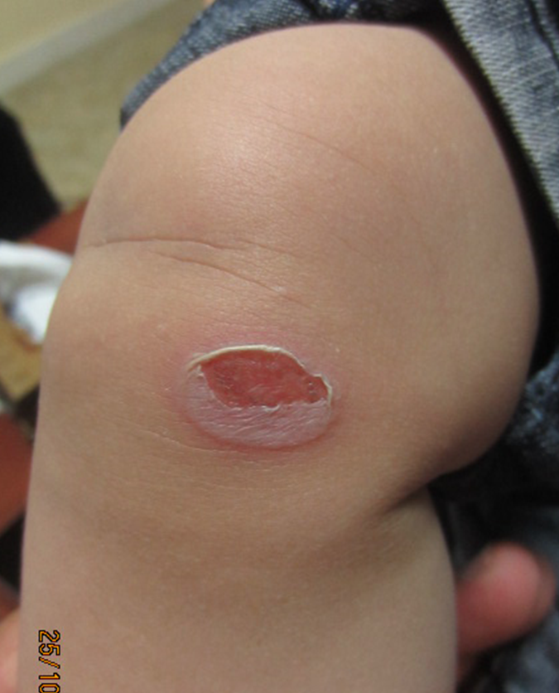
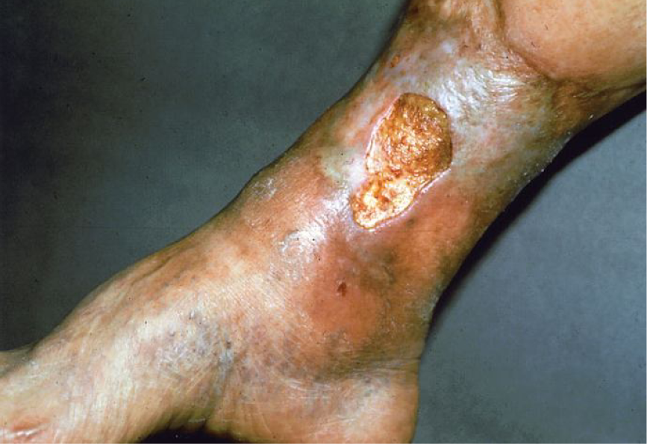
Secondary Skin Lesions
Erosion / Ulcer

Slide 26
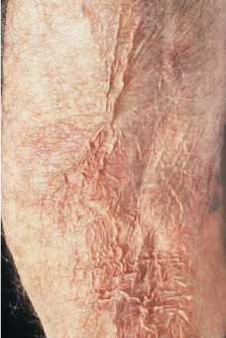
Secondary Skin Lesions
Atrophy

Slide 27
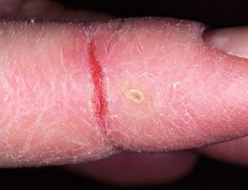
Secondary Skin Lesions
Fissure (s)

Slide 28
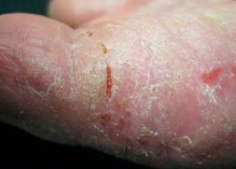
Secondary Skin Lesions
Fissure (s)

Slide 29
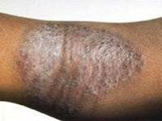
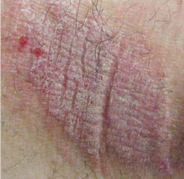
Lichenification

Slide 30
Specific Skin Lesions
Wheal
Burrow
Comedon
Target Lesion

Slide 31
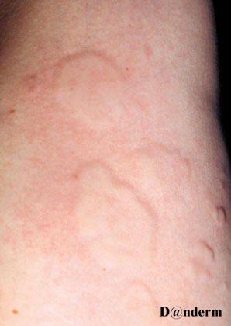
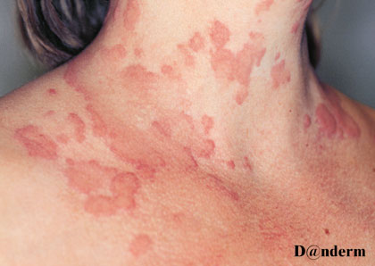
Specific Skin Lesions
Wheal
Urticaria

Slide 32
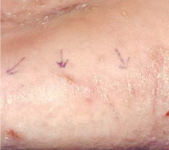
Specific Skin Lesions
Burrow

Slide 33
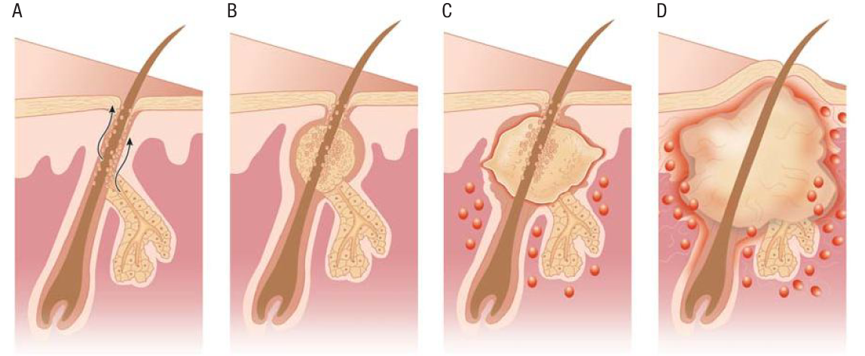
Specific Skin Lesions
Comedon

Slide 34
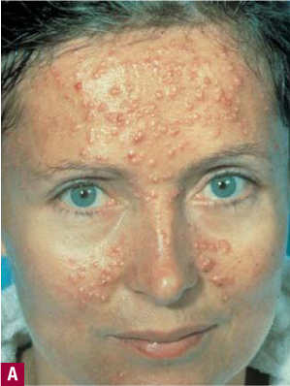
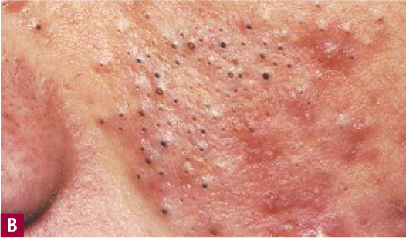
Specific Skin Lesions
Comedon

Slide 35
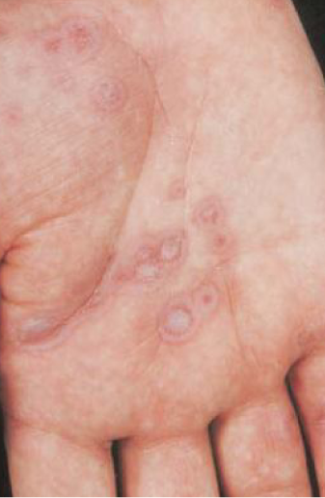
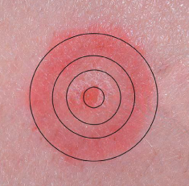
Specific Skin Lesions
Target Lesion

Slide 36
Arrangement of skin lesions in relation to each other
Configuration of Lesions

Slide 37
Linear Polycyclic Annular Discoid Groped
B. Configuration of Lesions
Arrangement of skin lesions in relation to each other

Slide 38
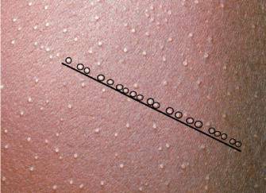
Configuration of Lesions
Linear

Slide 39
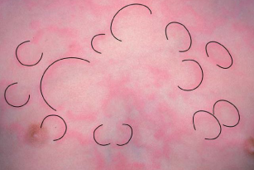
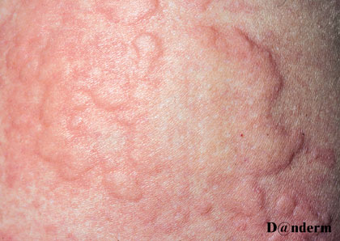
Configuration of Lesions
Polycyclic

Slide 40
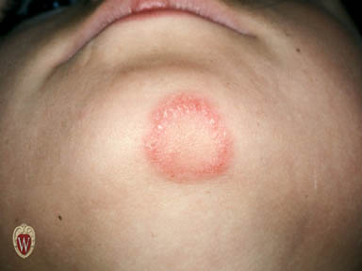
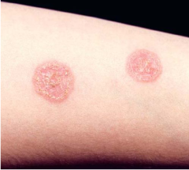
Configuration of Lesions
Annular
Discoid

Slide 41
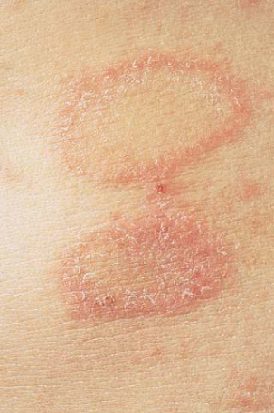
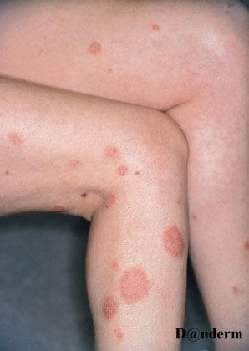
Configuration of Lesions
Annular
Discoid

Slide 42
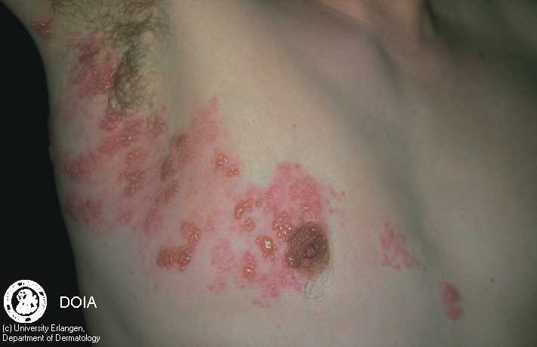
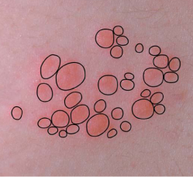
Configuration of Lesions
Grouped

Slide 43
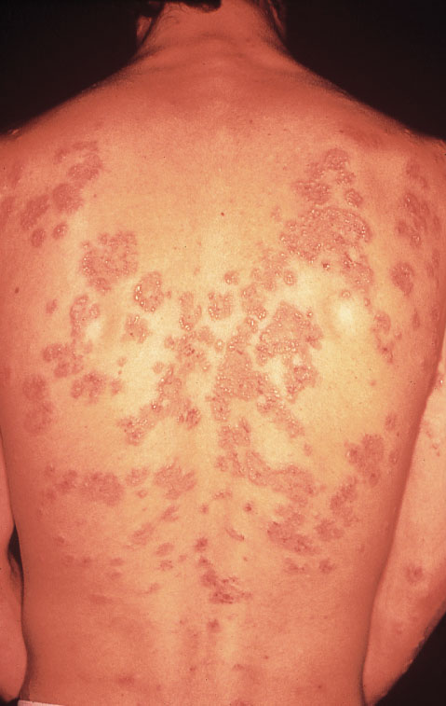
Configuration of Lesions
Grouped

Slide 44
C. Distribution of Lesions
Extensor aspects /Flexor aspects.
Truncal / (Acral) extremities.
Seborrhoeic area.
Intertriginous area.
Dermatomal /zosteriform.
Palms, soles and scalp.
Mucous membranes.
Generalized / universal

Slide 45
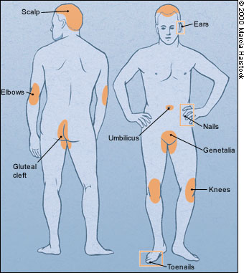

Slide 46
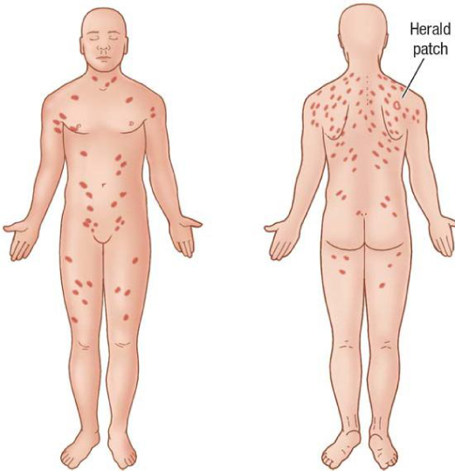

Slide 47
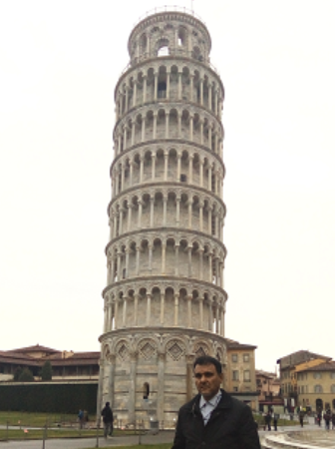
Thank you for attentions

