Slide 1
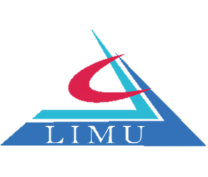

The Growing Cost of Supply Chain
Libyan International Medical University
Faculty of Business Administration
Ahmed Bushnak – 2528
Mohamed Alzanati – 2344
Instructor: Mr. Mohamed Zuwawi
Date: 31.12.2021

Slide 2
Content
Supply chain management.
Supply chain cost.
Conclusion.
Reference.
2

Slide 3
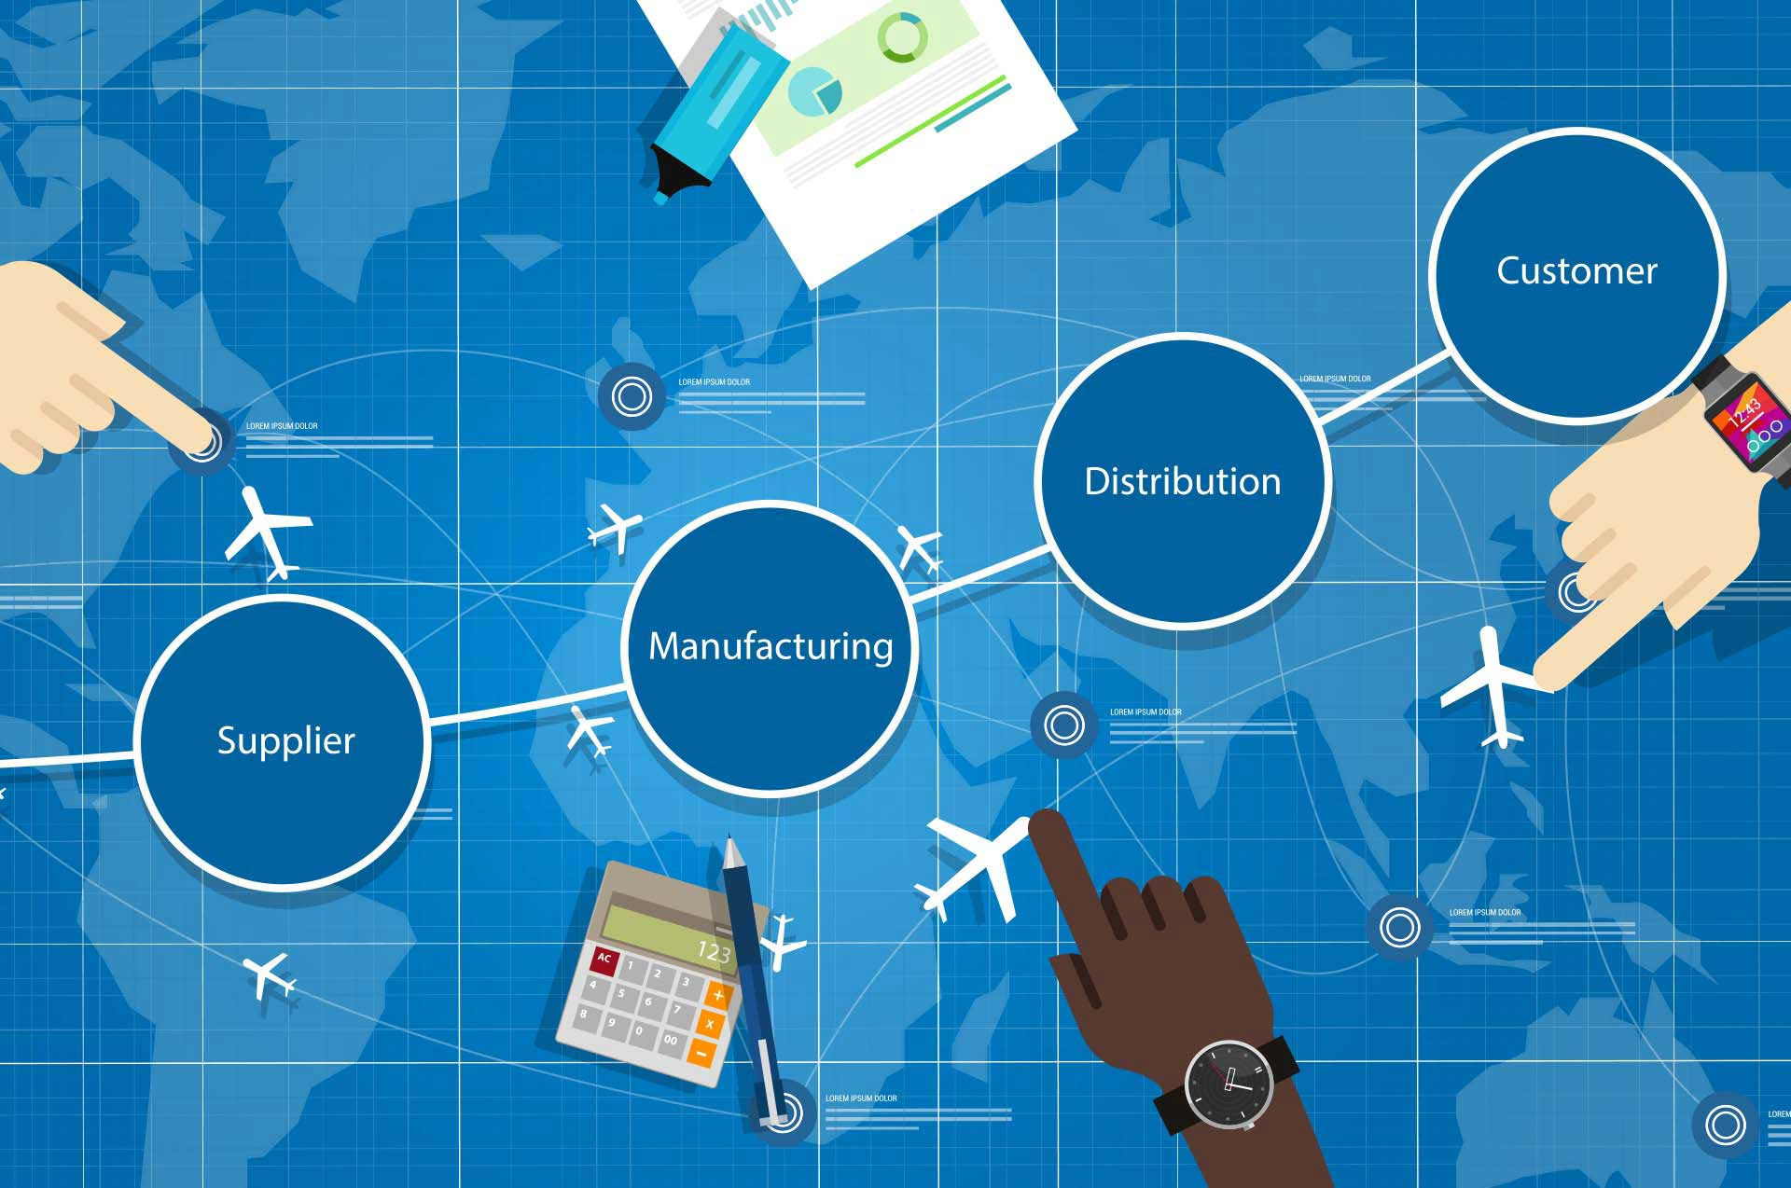
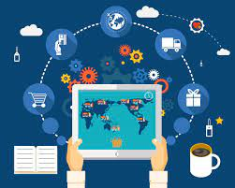
Supply chain management
Supply chain management refers to the management of a product's or service's full production cycle, starting from the raw components all the way to delivering the final product to the consumer.
3

Slide 4
Although supply chain improved operation and increase sales it has a lot of costs
4

Slide 5
cost of supply chain
There are five areas that drive most of the costs in any supply chain. Thinking about all these items together can help you find true opportunities for savings
Which are
Investment cost
Transportation cost
Procurement cost
Production cost
Inventory cost
5

Slide 6
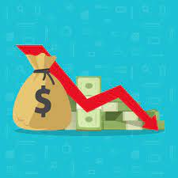
Investment cost
In this business environment, it is essential to make smart strategic decisions about where and when to invest in new facilities such as warehouses and stores and resources such as equipment and employees.
Many supply chain companies pump too much money into the wrong locations at the wrong times, such decision that lack consideration and study can lead to the firm downfall
6

Slide 7
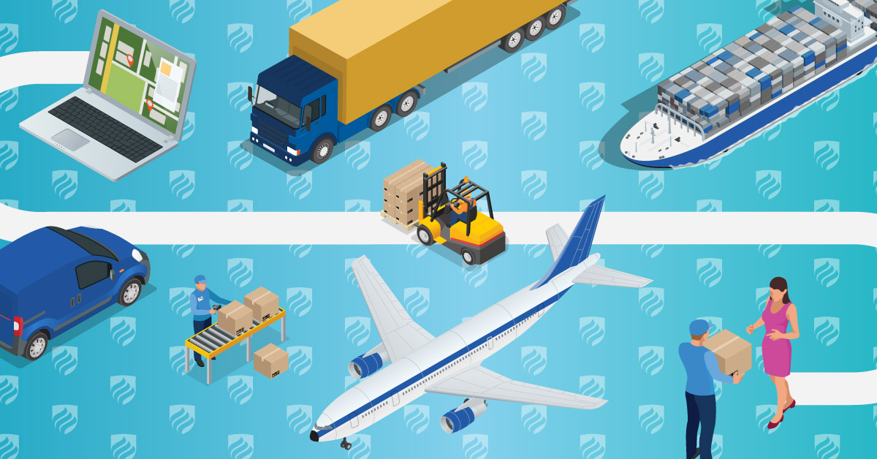
Transportation costs
Moving a product from one place to another costs money, and different modes of transportation have different costs.
factors that influence it like delivery lead time, fuel price, and cargo regulations, etc.
For example
a faster and more expensive transportation mode help you cope with high demand
7

Slide 8
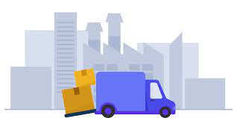
How to reduce transportation cost
For example
a common way to reduce transportation costs is to pack more products into each load, thereby improving capacity utilization, but it can be risky.
The crucial point to remember is that while adopting a slower and less dependable mode of delivery may minimize transportation costs, it will raise inventory and waste working capital.
8

Slide 9
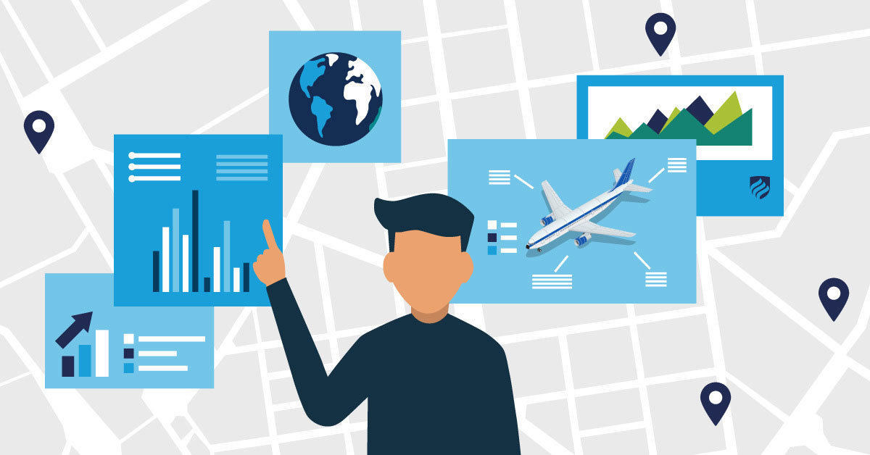
Procurement Costs
Procurement is the entire process of obtaining services or goods for business operations, The supplier you choose for your supply chain deliverables can have an impact on your total supply chain expenses.
To minimize procurement costs, your company must be able to:
Choose the most reliable supplier.
Use historical data to evaluate and compare the performance and pricing of various suppliers.
agree to buy larger quantities over a longer period.
9

Slide 10
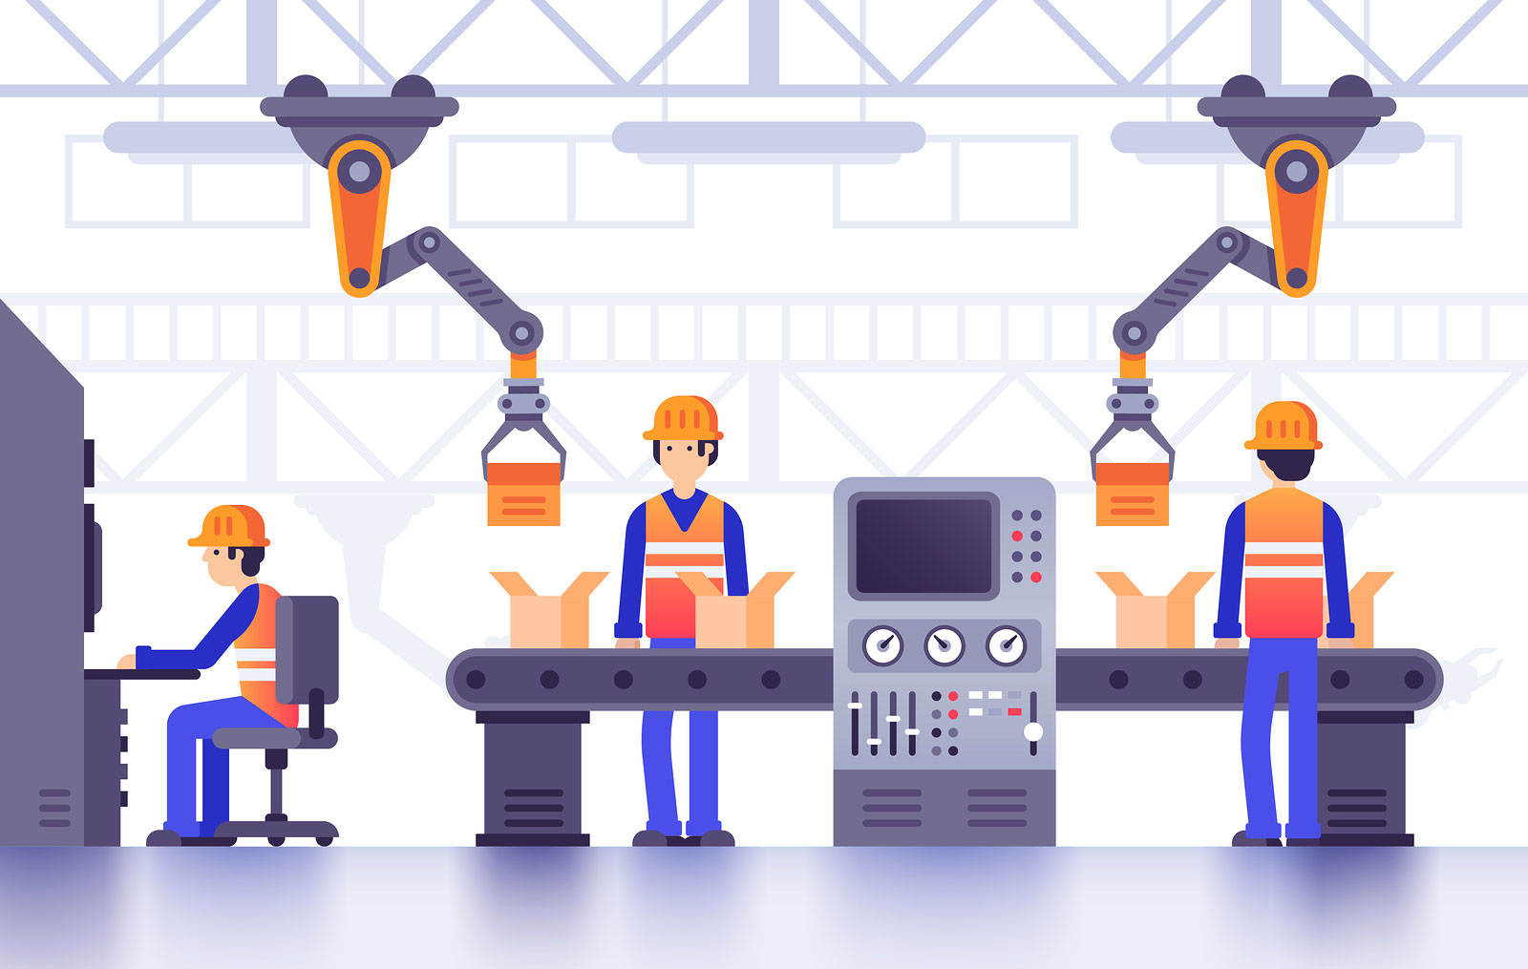
Production cost
Which can happen due to different factors:
Inefficient utilization of assets such as production machines and other equipment.
Ineffective workforce management, which often results in a spike in overtime hours.
Rework.
Simple manufacturing overhead expenditures, such as energy, water, and equipment maintenance and repair, can significantly increase production costs.
Production costs have a direct influence on supply chain costs, thus companies must have a strategic, logical, tactical, and operational production strategy in place.
10

Slide 11
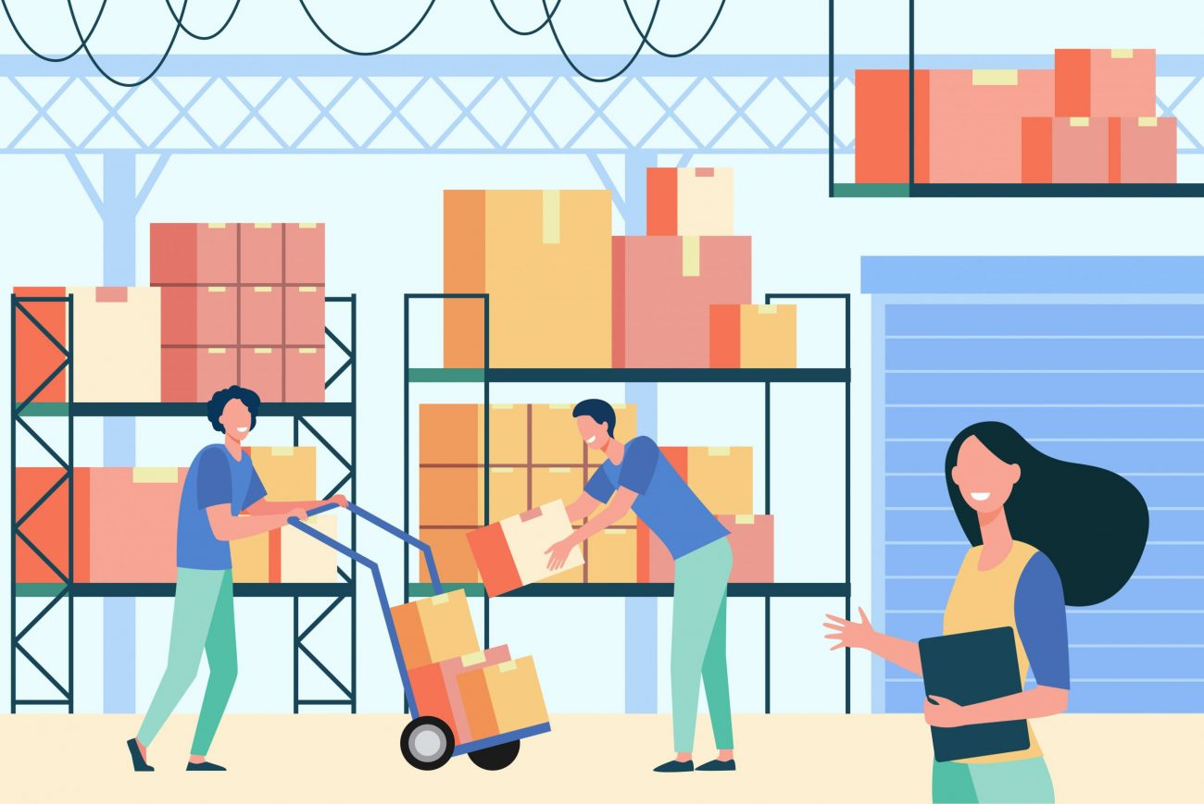
Inventory cost
Although inventory is undoubtedly a source of comfort for supply chain executives, it is also a source of costs.
inventory costs money. Other costs include paying for a building to keep the inventory safe and paying people to move the inventory around inside the building. You also run the risk that products could be lost, damaged, stolen or expire.
For example
When banks sign an insurance contract with an insurance company, usually the insurance company write the maximum amount the bank can have on storage, so they can minimize the loss in case of a fire accident or a robbery
11

Slide 12
one of the big challenges with supply chains is that things are often interconnected, so making a change in one area to lower costs can cause a change somewhere else that.
12

Slide 13
Conclusion
supply chains are quite complex and very intricately interconnected. Therefore, a cost reduction in one area of operations can directly result in a cost hike or cost variation in another.
13

Slide 14
reference
Supply Chain Costs - Everything you need to know. (2021). Retrieved 25 December 2021, from https://throughput.world/blog/topic/supply-chain-costs/.
What Are the Five Basic Components of a Supply Chain Management System? - IIMU BLOG. (2021). Retrieved 25 December 2021, from https://www.iimu.ac.in/blog/what-are-the-five-basic-components-of-a-supply-chain-management-system/.
14

Slide 15
Thank you

