Slide 1


Cultural Dimensions: “Hofstede’s Theory”
Abdurrahman Alkalani / 3152
Abdurrahman_3152@limu.edu.ly

Slide 2

01
02
03
Hofstede’s Cultural Dimensions
Power Distance
Individualism
TABLE OF CONTENTS
04
05
06
Masculinity
Uncertainty Avoidance
Time Orientation
00
Introduction
07
08
09
Indulgence
Conclusion
References
1

Slide 3
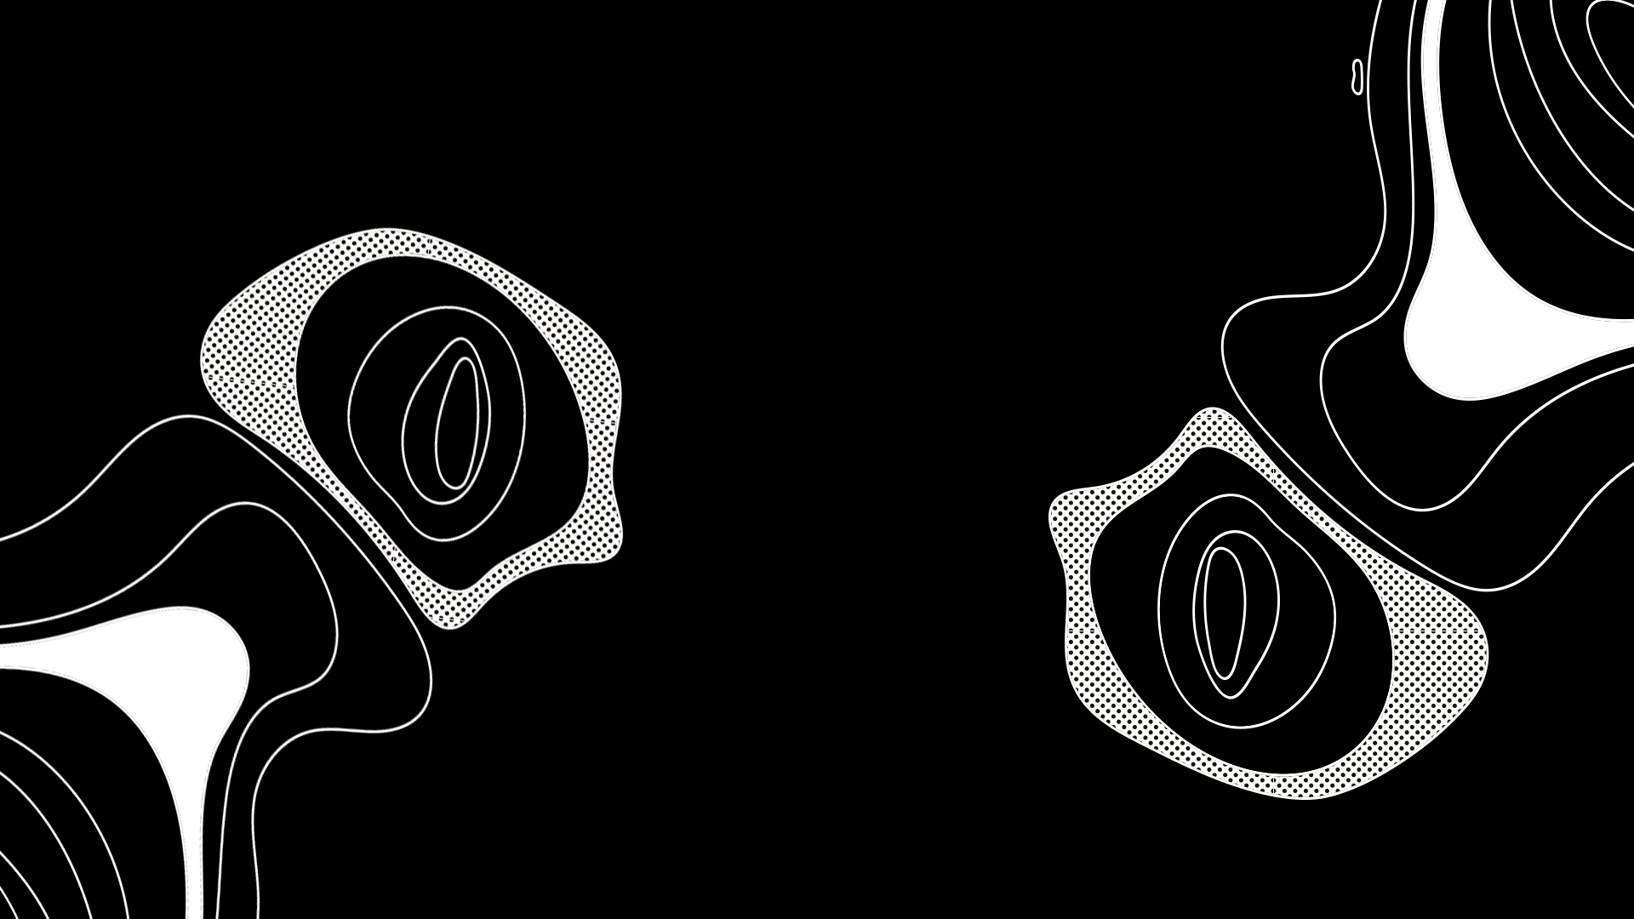
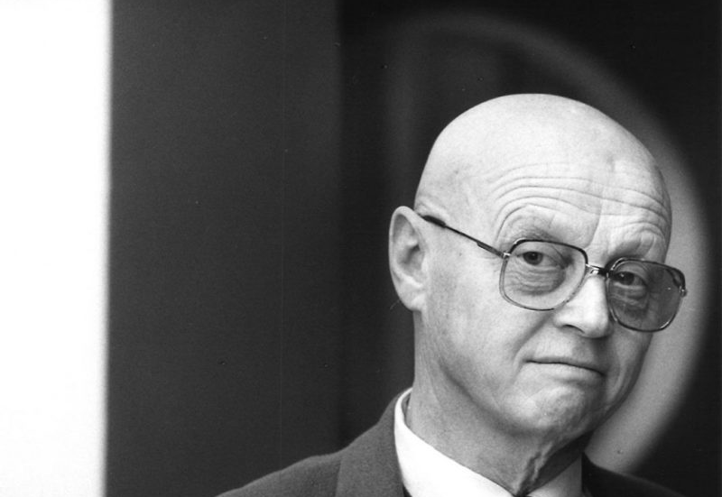
Introduction
2

Slide 4
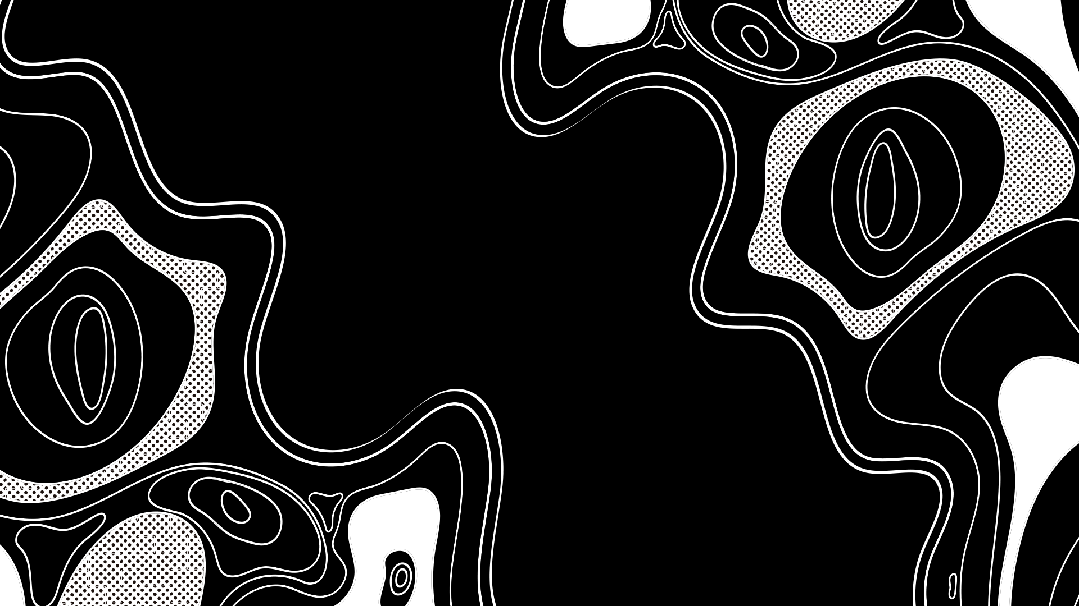
Geert Hofstede
Was a Dutch social psychologist
Born in 1928 and recently passed away in 2020 ( 92 years old )
He was interested in researching about National culture and Organizational culture
3

Slide 5
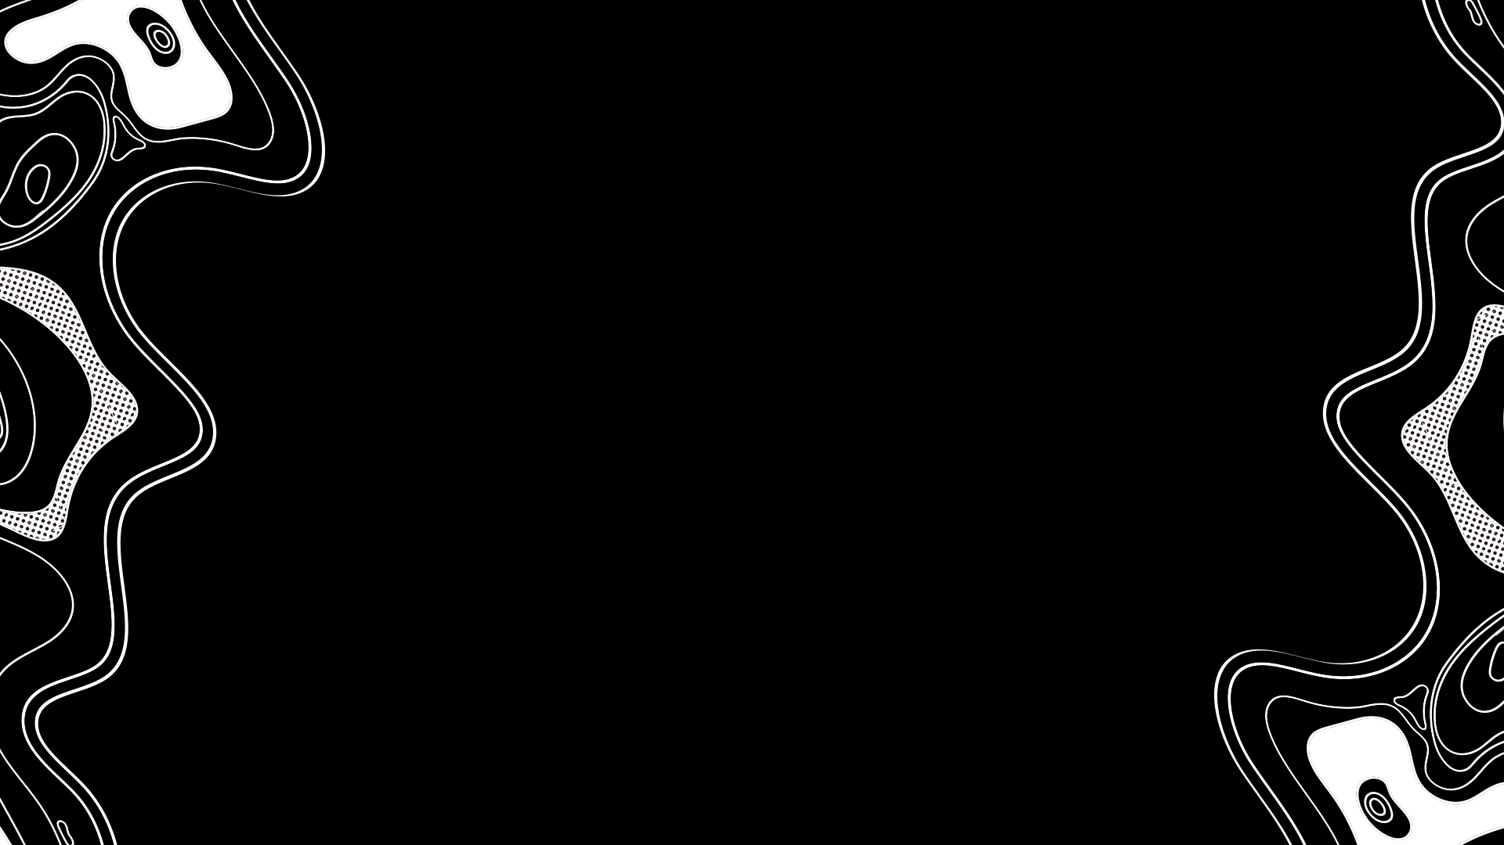
01
Hofstede’s Cultural Dimensions
4

Slide 6
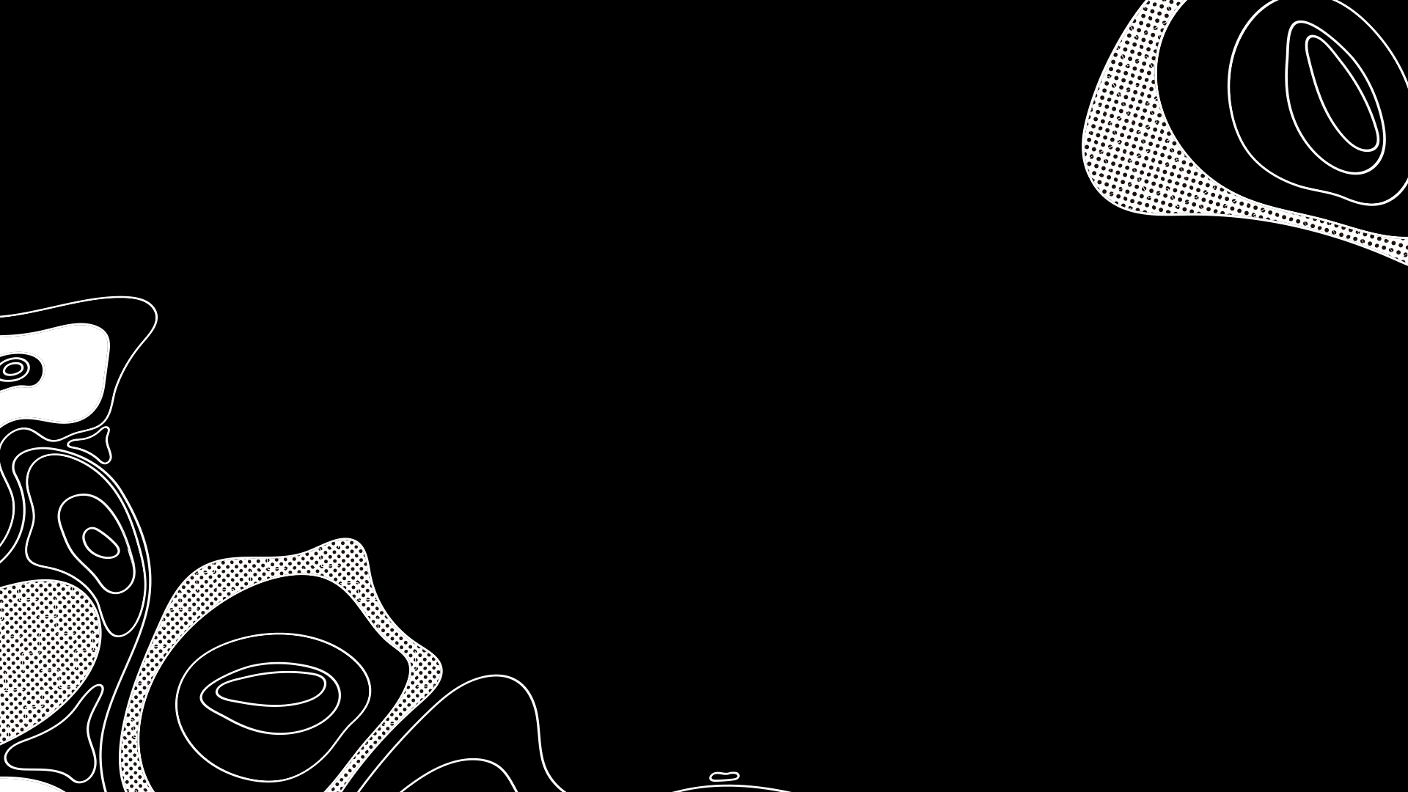
Hofstede’s Cultural Dimensions
Cultures around the world are getting more and more interconnected and the business world is becoming increasingly global. For managers this means that they should be able to work with a large variety of people from different countries and cultural backgrounds. However, since most people are so strongly immersed in their own culture, they often fail to see how it affects their patterns of thinking or their behavior.
To overcome this, researchers suggest some kind of tools or mechanisms with which to compare countries on cultural similarities and differences.
5

Slide 7
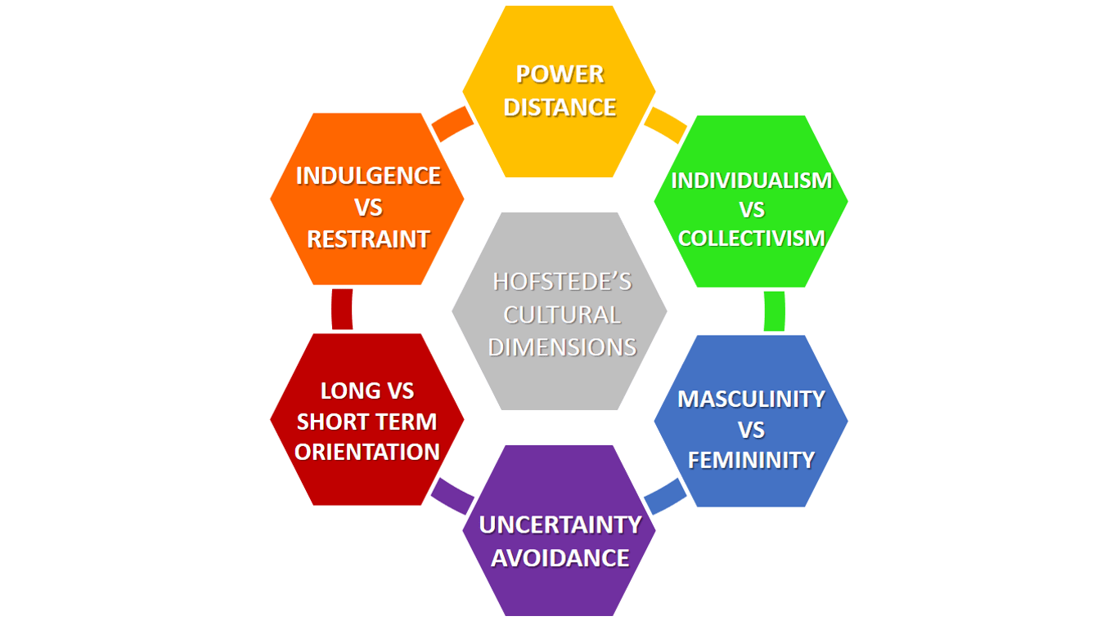
Hofstede’s Cultural Dimension
6

Slide 8
02
Power Distance
7

Slide 9
Power Distance
This dimension expresses the degree to which the less powerful members of a society accept and expect that power is distributed unequally: beliefs about the appropriate distribution of power in society.
The fundamental issue here is how a society handles inequalities among people.
8

Slide 10

03
Individualism
9

Slide 11
Individualism
The Individualism/Collectivism dimension is about the relative importance of individual versus group interests. The high side of this dimension, called individualism, can be defined as a preference for a loosely-knit social framework in which individuals are expected to take care of only themselves and their immediate families.
Its opposite, collectivism, represents a preference for a tightly-knit framework in society in which individuals can expect their relatives or members of a particular in-group to look after them in exchange for unquestioning loyalty.
10

Slide 12

04
Masculinity
11

Slide 13
Masculinity
The Masculinity/Femininity dimension is about what values are considered more important in a society. The Masculine side of this dimension represents a preference in society for achievement, heroism, assertiveness and material rewards for success.
Its opposite, femininity, stands for a preference for cooperation, modesty, caring for the weak and quality of life.
12

Slide 14
05
Uncertainty Avoidance
13

Slide 15
Uncertainty Avoidance
The Uncertainty Avoidance dimension expresses the degree to which the members of a society feel uncomfortable with uncertainty and ambiguity.
Countries exhibiting a high Uncertainty Avoidance maintain rigid codes of belief and behavior and are intolerant of unorthodox behavior and ideas. These countries often need many rules to constrain uncertainty.
Countries with low Uncertainty Avoidance are the total opposite.
14

Slide 16
06
Time Orientation
15

Slide 17
Time Orientation
Every society has to maintain some links with its own past while dealing with the challenges of the present and the future.
Countries that score low on this dimension, for example, prefer to maintain time-honored traditions and norms while viewing societal change with suspicion. Countries with cultures that scores high on this dimension on the other hand take a more pragmatic approach: they are future oriented and encourage thrift and efforts in modern education as a way to prepare for the future.
16

Slide 18
07
Indulgence
171

Slide 19
Indulgence
The Indulgence dimension is a relatively new dimension to the model. This dimension is defined as the extent to which people try to control their desires and impulses, based on the way they were raised. Relatively weak control is called Indulgence and relatively strong control is called Restraint.
Indulgence stands for a society that allows relatively free gratification of basic and natural human drives related to enjoying life and having fun. Restraint stands for a society that suppresses gratification of needs and regulates it by means of strict social norms.
181

Slide 20
08
Conclusion
19

Slide 21
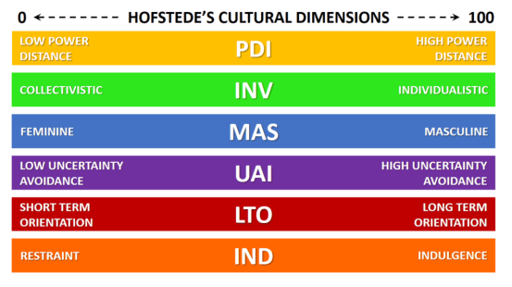
Conclusion
In a time where businesses were thriving a lot of scientist tried to find a way to categorize countries based on specific dimensions.
Hofstede's study was the one they chose as it was more detailed and more accurate than the other studies.
20

Slide 22
09
References
21

Slide 23
References
Bruin, L. de. (2020, January 19). Hofstede's cultural dimensions explained with examples: B2u. Business To You. from https://www.business-to-you.com/hofstedes-cultural-dimensions/.
22

Slide 24
Thank You
23

