Slide 1


Recognize the Public Participation Spectrum
Libyan International Medical University
Faculty of Business Administration
Salem alshuhoomi
Salima_2708@limu.edu.ly

Slide 2

CONTENTS
1.The Public Participation SPECTRUM
2. Hierarchy of Participation
3. conclusion
4. references

Slide 3

The Public Participation SPECTRUM
Public participation can be any process that directly engages the public in decision-making and gives full consideration to public input in making that decision.

Slide 4

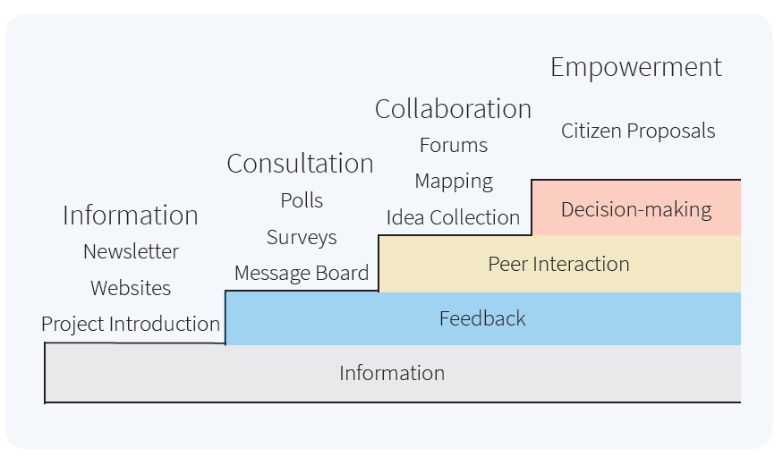
Quotations are commonly printed as a means of inspiration and to invoke philosophical thoughts from the reader.

Slide 5
At what stage do you think the Libyan elections have reached and why?
Information
Collaboration
1
3
3
4
2
Consultation
Empowerment

Slide 6
conclusion
The Spectrum of Public Participation was developed to help clarify the role of the public in planning and decision-making, and how much influence the community has over planning or decision-making processes.

Slide 7

References
What is the spectrum of public participation? Sustaining Community. (2020, August 26). Retrieved December 8, 2021, from https://sustainingcommunity.wordpress.com/2017/02/14/spectrum-of-public-participatio
Spectrum of public participation. Organizing Engagement. (2019, November 5). Retrieved December 8, 2021, from https://organizingengagement.org/models/spectrum-of-public-participation

Slide 8

THANKS!
Any questions?
You can find me at:
00218919805705

