Slide 1


Liver
By: Mohamed Abd algader and Noor alhuda Hossam

Slide 2
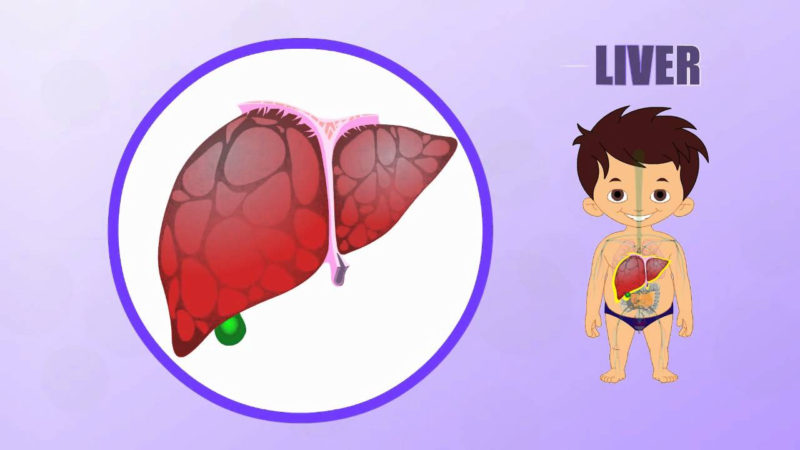
Function of the Liver

Slide 3
1- Metabolic functions of the liver:
The liver is a large, chemically reactant pool of cells that have a high rate of metabolism.
Carbohydrate metabolism:
In carbohydrate metabolism, the liver performs the following functions:
1. Storage of large amounts of glycogen.
2. Conversion of galactose and fructose to glucose.
3. Gluconeogenesis.
4. Formation of many chemical compounds from intermediate products of carbohydrate metabolism.

Slide 4
Fat metabolism:
Although most cells of the body metabolize fat, certain aspects of fat metabolism occur mainly in the liver. Specific functions of the liver in fat metabolism, are the following:
1. Oxidation of fatty acids to supply energy for other body functions.
2. Synthesis of large quantities of cholesterol, phospholipids, and most lipoproteins.
3. Synthesis of fat from proteins and carbohydrates.

Slide 5
Protein metabolism:
1. Deamination of amino acids.
2. Formation of urea for removal of ammonia from the body fluids.
3. Formation of plasma proteins
4. Interconversions of the various amino acids and synthesis of other compounds from amino acids.

Slide 6
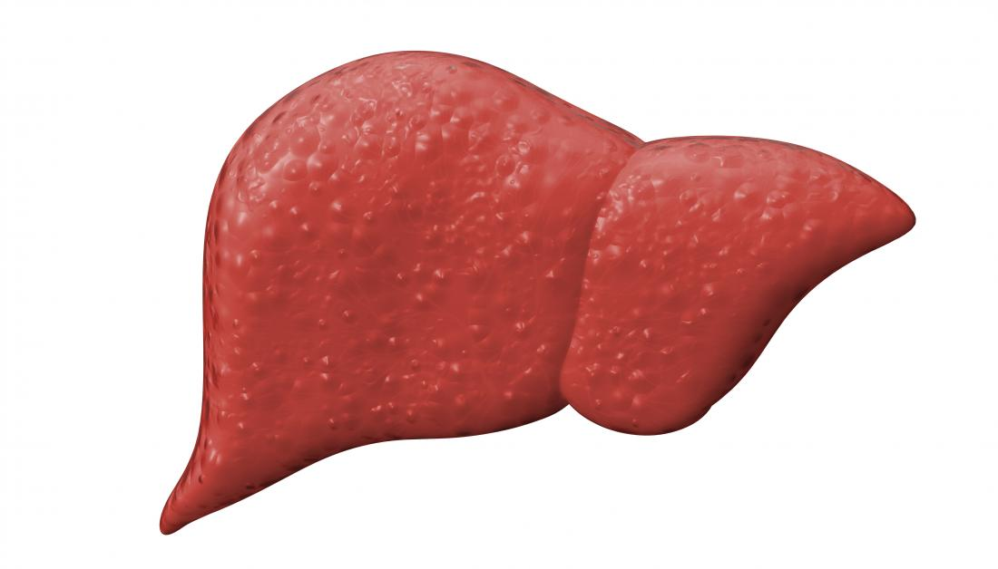
2-Among the most important functions of the liver is its ability to synthesize certain amino acids and to synthesize other important chemical compounds from amino acids.
3-The liver is a storage site for vitamins. The liver has a particular propensity for storing vitamins and has long been known as an excellent source of certain vitamins in the treatment of patients.
4-The liver stores iron as ferritin. Except for the iron in the hemoglobin of the blood, by far the greatest proportion of iron in the body is stored in the liver in the form of ferritin.

Slide 7
5-The liver forms the blood substances used in coagulation. Substances formed in the liver that are used in the coagulation process include fibrinogen, prothrombin, accelerator globulin, Factor VII, and several other important factors.
6-The liver removes or excretes drugs, hormones, and other substances. The active chemical medium of the liver is well known for its ability to detoxify or excrete into the bile many drugs, including sulfonamides, penicillin, ampicillin, and erythromycin.
7- One of the major routes for excreting calcium from the body is secretion by the liver into the bile, which then passes into the gut and is lot in the feces.

Slide 8
8-The liver functions as a blood reservoir.
Because the liver is an expandable organ, large quantities of blood can be stored in its blood vessels.
Its normal blood volume, including both that in the hepatic vein and that in the hepatic sinuses, is about 450 milliliters, or almost 10 percent of the body’s total blood volume.
When high pressure in the right atrium causes backpressure in the liver, the liver expands, and 0.5 to 1 liter of extra blood is occasionally stored in the hepatic veins and sinuses. This occurs especially in cardiac failure with peripheral congestion.

Slide 9
Thanks for your attention

