Slide 1


Libyan International Medical University
Faculty of Business Administration
Social Penetration Theory
Name:Mohamed Fathi
ID:3761 Email:mohammed_3761@limu.edu.ly

Slide 2
TABLE OF CONTENTS
01
04
INTRODUCTION
Conclusion
02
Who made social penetration theory
05
Reflection
03
06
Penetration theory in mass transfer
References
2

Slide 3
01
INTRODUCTION
3

Slide 4
INTRODUCTION
According to the social penetration theory, communication progresses from relatively superficial, nonintimate levels to deeper, more personal ones as relationships grow.
4

Slide 5
02
Who made social penetration theory
5

Slide 6
Altman and Taylor
Originally proposed by Altman and Taylor in 1973, the theory has been expanded upon over the years. Altman and Taylor laid out a framework for examining interpersonal relationships.
6

Slide 7
03
Social penetration theory objective or interpretive
7

Slide 8
“SPT is known as an objective theory as opposed to an interpretive theory, meaning it is based on data drawn from actual experiments and not simply from conclusions based on individuals' specific experiences.”
8

Slide 9
04
Penetration theory in mass transfer
9

Slide 10
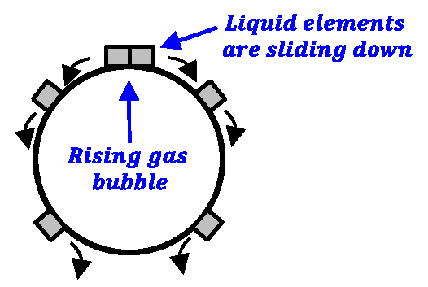
Project timeline
Mercury is the closest planet to the Sun
Venus is the second planet from the Sun
Saturn is a gas giant and has several rings
Mars is actually a cold place. It’s full of iron oxide dust
Mercury
Venus
Saturn
Mars
01
02
03
04
10

Slide 11
05
Assumption of Social Penetration Theory
11

Slide 12
The main assumption of social penetration theory is that individuals will share a lot of information with those whom they trust. The other assumption is that individuals will talk about a wide variety of impersonal subjects with people they are not familiar with.
12

Slide 13
06
Social
Penetration theory Example
13

Slide 14

For instance, if two acquaintances meet at a demonstration for college Democrats, their initial discussions may center on their political engagement, preferred candidates, and opinions on current political concerns. At this point, the personality starts to show
14

Slide 15

An example of social penetration is two people who meet at work. They initially only talk about sports teams or local events. However, as they grow to be more comfortable with each other they begin to talk about religion and politics. They have transferred from the orientation stage to the exploratory stage. Some may say they have even reached the affective stage.
15

Slide 16
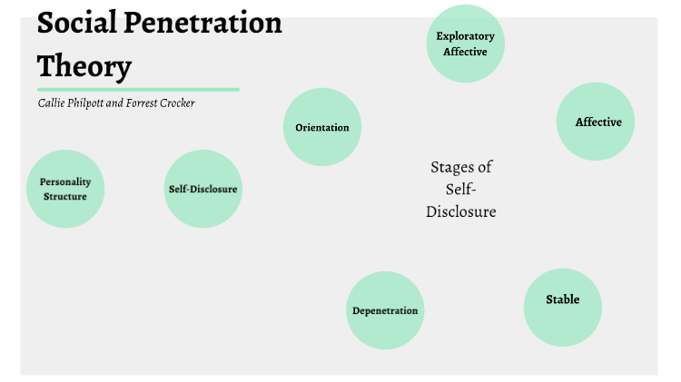

Website
You can replace the image on the screen with your own work. Just delete this one, add yours and center it properly
16

Slide 17

Conclusion
The social penetration theory states that as relationships develop, communication advances from relatively superficial, nonintimate levels to deeper, more personal ones.
17

Slide 18
Reflection
The theory of social penetration gives deeper and expanded concepts about the interaction processes between two personalities and the stages.
18

Slide 19
References
Richardson, G. (n.d.). Social penetration - interpersonal communication context. Retrieved December 19, 2022, from http://www.uky.edu/~drlane/capstone/interpersonal/socpen.html
/entity/gennaro-Cuofano. (2022, December 5). What is social penetration theory? social penetration theory in a Nutshell. FourWeekMBA. Retrieved December 19, 2022, from https://fourweekmba.com/social-penetration-theory/
Gora, S. (2018, March 8). Social penetration theory. LinkedIn. Retrieved December 19, 2022, from https://www.linkedin.com/pulse/social-penetration-theory-sanjay-gora
Take online courses. earn college credit. Research Schools, Degrees &amp; Careers. Study.com | Take Online Courses. Earn College Credit. Research Schools, Degrees &amp; Careers. (n.d.). Retrieved December 19, 2022, from https://study.com/learn/lesson/social-penetration-theory-concept-examples.html
19

Slide 20
Thank You
Any question?

